Slide 1
YouTube API
Neha Dixit
6/3/2019

Slide 2
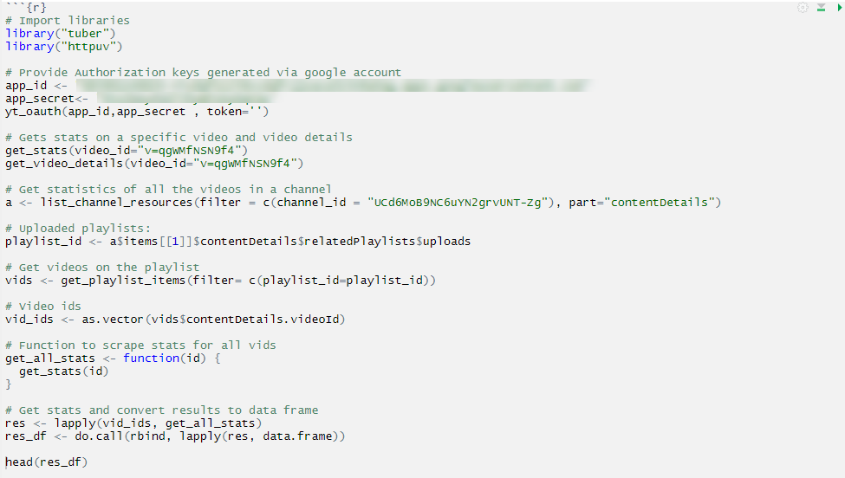
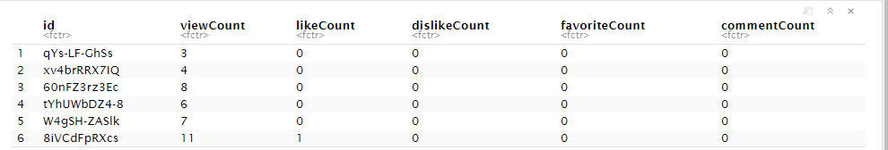
YouTube API
Used to retrieve information about the uploaded content.
The API can be used with tuber r package.
Shown on the right is the code snippet to gauge the popularity of the uploaded content by Amazon Web services

