Slide 1
WEEK 5 – CYBER SECURITY INTERNSHIP
VAPT Tools – Practical Learning
Student: Neha Fule
Submission Date: 7 October 2026
Tools: Nmap • Nikto • Burp Suite

Slide 2
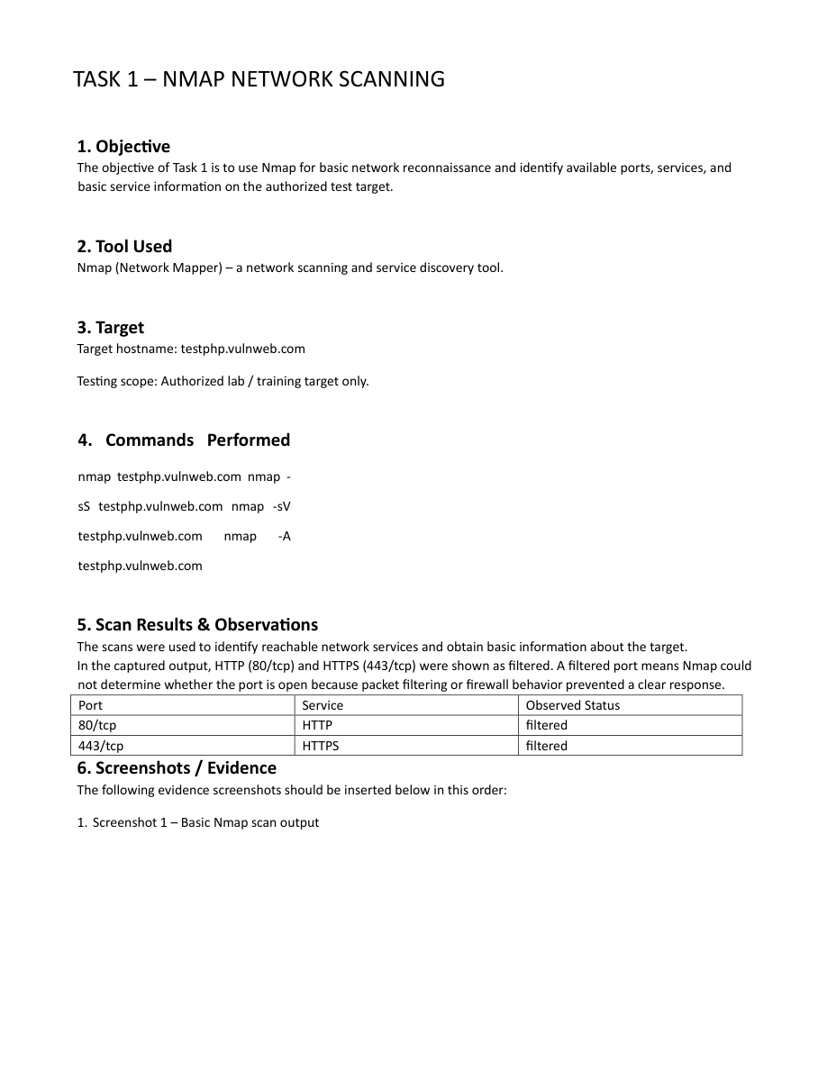
Task 1 – Nmap Network Scanning
Objective: Perform basic network reconnaissance and identify ports and services.
Target: testphp.vulnweb.com (authorized training target).
Commands: nmap, -sS, -sV and -A scans.
Observed: 80/tcp HTTP – filtered; 443/tcp HTTPS – filtered.
Filtered means Nmap could not determine whether the port was open due to filtering/firewall behavior.

Slide 3
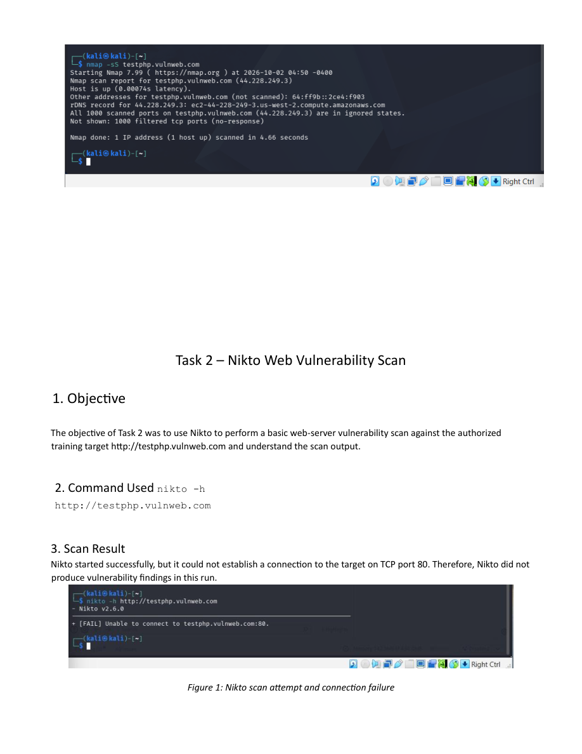
Task 2 – Nikto Web Vulnerability Scan
Command: nikto -h http://testphp.vulnweb.com
Nikto started, but could not establish a connection to TCP port 80.
No vulnerability findings were produced in this run.
Troubleshooting included ping, curl, direct IP testing, Internet verification and proxy checks.
Nmap had previously shown ports 80 and 443 as filtered.

Slide 4
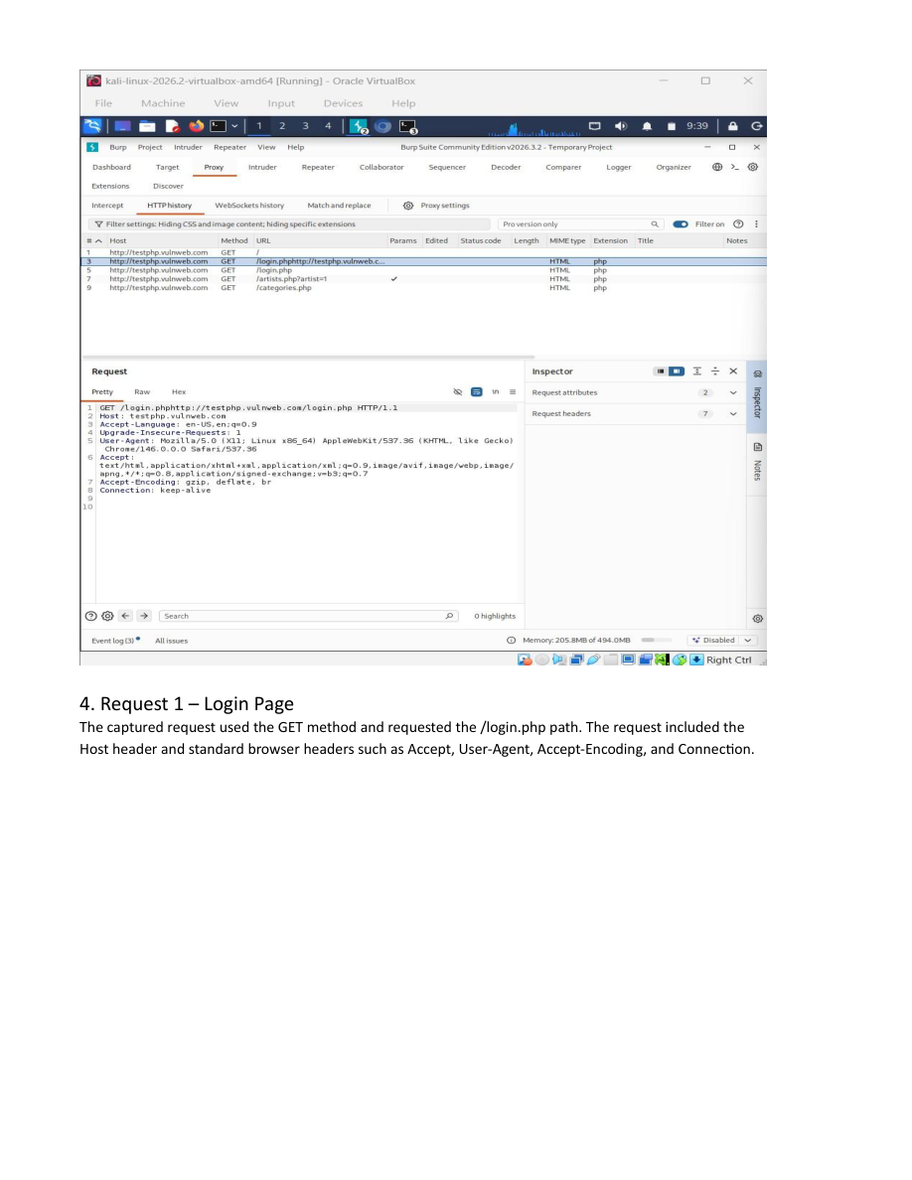
Task 3 – Burp Suite: Intercept & Analyze HTTP Requests
Burp Suite Community Edition was used as an HTTP proxy.
HTTP history captured browser-generated GET requests.
Examples: /login.php, /artists.php?artist=1 and /categories.php.
Requests exposed headers such as Host, User-Agent, Accept and Accept-Encoding.
Query parameter artist=1 demonstrates how values can appear in a URL.

Slide 5
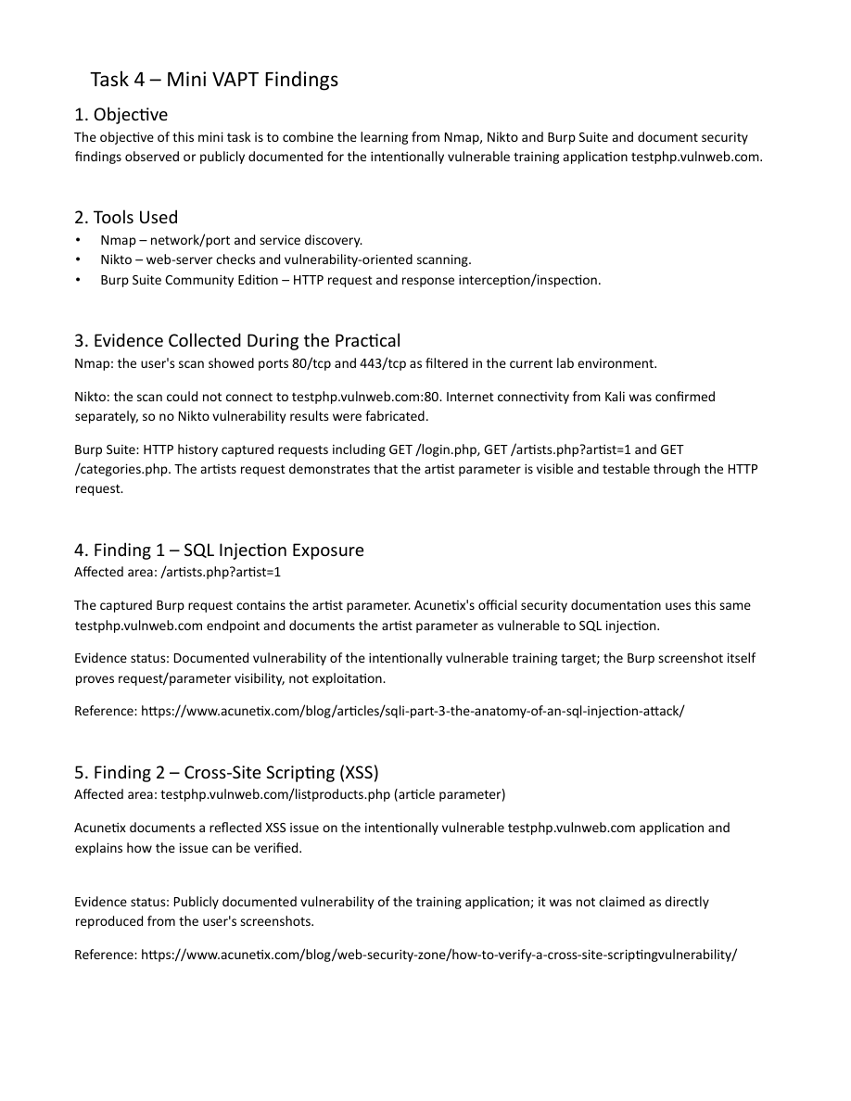
Task 4 – Mini VAPT Findings
Finding 1: SQL Injection exposure documented for /artists.php?artist=1.
Finding 2: Reflected XSS documented for listproducts.php using the article parameter.
Additional SQL injection / blind SQL injection exposure is publicly documented.
Important: these vulnerability claims are documented training-target information, not fresh Nikto results.
The Burp screenshot proves request/parameter visibility, not exploitation.

Slide 6
Evidence Collected & Limitations
Nmap: 80/tcp and 443/tcp were filtered in the current lab environment.
Nikto: connection to port 80 failed; Internet connectivity from Kali was separately verified.
Burp Suite: captured GET /login.php, GET /artists.php?artist=1 and GET /categories.php.
No fabricated scan output was included.
The report distinguishes practical evidence from publicly documented training-target vulnerabilities.

Slide 7
Conclusion
The practical demonstrated a basic VAPT workflow.
Nmap was used for network/service discovery.
Nikto was attempted and its connection limitation was documented.
Burp Suite provided practical HTTP request and parameter inspection.
The exercise highlighted the importance of input validation and output encoding in web application security.

Slide 8
Submission Checklist
✓ Task 1 – Nmap: completed with screenshots.
✓ Task 2 – Nikto: attempted; connection failure documented.
✓ Task 3 – Burp Suite: completed with captured HTTP history/request screenshots.
✓ Task 4 – Mini VAPT Findings: prepared with evidence limitations.
Next: upload final report, screenshots and PPT to GitHub if required.
Next: complete LinkedIn post and final submission form.

