Slide 1
Quaderno Provider
Participants:
Neha Neha

Slide 2
Quaderno
What is webMethods CloudStreams Provider for Quaderno
Quaderno provides automatic tax compliance for SaaS, eCommerce, and digital businesses worldwide.
In addition to sales tax management, Quaderno offers automatic invoicing, instant tax reports, a variety of useful integrations, and great customer support.

Slide 3
Quaderno
Connector capabilities and how it can benefit users
The WmQuadernoProvider connector developed using cloudstreams helps to perform various operations like tax compliance, sales tax automation, customer support, tax receipts etc .
Using the below resources created, users can manage their tax , create contacts , create credits, create expenses and also get notified via webhooks when new invoice is created in Quderno account.
List All Contacts: List All Contacts.
List All Credits: List All Credits
List All Invoices: List All Invoices
List All Tax IDs: List All Tax IDs
List All Webhooks : List All Webhooks
Retrieve Contact : Retrieve a contact
Retrieve Credit : Retrieve a credit
Retrieve expense : Retrieve an expense

Slide 4
Quaderno
Connector capabilities and how it can benefit users
9. Retrieve Invoice: Retrieve an invoice
10. Retrieve Tax ID: Retrieve a tax ID
11. Retrieve Webhook: Retrieve a webhook
12. Update Contact: Update a contact
13. Update credit: Update a credit
14. Update Expense : Update an expense
15. Update Invoice : Update an invoice
16. Update Tax ID : Update a tax ID
17. Update Webhook : Update a webhook
18. Void Credit : Void a credit
19. Create Contact : Create a contact
20. Create Credit : Create a credit

Slide 5
Quaderno
Connector capabilities and how it can benefit users
21 . Create Expense : Create an expense
22 . Create Invoice : Create an invoice
23. Create Tax ID : Create a tax ID
24. Create Webhook : Create a webhook
25. Delete Contact : Delete a contact
26. Delete Expense : Delete an expense
27. Delete Tax ID : Delete a tax ID
28. Delete Webhook : Delete a webhook

Slide 6
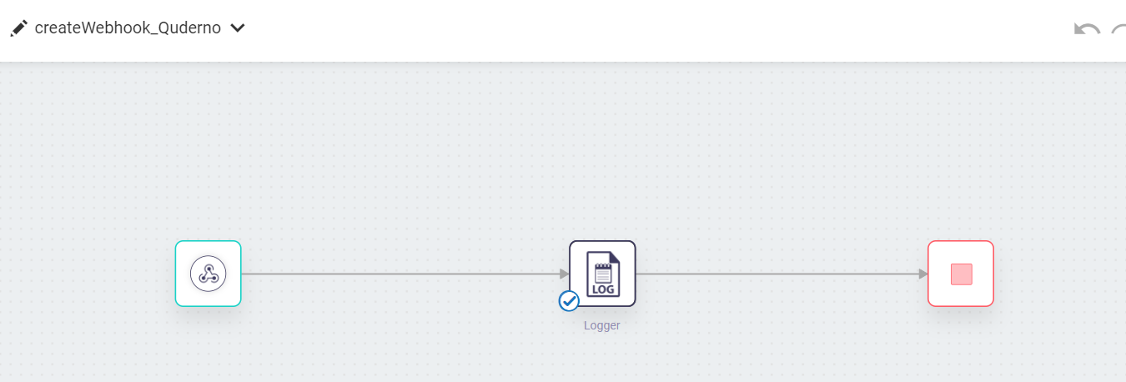
Screenshots for workflow
Workflow to show webhook capability

Slide 7
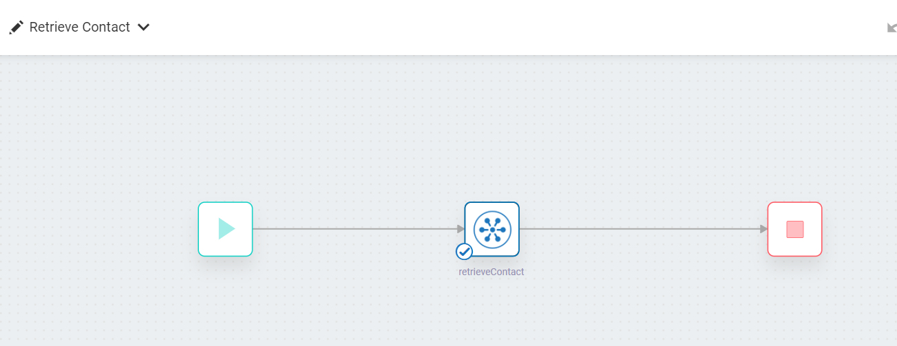
Screenshots for workflow
2. Workflow for Retrieve Contact action

Slide 8
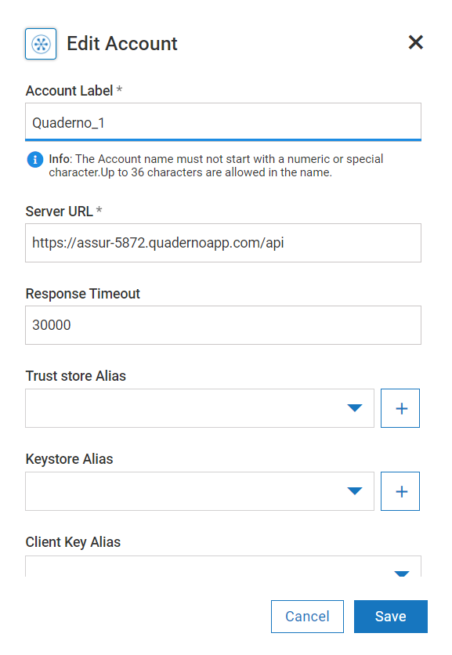
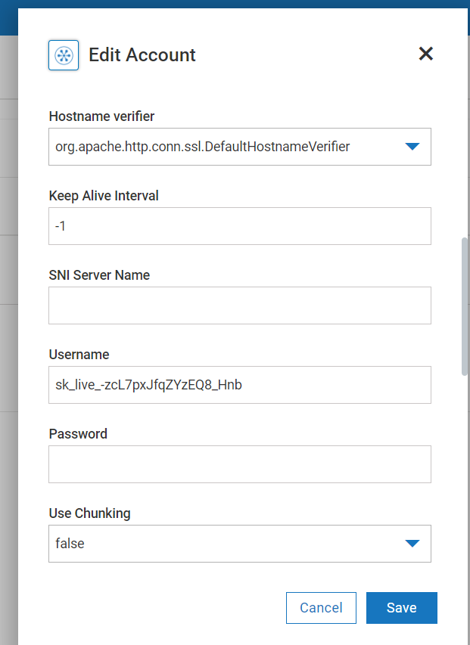
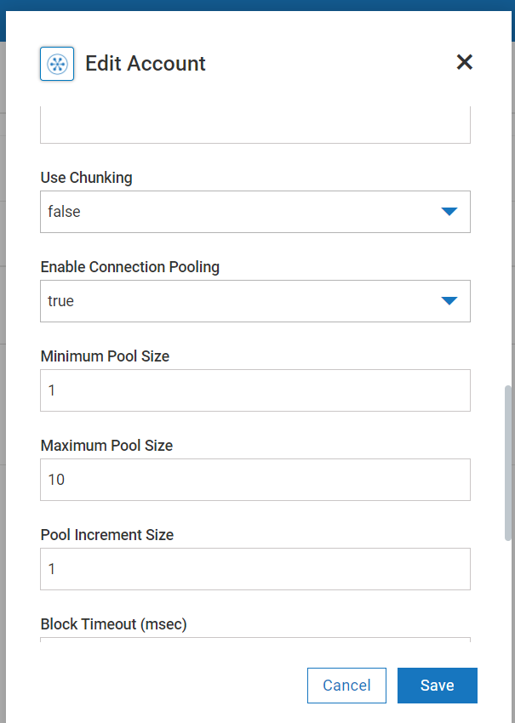
Screenshots for workflow
3. Quaderno account configuration in webMethods.io

