Slide 1
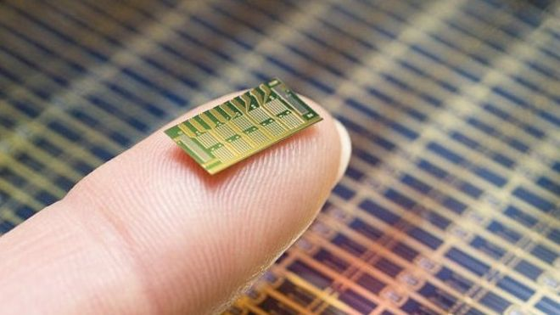
FIELD PROGRAMMABLE GATE ARRAY
Presented by:
Neha Gour
M.Tech(VLSI Design)

Slide 2
Contents
Introduction
Evaluation of FPGA
Architecture of FPGA
FPGA classification on user programmable switch technology
FPGA Structural classification
FPGA Design flow
Required tools
Advantages & Disadvantages
Applications

Slide 3


Slide 4
Introduction
In the world of digital electronics system , there are three basic kind of devices: memory, microprocessor and logic devices.
Memory device to store the random information.
Microprocessor are for execution of instruction to perform a task.
Logic devices provide specific functions.

Slide 5
(cont..)
An FPGA (Field Programmable Gate Arrays) is a device contains a matrix of reconfigurable gate array logic circuitry for a desired application or function any time after manufacturing by the users.
Combination of general-purpose processors and ASICs (Application-Specific IC).

Slide 6
Evaluation of FPGA
FPGA
CPLD
PAL
PLA
PROM
Programmable Logic Devices
Fixed Logic Devices
Logic devices

Slide 7
Difference between CPLD &FPGA
CPLD | FPGA
Coarse grain Architecture | 1. Fine grain Architecture
2. More Faster compare to FPGA | 2. Faster
3. Better for simple applications | 3. Good for complex applications
4. EEPROM based Architecture | 4. RAM based Architecture
5. Cheaper | 5. Expensive
6.Made up of Larger blocks | 6. Made up of Tiny blocks

Slide 8
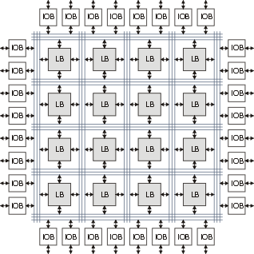
Architecture of FPGA
FPGA chip consist of a matrix of CLBs surrounded by a periphery of I/O blocks & signals are routed by the programmable interconnects .

Slide 9
(cont…)
Configurable Logic Blocks(CLBs)
CLB is a basic component that provides a logic & storage for a target application.
A logic blocks are made up of NAND gate , an interconnection of Multiplexer, LUTs & PAL style wide input gate.
The output of LUT is connected to an optional Flip-Flop. A multiplexer selects the BLE output to be either the output of a Flip-Flop or the LUT.
A CLB can contain a cluster of BLEs connected through a local routing network.

Slide 10
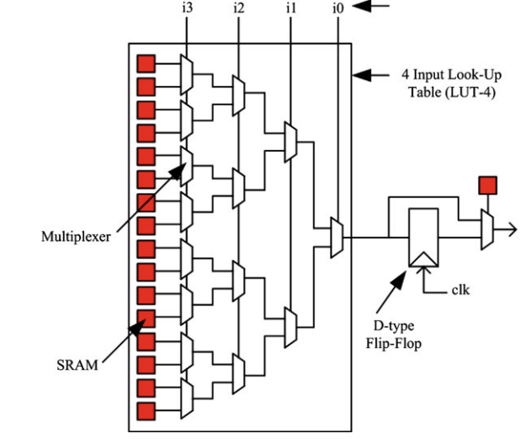
(cont…)
Modern FPGAs contain typically 4 to 10 BLEs in a single cluster.

Slide 11
(cont…)
I/O blocks
I/O blocks are storage element ,they are configured by either flip-flops or latches.
Each I/O blocks can be programmed in to :
Input Path
Output Path

Slide 12
(cont…)
Resources for interconnection
FPGA routing architecture provides connection between Logic blocks & i/o blocks.
Architecture consist of wires & programmable switches that form the connection.
Programmable switches are configured by programmable technology.
There is a trade off between density of Logic blocks & amount of area used up for routing.

Slide 13
FPGA Classification on user programmable switch technology
FPGA
SRAM Programmed
Antifuse -Programmed
EEPROM Programmed

Slide 14
FPGA Structural classification
FPGA
Symmetrical arrays
Hierarchical PLDs
Row based architecture

Slide 15
FPGA Design flow
Design entry
simulation
Synthesis
Place and route
Dump code and Verify

Slide 16
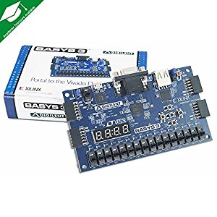
Required Tools
Text Editor
Xilinx ISE or Vivado
FPGA Development Board

Slide 17
Advantages & Disadvantages
Advantages of FPGAs
Highest performance.
Ability of Parallel processing.
Provide flexibility of reprogramability to user.
Improvement of Density relative to discrete SSI/MSI component.

Slide 18
(cont..)
Disadvantages of FPGAs
Delay introduced for product to market, because of increased Design time.
Expensive to Develop.

Slide 19
Applications
Automotive.
Digital Display.
Medical Electronics.
Telecommunications.
Consumer electronics.
High resolution video.
Digital signal processing etc…

Slide 20


