Slide 1


Reducing Computational complexity of Mathematical functions using FPGA
Neha Gour, M.Tech. (VLSI Design)
Department of Electronics, Banasthali University
Guided by:
Prof. Arup Banerjee
RRCAT, Indore

Slide 2
Outline
Introduction
Motivation
Conventional Processor vs. FPGA
Basic skeleton of project
Work carried out
Optimization Directives
Addition of Fixed Point Numbers
Addition of Floating Point Numbers
Matrix Multiplication using Integer Numbers
Result and Discussion

Slide 3
Introduction
Analysis of complex algorithm demand for less execution time and low storage space.
Computationally intensive applications such as machine learning, weather forecasting, big data, computational biology etc.
Require a lot of computation time to execute, because usually the task is sequentially simulated.

Slide 4
Motivation
To reduce the computation time and make system efficient using concept of parallelism.
Parallel processing through FPGA is one possible solution to reduce execution time.
Objective of this work is to improve the execution time of mathematical functions using optimization directives such as loop pipeline and loop unrolling.

Slide 5
Conventional Processor vs. FPGA
Conventional Processor | FPGA
Sequential processing device. | Parallel processing device.
Large no. of clock cycles are required to perform a specific task. | Fewer clock cycles are required to execute the task.
It has fixed ALU. | FPGA has programmable ALUs.

Slide 6
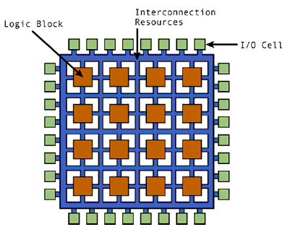
Overview of an FPGA
2-D array of logic blocks with electrically programmable interconnections.
User can configure
Interconnection between logic blocks,
The function of each block.
Figure: Basic structure of FPGA

Slide 7
Basic Skeleton of the Project
High-Level language (C-program)
LUT 1
LUT 2
LUT 3
Parallel processing through FPGA is implemented using High-Level Synthesis(HLS).

Slide 8
Work Carried Out
APPLYING DIRECTIVES
LOOP PIPELINE
LOOP UNROLL
C-Language
FPGA
Fig. Basic Block diagram of design
NOTE: HLS is done by Vivado HLS(2017.2) software. Hardware implementation is done using Artix-7 FPGA.

Slide 9
1. Sequential loop
For(i=0; i<5; i++)
{
C[i]=A[i]+ B[i];
}
+
C[0]
1
2
3
4
5
+
C[1]
A[5]
C[2]
+
DATA
B[5]
1
2
3
4
5
+
C[3]
+
C[4]

Slide 10
I. Optimization Directives
1. Loop unrolling
Loop unrolling is a directive that exploits the parallelism between loop iteration.
It creates multiple copies of the loop body and adjust the loop iteration counter accordingly.
Directive command: #pragma HLS UNROLL factor = <INTEGER>.
Unrolled loop
For( i=0;i<5; i++){
C[i]=A[i]+B[i];
C[i+1]=A[i+1]+B[i+1];
.
.
.
C[i+4]=A[i+4]+B[i+4]
}

Slide 11
cont..
DATA
+
C[0]
1
2
3
4
5
+
C[1]
+
C[2]
A[5]
B[5]
1
2
3
4
5
C[3]
+
+
C[4]

Slide 12
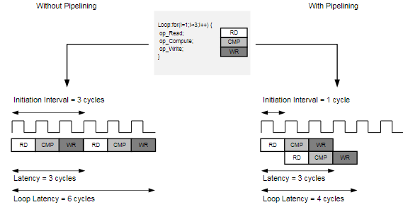
2. Loop Pipelining
Loop pipelining allows the operation in a loop to be implemented in a concurrent manner.
In pipelining the next iteration of loop can start before current iteration is finished.
Directive command: #pragma HLS PIPELINE initiation interval(II)* = <INTEGER>.
*Initiation Interval (II) is the number of clock cycles between the start times of consecutive loop iterations.

Slide 13
cont..
+
C[0]
1
2
+
C[1]
3
4
5
+
C[2]
A[5]
DATA
B[5]
1
+
C[3]
2
3
4
+
C[4]
5

Slide 14
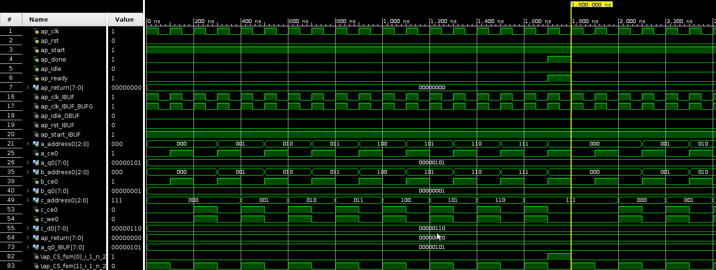
II. Addition of Fixed-Point Numbers
1. Sequential loop
int i, int A[i], int B[i], int C[i];
For(i=0; i<8; i++) {
C[i]=A[i]+ B[i];
}
Fig. Fixed point addition simulation result of sequential process

Slide 15
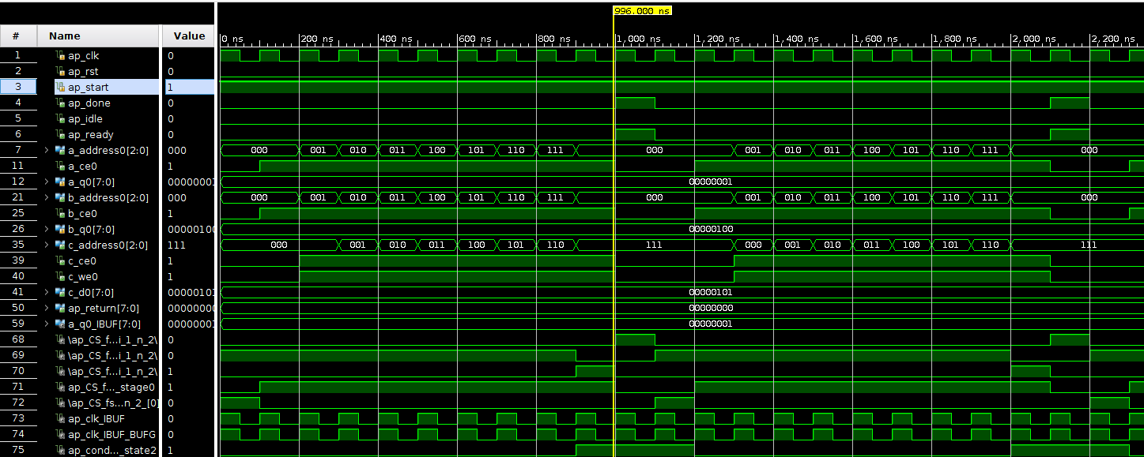
2. Loop Pipelining
For(i=0; i<8; i++)
{
#pragma HLS pipeline II=1;
C[i]=A[i]+ B[i];
}
Fig. Fixed point addition simulation result after applying pipelining

Slide 16
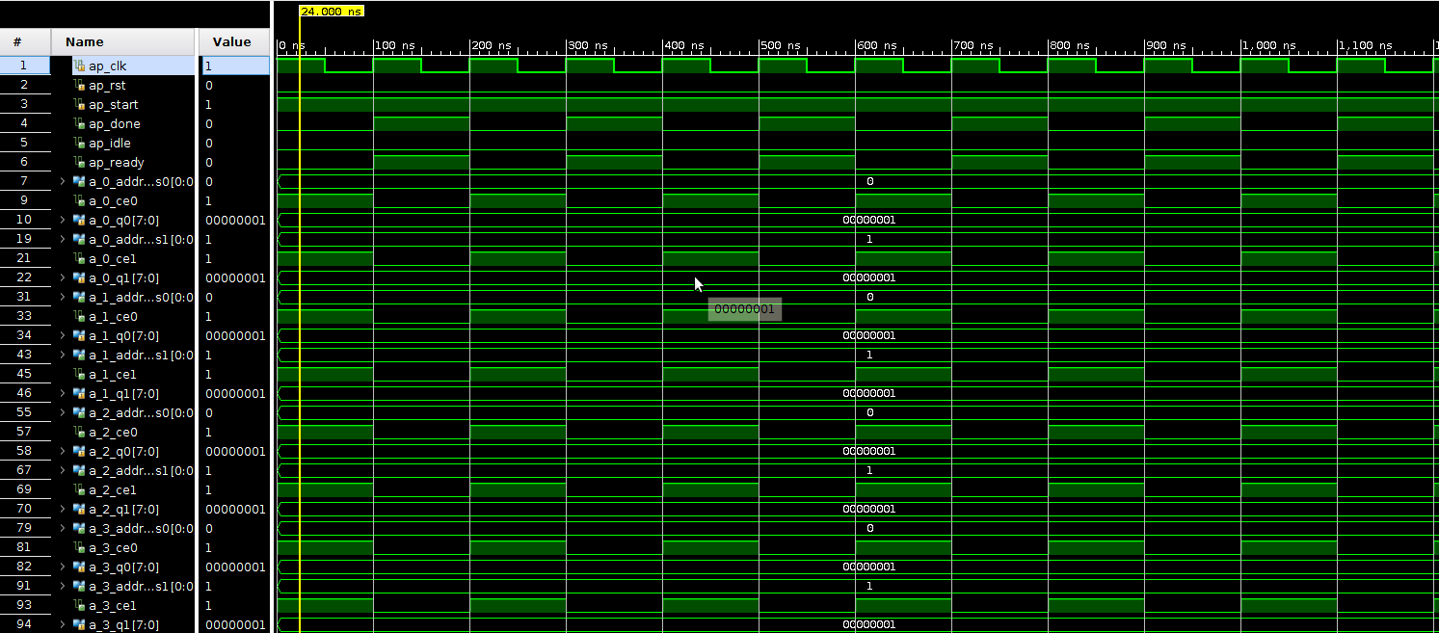
3. Loop Unrolling
For(i =0; i<8; i ++) {
C[i]=A[i]+ B[i];
C[i+1]=A[i+1]+ B[i+1];
.
.
.
C[i+7]=A[i+7]+ B[i+7];
}
Fig. Fixed point addition simulation result after applying unrolling

Slide 17
Hardware Realization of Fixed-Point Addition 1. Sequential loop
RESET
State 1
State 2
EXIT CONDITION
EXIT=1
State 3
EXIT=0
OPERATION

Slide 18
2. Loop pipelining
RESET
State 1
State 2
OPERATION
EXIT=1
State 3
EXIT=0
EXIT CONDITION

Slide 19
3. Loop unrolling
RESET
State 1
State 2
OPERATION
EXIT
Comparison of computational optimization Directive of fixed-point addition
PARAMETERS | Sequential | Pipeline | Unroll
Loop latency | 17 | 10 | 1
LUTs | 50 | 67 | 117
I/O ports | 142 | 187 | 468

Slide 20
III. Addition of Floating Point Numbers
For the addition and multiplication of floating point numbers we have to use floating point IPs.
Numbers written in scientific notation have three components
Sign
1bit
8 bits
23 bits
 | Exponent | Mantissa
31
30 23
22 0
Single precision format(32 bit)

Slide 21
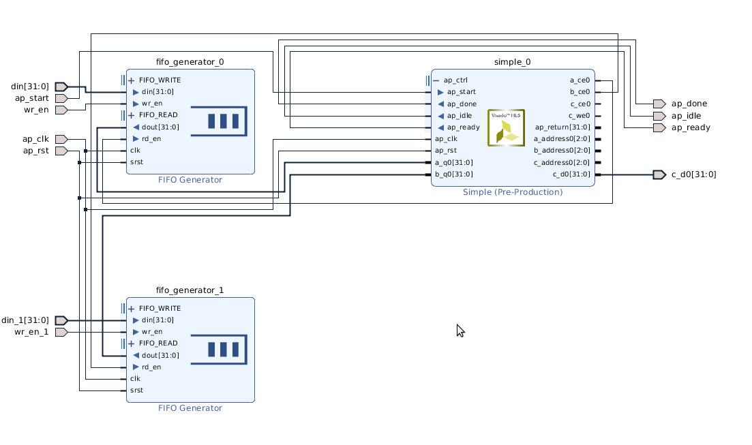
Floating-point Addition Block diagram(IP)

Slide 22
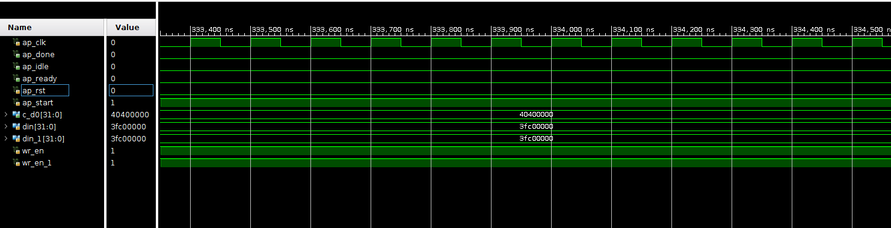
1. Sequential loop
int i, float A[i], float B[i], float C[i];
For(i=0; i<8; i++;) {
C[i]=A[i]+ B[i];
}
Fig. Floating point addition simulation result of sequential process

Slide 23
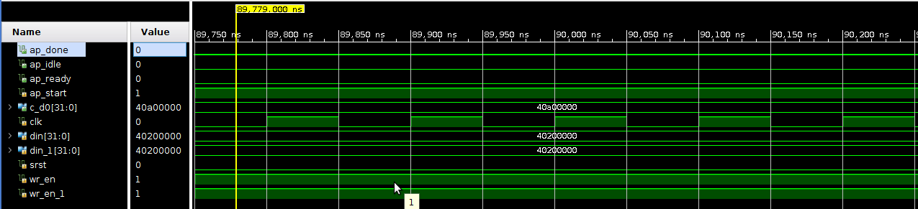
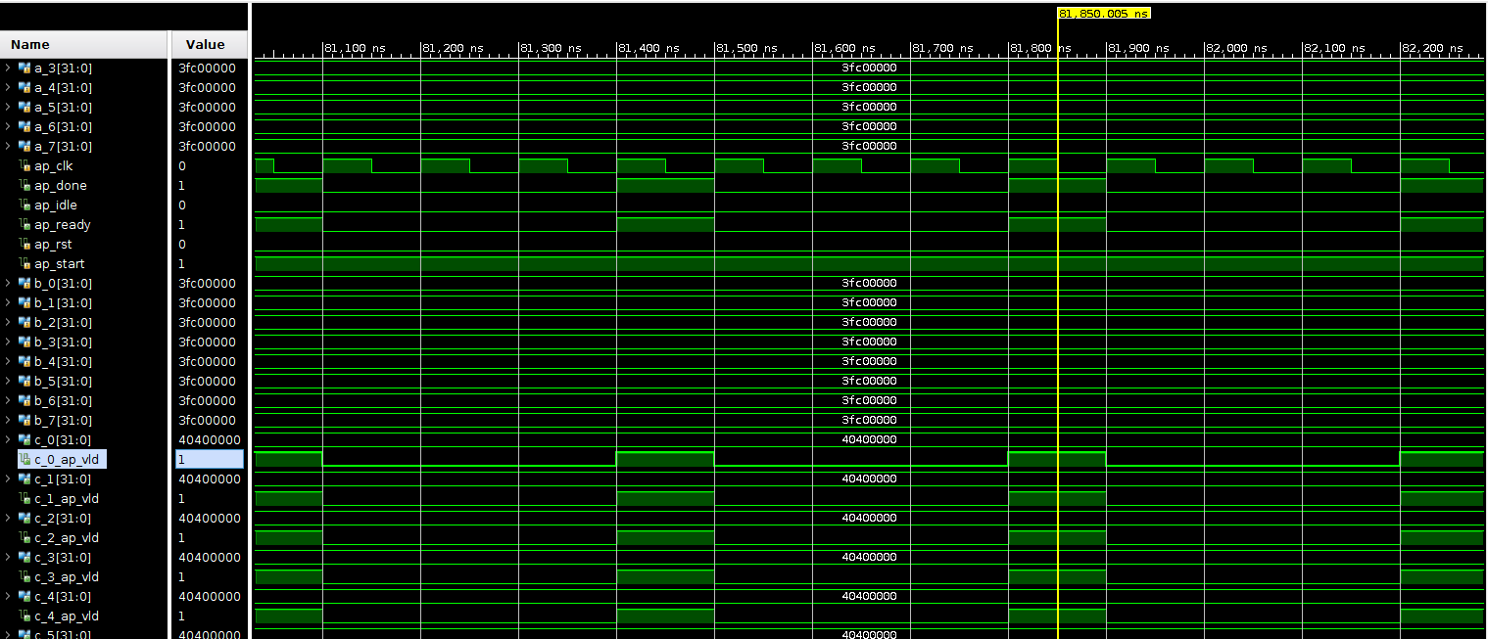
2. Loop Pipelining
Fig. Floating point addition simulation result after applying pipelining
3. Loop Unrolling
Fig. Floating point addition simulation result after applying unrolling

Slide 24
Hardware Realization of Floating-Point Addition
1. Sequential loop
RESET
EXIT CONDITION
EXIT =0
State 1
State 2
State 3
State 4
EXIT =1
State
9
State
5
State 8
State 7
State 6

Slide 25
2. Loop pipelining
RESET
State 1
State 2
OPERATION
EXIT =0
EXIT =1
State 3
25

Slide 26
3. Loop Unrolling
RESET
State 1
State 2
State 4
State 3

Slide 27
Comparison of computational optimization Directive of floating-point addition
PARAMETER | Sequential | Pipeline | Unroll
Loop latency | 65 | 14 | 3
LUTs | 272 | 326 | 1771
I/O ports | 104 | 205 | 708
DSP48E | 2 | 2 | 16

Slide 28
IV. Matrix multiplication using integer numbers
Algorithm of Matrix multiplication
start
Read a[3][3],b[3][3]
rows
For i=0 to 2
columns
For j=0 to 2
product
For k=0 to 2
C[i][j] += A[i][k] * B[k][j];
* Sequential implementation of above code will take 79 clock cycles for completion.
28

Slide 29
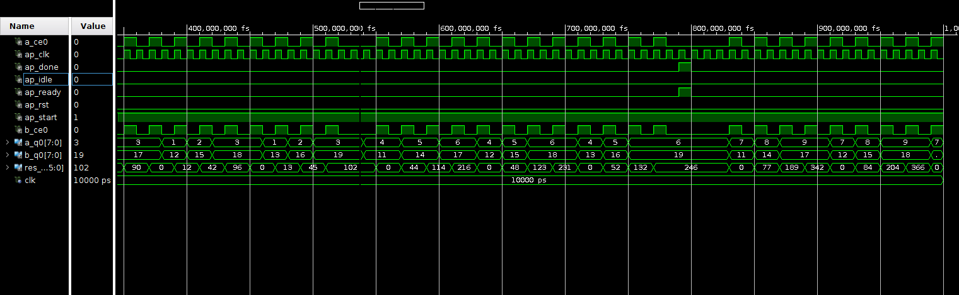
1. Sequential implementation of matrix multiplication
Fig. Matrix multiplication simulation result by conventional method

Slide 30
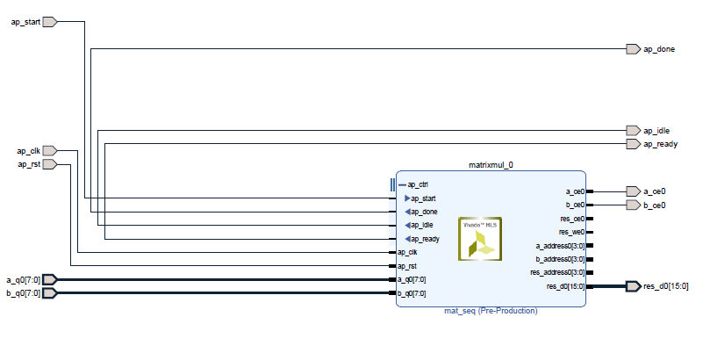
Matrix multiplication with integer numbers Block diagram(IP)

Slide 31
Comparison of computational optimization Directive of Matrix multiplication
PARAMETER | Sequential | Pipelining | Unrolling
Loop latency | 79 | 21 | 10
LUTs | 142 | 282 | 367
I/O ports | 41 | 58 | 270
DSP48E | 1 | 2 | 6

Slide 32
Results and Conclusion
Applications of optimization directives have explored to reduce execution time.
Loop Pipelining and loop unrolling of fixed-point addition show the reduction in delay by approx. 28% and 71%, and increase in hardware by 14% and 68% respectively, as compared to sequential.
Experimental results demonstrate that, pipelining and unrolling of floating-point addition show the reduction in delay by 72% and 91%, and increase in hardware 2 times and 5 times respectively, as compared to sequential processing. DSP48E increased by 16 from 2 slices compare to the conventional.
Loop Pipelining and loop unrolling of matrix multiplication with integer entries show the reduction in delay by approx. 73% and 87%, and increase in hardware by 30% and nearly 75% respectively, as compared to sequential. In addition increase in DSP48E slices is also observed.
Simulation results show that proposed design has reduced time complexity for mathematical functions.

Slide 33
References
[1]
[2]
[3]
[4]
[5]

Slide 34
Acknowledgement
I would like to thank my project coordinator Prof. Arup Banerjee, who gave me the opportunity to do this wonderful project.
I express my sincere thanks and deepest regards to Dr. Srivathsan Vasudevan and Dr. Satya S. Bulusu of IIT Indore who always gave the valuable suggestion and guidance for this work.

Slide 35


