Slide 1


Reducing computational complexity of mathematical functions using FPGA
Neha Gour, M.Tech. (VLSI Design)
Department of Electronics, Banasthali University
Guided by:
Prof. Arup Banerjee
RRCAT, Indore

Slide 2
Outline
Introduction
Motivation
Conventional Processor vs. FPGA
Overview of an FPGA
Basic Skeleton of Project
Work carried out
Directives
Addition of 1X8 Matrix with Integer Entries
Addition of 1X8 Matrix with Real Number Entries
Matrix Multiplication using Integer Numbers
Result and Discussion

Slide 3
Introduction
High performance computing is a rapidly growing field in computer and electronics engineering.
Conventional computers take a long time for performing the task, because CPU used in conventional computers generally work sequentially.
Computationally intensive applications such as, real time weather forecasting, big data mining, computational biology etc.

Slide 4
Motivation
To reduce the computation time and make system efficient using concept of parallelism.
Parallel processing through Field Programmable Gate Array (FPGA) is one possible solution to improve the latency.
Objective of this work is to improve the latency in computation of mathematical functions using directives such as loop pipeline, loop unrolling and array partitioning.

Slide 5
Conventional Processors vs. FPGA
Conventional processors | FPGA
Sequential processing device. | Parallel processing device.
Large no. of clock cycles are required to perform a specific task. | Fewer clock cycles are required to execute the task.
It has fixed Arithmetic Logic Unit (ALU). | FPGA has programmable ALUs.

Slide 6
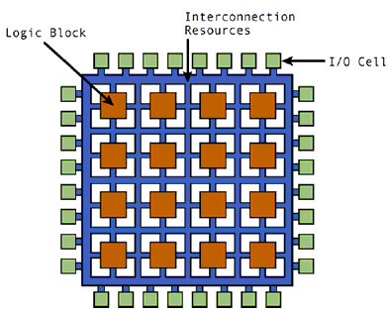
Overview Of An FPGA
A IC that can be programmed in laboratory after manufacture.
User can configure
Interconnection between Logic Blocks (CLBs)
The function of each block.
Characteristics of an FPGA
Operating frequency (< 100MHz)
6-input Lookup Table technology configured
Max user I/O at a time
I/O voltage from 1.2 V to 3.3 V
Highest performance and lowest power.
Basic structure of FPGA[1]

Slide 7
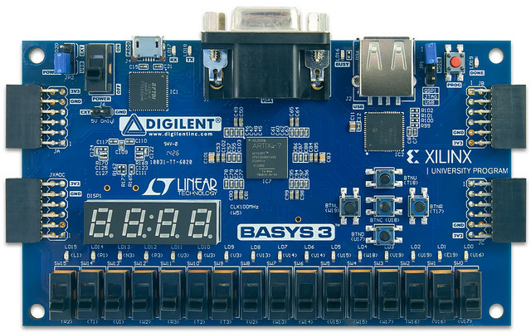
Technical Aspects Of Artix-7 FPGA
33,280 logic cells in 5200 slices(each slice contains four 6- INPUT LUTs and 8 flip-flops)
1,800 Kbits of fast block RAM (BRAM)
90 DSP slices
Internal clock speeds exceeding 450 MHz
On-chip analog to digital converter(XADC).
The basys 3 Artix-7 FPGA board [2]

Slide 8
Programming Of FPGA
FPGA programming can be carried out by two approaches:
Hardware description Language(HDL) like Verilog/ VHDL
High level language (C/C++) using Vivado HLS.
Approach 2
Approach 1
High-level language (C/C++)
HDL Code
High Level Synthesis
RTL Design
RTL Design
Export and implement on FPGA
Export and implement on FPGA

Slide 9
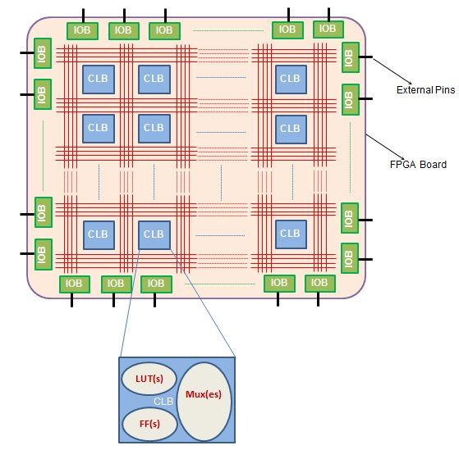
Basic Skeleton Of The Project
High-Level language (C-program)
Parallel processing through FPGA is implemented using High-Level Synthesis (HLS).

Slide 10
Work Carried Out
APPLYING DIRECTIVES
LOOP PIPELINE
LOOP UNROLL
C-Language
FPGA
Basic block diagram of design
NOTE: HLS is done by Vivado HLS (2017.2) software. Hardware implementation is done using Artix-7 FPGA.

Slide 11
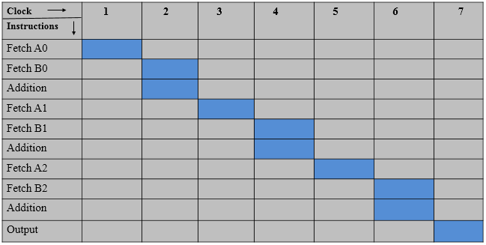
Sequential Loop(C- Language)
For(i=0; i<8; i ++){
C[i] = A[ i ] + B[i ];
} Analysis of sequential loop
Loop latency = 17 for loop size 8
* Loop latency is the number of clock cycles required to execute all iteration of loop.

Slide 12
I. Directives
1. Loop unrolling
Loop unrolling is a directive that exploits the parallelism between loop iteration.
It creates multiple copies of the loop body and adjust the loop iteration counter accordingly.
Sequential loop Unrolled loop
For( i=0;i<8; i++)
{ {
C[i]=A[i]+B[i]; C[i]=A[i]+B[i];
} C[i+1]=A[i+1]+B[i+1];
.
.
C[i+7]=A[i+7]+B[i+7];
}

Slide 13
Analysis of unrolled loop
Clock cycle Instructions | 1 | 2 | 3 | 4
Fetch (A[0],B[0]) (A[4], B[4])
Add
Fetch (A[1],B[1]) (A[5],A[5])
Add
Fetch (A[2],B[2]) (A[6],B[6])
Add
Fetch (A[3],B[3]) (A[7], B[7])
Loop latency = 4 for loop size 8

Slide 14
2. Array partition
partition an array into smaller arrays or individual element.
The partitioning
Results in RTL with small memory or multiple registers instead of one large memory
Increases the amount of read and write ports for the storage
Array partition potentially improves the latency of design.
Unrolled loop Unrolled loop with array partition
For (i=0; i<8; i++) For (i=0; i<8; i++)
{ C[i]= A[i]+ B[i]; { C[i]= A[i]+ B[i]; . .
. .
. .
C[i+4]= A[i+4]+ B[i+4] ;} C[i+7]= A[i+7]+ B[i+7] ;}

Slide 15
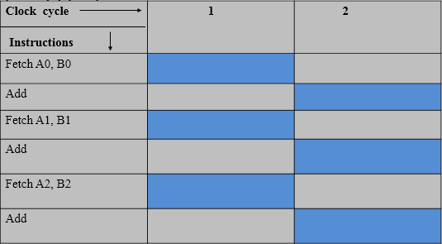
Analysis of unrolled loop with array partition

Slide 16
2. Loop Pipelining
Loop pipelining allows the operation in a loop to be implemented in a concurrent manner.
In pipelining the next iteration of loop can start before current iteration is finished.
Analysis of loop pipelining
Clock cycle instruction | 1 | 2 | 3 | 4 | 5 | 6
Instruction 1 | Fetch A[0] | Fetch B[0] | ADD
Instruction 2 |  | Fetch A[1] | Fetch B[1] | ADD
Instruction 3 |  |  | Fetch A[2] | Fetch B[2] | ADD
Instruction 4 |  |  |  | Fetch A[3] | Fetch B[3] | ADD
Loop latency = 10 for loop size 8

Slide 17
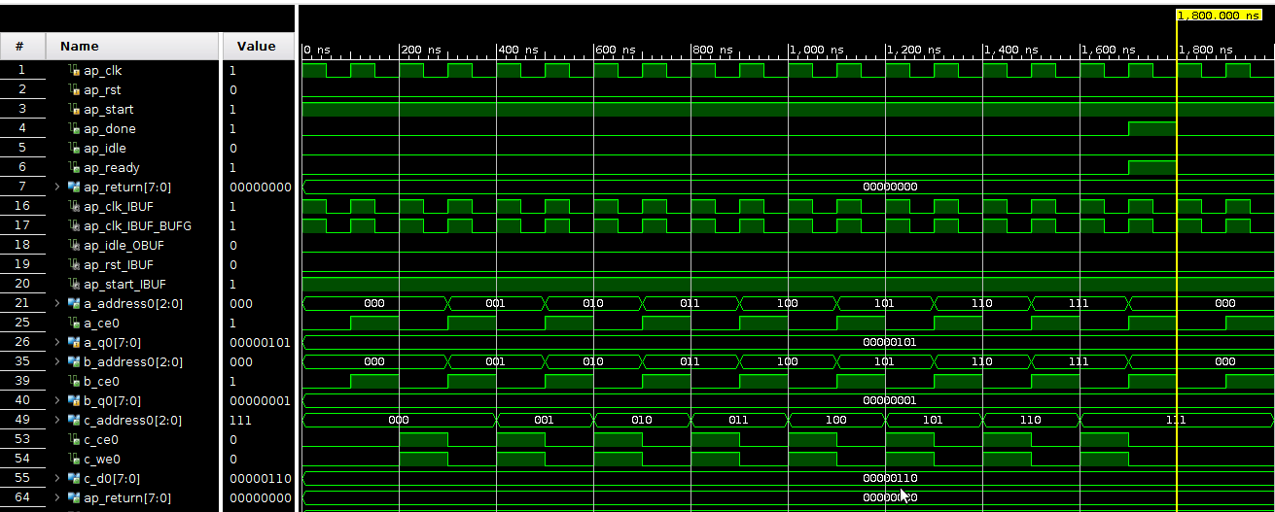
II. Addition Of 1x8 Matrix With Integer Entries
1. Sequential loop
Loop latency = 17*
Simulation result of Integer addition using conventional method( sequential process)
*size of the loop is 8

Slide 18
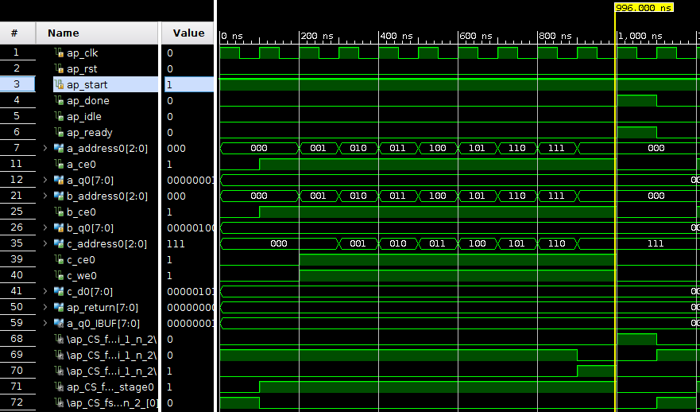
2. Loop Pipelining
Loop latency = 10*
Simulation result of integer addition after applying pipelining
*size of the loop is 8

Slide 19
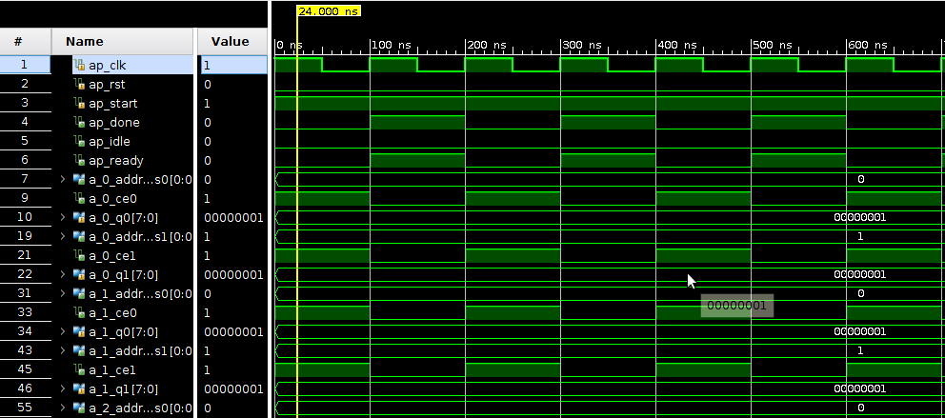
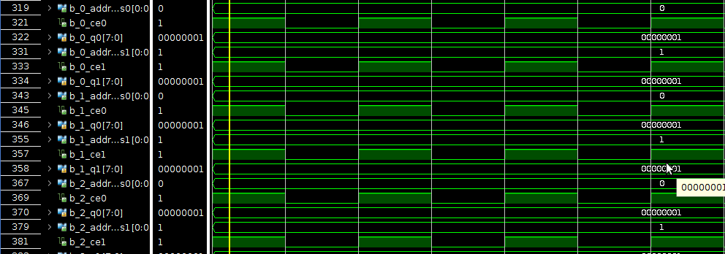
3. Loop Unrolling
Simulation Inputs of integer addition

Slide 20
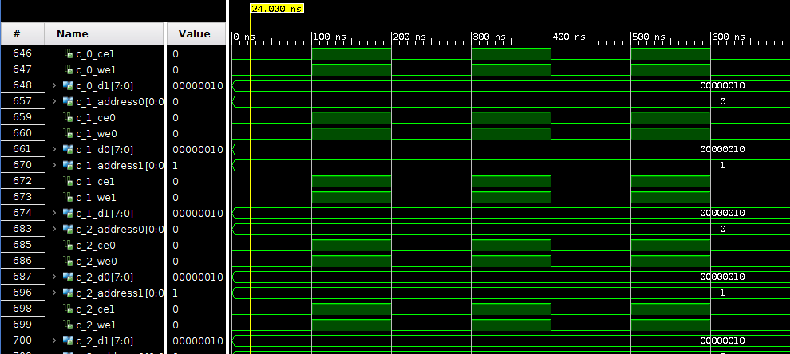
Cont.….
Loop latency = 1*
Simulation result of integer addition after applying unrolling
*size of the loop is 8

Slide 21
Hardware Realization Of Integer Numbers Addition
1. Sequential process
RESET
TERMINATION CONDITION
Initially, state 1 at reset = 1
State 2 shows that Termination condition for loop size.
State 3 perform the operation. If termination condition is false( i is less than loop size).
Otherwise, the Loop will end.
State 1
State 2
( I > 8)
( I < 8)
State 3
OPERATION
State diagram of FSM of integers addition
using sequential process

Slide 22
2. Loop pipelining
RESET
OPERATION
State 1 is an initial state.
Initially, state 2 Fetch the data and move to state 3.
State 3 shows the termination condition
if termination condition is false( I < 8), then state 2 will be next state and perform the operation and fetch the data of next instruction at same cycle.
Otherwise , Loop will terminated.
State 1
State 2
(I > 8)
(I < 8)
State 3
TERMINATION CONDITION
State diagram of FSM of integers addition using loop pipelining
Pipeline process are dynamic multi-processing workflows exhibiting some consistent patterns in their design.

Slide 23
3. Loop unrolling
State 1 is an initial state.
When state 1 changes from reset = 1 to reset = 0, then state 2 will be the current state.
State 2 will perform the operation in parallel mode.
It improves the latency as well as increase the hardware, compared to sequential and pipeline process.
RESET
OPERATION
State 1
State 2
TERMINATED
State diagram of FSM of integers addition
using loop unrolling

Slide 24
Comparison Of Directive For Addition of 1x8 Matrix With Integers
Parameter | Sequential | Pipeline | Unroll
Loop latency (Clock cycles) | 17 | 10 | 1
LUTs | 78 | 97 | 311
I/O port | 142 | 187 | 468
DSP48E | 0 | 0 | 0
NOTE: above data obtained using Artix-7 FPGA at 100MHz clock frequency.
100MHz= 10ns(p).

Slide 25
III. Addition Of Real Numbers Using Floating Point Model
For the addition and multiplication of floating point numbers we have to use floating point IPs.
Numbers written in scientific notation have three components
Sign
1 bit
8 bits
23 bits
 | Exponent | Mantissa
31
30 23
22 0
Single precision format(32 bit)[3]
Sign
1 bit
11 bits
52 bits
 | Exponent | Mantissa
63
62 52
51 0
Double precision format(32 bit)[3]

Slide 26
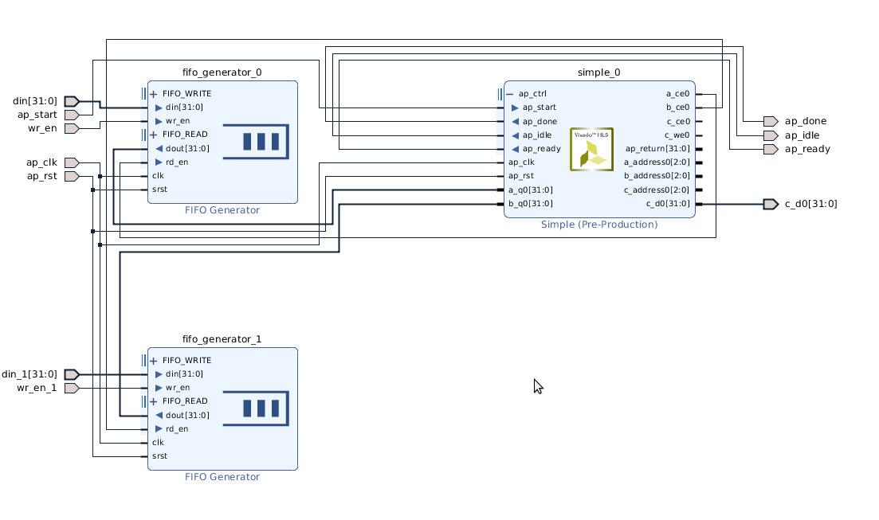
Real Number Addition Block diagram(IP)

Slide 27
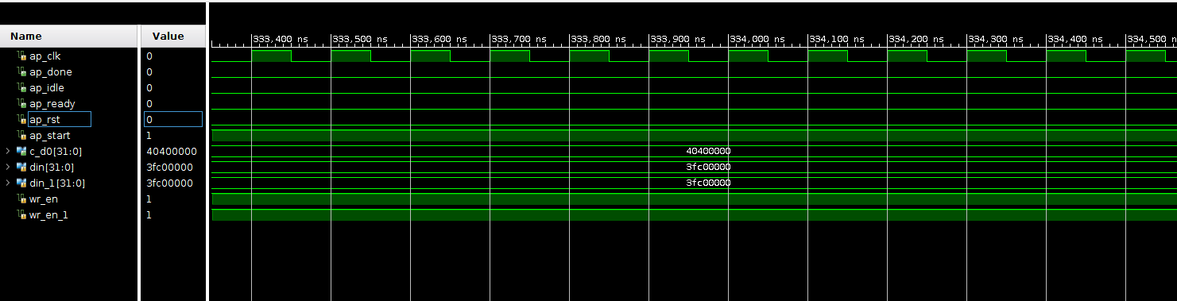
Addition of 1x8 matrix with Real number entries
1. Sequential loop
Simulation result of real number addition using sequential process

Slide 28
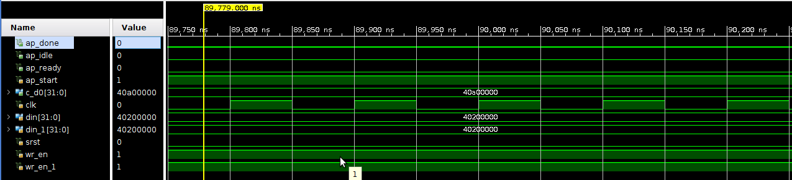
2. Loop Pipelining
Simulation results of real number addition after applying pipelining

Slide 29
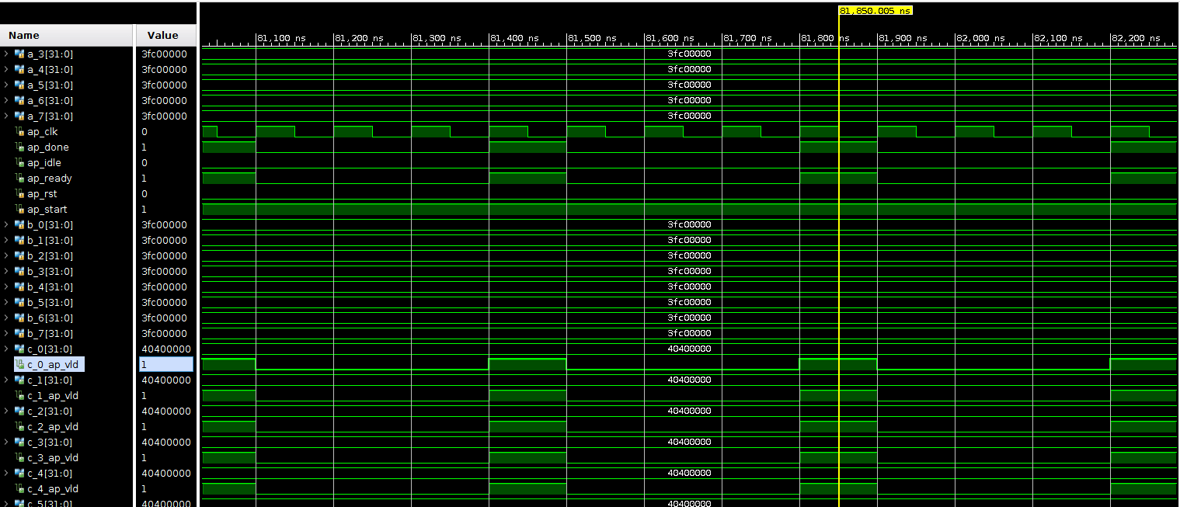
3. Loop Unrolling
Simulation results of real number addition after applying unrolling

Slide 30
Hardware Realization Of Real Number Addition
1. Sequential loop
RESET
TERMINATION CONDITION
EXIT =0
State 1
State 2
State 3
State 4
EXIT =1
State
9
State
5
State 8
State 7
State 6
State diagram of FSM of real number addition using sequential process

Slide 31
2. Loop pipelining
RESET
OPERATION
State 1
State 2
EXIT =0
EXIT =1
State 3
State diagram of FSM of real number addition using loop pipelining
31

Slide 32
3. Loop Unrolling
RESET
State 1
State 2
State 4
State 3
State diagram of FSM of real number addition using loop unrolling

Slide 33
Comparison Of Directive For 1x8 Matrix Addition With Real Number Entries
PARAMETER | Sequential | Pipeline | Unroll
Loop latency (Clock cycle) | 65 | 14 | 3
LUTs | 272 | 326 | 1771
I/O ports | 104 | 205 | 708
DSP48E | 2 | 2 | 16
NOTE: above data obtained using Artix-7 FPGA at clock period of 10 ns .

Slide 34
IV. Matrix multiplication(3x3) using integer numbers
Algorithm of Matrix multiplication
start
Read a[3][3],b[3][3]
rows
For i=0 to 2
columns
For j=0 to 2
product
For k=0 to 2
C[i][j] += A[i][k] * B[k][j];
* Sequential implementation of above code will take 79 clock cycles for completion.
34

Slide 35
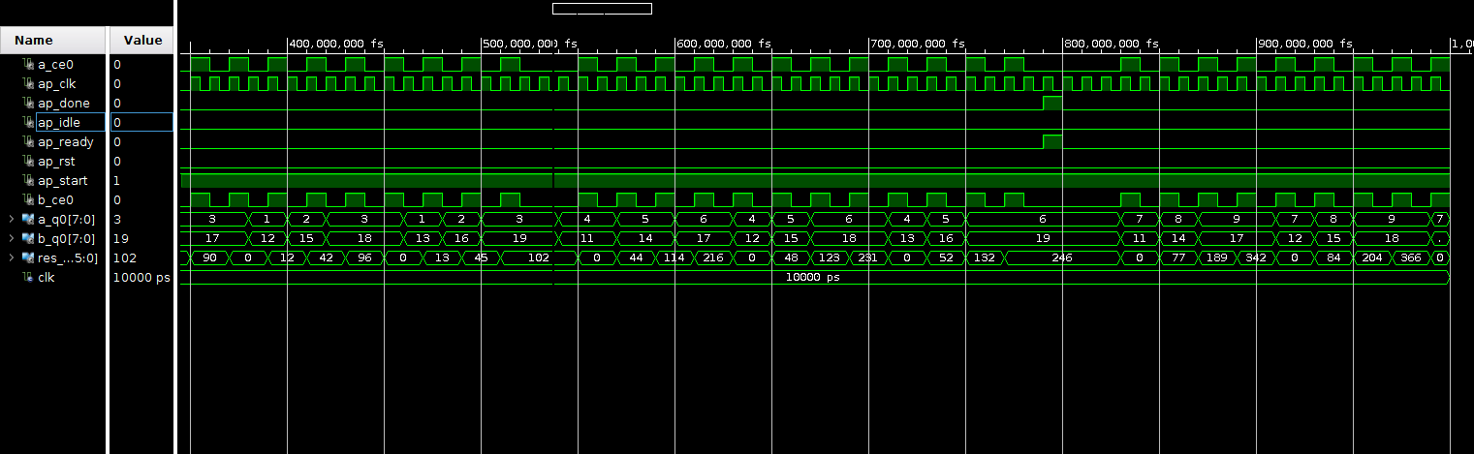
1. Sequential implementation of matrix multiplication
Matrix multiplication simulation result by sequential process

Slide 36
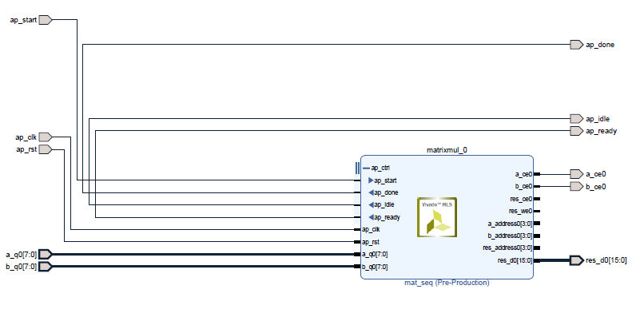
Matrix multiplication with integer numbers Block diagram(IP)

Slide 37
Comparison Of Synthesized Results Of Matrix Multiplication(3x3)
PARAMETER | Sequential | Pipelining | Unrolling
Loop latency (Clock cycle) | 79 | 21 | 10
LUTs | 142 | 282 | 367
I/O ports | 41 | 58 | 270
DSP48E | 1 | 2 | 6
NOTE: above data obtained at clock period of 10 ns .

Slide 38
Result and Discussion
Improvement in Latency
MATHEMATICAL FUNCTIONS | PIPELINING (In %) | UNROLLING (In %)
Integer number addition | 28 | 71
Real number addition | 72 | 91
Matrix multiplication | 73 | 87
Increase in Hardware
MATHEMATICAL FUNCTIONS | PIPELINING (In %) | UNROLLING (In %)
Integer number addition | 14 | 68
Real number addition | 20 | 83
Matrix multiplication | 30 | 75
NOTE: Numbers represent percentage change with respect to sequential process for loop size 8.

Slide 39
Future Scope
Hardware realization of matrix multiplication with integer entries.
Real number matrix multiplication would be performed using directives
Hardware realization of matrix with real number entries would be ascertained.

Slide 40
References
[1] Bob Z, ”Introduction to FPGA design” . Embedded system conference Europe.1999 classes 304-314.
[2] Diligent-Basys 3™ FPGA Board Reference Manual
[3] James H, “Floating Point Design with Vivado HLS XAP599 (v1.0)” September 20, 2012
[4] Sumit G, Rajesh G, Nikhil D. D, Alexandru N, “SPARK: A Parallelization approach to the High-Level Synthesis of Digital Circuit”. 2004, Springer Science US.
[5] Mohsen E, “Reducing system power and cost with Artix-7 FPGAs” . Xilinx, Artix-7, 2012:7:1-2.
[6] Prosenjit M, Jason. F. C, Fred. R. B, “THE CIRCUIT DESIGNS OF AN SRAM BASED LOOK-UP
TABLE FOR HIGH PERMORMANE FPGA ARCHITECTURE” . IEEE (vol. 5) 2003,

Slide 41
Acknowledgement
I would like to thank my supervisor Prof. Arup Banerjee, RRCAT who gave me the opportunity to do this wonderful project.
I would like to convey my sincere thanks and deepest regards to Dr. Srivathsan Vasudevan and Dr. Satya S. Bulusu of IIT Indore for technical discussions and guidance for this work.
I would also like to show my gratitude to Miss Megha Sharma, RRCAT and Mr Abhijeet Gorey, IIT Indore for sharing their pearls of wisdom with me during this course of research.

Slide 42


