Slide 1
A Presentation on White light InterferometrY
Presented by-
Neha Gour
Banasthali University

Slide 2
Contents
Interference
White light interferometry
Typical interferometer setup
Applications
Limitations
References

Slide 3
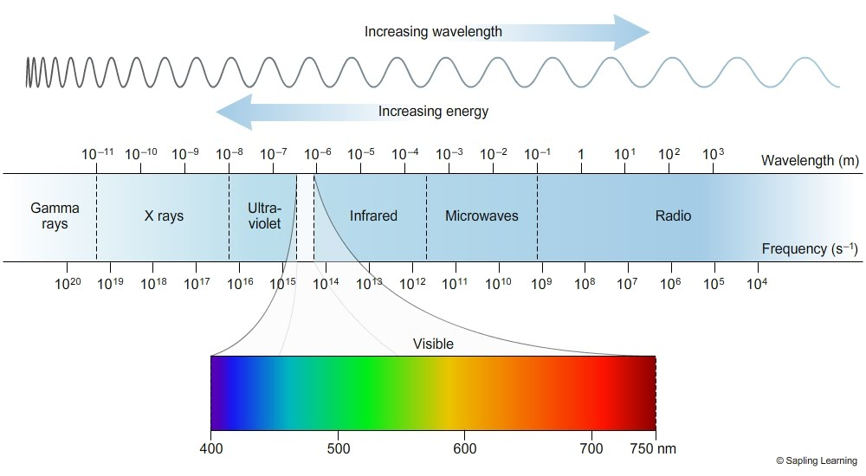

Slide 4
Interference
Interference is the process in which two waves are superimposed to form a resultant wave greater, equal or less amplitude.
necessary condition of interference
monochromatic
coherent

Slide 5
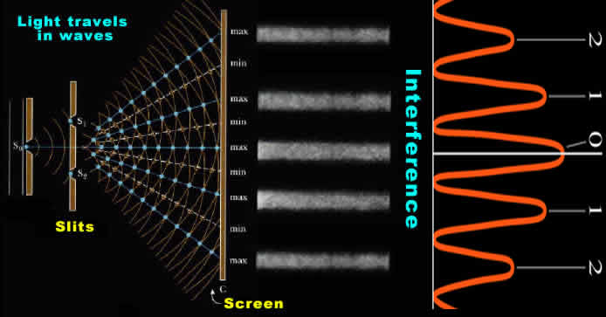

Slide 6
White light interferometry
White light interferometer widely used technique for surface height measurement on 3D structure with surface profile varying between a range .

Slide 7
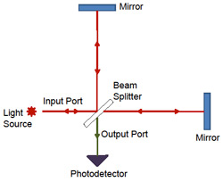
Typical interferometer

Slide 8
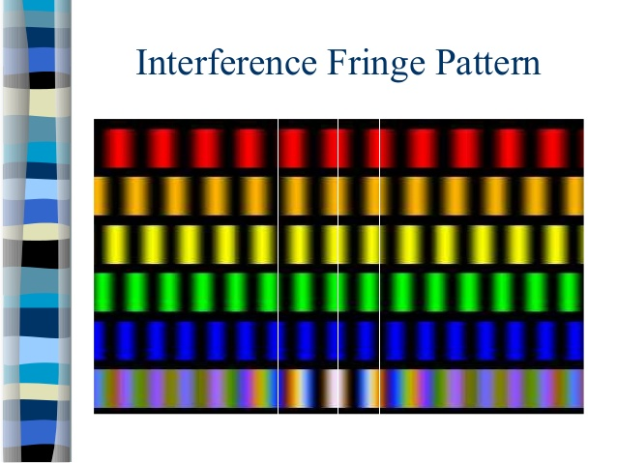

Slide 9
Applications
Surface profiling
Noise due to spurious interference fringes is avoided
Biomedical application
Precisely define the correct focus
Thin film fabrication

Slide 10
Limitations
Requirement of dispersion compensation
Imaging capability is limited .

Slide 11
References
[1] James C. Wyant ” White Light Interferometry” Optical Sciences Center, University of Arizona, Tucson, AZ 85721
[2] ajoy ghatak “ optics”

Slide 12


