Slide 1

DSE July 2022 – Online
CAPSTONE PROJECT
FINAL REPORT PRESENTATION
Title: Loan Defaulter Prediction using ML Techniques

Slide 2
PREM
DEEPTI
ROHAN
VIJAY
NEHA

Slide 3


BUSINESS PROBLEM
Financial institutions face the challenge of accurately identifying and managing loan defaulters to minimize financial losses and maintain a healthy loan portfolio.
The lack of a robust system for predicting loan defaulters results in increased risks and potential losses for the institution.

Slide 4
LOAN SANCTIONED
LOAN NOT SANCTIONED
PROFIT
Right decision
LOSS
of an opportunity
ABLE TO REPAY
NOT ABLE TO REPAY
LOSS
Due to default
PROFIT
Escaped from loss

Slide 5
LOAN SANCTIONED
LOAN NOT SANCTIONED
ABLE TO REPAY
NOT ABLE TO REPAY
PROFIT
Right decision
LOSS
of an opportunity
LOSS
Due to default
PROFIT
Escaped from loss

Slide 6
Maximization
Overall Profit =
PROFIT
Right decision
PROFIT
Escaped from loss
LOSS
of an opportunity
LOSS
Due to default
+
-
-

Slide 7
Maximization
Maximized
Minimized
PROFIT
Right decision
PROFIT
Escaped from loss
LOSS
of an opportunity
LOSS
Due to default
+
-
-
Overall Profit =

Slide 8
Maximization
Maximized
Minimized
PROFIT
Right decision
PROFIT
Escaped from loss
LOSS
of an opportunity
LOSS
Due to default
+
-
-
RISK
Based Decision

Slide 9
Maximized
Minimized
PROFIT
Right decision
PROFIT
Escaped from loss
LOSS
of an opportunity
LOSS
Due to default
+
Maximization
-
-
RISK
Based Decision
CLASSIFICATION
Machine Learning Model
DEFAULTER
NON DEFAULTER
DATA

Slide 10
VALUE ADDITION
some value additions and business recommendations for loan default prediction include
Enhanced Risk Assessment,
Customized Loan Terms,
Early Warning Systems,
Fraud Detection,
Optimization Of Collection Strategies,
Continuous Model Improvement, And
Compliance And Regulatory Support.

Slide 11
CONTENTS
Problem Statement
Phases of Analysis
Descriptive Statistics
Exploratory Analysis
Data Pre-Processing
Feature Engineering
Modelling
Business Implications
Conclusion

Slide 12





Descriptive
Statistics
Data
Preparation
Fine tuning
&
Deployment
Exploratory
Analysis
Model
Building
ANALYSIS PIPELINE

Slide 13
27 Variables
Records 3.9+L
loan_amnt
revol_bal
application_type
installment
revol_util
annual_inc
issue_d
address
term
grade
pub_rec_bankruptcies
Int_rate
emp_title
open_acc
mort_acc
Sub_grade
purpose
pub_rec
total_acc
emp_length
title
verification_status
dti
'home_ownership
initial_list_status
DATA DICTIONARY
'loan_status
earliest_cr_line

Slide 14
12 Numerical
15 Categorical
loan_amnt
installment
application_type
issue_d
annual_inc
Int_rate
address
grade
term
pub_rec_bankruptcies
verification_status
emp_title
open_acc
earliest_cr_line
purpose
mort_acc
initial_list_status
title
pub_rec
total_acc
Sub_grade
'home_ownership
dti
emp_length
'loan_status

Slide 15
Descriptive Statistics

Slide 16
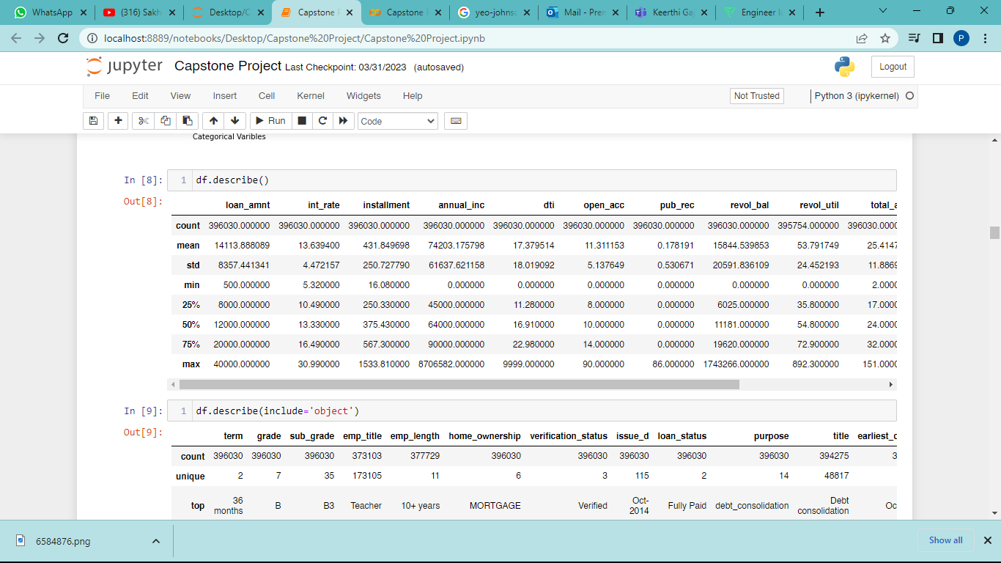
df.describe()

Slide 17
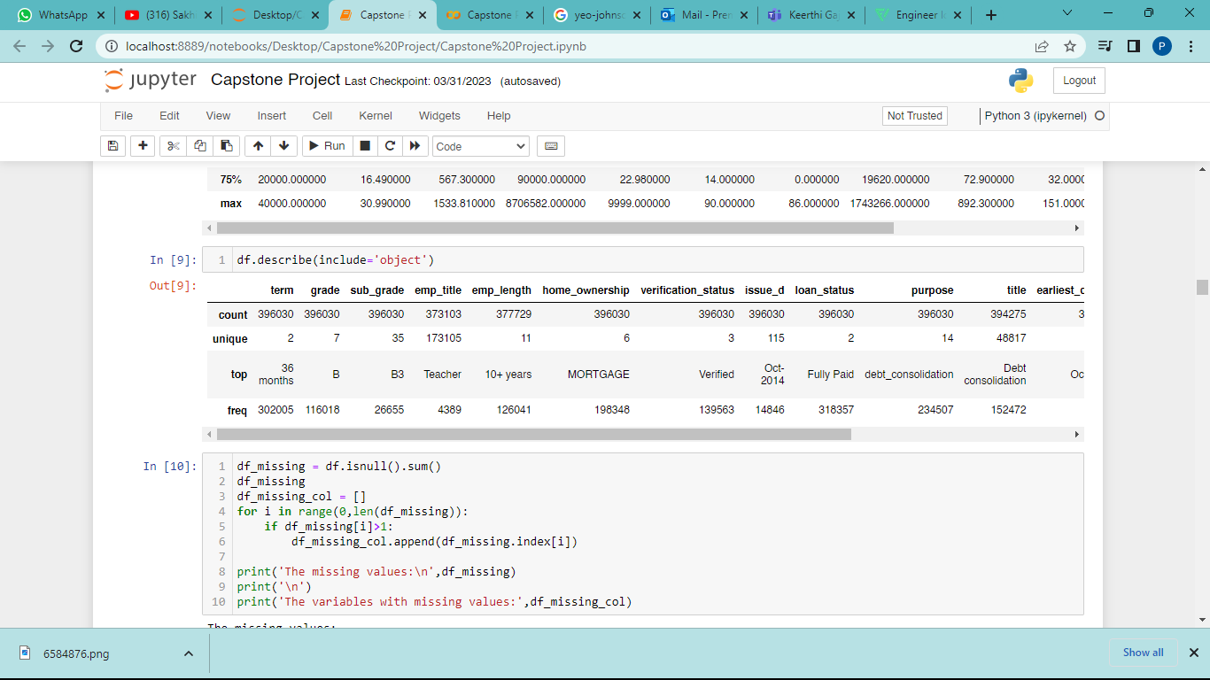
df.describe(include=‘object’)

Slide 18
Exploratory
Analysis

Slide 19
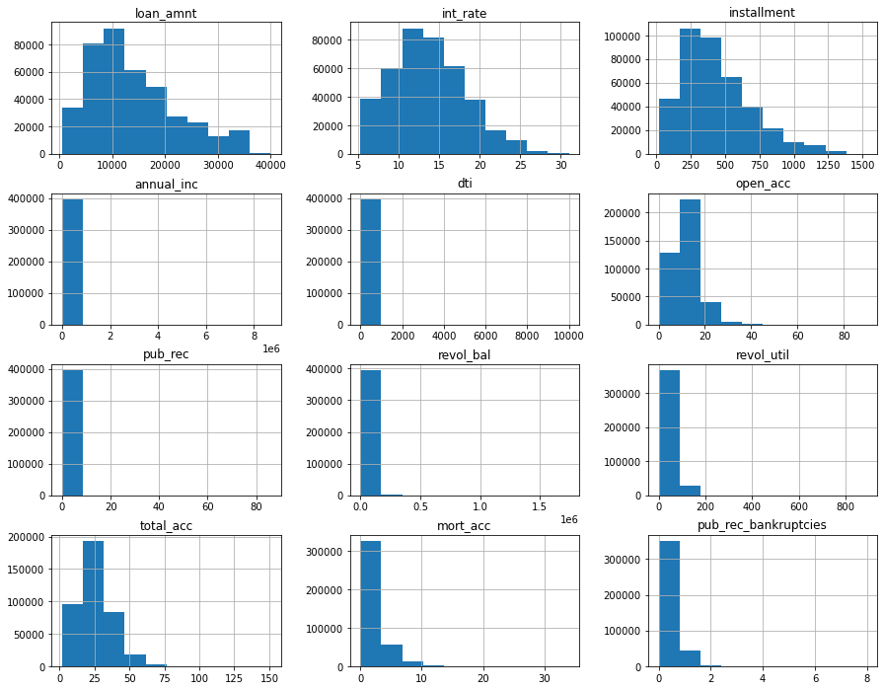
Histogram of Numerical Variables

Slide 20
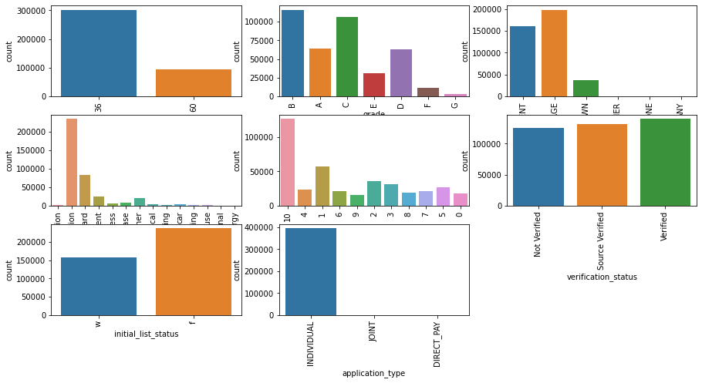
Count plot of category variables

Slide 21
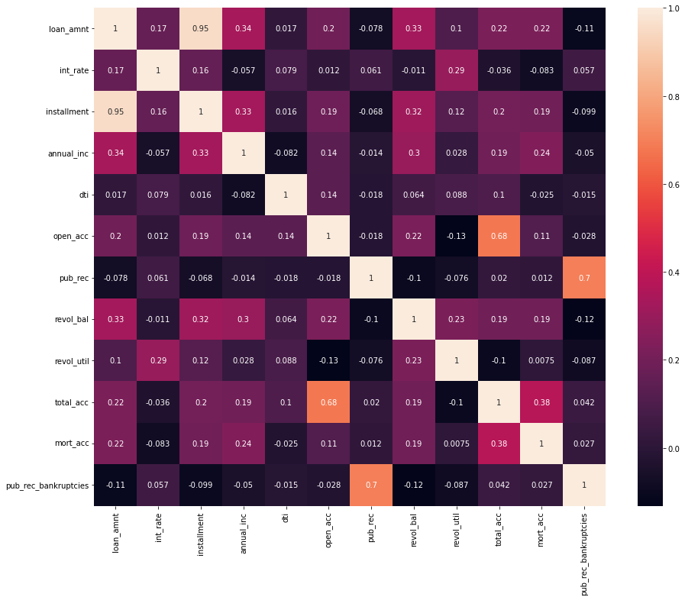
Heat map

Slide 22
Data
Preparation

Slide 23
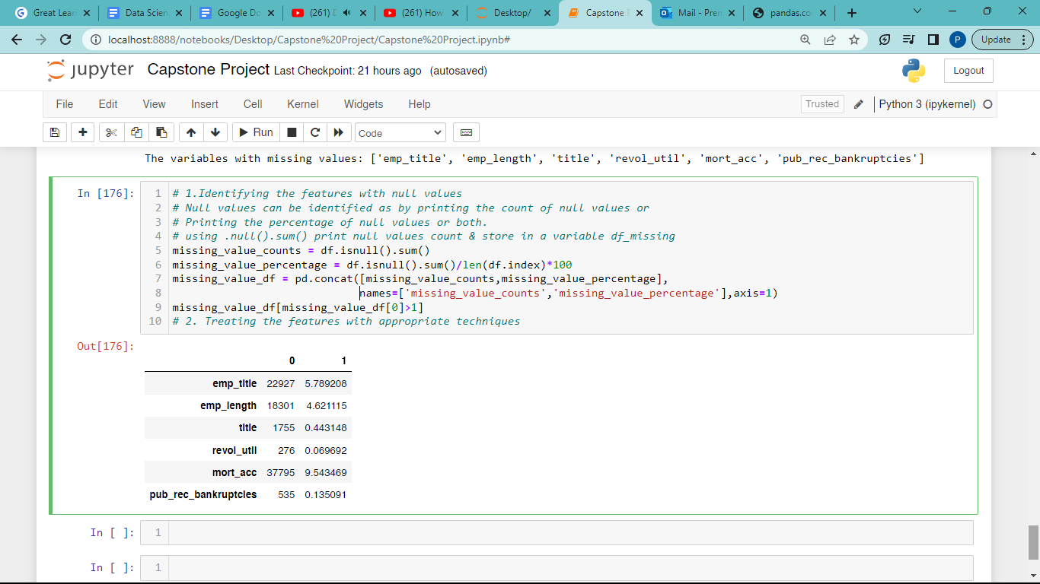
Detecting Null Values

Slide 24
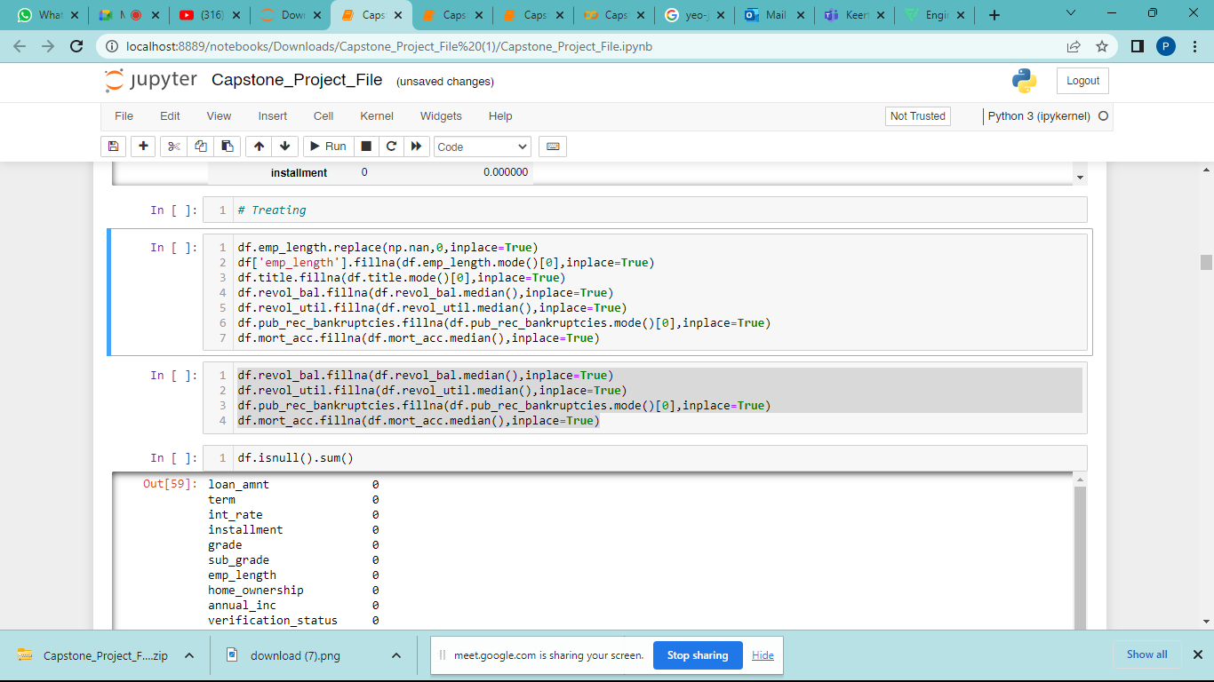
Treatment Null Values

Slide 25
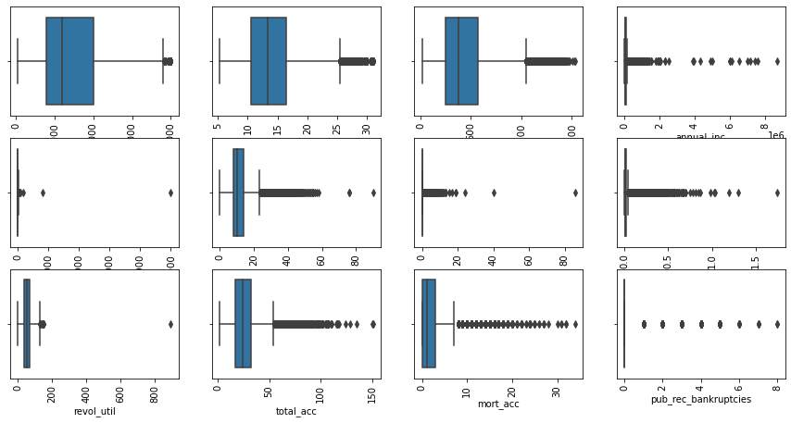
Detecting outliers

Slide 26
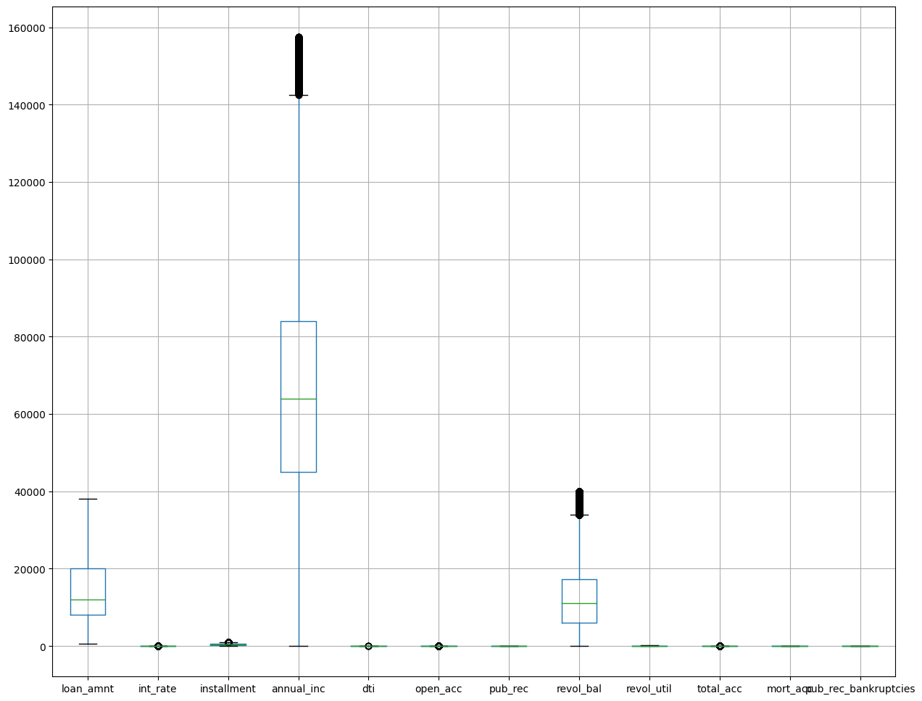
Treatment outliers

Slide 27
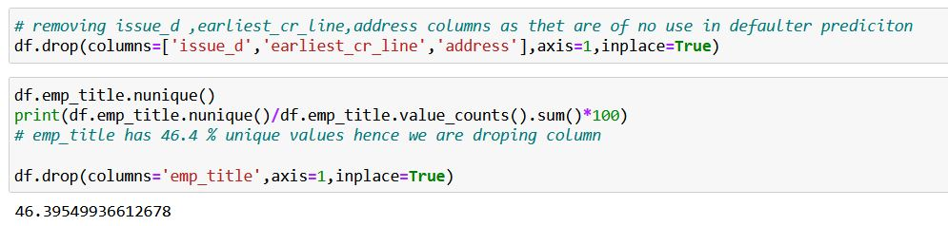
Dropping Redundant Columns

Slide 28

Feature
Engineering

Slide 29
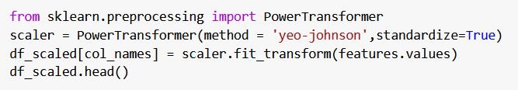
Feature Transformations

Slide 30
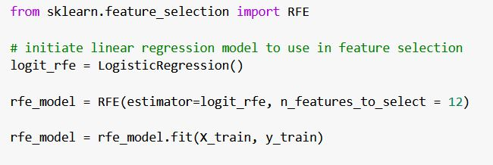
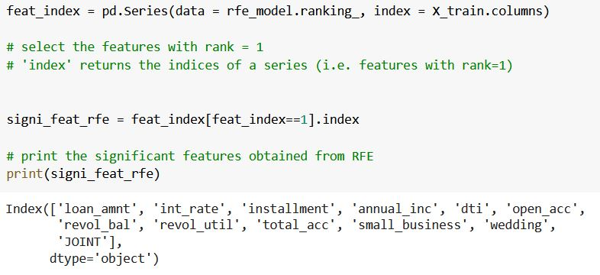
Feature Selection

Slide 31
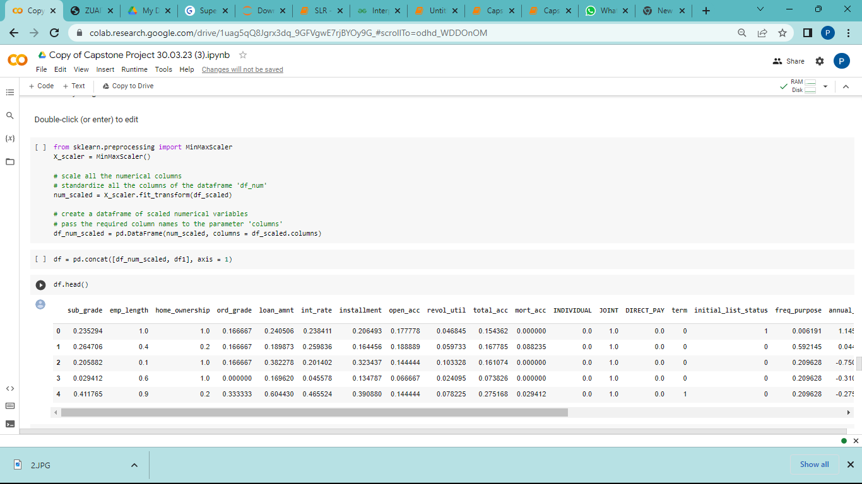
Feature Scaling

Slide 32
Scaled Data

Slide 33
Base
Model

Slide 34
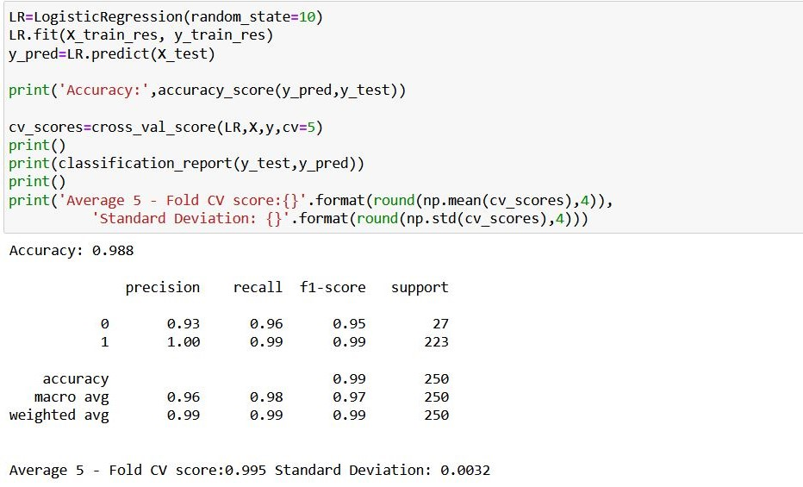
Base Model

Slide 35
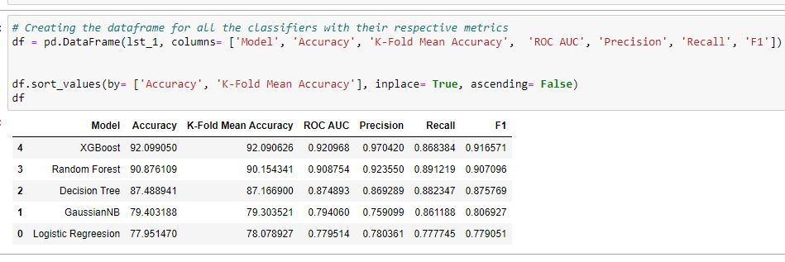
Algorithms Used

Slide 36
Base Model
1. Logistic Regression:
Pros: Simple and interpretable model, good for binary classification, provides estimated probabilities.
Cons: Assumes a linear relationship between features and the log-odds of default, may struggle with complex interactions between variables.
2. Decision Trees:
Pros: Easy to understand and interpret, can handle both numerical and categorical data, captures non-linear relationships and interactions.
Cons: Prone to overfitting, unstable model that can be sensitive to small changes in the data.
3. Random Forests:
Pros: Ensemble of decision trees that reduces overfitting and increases robustness, handles high-dimensional data well, provides feature importance.
Cons: Less interpretable than individual decision trees, can be computationally expensive for large datasets.

Slide 37
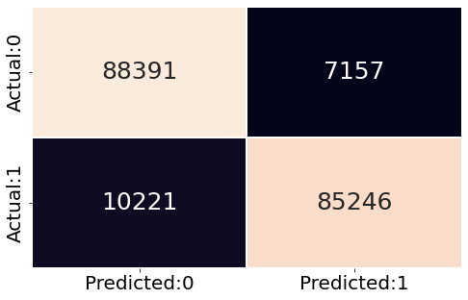
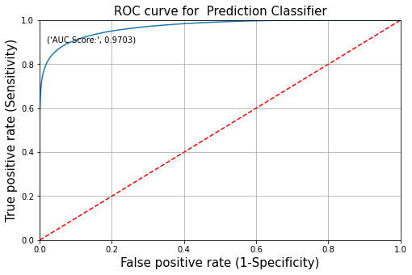
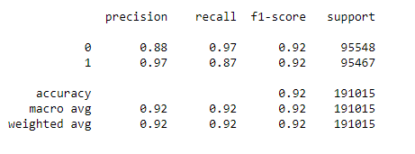
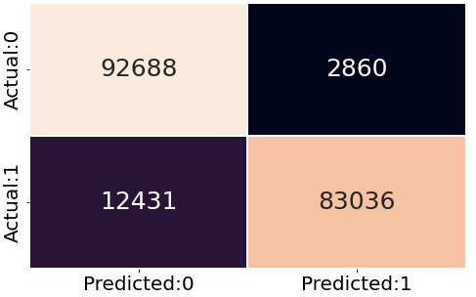
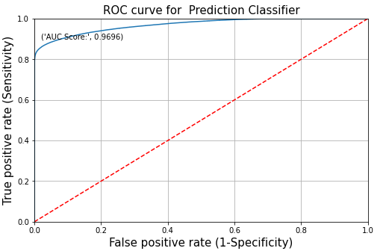
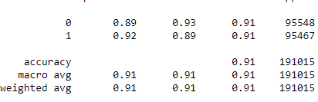
XG BOOST
RANDOM FOREST

Slide 38
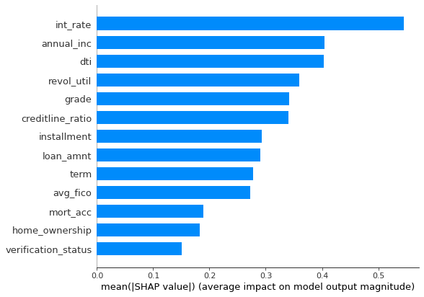
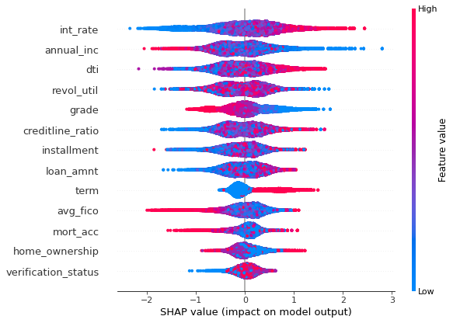
XG BOOST

Slide 39
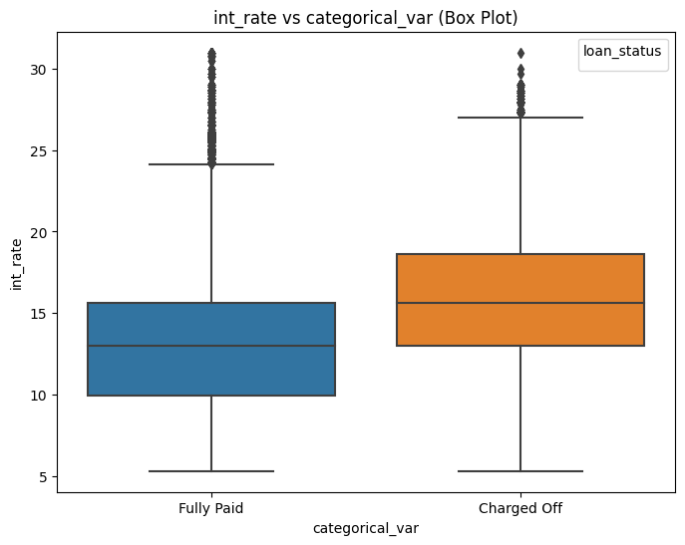
Business Implications

Slide 40
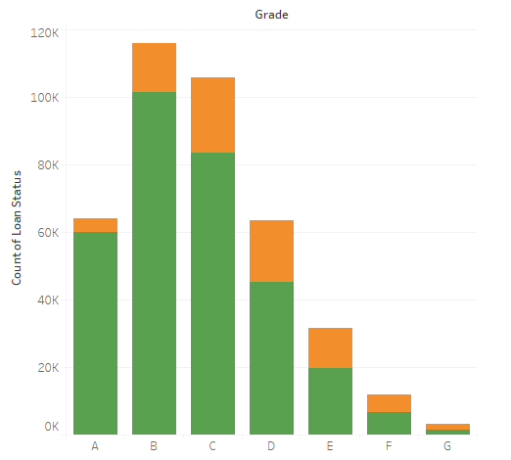
Business Implications

Slide 41
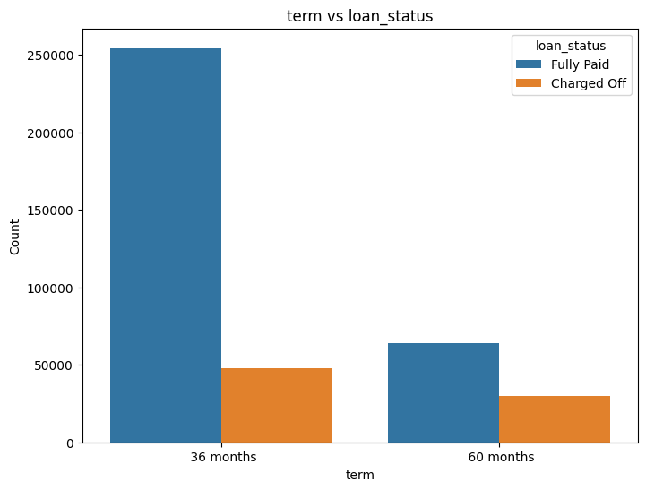
Business Implications

Slide 42
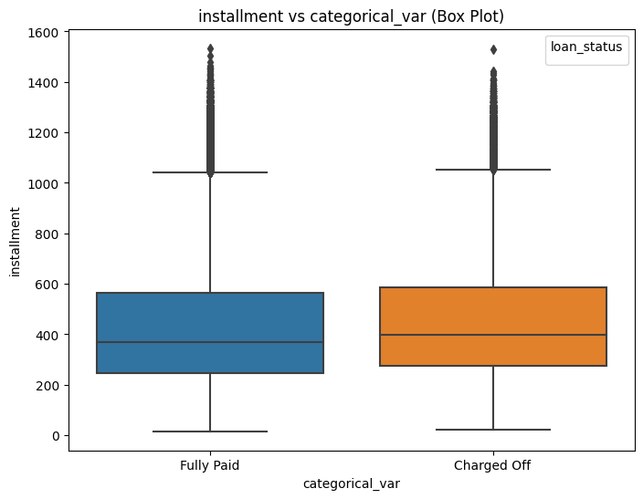
Business Implications

Slide 44

Model Deployment

