Slide 1
AI-POWERED
SMART CHATBOT
🤖
Final Capstone Project
Name: Neha Bansal
Trainer: Anant Verma
Institute: E&ICT IIT Roorkee
Course: Advanced Program In Applied Data Analytics & Generative AI
Date: 29/10/2026
Python • Streamlit • LangChain • Ollama

Slide 2
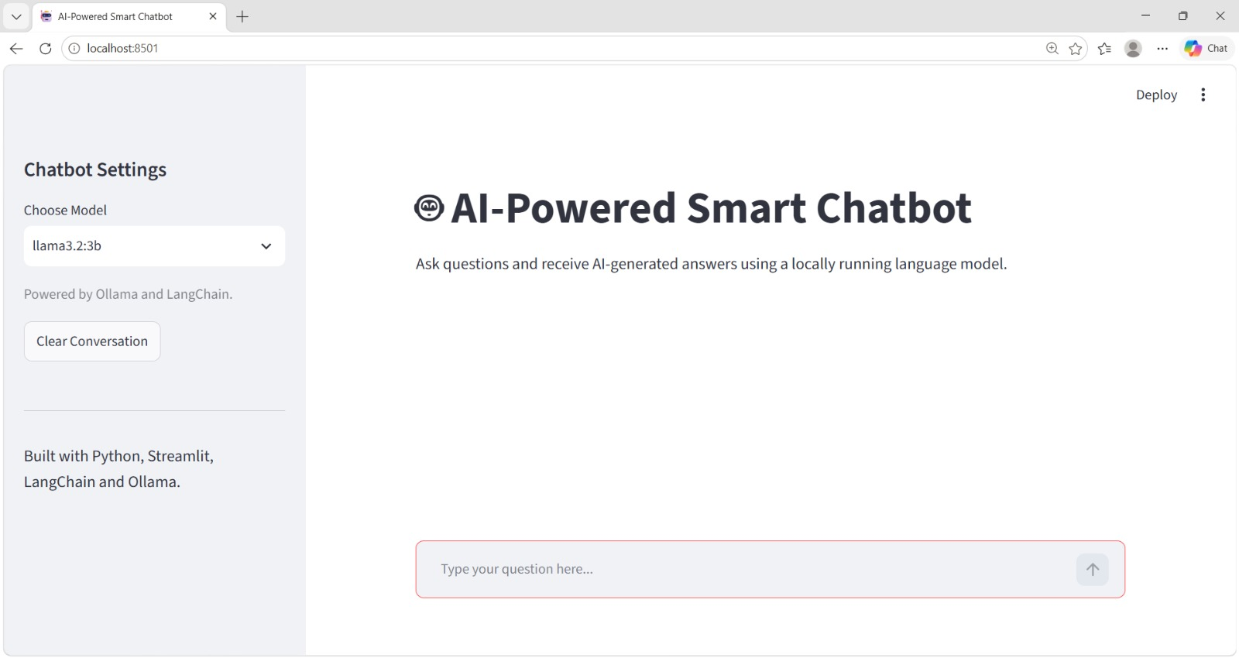

Slide 3
Project Overview
02
A Python-based chatbot that accepts user questions and generates AI responses.
Streamlit provides the interactive web interface.
LangChain connects the application to the language model.
Ollama runs the Llama 3.2 3B model locally on the computer.
Designed as a learning-focused capstone demonstrating local LLM integration.
AI-POWERED SMART CHATBOT • FINAL CAPSTONE PROJECT

Slide 4
Project Objectives
03
Build an interactive chatbot interface.
Generate natural-language answers to user questions.
Maintain conversation history during the active session.
Connect a local language model through LangChain.
Test core functionality and basic error handling.
AI-POWERED SMART CHATBOT • FINAL CAPSTONE PROJECT

Slide 5
Technologies Used
04
Python — core programming language.
Streamlit — web application and chat interface.
LangChain — message handling and language-model integration.
Ollama — local model runtime.
Llama 3.2 3B — language model used by the application.
Jupyter Notebook — experimentation, testing, and documentation.
AI-POWERED SMART CHATBOT • FINAL CAPSTONE PROJECT

Slide 6
System Architecture
05
1
2
3
4
5
User enters a question
→
Streamlit receives input
→
LangChain formats message history
→
Ollama runs Llama 3.2 3B
→
Response appears in chat
The model runs locally after installation and download; no paid API key is required for this setup.
AI-POWERED SMART CHATBOT • FINAL CAPSTONE PROJECT

Slide 7
Project File Structure
06
app.py — main Streamlit chatbot application.
project.ipynb — notebook for setup, sample interactions, and testing notes.
requirements.txt — Python package dependencies.
README.md — project overview and setup instructions.
report.pptx — this project presentation.
Final_Capstone_Project.zip — packaged submission files.
Keep .venv and local environment files out of the ZIP.
AI-POWERED SMART CHATBOT • FINAL CAPSTONE PROJECT

Slide 8
System Requirements
07
Windows, macOS, or Linux computer.
Python 3.11 or 3.12 recommended for compatibility.
Visual Studio Code or another Python editor.
Ollama installed and the selected model downloaded.
Enough disk space and memory to run the local model.
Internet access is needed for initial package/model downloads.
AI-POWERED SMART CHATBOT • FINAL CAPSTONE PROJECT

Slide 9
Installation and Setup
08
1
Create virtual environment
py -3.12 -m venv .venv
2
Activate on Windows PowerShell
.\.venv\Scripts\Activate.ps1
3
Install Python dependencies
python -m pip install -r requirements.txt
4
Download the model
ollama pull llama3.2:3b
5
Check downloaded models
ollama list
AI-POWERED SMART CHATBOT • FINAL CAPSTONE PROJECT

Slide 10
Run the Application
09
Start the chatbot from the project folder:
python -m streamlit run app.py
What to expect
Streamlit opens the app in your browser.
Type a question in the chat input and press Enter.
The model generates a response and displays it in the conversation.
Use the sidebar button to clear the active conversation.
AI-POWERED SMART CHATBOT • FINAL CAPSTONE PROJECT

Slide 11
Key Features
10
Interactive chat interface built with Streamlit.
AI-generated responses from a local language model.
Conversation history maintained during the current session.
Clear-conversation control.
Configurable model selection in the sidebar (currently Llama 3.2 3B).
Basic error message if the model is unavailable.
AI-POWERED SMART CHATBOT • FINAL CAPSTONE PROJECT

Slide 12
Jupyter Notebook
11
Introduces the problem statement and project objectives.
Documents the system workflow and selected model.
Shows model configuration and sample interactions.
Includes a Python-related test question and follow-up demonstration.
Provides testing guidance, limitations, and possible improvements.
Select the project virtual environment as the notebook kernel before running cells.
AI-POWERED SMART CHATBOT • FINAL CAPSTONE PROJECT

Slide 13
Testing and Evaluation
12
General knowledge question — confirm that a response is generated.
Python programming question — check clarity and relevance.
Follow-up question — check use of recent conversation context.
Clear conversation — verify that the visible history resets.
Ollama unavailable — verify that the app shows an understandable error.
Record actual results during testing; do not claim unperformed tests passed.
AI-POWERED SMART CHATBOT • FINAL CAPSTONE PROJECT

Slide 14
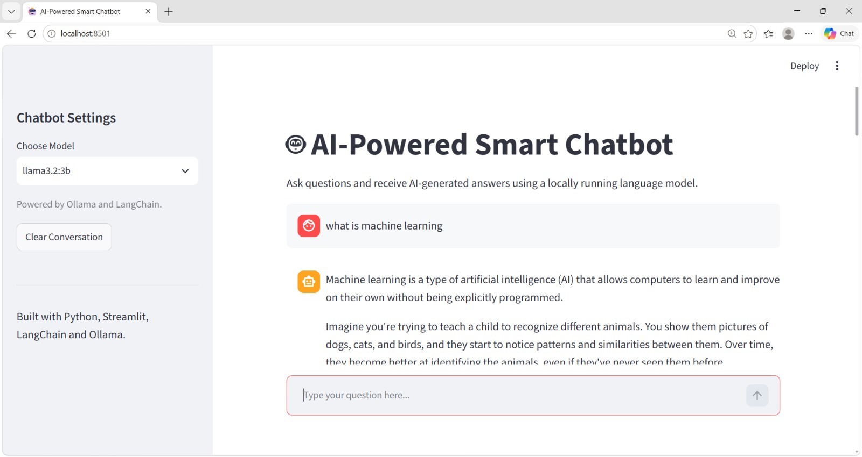
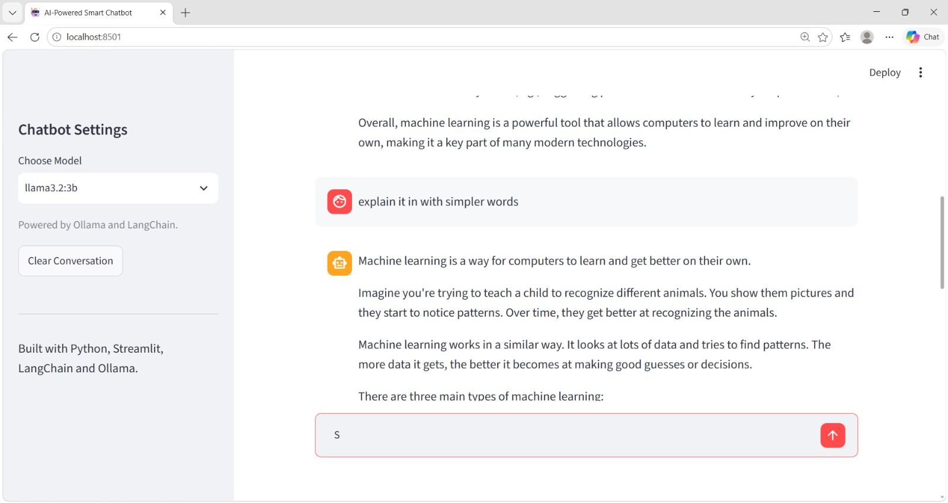
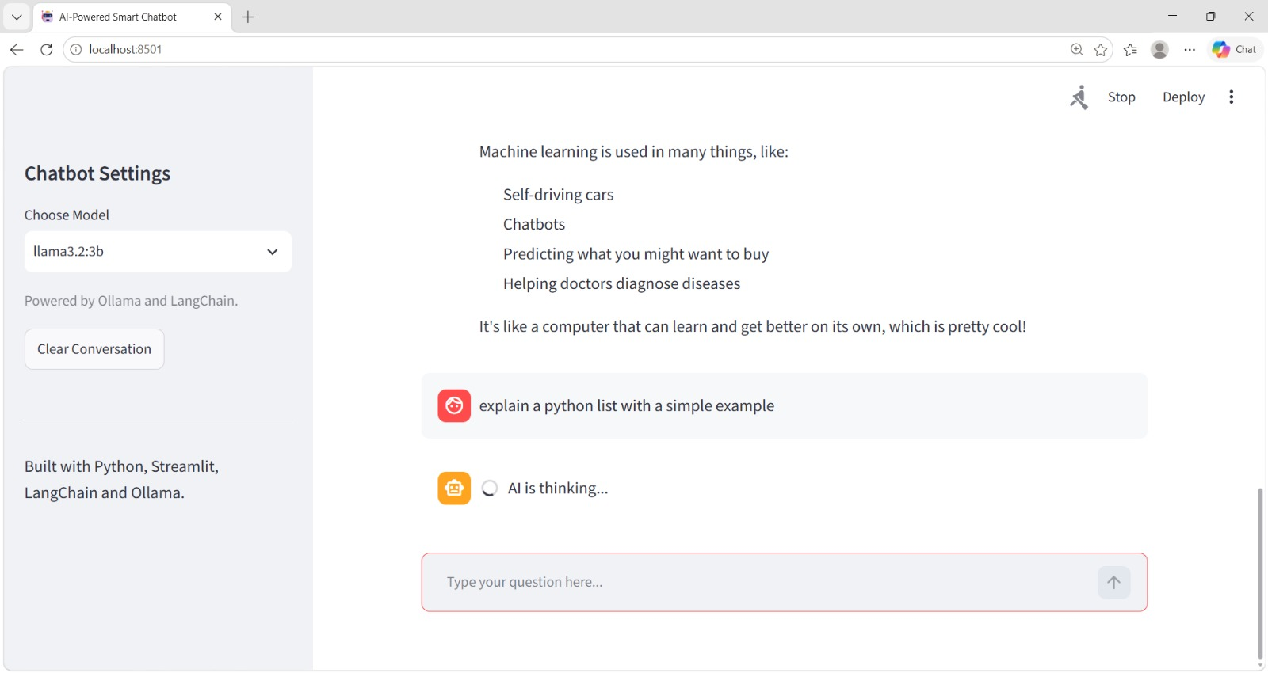
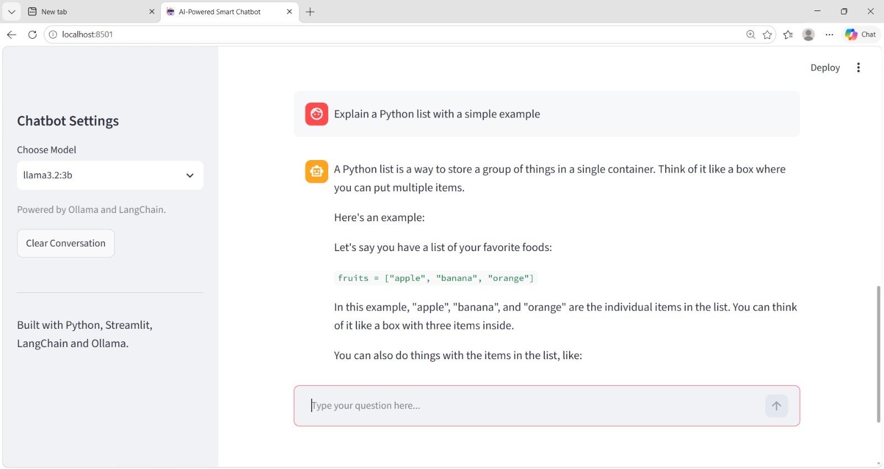

Slide 15
Limitations
13
AI responses can be inaccurate or incomplete and should be checked.
Response speed depends on computer hardware and available memory.
The model must be downloaded before local use.
The application does not independently verify answers against external sources.
Conversation history is not permanently stored.
The current version does not include document-based RAG.
AI-POWERED SMART CHATBOT • FINAL CAPSTONE PROJECT

Slide 16
Future Improvements
14
Add document-based question answering using Retrieval-Augmented Generation (RAG).
Support additional local language models.
Add configurable model settings and response evaluation.
Optionally save conversation history with user consent.
Improve validation, logging, and user-facing error messages.
AI-POWERED SMART CHATBOT • FINAL CAPSTONE PROJECT

Slide 17
Conclusion
15
The project demonstrates a local AI chatbot built with Python and Streamlit.
LangChain connects the app to the Ollama-hosted Llama model.
The application provides interactive question answering and session-based chat history.
The capstone offers practical experience with LLM integration and local AI deployment.
Before submission, test the application and replace all presentation placeholders.
AI-POWERED SMART CHATBOT • FINAL CAPSTONE PROJECT

Slide 18
Author and Project Details
16
Project Title
AI-Powered Smart Chatbot
Project Type
Final Capstone Project
Author
Neha Bansal
Trainer
Anant Verma
Institute
E&ICT IIT Roorkee
Course
Advanced Program In Applied Data Analytics & Generative AI
GitHub
https://github.com/nehaguptarke6-cmyk/AI-Powered-Smart-Chatbot
AI-POWERED SMART CHATBOT • FINAL CAPSTONE PROJECT

Slide 19
THANK YOU!
Any Questions?
AI-Powered Smart Chatbot • Final Capstone Project

