Slide 1
RTF on Self Managed AKS(Azure Kubernetes Service)
MuleSoft Monday
Presented By :
Nirad Smart
Naimish Kakkad

Slide 2
“I am always doing that which I cannot do, in order that I may learn how to do it.”
-Pablo Picasso

Slide 3
Agenda
Anypoint Runtime Fabric overview
Anypoint Runtime Fabric on Self Managed Kubernetes
Key Difference
Live Demo

Slide 4

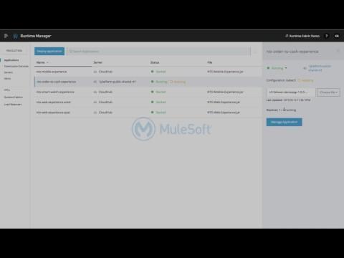
Anypoint Runtime Fabric
Deploy and manage runtimes across any cloud
Centrally manage all applications Manage applications in your private cloud (AWS, Azure) and CloudHub within Anypoint Platform
Run Mule apps on Kubernetes Get containerization benefits such as isolation, horizontal scaling, and auto redeploy by default
Move deployments in a few clicks Pivot your deployments between CloudHub, your private cloud, or a data center with no impact

Slide 5
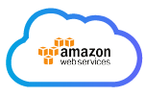
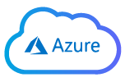


Runtime Fabric Appliance
App
App
App
App
App
App
Mule
Mule
Mule
Mule
Mule
Mule
Runtime Fabric components
Runtime Fabric appliance
VM
VM
VM
network

Slide 6
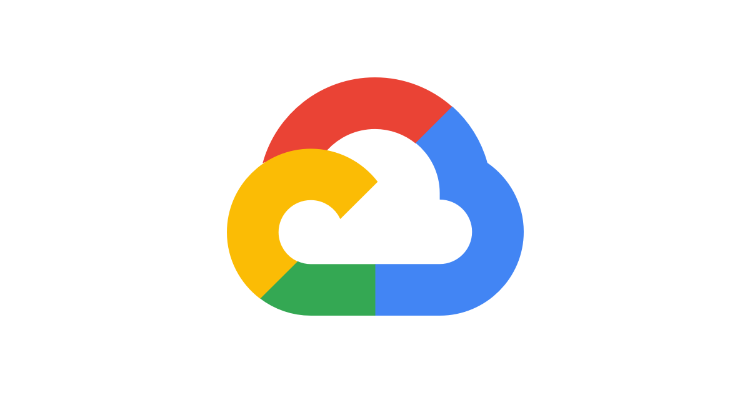
Runtime Fabric on Self Managed
Managed within Anypoint Platform
App
App
App
App
App
App
Mule
Mule
Mule
Mule
Mule
Mule
Runtime Fabric services
Node
Node
Node
network
EKS or AKS
EKS / AKS / GKE
Managed by K8s specialist

Slide 7
Demo Time

Slide 8
Benefits of RTF on EKS / AKS
Lower Cost
AKS / EKS replaces the controller nodes.
AKS is provided by Azure at no cost.
EKS charges $0.10/hr.*
More Flexible
More customizable to your organization’s environment.
Choose your own ingress controller and log forwarding agents
Less Overhead
EKS / AKS are highly available and managed by cloud provider.
Managed worker nodes simplify node scaling and upgrades.

Slide 9
Key Changes
 | RTF on EKS/AKS | RTF appliance
Support for deploying Mules and API Gateways | Supported. | Supported.
Kubernetes and Docker | Customers bring their own K8s via provisioning EKS or AKS clusters. MuleSoft supplies Docker images | Included.
Support for installing on any Linux distribution | Supported. | RHEL and CentOS only.
Support for node auto-scaling | Supported using Azure or AWS settings. | Not supported.
Support for external log forwarding | Customers bring their own external log forwarder. | Included.
Support for internal load balancer | Customers bring their own internal load balancer (called “Ingress Controller”) | Included.
Support for Anypoint Security Edge | Not supported. | Supported.
Ops Center | Not included. Customers can enable similar monitoring and alerting from AWS or Azure console. | Included.

Slide 10
Any Questions ??
“It is not the answer that enlightens, but the question.”
– Eugene Ionesco

Slide 11
Thanks

