Slide 1
Rule-Based Auto Remediation for Known Issues
Notes:
AI-generated content may be incorrect. ---

Slide 2
Rule-based engine automates fixes for repetitive Windows Event Viewer alerts.
Manual intervention is slow and error-prone; automation boosts speed and reliability.
Human-in-the-loop ensures safe execution and auditability.
Aligned with Unisys vision for resilient, efficient infrastructure.
Rule-Based Auto Remediation for Known Issues

Slide 3
Challenges in Current Alert Handling
Human-driven resolution causes delays and raises operational risk.
Frequent alerts (disk space, service failures, driver crashes) overwhelm teams.
Manual, reactive approaches do not scale for enterprise needs.
Automation is required to reduce downtime and improve scalability.

Slide 4

Goals of the Rule-Based System
Automated detection and remediation for common alerts.
Execute predefined actions (restart services, clear temp files, notify admins).
Admin review and approval before execution (human-in-the-loop).
Capture feedback to refine and expand rule sets.

Slide 5
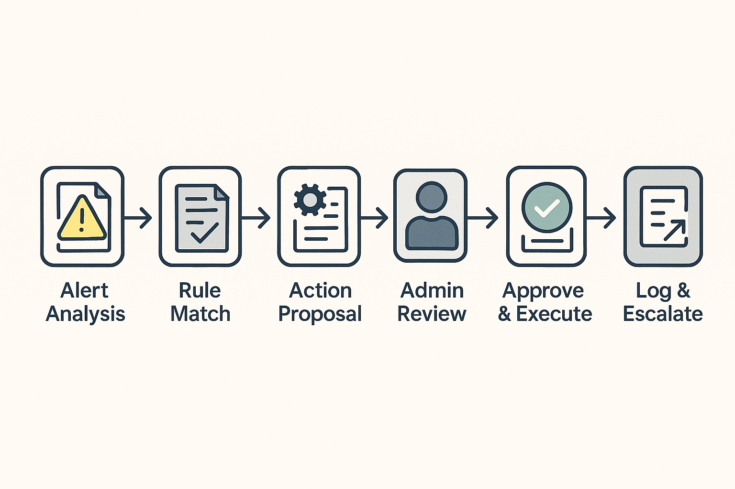
Rule-Based Remediation Workflow

Slide 6
Core Components and Skills
Technologies: PowerShell, Python, WMI, HTML/CSS/JSS/Power Bi.
Tools: : Windows Event Viewer, Task Scheduler, audit/logging.
Skills: Windows admin, automation scripting, event log analysis, HTML/CSS/JSS/Power bi, workflow design.
Event Viewer
PowerShell
Python
WMI
Scheduler
Incident Mgmt
Audit
Monitoring

Slide 7
Deliverables & Milestones
✔ Working automation product for known issues.
✔ Configurable rules engine mapping events to actions.
✔ Admin review/approval workflow for all automated actions.
✔ Comprehensive incident logging and escalation.
✔ Documentation & best practices for extending rule sets.

Slide 8
Deliverables & Milestones
POC (Disk/Service/Driver/Security)
Validation Workflow
Rule Set Expansion
Enterprise Scale-Up

Slide 9
Faster resolution, reduced manual effort, improved resilience.
Integrate admin validation; ensure traceability and auditability.
Expand rule coverage based on feedback and incident data.
Continuous monitoring and iterative improvement.
Benefits

Slide 10
Reduce MTTR for critical alerts and lower operational costs.
Enhance reliability and customer satisfaction.
Free support teams to focus on complex, value-added tasks.
Strengthen leadership in intelligent infrastructure automation.
Strategic Importance to Unisys

Slide 11
Thank you

