Slide 1


K.RAMAKRISHNAN COLLEGE OF ENGINEERING
(AUTONOMOUS), TRICHY
Data Model and Management System for a Recycling Center: Optimizing Operations and Sustainability
PRESENTED BY
SWEATHA A - 2303811714822050

Slide 2
PRESENTATION OVERVIEW
Objective
  Database design
  Modules
  Modules Explanation
  Conclusion & Future Scope

Slide 3
OBJECTIVE
The objective of the Data Model and Management System for a Recycling Center is to enhance efficiency, sustainability, and operational transparency in waste management.
This system aims to streamline the collection, sorting, processing, and distribution of recyclable materials while ensuring optimal resource utilization and real-time data tracking

Slide 4
DATABASE DESIGN
A well-structured database design is essential for efficiently managing waste collection, processing, and sales in a recycling center.
Users Table (Stores employee, supplier, and buyer details)
Waste_Materials Table (Stores recyclable material details)
Suppliers Table (Tracks suppliers providing recyclable materials)
Buyers Table (Tracks companies/individuals purchasing recycled materials)
Waste_Transactions Table (Records all recycling transactions)

Slide 5
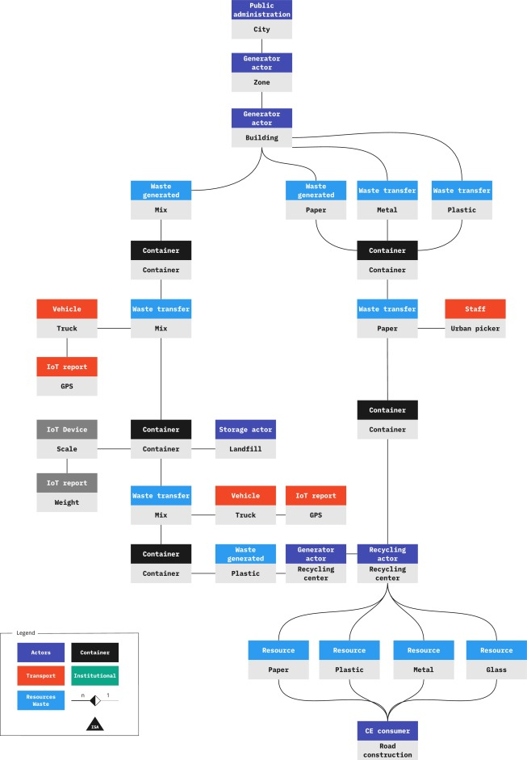
DIAGRAM FOR PROPOSED SYSTEM

Slide 6
MODULES
User Management Module – Handles user registration, authentication, and role-based access for admins, employees, and customers.
Material Management Module – Manages recyclable materials, categorization, pricing, and environmental impact data.
Collection Management Module – Tracks recyclable material collections from customers, including weight and collection dates.
Inventory Management Module – Maintains stock levels of collected materials and updates inventory after collections or sales.
Transaction Management Module – Manages buying and selling of recyclable materials, calculating total price based on weight.

Slide 7
MODULES
1. User Management Module :
The User Management Module is responsible for handling user registration, authentication, and role-based access control. It allows different types of users—Admins, Employees, and Customers—to access specific features based on their roles.
2. Material Management Module :
The Material Management Module is designed to manage different types of recyclable materials, their categorization, and pricing. It helps the system keep track of available materials and their environmental impact.

Slide 8
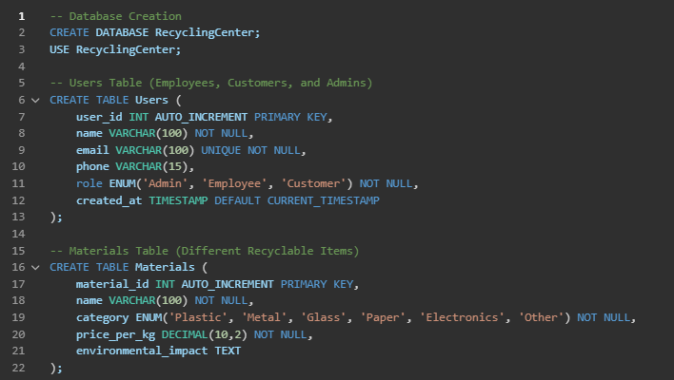
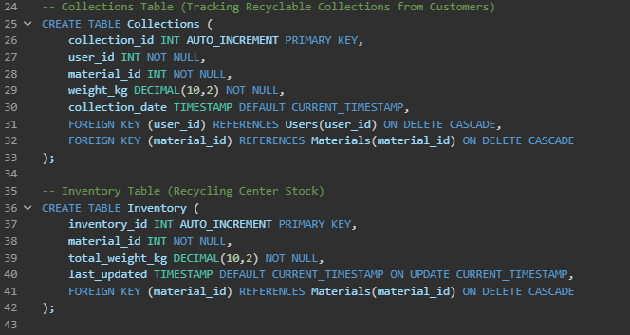
MODULE IMPLEMENTATION

Slide 9
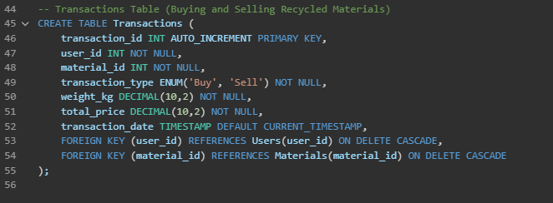
  MODULE IMPLEMENTATION

Slide 10
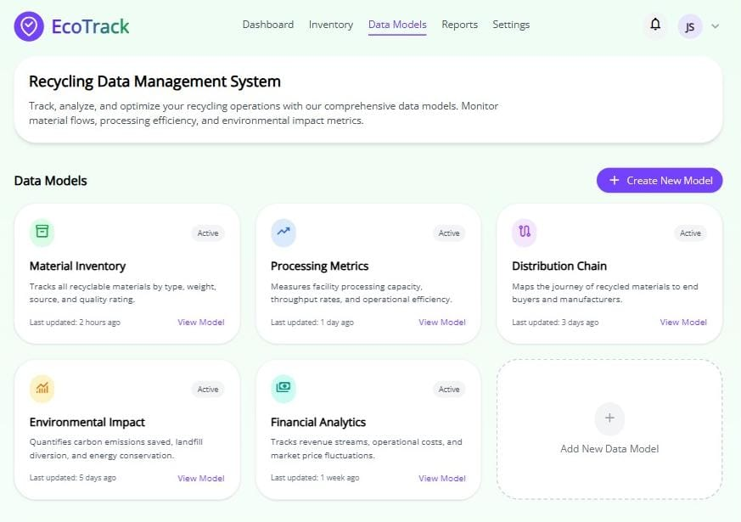
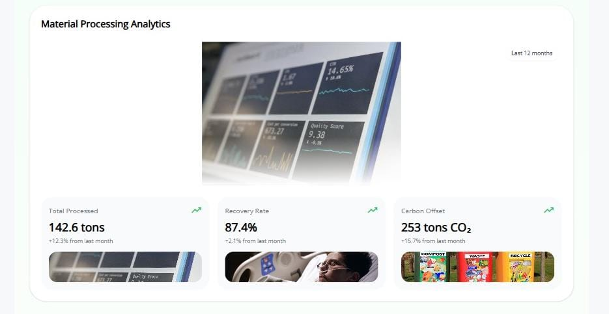
  OUTPUT

Slide 11
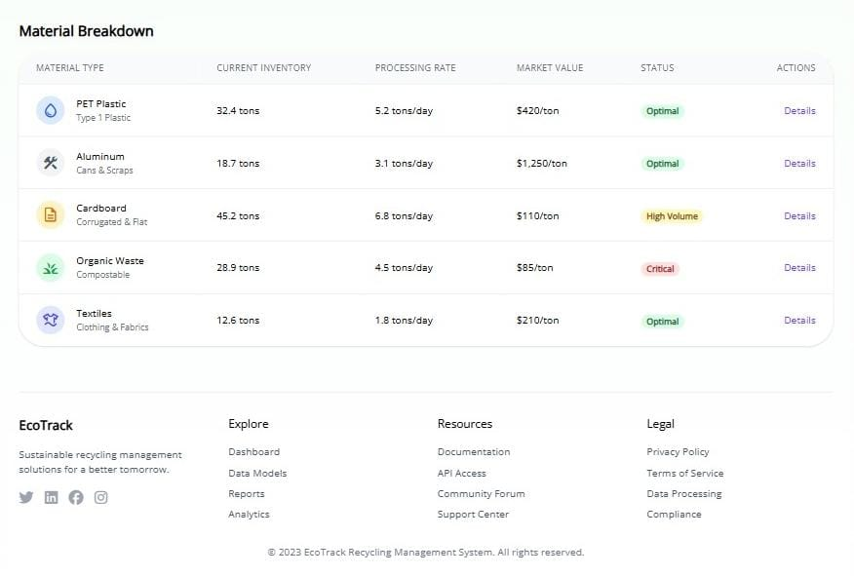
  OUTPUT

Slide 12
CONCLUSION
The Recycling Center Management System successfully optimizes operations and promotes sustainability by efficiently managing users, materials, collections, inventory, and transactions.This system enhances waste management efficiency, supports environmental conservation, and contributes to a sustainable future.

Slide 13


