Slide 1


“SAMVED” HACKATHON 2026
TITLE PAGE
Problem Statement ID – 04
Problem Statement Title- Smart Safety and Assistance System for Sanitation Workers of Solapur Municipal Corporation
Theme- IoT + AI Smart Wearable Safety System (Hardware + Software)
Team ID- 30336EBB
Team Name- Elevate

Slide 2
SmartWear-AI: Intelligent Safety & Rescue System for Sanitation Workers
Elevate
PROPOSED SOLUTION
AI-enabled smart wearable wristband with gas, temperature, heart-rate sensors & GPS
Mobile application with AI decision engine for real-time analysis and decision-making
Continuous safety and health monitoring with autonomous emergency response
How It Addresses the Problem
Real-time detection of toxic gases, unsafe temperature, and abnormal heart rate
Live GPS tracking with buzzer alerts during unsafe conditions
Automatic emergency escalation if no response within 5 minutes, including alerts to authorities and ambulance with exact location
Eliminates dependency on manual reporting
Innovation & Uniqueness
Zero-trust safety model: no response triggers automatic escalation
Autonomous emergency handling without human intervention
AI-based risk analysis to predict unsafe conditions and support pre-deployment area safety assessment
Worker-centric design focused on safety, dignity, and prevention

Slide 3
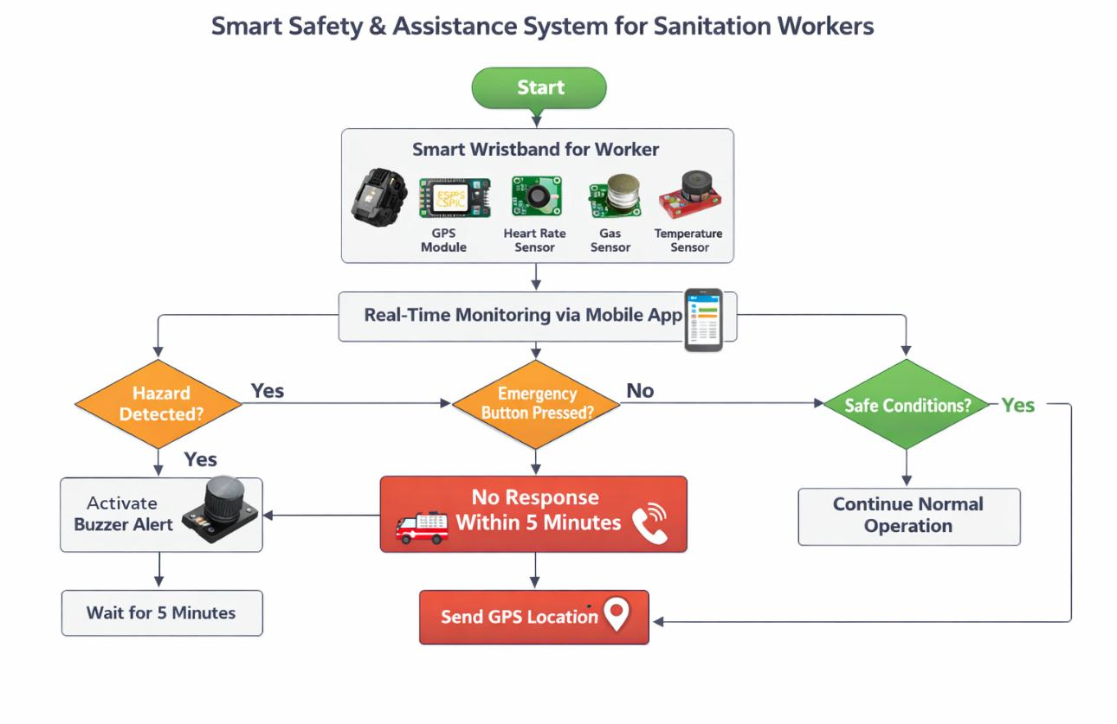
TECHNICAL APPROACH
Elevate
Technologies Used
Hardware
ESP32 Microcontroller
Gas Sensor (toxic gas detection)
Temperature Sensor
Heart Rate Sensor
GPS Module
Emergency Push Button
Buzzer / Alert Unit
Software
Mobile Application
Programming: Embedded C / Arduino,
Python ,AI / ML for risk analysis
Cloud / Database for real-time data storage

Slide 4
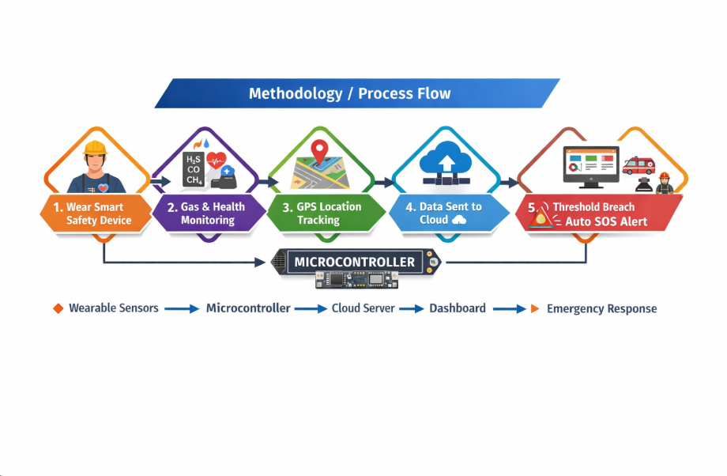
FEASIBILITY AND VIABILITY
Elevate
Feasibility Analysis
Low-cost, proven technologies: ESP32, Android application, cloud database
No dependency on experimental hardware, ensuring reliability
Scalable deployment across multiple workers and locations
Suitable for real sanitation environments
Potential Challenges & Risks
Sensor malfunction or noise in harsh conditions
Network connectivity loss in underground areas
Worker adoption concerns and data privacy risks
Strategies to Overcome Challenges
Multi-sensor validation and calibration to reduce false alarms
Local alert mechanisms (buzzer/vibration) for offline safety
Offline data buffering with auto-sync when connectivity is restored
Compact wearable design with encrypted data transmission

Slide 5
IMPACT AND BENEFITS
Elevate
Impact on Target Audience
Reduced worker fatalities through real-time health and safety monitoring
Faster emergency response and rescue, improving survival outcomes
Improved confidence, morale, and safety awareness among workers
Enhanced supervision and decision-making for authorities
Benefits of the Solution
Social: Protects lives, promotes dignity, and supports humane sanitation systems
Economic: Reduces medical and compensation costs, prevents accident-related delays, and offers high safety return at low cost
Environmental: Enables safer waste management, prevents hazardous-zone accidents, and encourages sustainable sanitation practices

Slide 6
RESEARCH AND REFERENCES
Elevate
Technology & Hardware References
ESP32 Technical Documentation – Espressif Systems
MQ Gas Sensors Datasheets (MQ-2, MQ-7, MQ-135)
MAX30100 / MAX30102 Pulse Oximeter Sensor Docs
DHT11 / DHT22 Temperature & Humidity Sensor Docs
Google Maps API Documentation
Firebase Realtime Database Documentation
Web & Learning Resources
Arduino & ESP32 Community Forums
GitHub Open-source IoT Safety Projects
WHO Occupational Safety Guidelines
Open Government Data (data.gov.in)

