Slide 1
Capstone Presentation
Facebook Comment Volume Prediction
Neha Jasani-PGP BABI batch Jan 2019

Slide 2
Introduction
Social media platforms are considered as one of the most important source for data. On a day to day basis, these platforms are being updated with massive amount of data. One such platform which serves the best source for data is Facebook.
Facebook generates 4 petabytes of data per day—that's a million gigabytes. All that data is stored in what is known as the Hive, which contains about 300 petabytes of data.

Slide 3
The purpose of this project is to predict how many comments a user-generated post is expected to receive in the given set of hours.
We need to model the user comments pattern over a set of variables which are provided and get to the right number of comments for each post with minimum error possible and finally derive meaningful insights for effective marketing strategies.

Slide 4
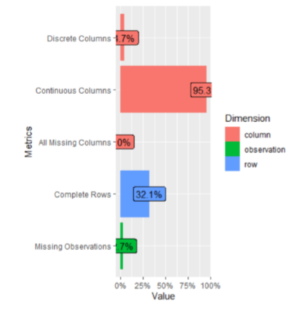
Exploratory data analysis
The data had 7% missing observations.
Most of the independent variable in the data were skewed.
Post Promotion Status variable has only ‘0’ entries.
There were only 2 variables Post published weekday and Base date time categorical in nature , which were ate converted.
Since Post promotion status and ID doesnot make any additions to our analysis, these variables can be removed.

Slide 5
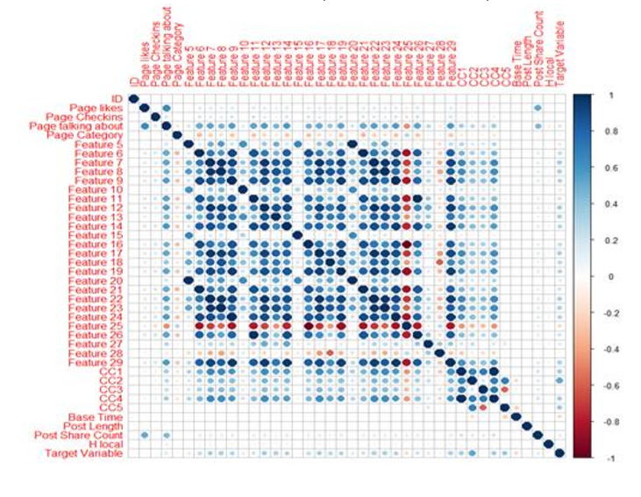
Correlation Heat Map
Target Variable is highly correlated with CC2 variables.
Post Share Count variable is highly correlated with Page Likes and Page Talking about.
CC5 Variable is positively correlated with CC2 variable and negatively correlated variable.
All the Derived Features (Feature 5 – Feature 29) are highly correlated with each other except for Feature 25 which is negatively correlated with other derived features.

Slide 6
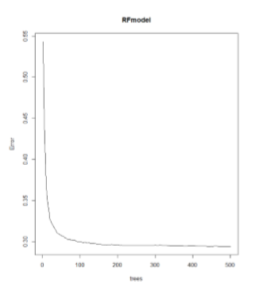
Modelling Approach Used
Random Forest model
For feature selection we used Random forest model, and found that there were 14 independent variables and 1 dependent variable which will help us predict the dependent variable much better.
Those variables are Page likes, feature 9, feature 12, feature 13, feature 24, feature 27, feature 28, cc1, cc2, cc3, cc4, cc5, base time, post share count.
Model Result:
Rmse = 0.36
MAPE = 0.27

Slide 7
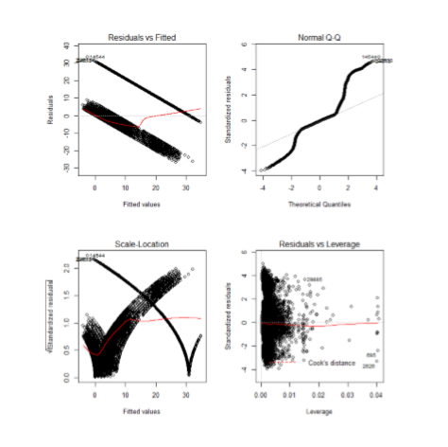
Linear Regression Model
As we have established that the variables have a linear co-relationship, we will build a linear model first.
We can see a lot of variance in the data.
The RMSE value and mape both are very low, hence the model will need some tuning.
Model Result:
Rmse = 9.03
MAPE = 600.27

Slide 8
Prediction result of other models on test set.
SVM
Extreme Gradient Boosting
Model Result :
Rmse = 8.99
Model Result :
Rmse = 6.3
MAPE = 1.1

Slide 9
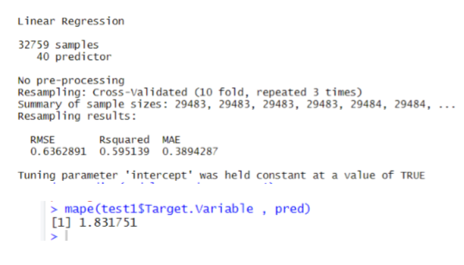
Tuning of Linear regression model
Step wise regression model
In order understand and choose the best variables that would be a great fit and significant to make predictions on the target variable we build a regression model. We selected the variables with the least AIC.
Performing cross validation and measuring the accuracy.
The model has a mape of 1.83 which will give a very good performance.

Slide 10
Insights from Analysis
Post Share Count variable is highly correlated with Page Likes and Page Talking about. So, we can assume that more the people talk about or like the pages then Post Share Count will be higher
Linear Regression model is the ideal fit since it has provided the best prediction accuracy when compared with other models after tuning.
Page likes, Base time and Post share count are some of the most important variables.
This model will help to get the idea of popularity of the topic before its publications

Slide 11
Recommendations
There are certain variables that are highly correlated, should have been avoided while collecting data.
Make use of significant variables for solving business problems.
The business should use the pages with maximum likes variables and post counts for marketing or attracting more comments.
Implementation of this model for marketing strategy.
Use the significant variables to attract more traffic.

Slide 12


