Slide 1
Loan Default Prediction using Machine learning techniques
Submitted by- Neha Narendra Jasani

Slide 2
Introduction
What is Loan default?
Loan default can be defined as the phenomena when a borrower fails to pay back a debt according to the promised arrangement
Why is it loan default prediction necessary?
The requirement of this analysis is so that bank can have an upperhand on who to provide loans to avoid any predictable losses

Slide 3
Research Question
The question is how,, accurately can the loan application for defaulters be predicted by analyzing the data using Machine Learning Algorithms?
The above question can be answered by understanding the following:
1. How to make a binary decision-making model using machine learning for loan applications?
2. Attribute selection from the models and optimization.

Slide 4
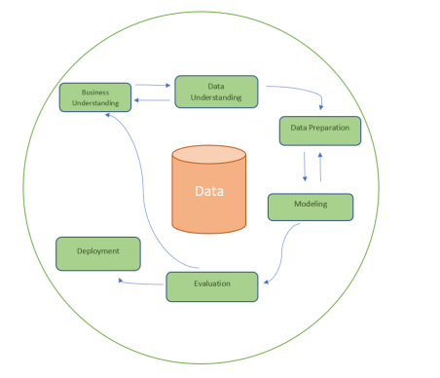
Methodology

Slide 5
Data Understanding
The dataset used in the research was available on UCI machine learning repository
The dataset consists of details of the members of bank with the credit history of a period of 1946- 2012. It consist of 41 variables which covers all the necessary details of the member which were recorded while issuing any credit/loan

Slide 6
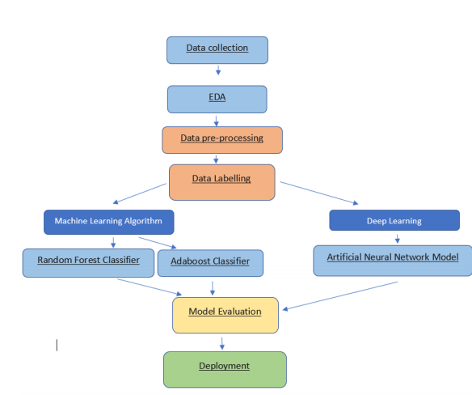
Data Preparation

Slide 7
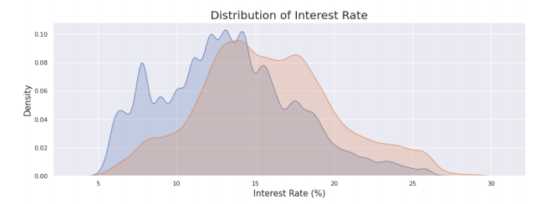
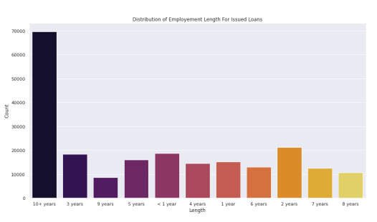
Exploratory Data Analysis
Some insights of the EDA are as follows
Most of the loans have interest rates between 12% to 18%.
People have worked for 10 or more years are more likely to take loans

Slide 8
Models used in the study
1. Random Forest Classifier
2. Adaboost Classifier
3. Artificial Neural Network

Slide 9
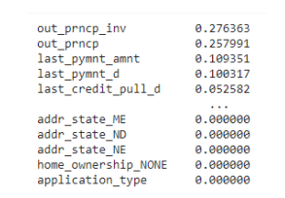
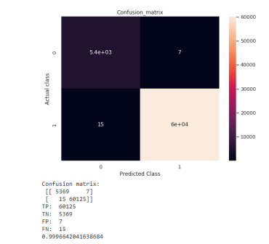
Random Forest model
Important Features as per the model
The Model provided an accuracy of 99.96%

Slide 10
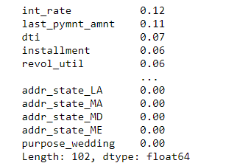
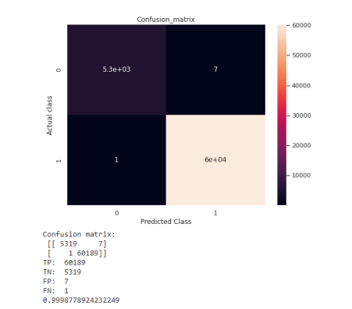
AdaBoost Classifier
List of Important features as per the model
The model provided an accuracy score of 99.89%

Slide 11
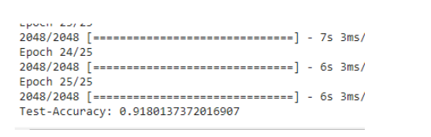
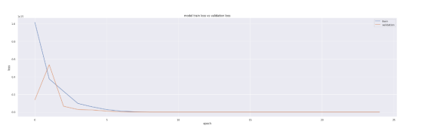
Artificial Neural Network
The model provided an accuracy score of 91.80%
Loss v/z Validation loss

Slide 12
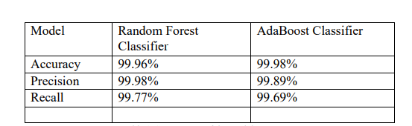
Comparison of the models and Deployment
Adaboost proved to be the best model with highest accuracy.

Slide 13
Future Scope
Addition of more geographical regions for better study
Working on Neural network model to improve its accuracy by changing the iterations of the epoch
Try to reduce the computation time for Adaboost model
Considering money attitude as a variable while creating models

Slide 14
Conclusion
As per the research Adaboost has proved to be the best model.
The research has a scope of improvement
Handling credit risk analysis in the most quantitative manner possible to avoid major hits of the banking industry, thus ensuring global economic stability

Slide 15
Thank you!

