Slide 1


Customer Churn Analysis Report with Zoho Analytics
This report analyzes customer churn in a telecommunications company to identify patterns, risk factors, and actionable insights for improving retention. Using Python for data cleaning, MySQL for querying, and Zoho Analytics for creating interactive dashboards, the analysis uncovers key drivers of churn
and provides recommendations for strategic interventions.
by Neha Jhakra

Slide 2
Key Questions & Tools Used
Key Questions Addressed:
Tools Used:
Distribution of monthly charges? Characteristics of churned vs. non-churned customers? Impact of contract types and service usage on churn? Customer segments most at risk? Billing patterns of high-value customers?
Python (Pandas) for data cleaning. MySQL for SQL querying. Zoho Analytics for interactive dashboards. Jupyter Notebook for data exploration. Git & GitHub for version control.

Slide 3
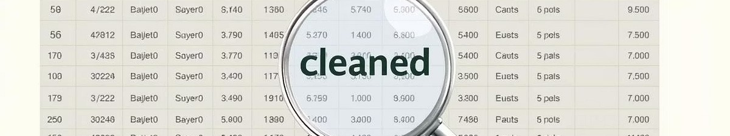
Data Cleaning and Preparation
Initial Dataset
7,043 customer records with 21 attributes, including demographics, service details, billing, and churn status.
Data Cleaning
Converted 'TotalCharges' to numeric, revealing 11 missing values. These rows were dropped.
Cleaned Dataset
Resulted in 7,032 records with no nulls, ready for import into Zoho Analytics.

Slide 4

Creating a Dashboard in Zoho Analytics
Dashboard Setup
Opened Zoho Analytics, created a new dashboard, and added thematic tabs like "Churn Overview" and "Billing Analysis."
Adding Visualizations
Dragged and dropped reports such as histograms for MonthlyCharges
and pie charts for Churn from the panel.
Interactive Elements
Configured KPI widgets for metrics and user filters for dynamic
exploration by contract or service type.

Slide 5

Churn Distribution and Customer Segmentation
Gender Distribution
Balanced at 50% male, 50% female.
Churn Rate
Approximately 26% of customers churned.
Tenure
Most customers are in the 0312 month ra n ge.
Contract Type
Month-to-month customers are at higher risk.
Internet Service
Fiber optic users show higher churn.

Slide 6
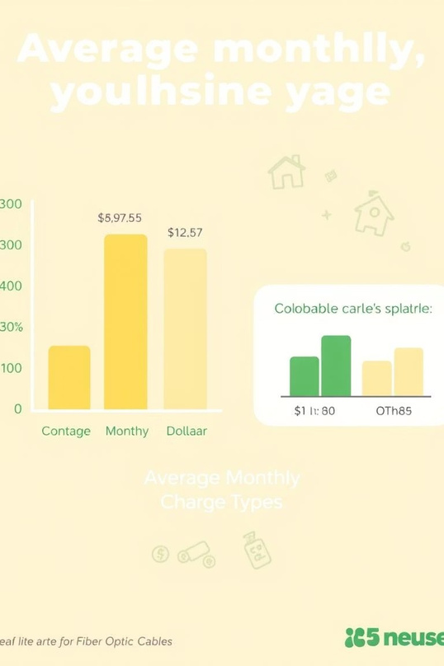
Billing and Service Usage Insights
Average Monthly Charges
Month-to-month contracts average $70, one-year $60, and two-year $50.
Fiber Optic Churn
Higher churn among fiber optic users, potentially due to cost.
Family-Oriented Customers
Customers with partners and dependents show potentially lower churn rates.

Slide 7
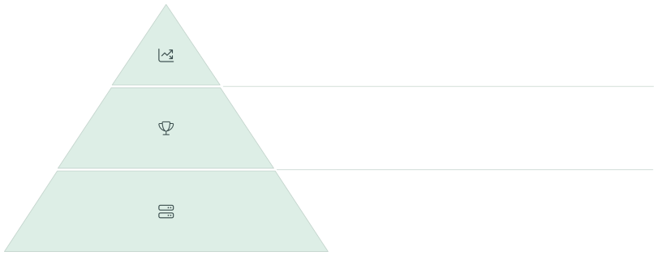
Advanced Analytics with Window Functions
Cumulative Revenue
Running totals of TotalCharges reveal cumulative revenue trends over time.
Customer Ranking
Customers ranked by MonthlyCharges identify high-value clients for targeted retention efforts.
SQL Window Functions
Utilized ROW_NUMBER() and other functions for advanced m etrics.

Slide 8
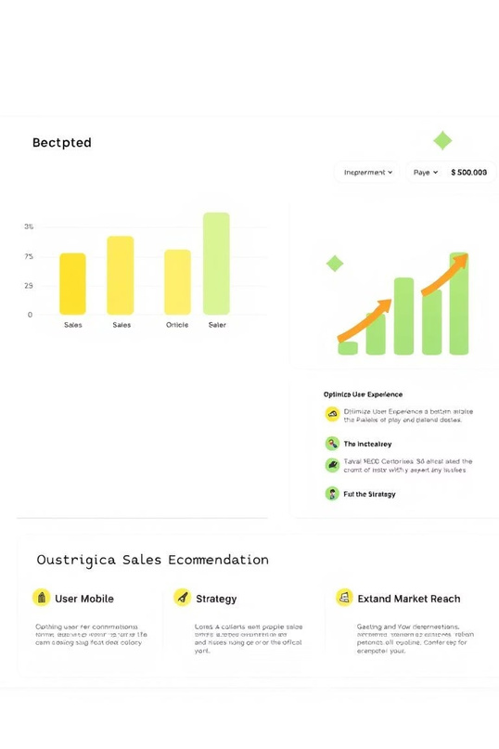
Conclusion & Learnings
Key Learnings
Recommendations
Python Data Processing (Pandas)
SQL Querying (aggregations,
joins, window functions)
Zoho Analytics Dashboards
(interactive visualizations)
Data Cleaning & Storytelling
Target fiber optic & month- to-month customers with offers.
Investigate zero TotalCharges
cases.
Develop loyalty programs for
new customers.
Zoho Analytics Advantage
Drag-and-drop dashboards enable rapid, interactive visualization of churn metrics, enhancing decision-making.

