Slide 1
Proposal on Air Pollution Analysis
Neha Kumari

Slide 2
Novel Contribution
K-means and Time series together can widen the scope of this analysis
While K-means can be used to group similar data together
Time series can help in forecasting the air pollutant levels
Time series on grouped data (from K-means) can be useful in area wise forecast.

Slide 3
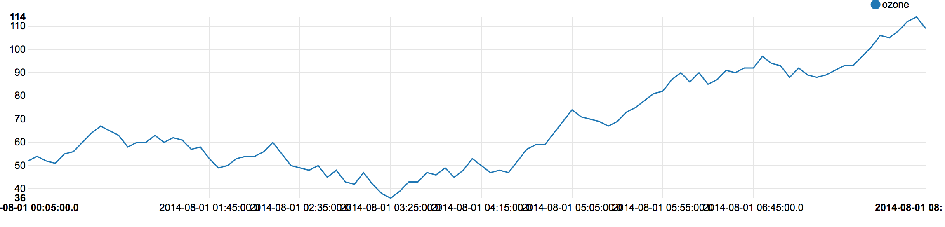
Ozone Vs Timestamp

Slide 4
Work by Competitors
Exploratory analysis is the most common type of study on the pollution data
It has helped in understanding the trends, relationships and in general, summarizing the data
Supervised learning: Regression analysis has been used in predicting the next day air pollutant levels. This analysis makes sense if done area wise (latitude and longitude)

Slide 5
Contd…
Neural networks is another techniques that has been employed in predicting the air pollutant levels
Unsupervised: Clustering techniques
K-means is the most common clustering technique used
It helps in identifying similar groups so that a logical conclusion can be drawn

Slide 6
Contd…
Hierarchical method: agglomerative clustering technique.
Used for reviewing the pollutant gas levels
Study role of meteorological conditions in the levels of pollutants
Studying weather schemes using clustering techniques

Slide 7
Data
Generated data from the Smart CityPulse Project
Total 449 files
Each file contains 8 attributes
Attribute details: Ozone, particulate matter, carbon monoxide, sulfur dioxide, nitrogen dioxide, longitude, latitude, timestamp
Each file has the pollutant levels of a certain

Slide 8
Contd…
Location in a city at various hours and dates.
The data has been merged from the multiple files into one file
For each file the average of each air pollutant has been calculated
This average value will represents the pollutant levels of a particular location in the city.

Slide 9
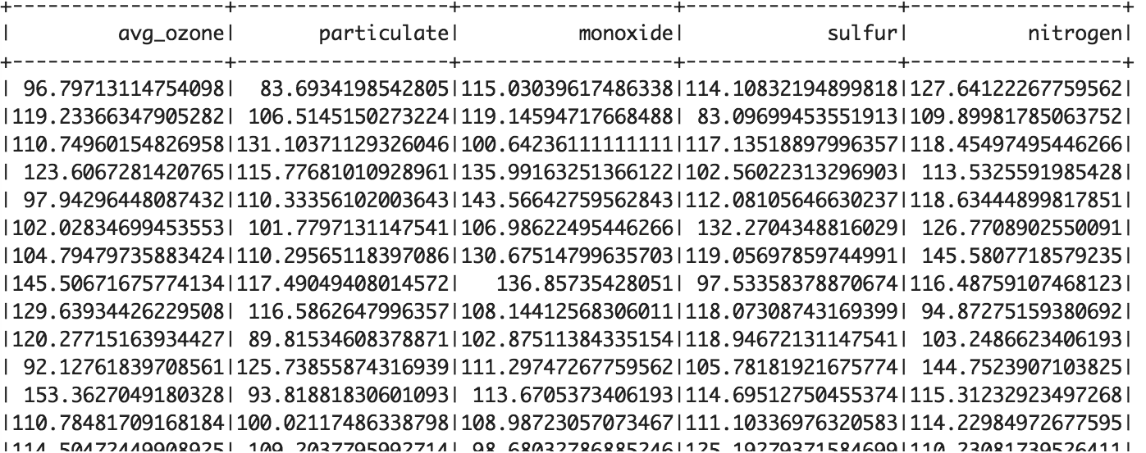

Slide 10
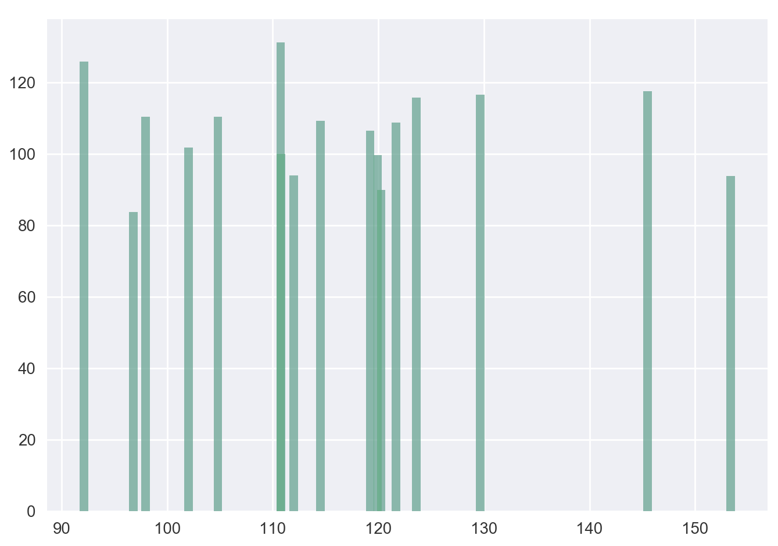
Ozone

Slide 11
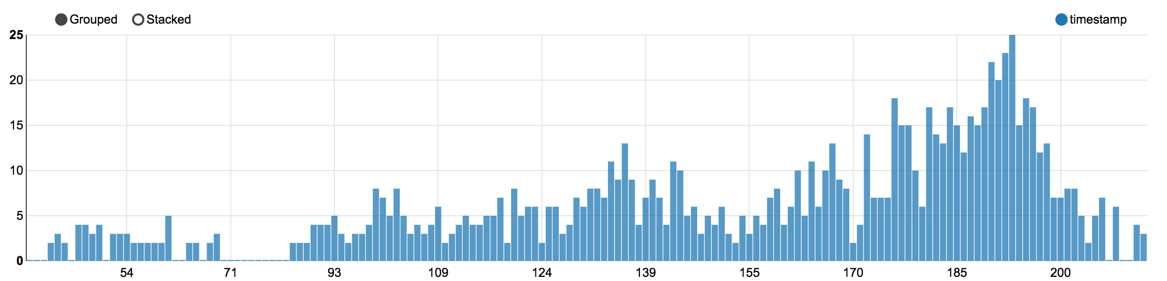
Ozone

Slide 12
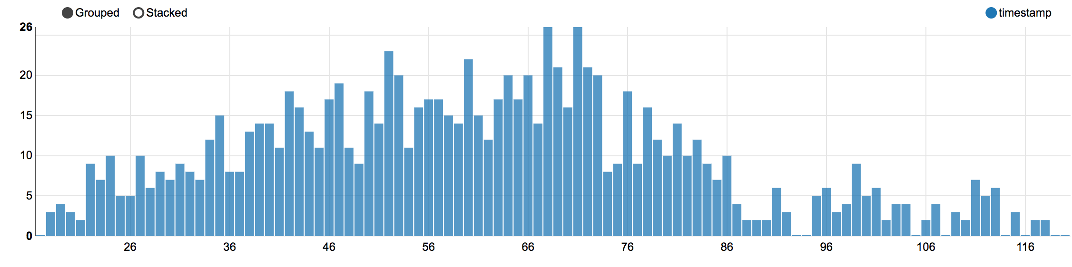
Particulate Matter

Slide 13
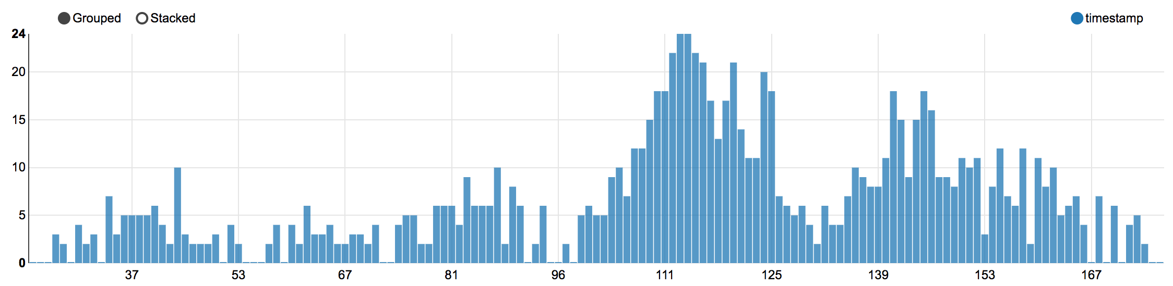
Carbon Monoxide

Slide 14
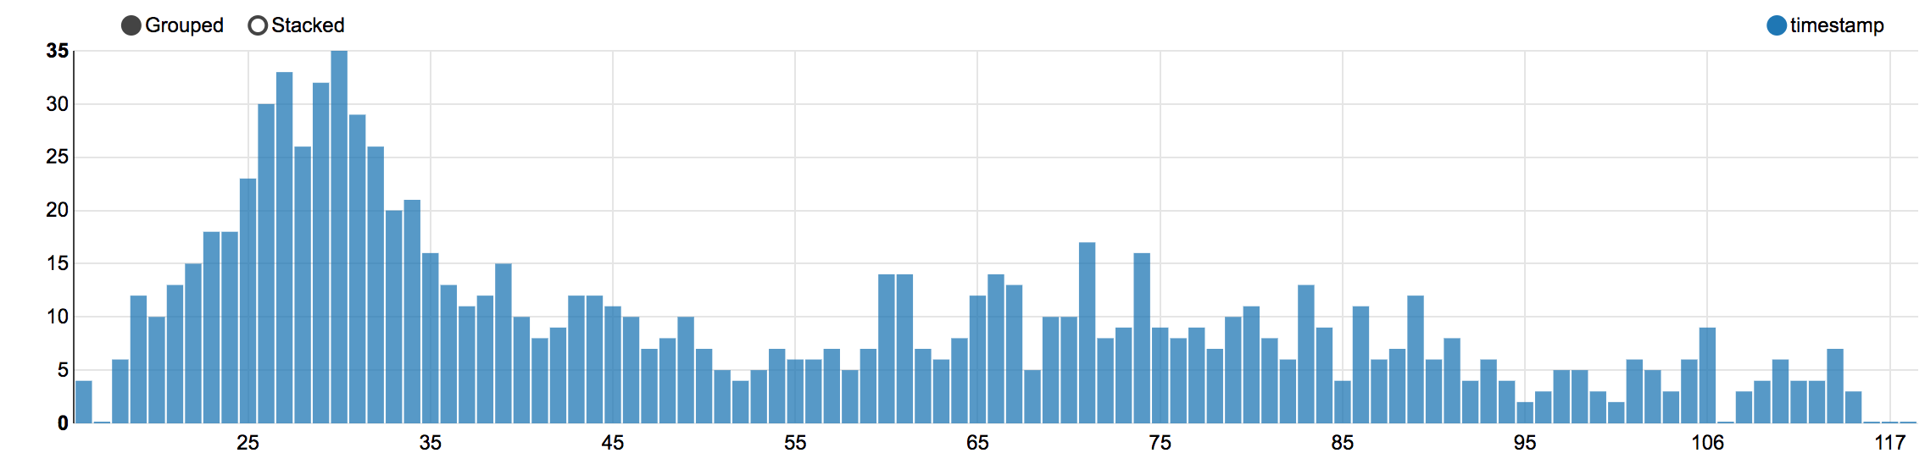
Sulfur Dioxide

Slide 15
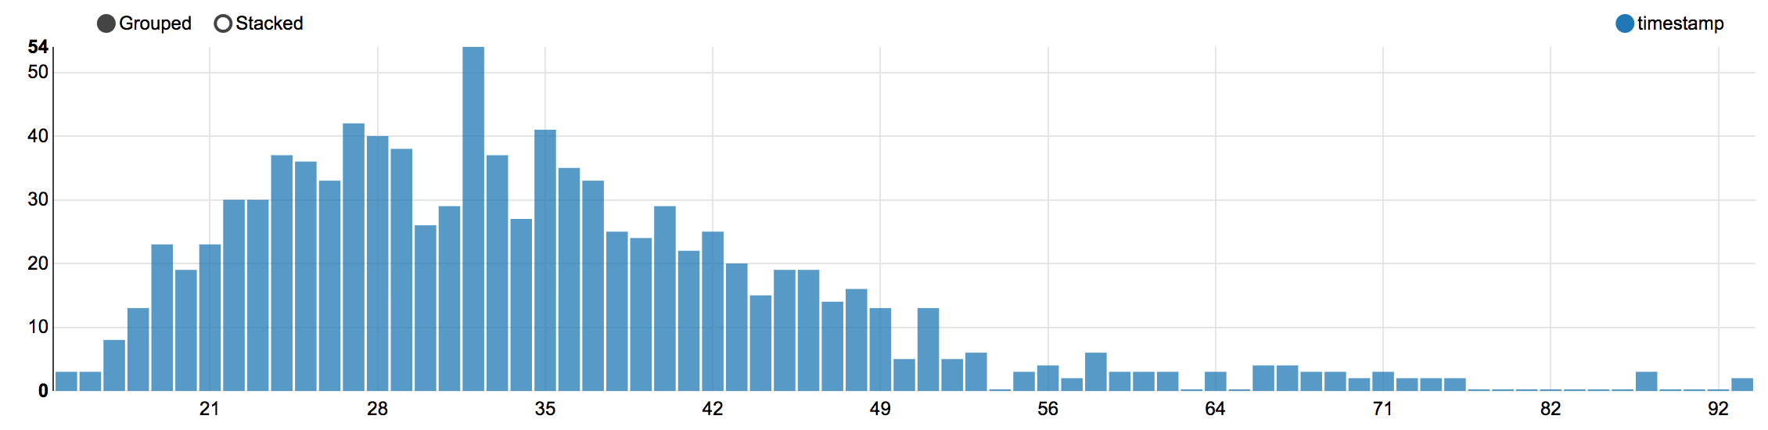
Nitrogen Dioxide

Slide 16
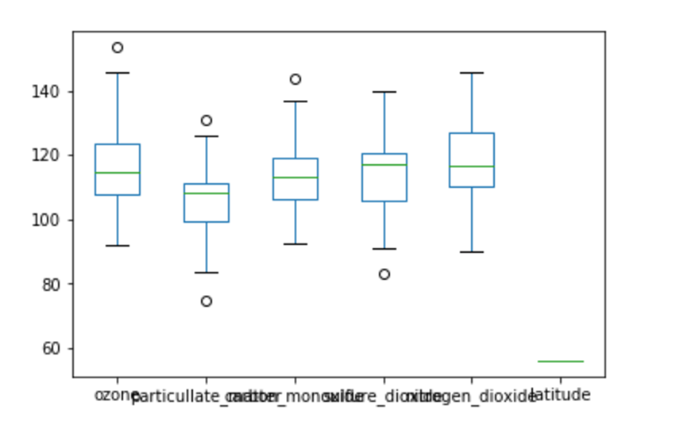

Slide 17
Method
K-means clustering will be employed in analyzing the data
It takes the data set, D and and number of initial clusters, k as input parameters
Initially based on the initial number of clusters the data point is assigned to each cluster, with centroid same as the data point.

Slide 18
Contd…
Now, based on Euclidean distance the rest of the data points are assigned to the clusters
The centroid of the cluster is re-calculated
The data points are re-assigned to the cluster based on the Euclidean distance from the centroid.
The process is repeated till convergence is attained

Slide 19
Contd…
The same process is repeated for different values of k
The optimum results would be obtained for values of k which is neither too large nor too small
As k-means groups data based on similarity
The grouping is based such that the difference

Slide 20
Contd…
Between the groups is maximum, so that we have well defined clusters and the difference within the group is minimum so that the similarity within the cluster is maximum.
From the results the healthiest and the unhealthiest area in the city can be identified.
In this study ozone levels is considered.

