Slide 1

StreamHub – Full-Stack Video Streaming Platform
Submitted by
Candidate Name: Neha Kaneriya
Enrolment. No.: 25034211020
Candidate Name: Vidhi Kansagara
Enrolment. No.: 25034211021
Submitted to MCA Department
A M Patel Institute of Computer Studies

Slide 2
1.1 Project Profile
Project Profile | Details
Project Title | StreamHub – Full-Stack Video Streaming Platform
Project Type | Web-Based Full-Stack Application
Objective | To develop a customizable, secure, and full-stack video streaming platform with adaptive HLS streaming, user authentication, role-based access, and administrative management.
Group No. | 04
Technology Stack | React.js, TypeScript, Vite, Tailwind CSS | Java, Spring Boot, Spring Security, Spring Data JPA, Redis
Database & Streaming | MySQL, Redis | HTTP Live Streaming (HLS) – Adaptive Bitrate Streaming
Authentication & API | JWT-Based Authentication with OAuth2 Login Support | Swagger / OpenAPI
Tools & IDE | IntelliJ IDEA, VS Code, Postman, Maven, Git & GitHub, FFmpeg
Operating System | Windows 11
Project Duration | MCA Semester III (2025–2027)
Project Guide | Dr. Aruna Gurjar
Coordinator / Principal | Dr. C. D. Patel | Dr. Nirbhay Chaubey
Submitted By | Neha V. Kaneriya & Vidhi K. Kansagara

Slide 3
1.2 About Organization
About College
                Acharya Moti bhai Patel Institute of Computer Studies (AMPICS) is a reputed institute specializing in Computer Applications and Information Technology. It focuses on quality education, technical skills, innovation, and industry-oriented learning.
About University
Ganpat University (GUNI) is a multidisciplinary university in Gujarat offering programs across various fields. It focuses on education, research, innovation, and skill development. AMPICS is a constituent institute of Ganpat University.
About Program
The Master of Computer Applications (MCA) is a postgraduate program focused on software development, programming, database management, web technologies, and modern computing practices.

Slide 4
2.1 Problem Statement
Raw video storage and direct playback can cause slow loading, buffering, and poor streaming performance.
Without role-based access control, separating user and administrator responsibilities becomes difficult.
Basic hosting solutions may lack secure authentication and proper user management.
Managing video uploads, users, feedback, and administrative activities can become complex and unorganized.
Video management can become complex and unorganized; StreamHub improves this through centralized management of users, videos, and feedback.

Slide 5
2.2 Existing System
Existing video-streaming solutions were studied, including:
ClipBucket : open-source video-sharing environment
PeerTube : self-hosted and federated video streaming
Datarhei Restreamer: on video streaming and stream management
These platforms provide useful streaming capabilities, but their architectures and workflows are designed for their own specific purposes.

Slide 6
2.2.1 Drawbacks
Aspect | ClipBucket | PeerTube | Datarhei Restreamer | StreamHub
Video Streaming | Yes | Yes | Yes | Yes
Role-Based Access | Yes | Yes | No | Yes
Google OAuth2 Login | No | No | No | Yes
Refresh-Token Rotation | No | No | No | Yes
OTP Email Verification | No | Yes | No | Yes
User Comments | Yes | Yes | No | Yes
Platform Feedback Module | No | No | No | Yes
Custom Admin Workflow | No | No | No | Yes

Slide 7
2.3 Proposed Systems
StreamHub is a customized full-stack video streaming platform designed to provide greater control over the application's features, workflows, and architecture.
Adaptive Video Streaming — FFmpeg-based HLS processing
Secure Authentication — JWT, refresh-token rotation & Google OAuth2
User & Admin Management — Separate roles and controlled access
Video Management — Upload, stream and manage videos
Admin Dashboard — Users, videos and feedback management
Custom Full-Stack Architecture — React.js + Spring Boot + MySQL
Email Verification — OTP-based verification using SMTP with Redis TTL and secure OTP expiration
Search & Pagination — Efficient video search and paginated content browsing

Slide 8
2.3.1 Comparison Study
Feature | ClipBucket | PeerTube | Datarhei Restreamer | StreamHub
Video Upload & Streaming | Available | Available | Streaming-focused | Available
Adaptive HLS Streaming | Available | Available | Available | HLS + FFmpeg
Role-Based Access | Available | Admin / Moderator / User | Admin-focused | User / Admin
Authentication | Login / Registration | Access Token / OAuth2 | Login / JWT | JWT + Google OAuth2
Video Management | Upload & Manage | Upload & Manage | Stream Management | Upload + My Videos
Comments | Available | Available | Not a core feature | Comments + Moderation
Email Verification | Not highlighted | Available | Not a core feature | OTP + Redis TTL
Feedback Module | Not a core feature | Not a core feature | Not a core feature | Built-in Feedback

Slide 9
2.3.2 Modules
USER AUTHENTICATION
Registration, JWT, refresh tokens & Google OAuth2
ADMIN AUTHENTICATION
Dedicated admin login & ROLE_ADMIN authorization
1
2
USER MANAGEMENT
Profile management & administrator account control
4
VIDEO UPLOAD & STREAMING
FFmpeg + HLS adaptive streaming + HTTP Range
3
MY VIDEOS
Personalized uploaded videos with manage/delete options
ADMIN DASHBOARD
Platform statistics, users, roles & video management
5
6
7
COMMENT
Users can comment and admins can moderate discussions.
8
Email Verification
6-digit OTP verification with secure expiry and resend control.

Slide 10
3.1 Hardware Requirements
1
PROCESSOR
Intel Core i5 (10th Gen) or higher
AMD Ryzen 5 or higher
2
RAM
8 GB minimum
16 GB recommended for video processing
STORAGE
256 GB SSD or higher
Additional storage for videos & HLS segments
DISPLAY
1366 × 768 resolution or higher
3
4
INTERNET CONNECTION
IBroadband connection
Minimum 5 Mbps for streaming & API testing
6
OTHER
Keyboard, Mouse
Stable power supply
5
Recommended: 16 GB RAM and sufficient storage for smoother video processing and HLS generation.

Slide 11
3.2 Software Requirements
  Software environment and technology stack used to develop StreamHub
DEVELOPMENT ENVIRONMENT
Windows 10 / 11 • Visual Studio Code • IntelliJ IDEA • Java JDK 21
FRONT-END
React.js • TypeScript • JavaScript • Vite • Tailwind CSS
Zustand • Axios • Video.js • React Router DOM
BACK-END
Spring Boot 3.5.7 • Spring Web • Spring Security
Spring Data JPA • Spring Validation • OAuth2 Client
DATA & VIDEO
MySQL • FFmpeg
Video processing and HLS conversion
SECURITY & API
JJWT • Spring Security • Google OAuth2
Swagger / OpenAPI (springdoc-openapi)
DEVELOPMENT & TESTING
ModelMapper • Git & GitHub • Postman • Maven • npm / Vite

Slide 12
3.3 Programming Environment
FRONT-END
React.js • TypeScript
Vite • Tailwind CSS
User Interface & Client-side Logic
BACK-END
Java • Spring Boot
Spring Security • Spring Data JPA
Business Logic & Server-side Processing
RESTful APIs
HTTP Request / Response
Front-End ↔ Back-End
DATABASE
MySQL
Persistent application data

Slide 13
3.3.1 About Front-End
REACT.JS + TYPESCRIPT
Component-based • Type-safe • Maintainable Front-End Architecture
VITE
Fast development server, bundling
& Hot Module Replacement
TAILWIND CSS
Utility-first styling for a clean,
responsive dark-themed interface
ZUSTAND
Lightweight state management
for user & admin authentication
VIDEO.JS
HTML5 video playback with
adaptive HLS streaming
AXIOS + REACT ROUTER DOM
Axios → REST API communication • Router DOM → client-side navigation

Slide 14
3.3.2 About Back-End
JAVA (JDK 21) + SPRING BOOT 3.5.7
Layered, secure and API-driven back-end architecture
LAYERED ARCHITECTURE
Controllers → Services
Repositories
DTOs • Entities
Separation of responsibilities
SECURITY & AUTHENTICATION
Spring Security + JWT
Refresh-token rotation
Google OAuth2
Secure stateless authentication
VIDEO PROCESSING
FFmpeg → HLS
.m3u8 master playlist .ts video segments
Adaptive streaming preparation
REST API & DATABASE
Spring Web → REST APIs
Spring Data JPA → MySQL
API exposure and entity-based database operations
SUPPORTING TOOLS
ModelMapper • Lombok
Springdoc-OpenAPI / Swagger
Mapping • Boilerplate reduction • API docs

Slide 15
4.1 Time Line Chart
Id | Task Name | Start | Finish | Duration | Jul-2026 |  |  |  | Aug-2026 |  |  |  |  | Sep-2026 |  |  |  | Oct-2026
 |  |  |  |  | 6-Jul | 13-Jul | 20-Jul | 27-Jul | 3-Aug | 10-Aug | 17-Aug | 24-Aug | 31-Aug | 7-Sep | 14-Sep | 21-Sep | 28-Sep | 03-Oct
1. | Planning & Requirement Analysis | 06-07-2026 | 15-07-2026 | 10 Days
2. | Backend Development – Authentication & User Module | 16-07-2026 | 04-08-2026 | 20 Days
3. | Backend Development – Video Module | 05-08-2026 | 22-08-2026 | 18 Days
4. | Backend Development – Admin, Comment & Feedback Modules | 23-08-2026 | 03-09-2026 | 12 Days
5. | Frontend Development | 04-09-2026 | 21-09-2026 | 18 Days
6. | Integration & Testing | 22-09-2026 | 28-10-2026 | 7 Days
7. | Deployment & Documentation | 29-10-2026 | 03-10-2026 | 5 Days

Slide 16
4.2 Data Dictionary
Table: User
Table: roles
Field | Data Type | Constraint | Description
user_id | UUID (CHAR 36) | Primary Key | Unique identifier of the user
user_email | VARCHAR (300) | NOT NULL, UNIQUE | Email address used for login
name | VARCHAR (255) | NOT NULL | Full name of the user
password | VARCHAR (255) | NULL (for OAuth users) | BCrypt-hashed password
enable | Boolean | DEFAULT true | Whether the account is active (enabled after OTP verification)
provider | Enum | DEFAULT 'LOCAL' | Source of account: LOCAL / GOOGLE / GITHUB
providerId | VARCHAR (255) | NULL | Unique user ID from the OAuth provider
createdAt | TIMESTAMP | NOT NULL | Registration date (auto-generated)
updatedAt | TIMESTAMP | NOT NULL | Last update time (auto-generated)
Field | Data Type | Constraint | Description
id | UUID (CHAR 36) | Primary Key | Unique identifier for each video
name | VARCHAR (255) | NOT NULL, UNIQUE | Name of the role (ROLE_USER, ROLE_ADMIN)
Table: feedbacks
Field | Data Type | Constraint | Description
id | CHAR(36) | Primary Key | Unique identifier of the feedback
message | VARCHAR(1000) | NOT NULL | Feedback text of the user
user_id | CHAR(36) | NOT NULL, FK → users(user_id) | User who submitted the feedback
created_at | TIMESTAMP | NOT NULL | Submission date
updated_at | TIMESTAMP | NOT NULL | Last update time

Slide 17
4.2 Data Dictionary
Table: yt_video
Table: user_roles
Field | Data Type | Constraint | Description
video_id | CHAR(36) | Primary Key | Unique identifier for each video
title | VARCHAR(255) | NOT NULL | Title of the uploaded video
description | TEXT | NULL | Short description of the video
contentType | VARCHAR(255) | NOT NULL | MIME type of the uploaded video file
category | VARCHAR(50) | NOT NULL, DEFAULT 'other' | Category name of the video
filePath | VARCHAR(255) | NOT NULL | Path where the video / HLS files are stored
view_count | BIGINT | NOT NULL, DEFAULT 0 | Total views (denormalized for faster reads)
user_id | CHAR(36) | NOT NULL, FK → users(user_id) | Uploader / owner of the video
createdAt | TIMESTAMP | NOT NULL | Timestamp when the video was uploaded
updated_at | TIMESTAMP | NOT NULL | Last update time
Field | Data Type | Constraint | Description
user_id | CHAR(36) | PK, FK → users(user_id) | Reference to the user
role_id | CHAR(36) | PK, FK → roles(id) | Reference to the role
Table: categories
Field | Data Type | Constraint | Description
id | CHAR(36) | Primary Key | Unique identifier of the category
name | VARCHAR(100) | NOT NULL,UNIQUE | Name of the category (e.g., Music, Education)
slug | VARCHAR(100) | NOT NULL, UNIQUE | URL-friendly name (e.g., music)
description | VARCHAR(500) | NULL | Short description of the category
created_at | TIMESTAMP | NOT NULL | Creation date
updated_at | TIMESTAMP | NOT NULL | Last update time

Slide 18
4.2 Data Dictionary
Table: comments
Table: refresh_tokens
Field | Data Type | Constraint | Description
id | CHAR(36) | Primary Key | Unique identifier of the comment
text | VARCHAR(100) | NOT NULL | Content of the comment
user_id | CHAR(36)) | NOT NULL, FK → users(user_id) | User who posted the comment
video_id | CHAR(36) | NOT NULL, FK → yt_video(video_id) | Video on which the comment was posted
parent_comment_id | CHAR(36) | NULL, FK → comments(id) | Parent comment for replies (NULL = top-level comment)
created_at | TIMESTAMP | NOT NULL | Comment date
updated_at | TIMESTAMP | NOT NULL | Last update time
Field | Data Type | Constraint | Description
id | CHAR(36) | Primary Key | Unique identifier of the token record
jti | VARCHAR(255) | NOT NULL, UNIQUE, UPDATABLE-FALSE | JWT ID — identity of the token
user_id | CHAR(36) | NOT NULL, FK → users(user_id | User to whom the token belongs
expires_at | TIMESTAMP | NOT NULL | Expiry time of the token
revoked | BOOLEAN (TINYINT 1) | NOT NULL, DEFAULT false | Whether the token is revoked (set true on logout/rotation)
replaced_by_token | VARCHAR(255) | NULL | Reference to the new token after rotation
created_at | TIMESTAMP | NOT NULL | Token issue date
updated_at | TIMESTAMP | NOT NULL | Last update time

Slide 19
4.2 Data Dictionary
Table: video_views
Field | Data Type | Constraint | Description
id | BIGINT | Primary Key | Unique identifier of the view record
video_id | CHAR(36) | NOT NULL, FK → yt_video(video_id) | Which video was viewed
user_id | CHAR(36) | NULL, FK → users(user_id) | Logged-in user (NULL for guests)
viewer_ip | VARCHAR(45) | NULL | IP address of guest viewers (used for repeat-view detection)
viewed_at | TIMESTAMP | NOT NULL, UPDATABLE-FALSE | Time of the view

Slide 20
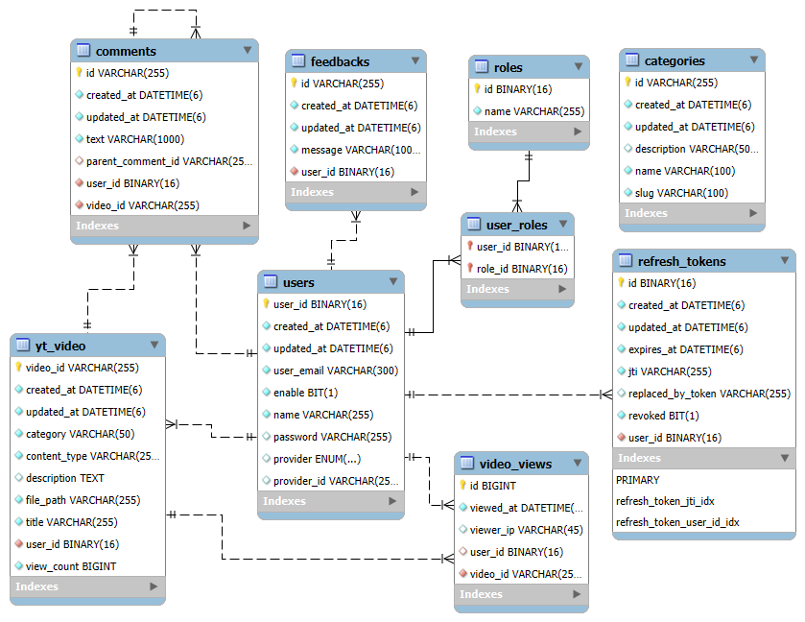
4.3 ER Diagram

Slide 21
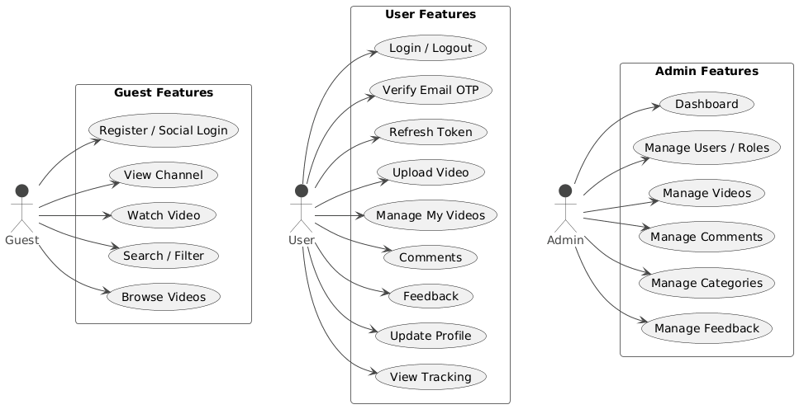
4.4.1 Use Case Diagrams

Slide 22
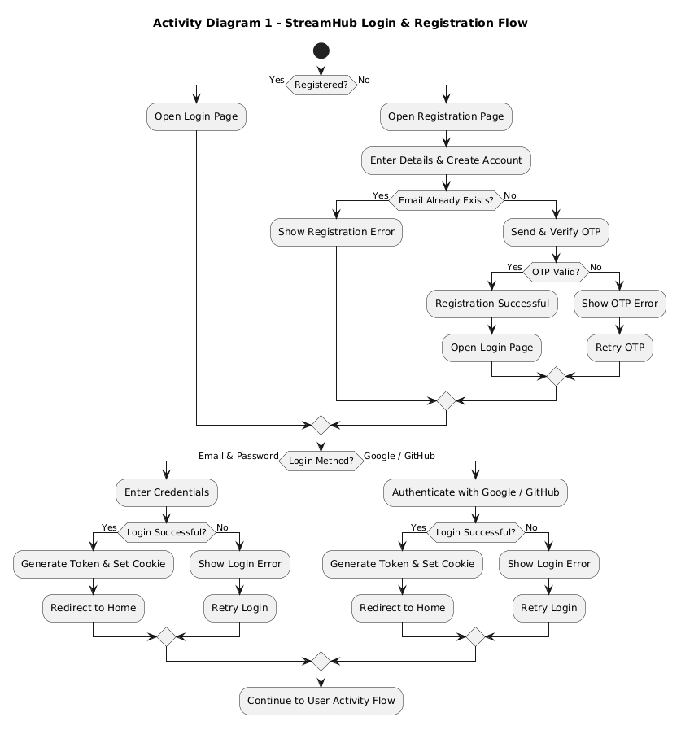
4.4.2 Activity Diagrams

Slide 23
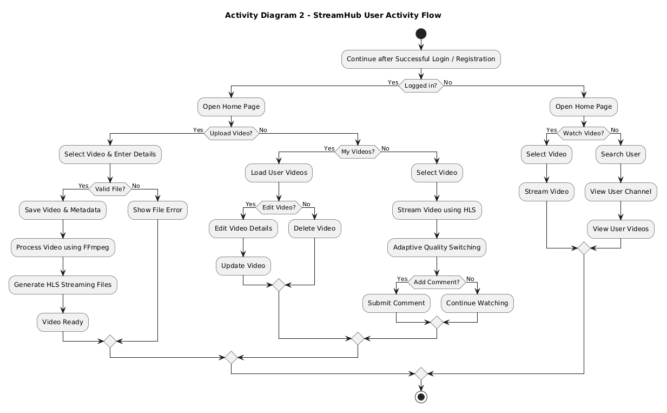
4.4.2 Activity Diagrams

Slide 24
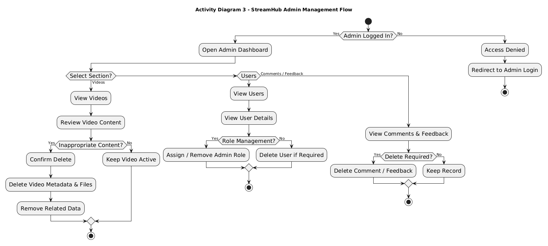
4.4.2 Activity Diagrams

Slide 25
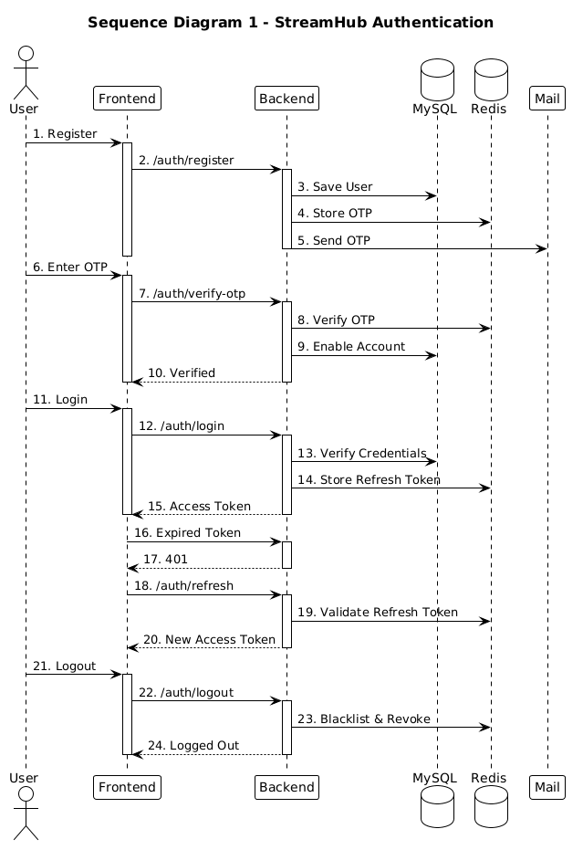
4.4.3 Sequence Diagrams

Slide 26
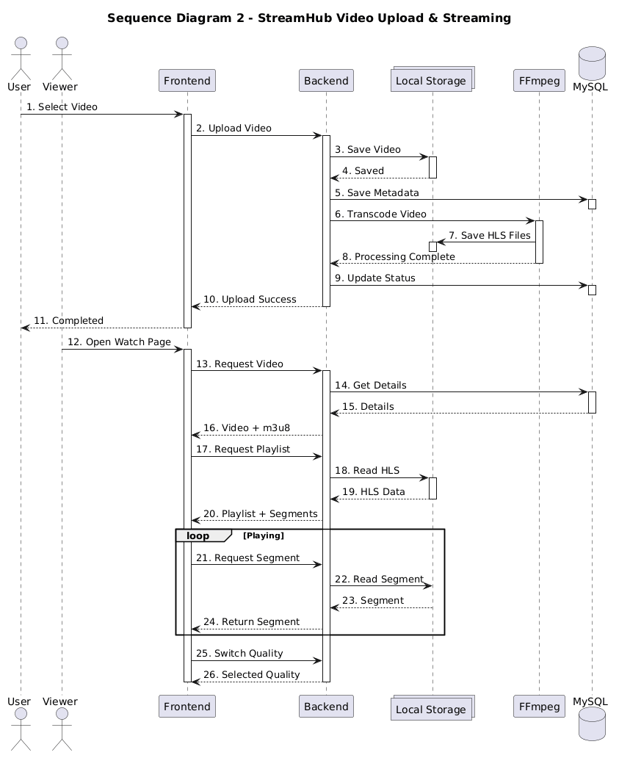
4.4.3 Sequence Diagrams

Slide 27
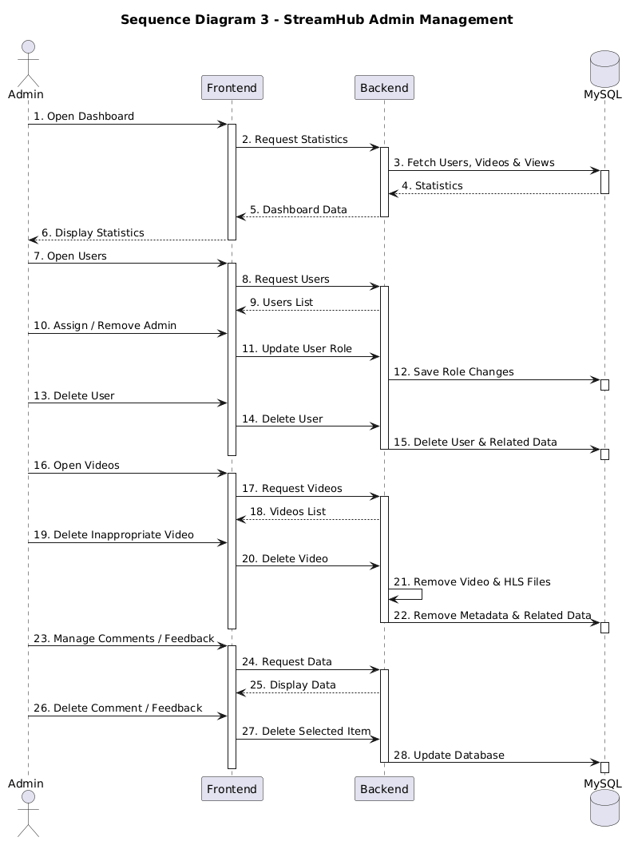
4.4.3 Sequence Diagrams

Slide 28
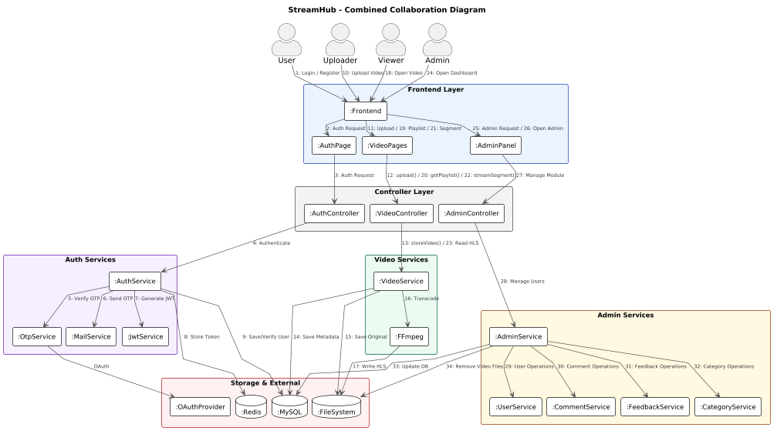
4.4.4 Collaboration Diagrams

Slide 29
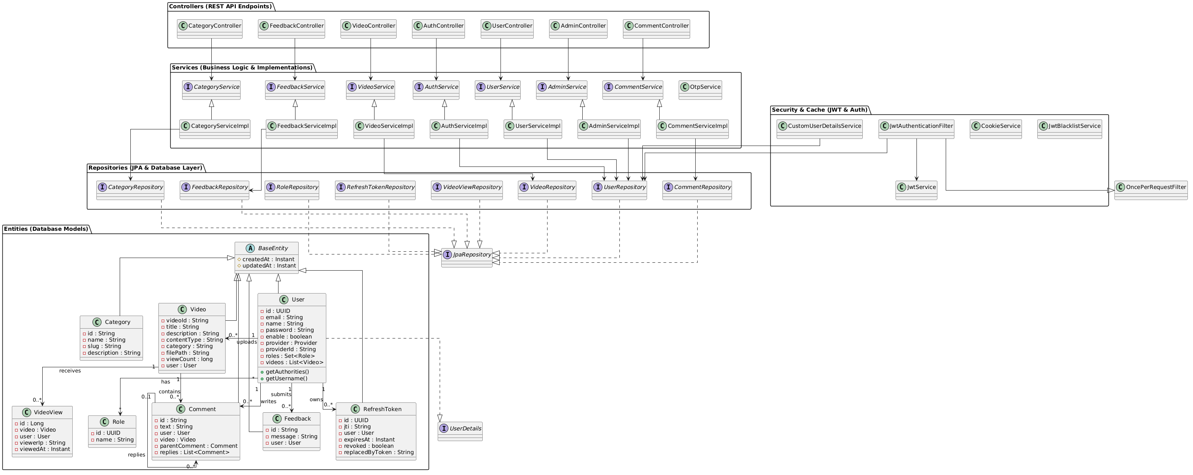
4.4.5 Class Diagrams

Slide 30
4.5 Input Design
Purpose
Main Input Forms
Makes data entry simple, consistent and easy to understand.
Built using React.js and Tailwind CSS.
Registration • OTP Verification • User/Admin Login
Video Upload/Edit • Comments • Feedback • Category • Search
Validation
Security & Feedback
Inputs are checked before submission.
Client-side validation in React and server-side validation in Spring Boot reduce invalid data.
Password masking and JWT-based authorization are used.
Loading indicators, progress and success/error messages keep users informed.

Slide 31
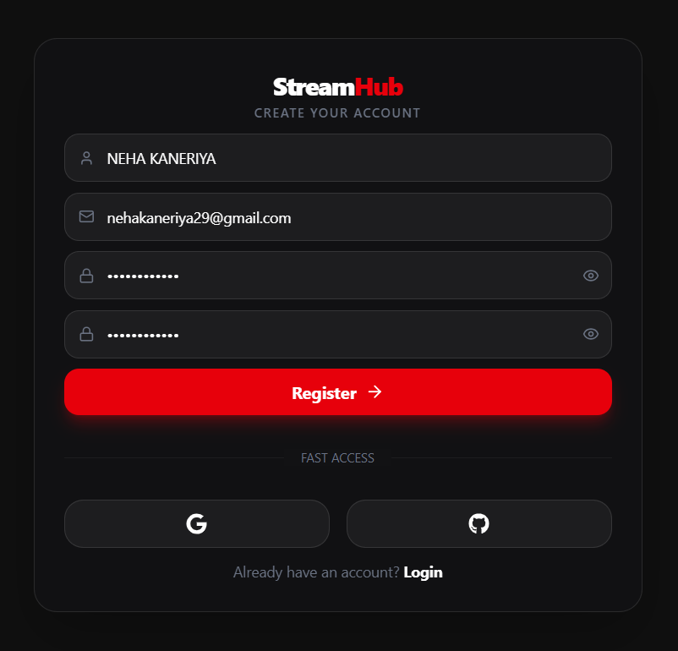
4.5.1 User Registration Form

Slide 32
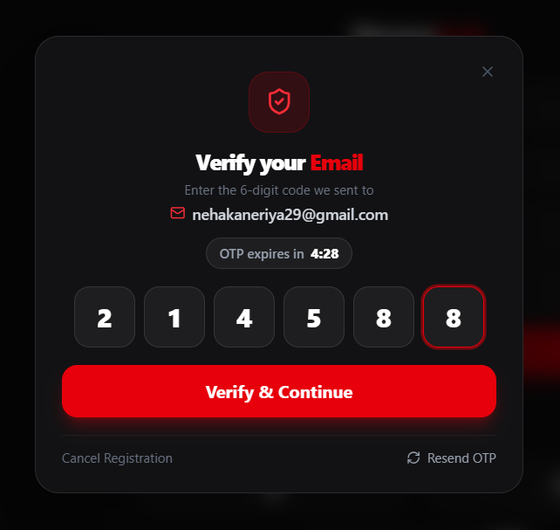
4.5.2 Email OTP Verification

Slide 33
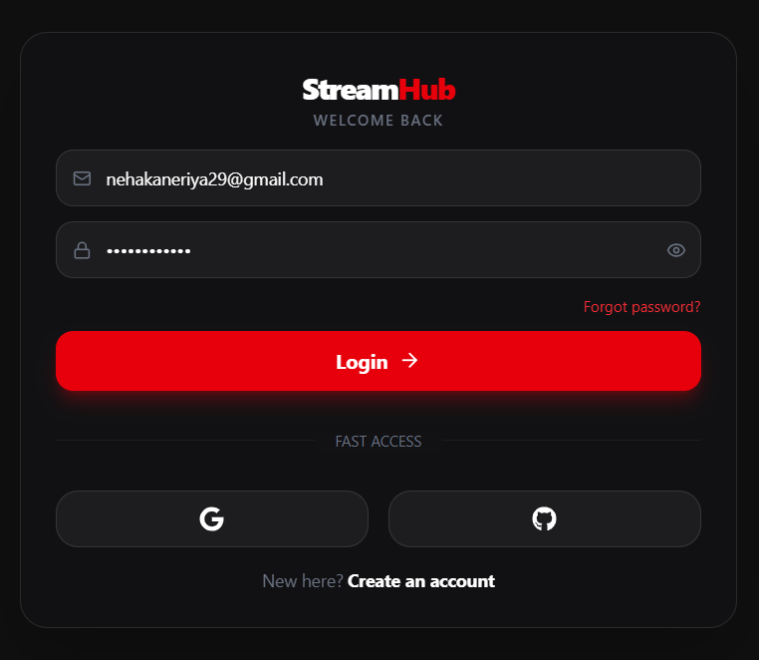
4.5.3 User Login Form

Slide 34
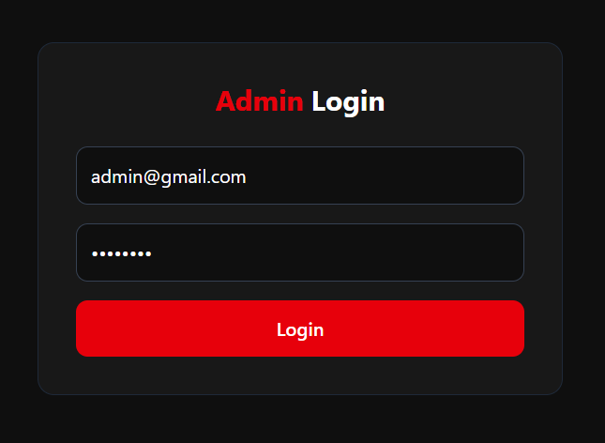
4.5.4 Admin Login Form

Slide 35
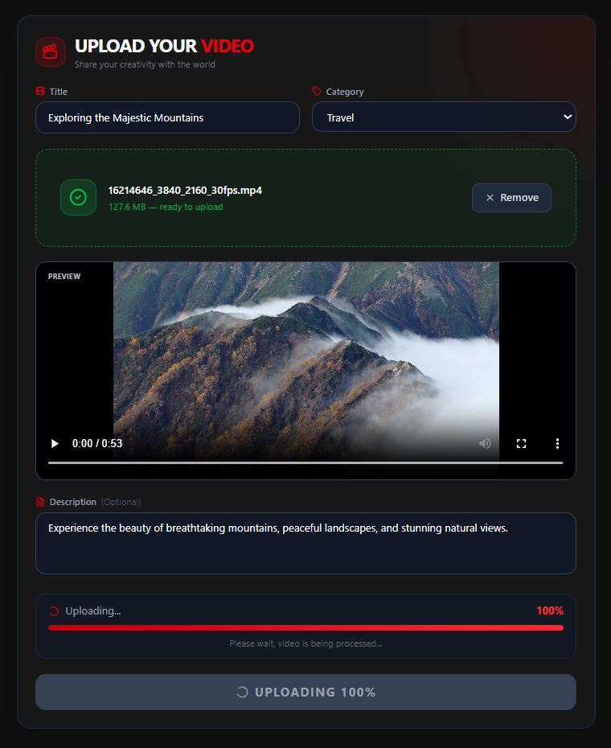
4.5.5 Video Upload Form

Slide 36
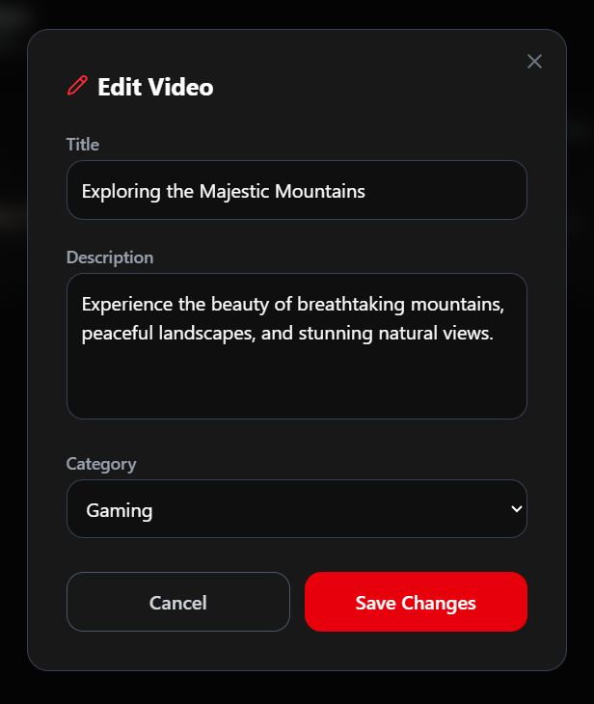
4.5.6 Edit Video Form

Slide 37
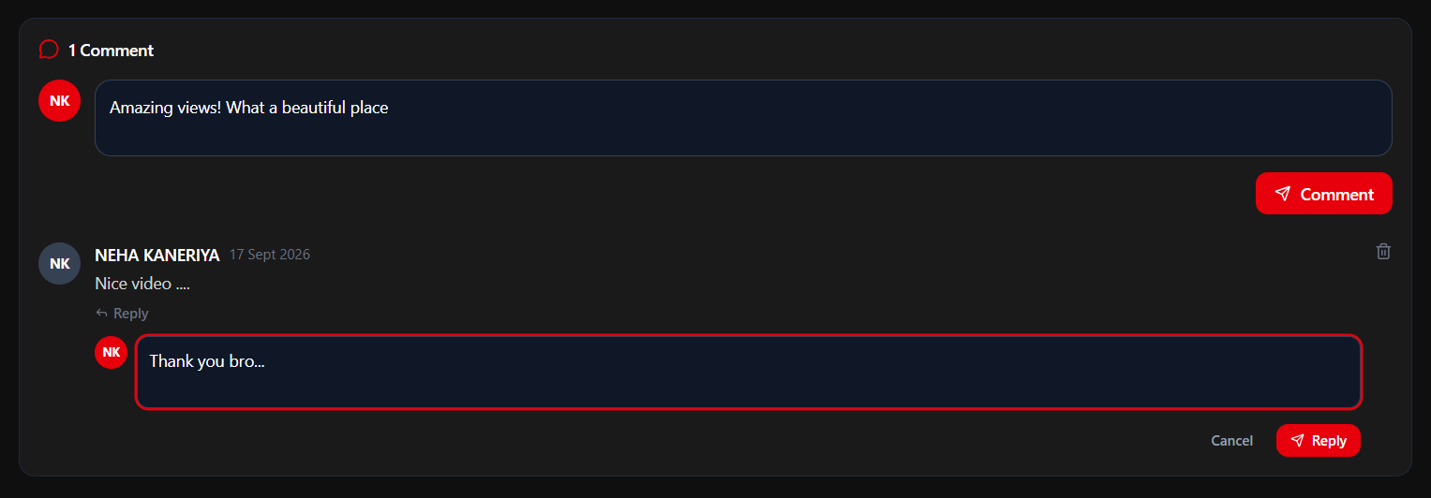
4.5.7 Comment Input

Slide 38
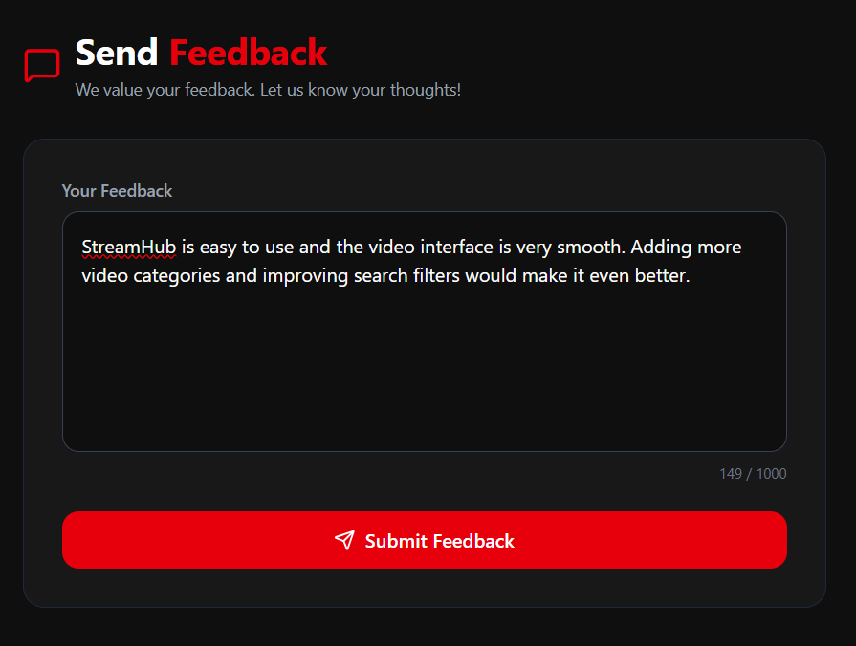
4.5.8 Feedback Form

Slide 39
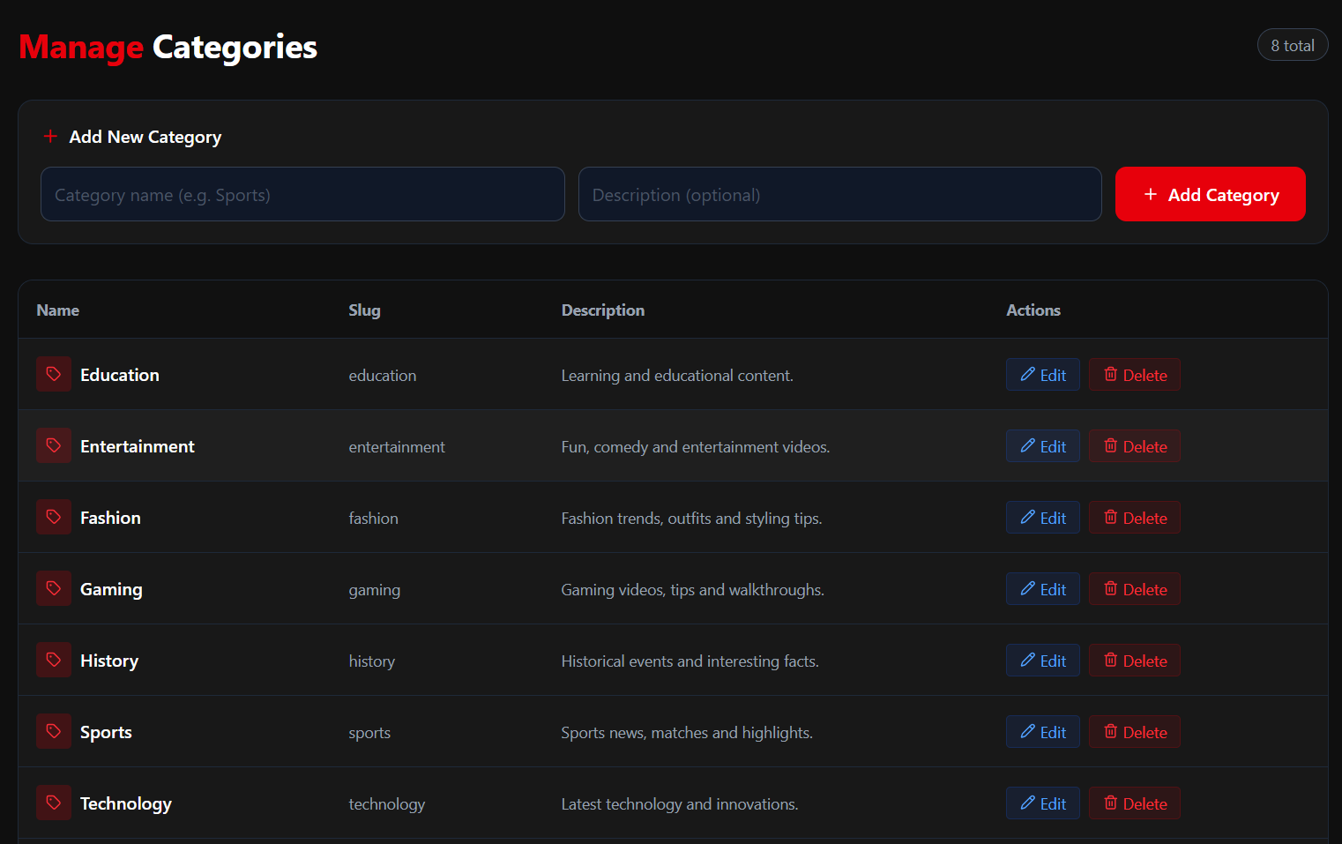
4.5.9 Category Management Form

Slide 40
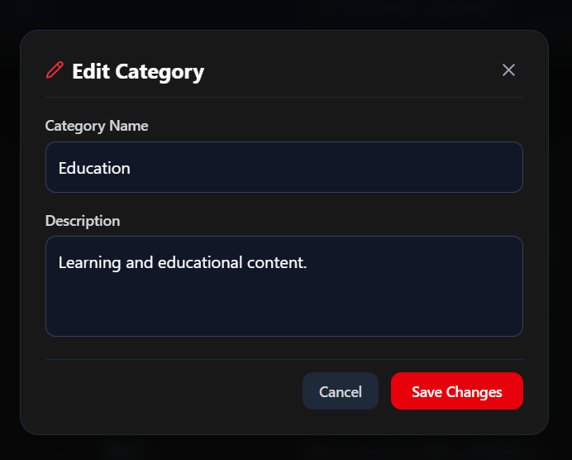
4.5.10 Edit Category Form

Slide 41
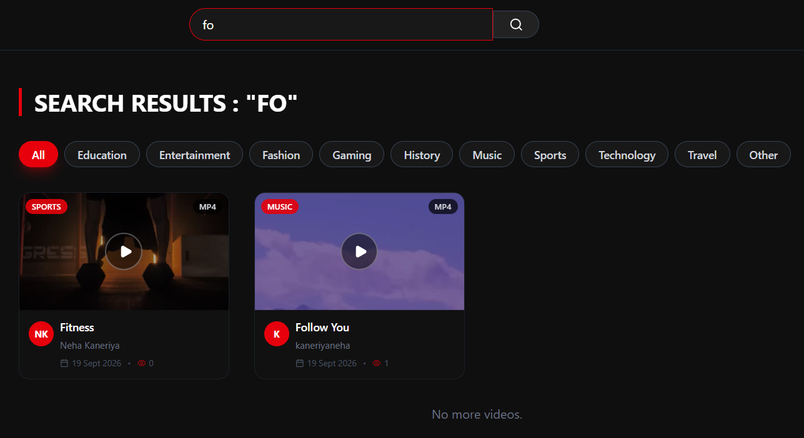
4.5.11 Search Bar

Slide 42
4.6 Output Design
Purpose
Clarity
Presents processed information clearly on-screen.
React renders outputs using JSON responses from Spring Boot REST APIs.
Video cards, tables and statistical cards
present information in a structured and easy-to-understand way.
Responsiveness
Feedback & Performance
Output layouts adapt to different screen sizes
for desktop, tablet and mobile users.
Toast messages show success/error status.
Infinite scrolling, Redis caching and adaptive HLS help deliver outputs quickly.

Slide 43
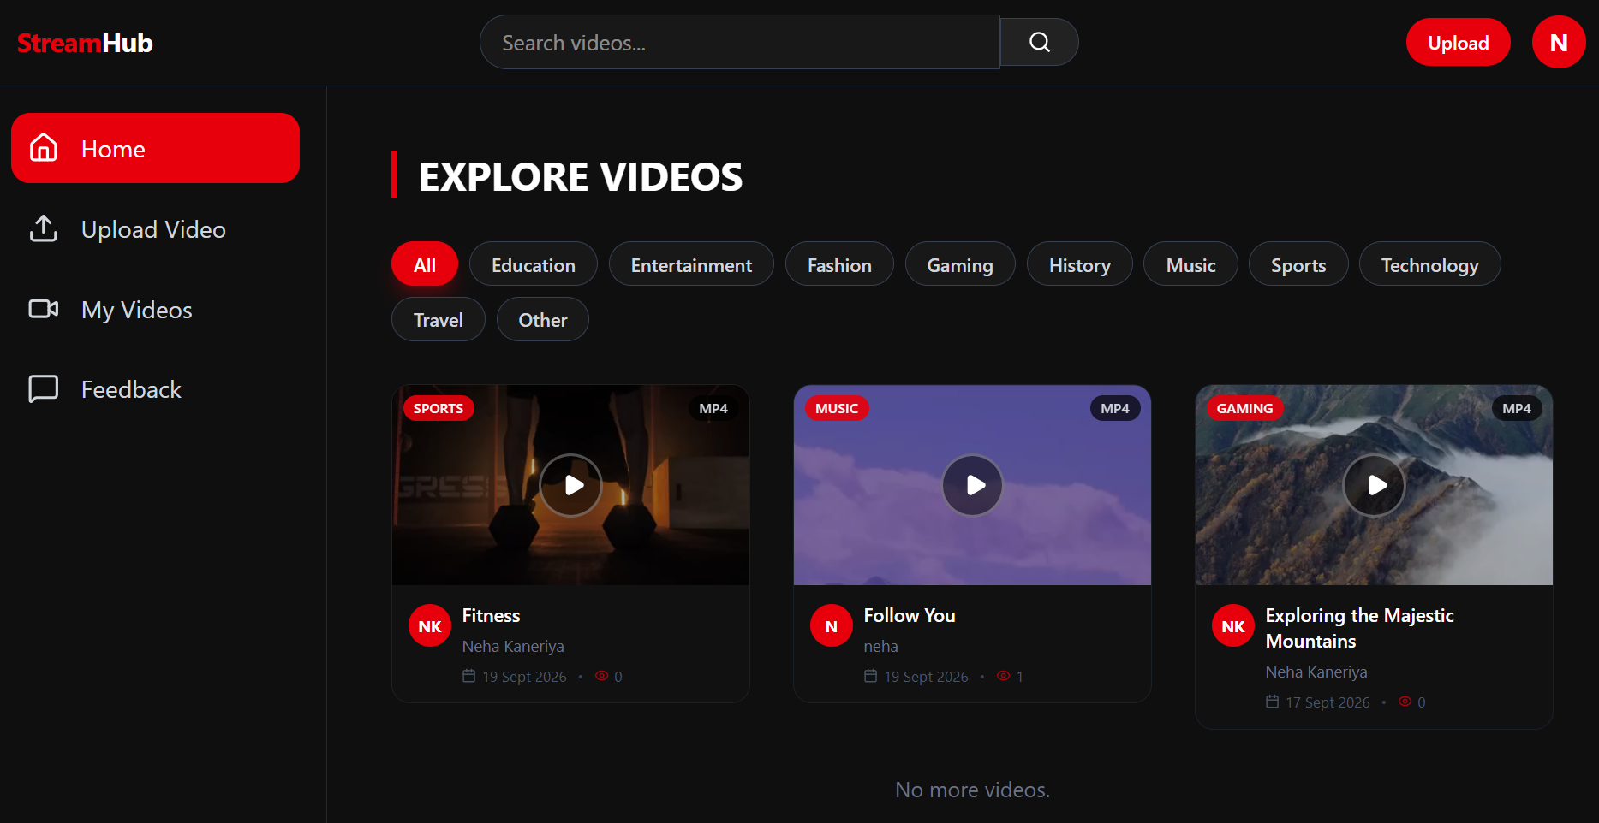
4.6.1 Home Page (Video Feed)

Slide 44
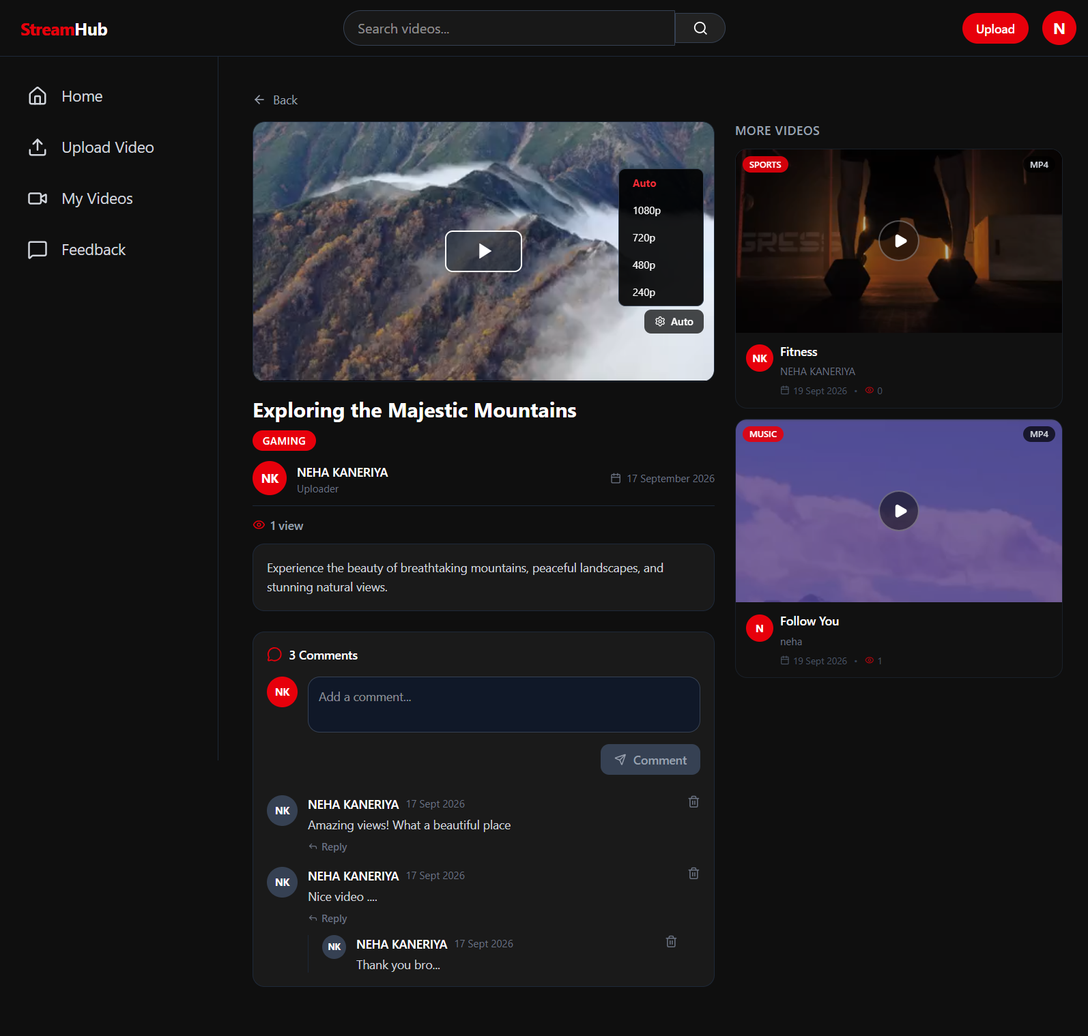
4.6.2 Video Watch Page

Slide 45
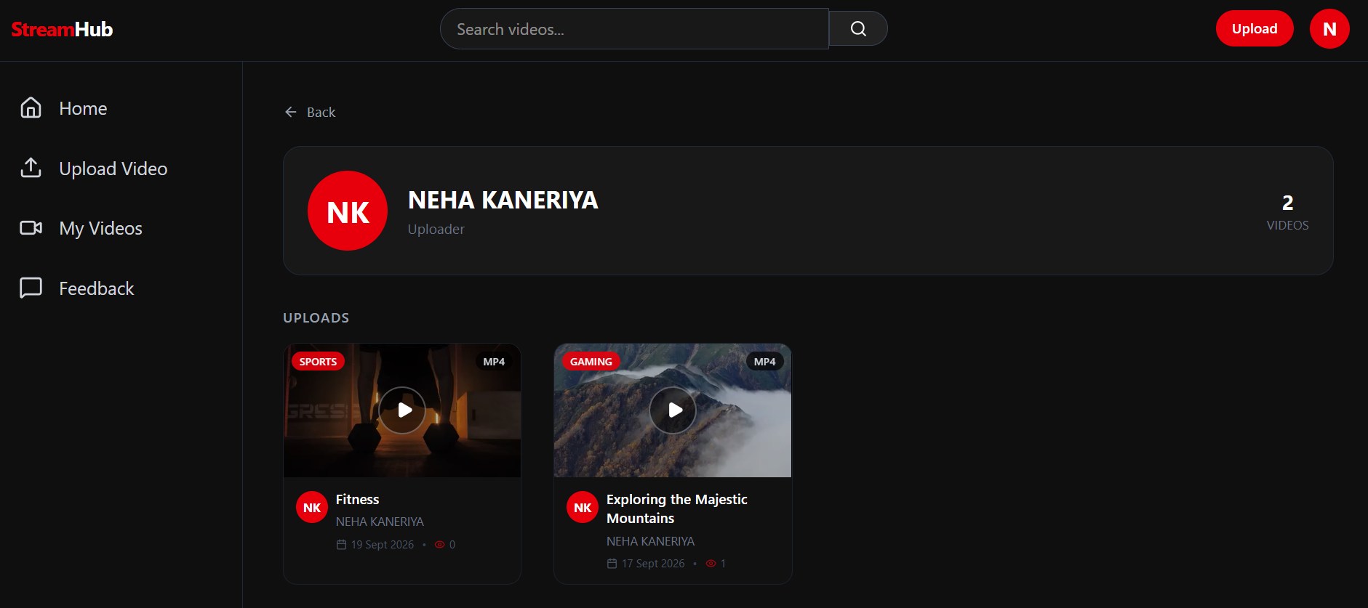
4.6.3 User Channel Page

Slide 46
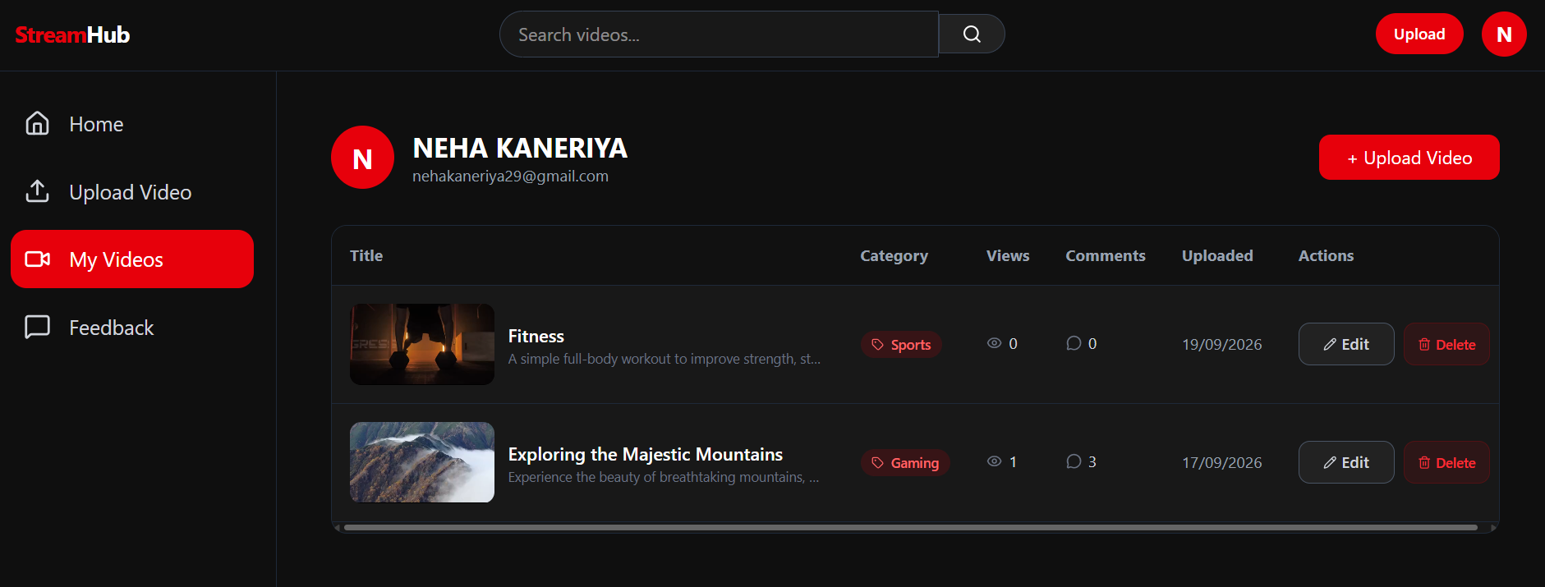
4.6.4 My Videos Page (User Dashboard)

Slide 47
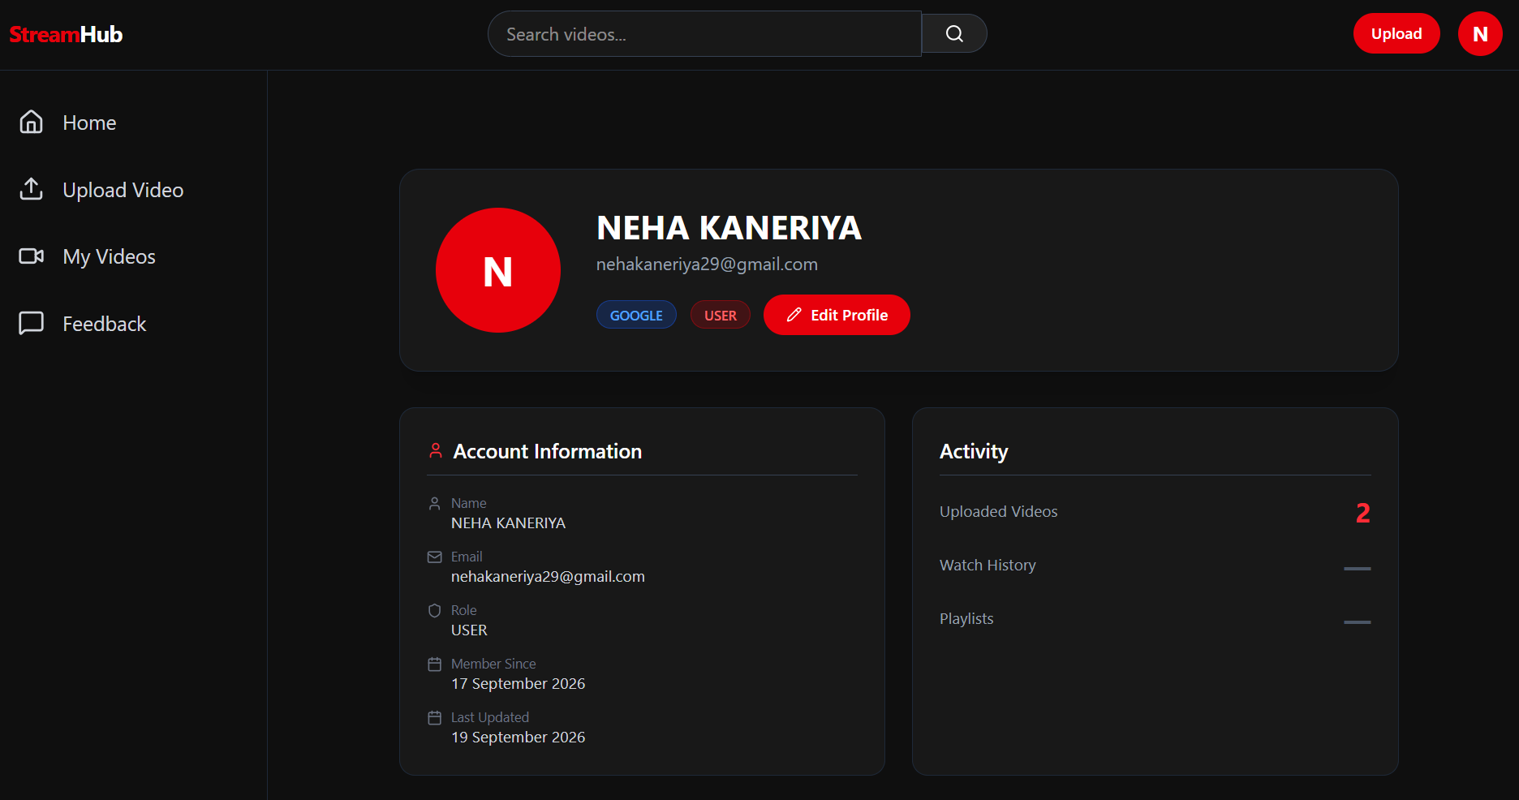
4.6.5 User Profile Page

Slide 48
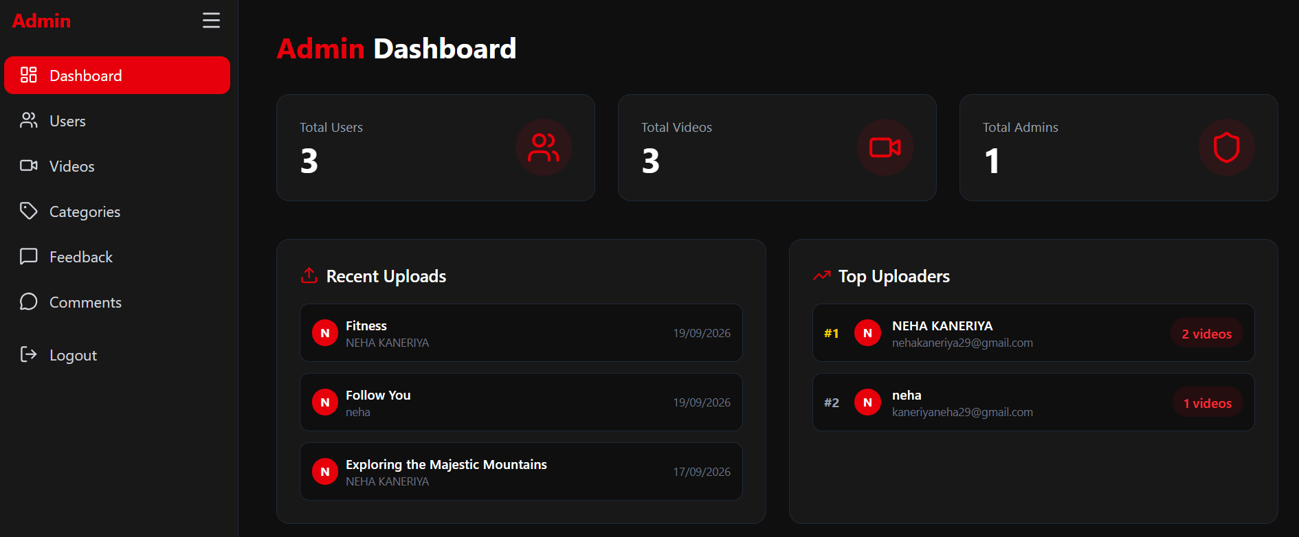
4.6.6 Admin Dashboard

Slide 49
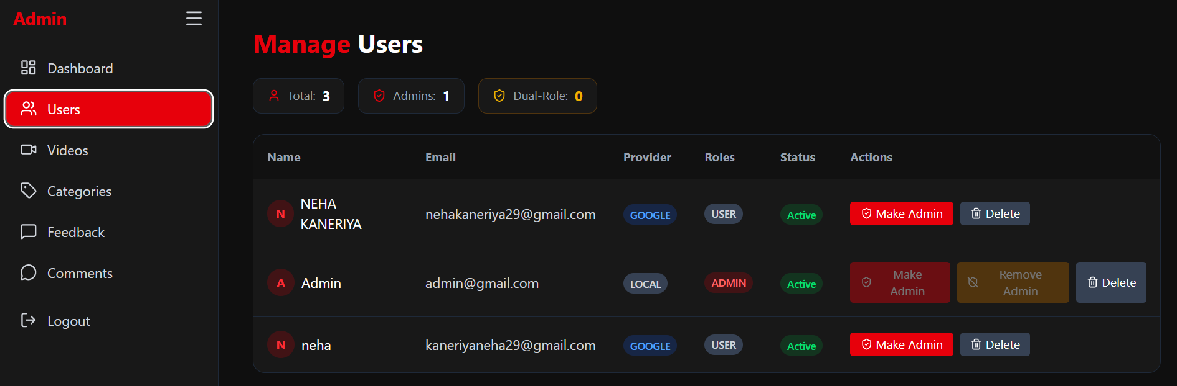
4.6.7 Admin – Manage Users

Slide 50
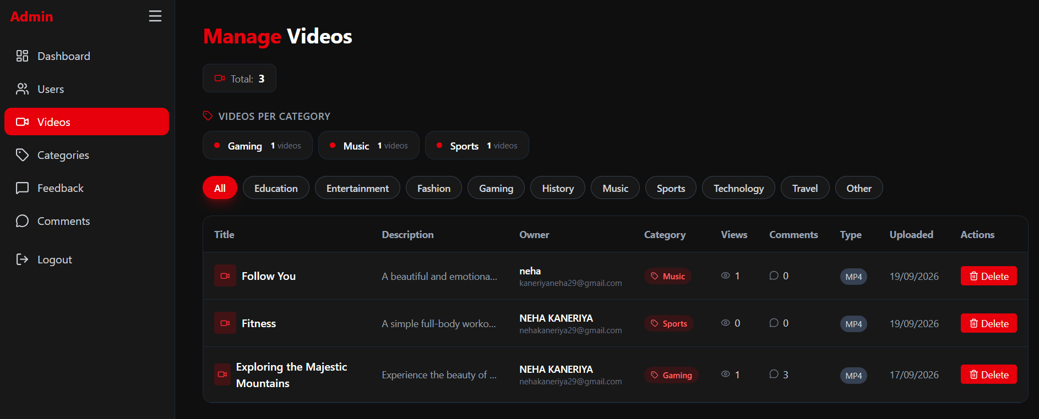
4.6.8 Admin – Manage Videos

Slide 51
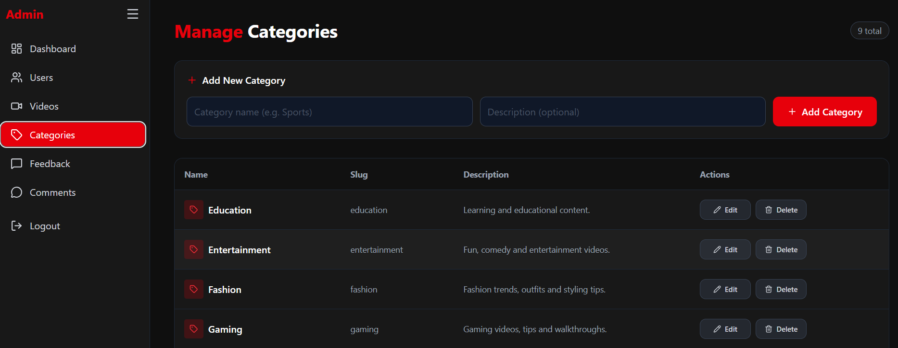
4.6.9 Admin – Manage Categories

Slide 52
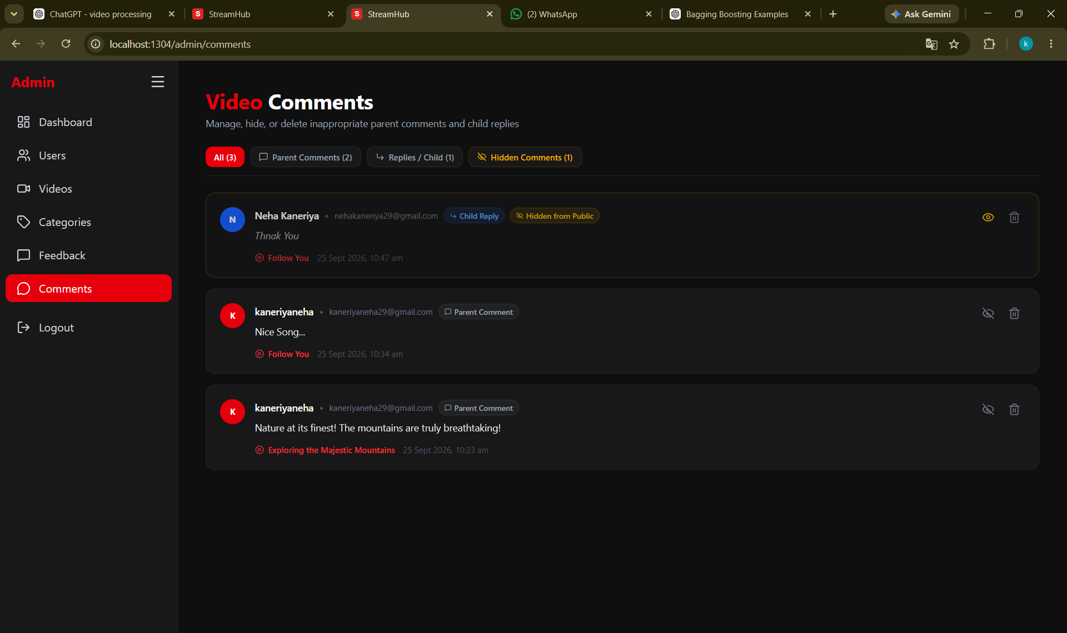
4.6.10 Admin – Manage Comments

Slide 53
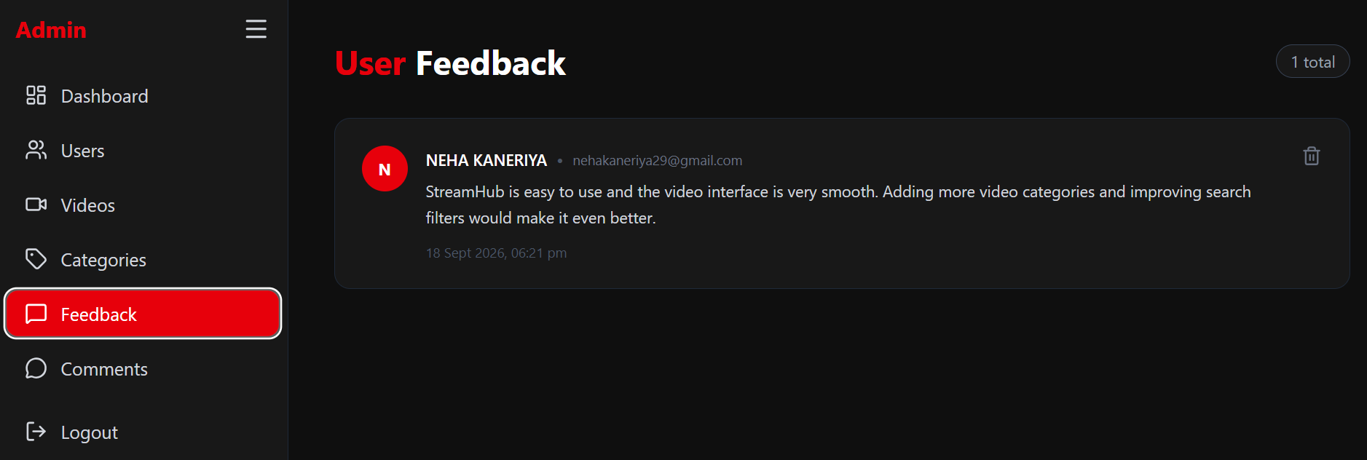
4.6.11 Admin – View Feedback

Slide 54
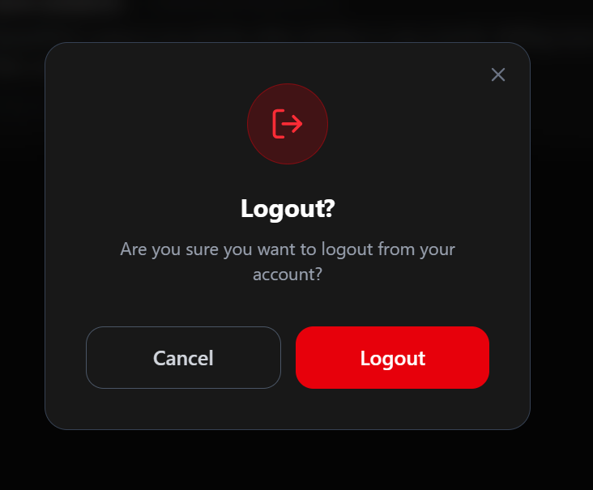
4.6.12 Logout Page

Slide 55
5.1 System Testing
AUTHENTICATION
USER FUNCTIONS
• Registration & Login
• JWT & Google OAuth2
• OTP Email Verification
• Profile & My Videos
• Video Upload
• Comments & Feedback
VIDEO & ADMIN
API & SECURITY
• HLS Video Playback
• User & Video Management
• Categories & Comments
• Search & Pagination
• REST API & MySQL
• Role-based Access & Validation

Slide 56
5.1.1 Output Testing
Home Feed

Slide 57
5.1.1 Output Testing
Video Playback + Quality

Slide 58
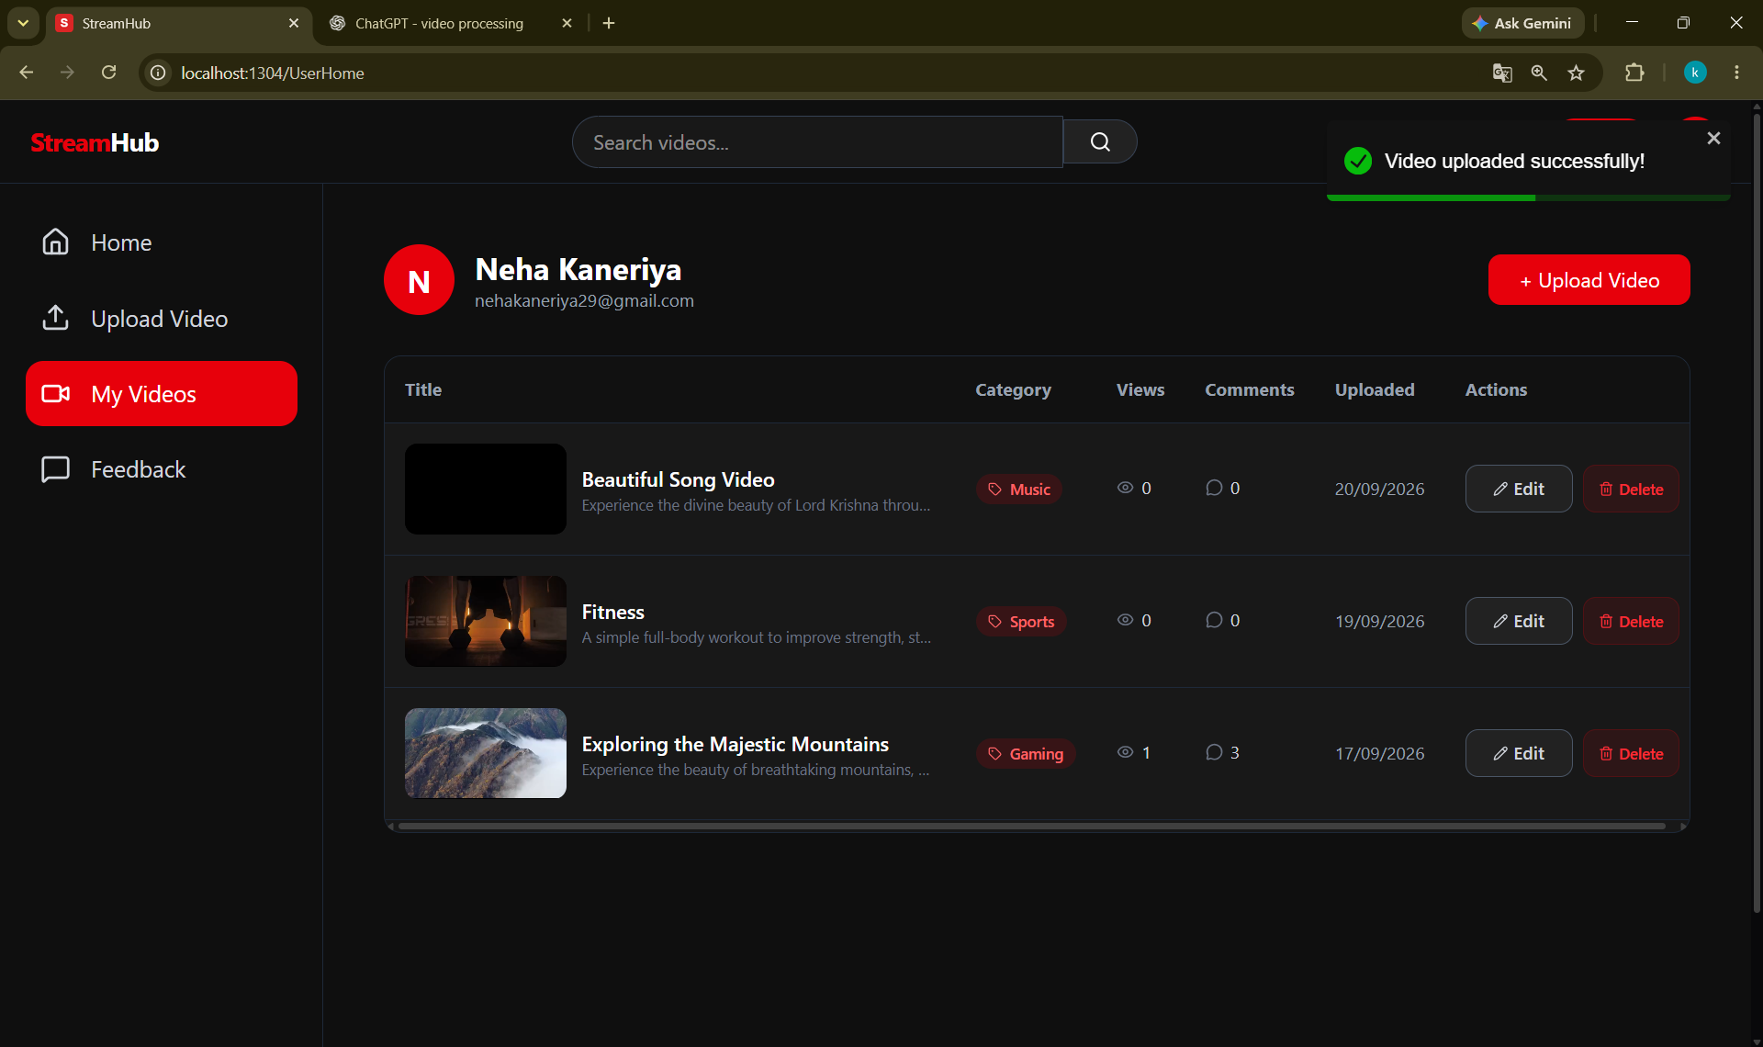
5.1.1 Output Testing
Upload Success

Slide 59
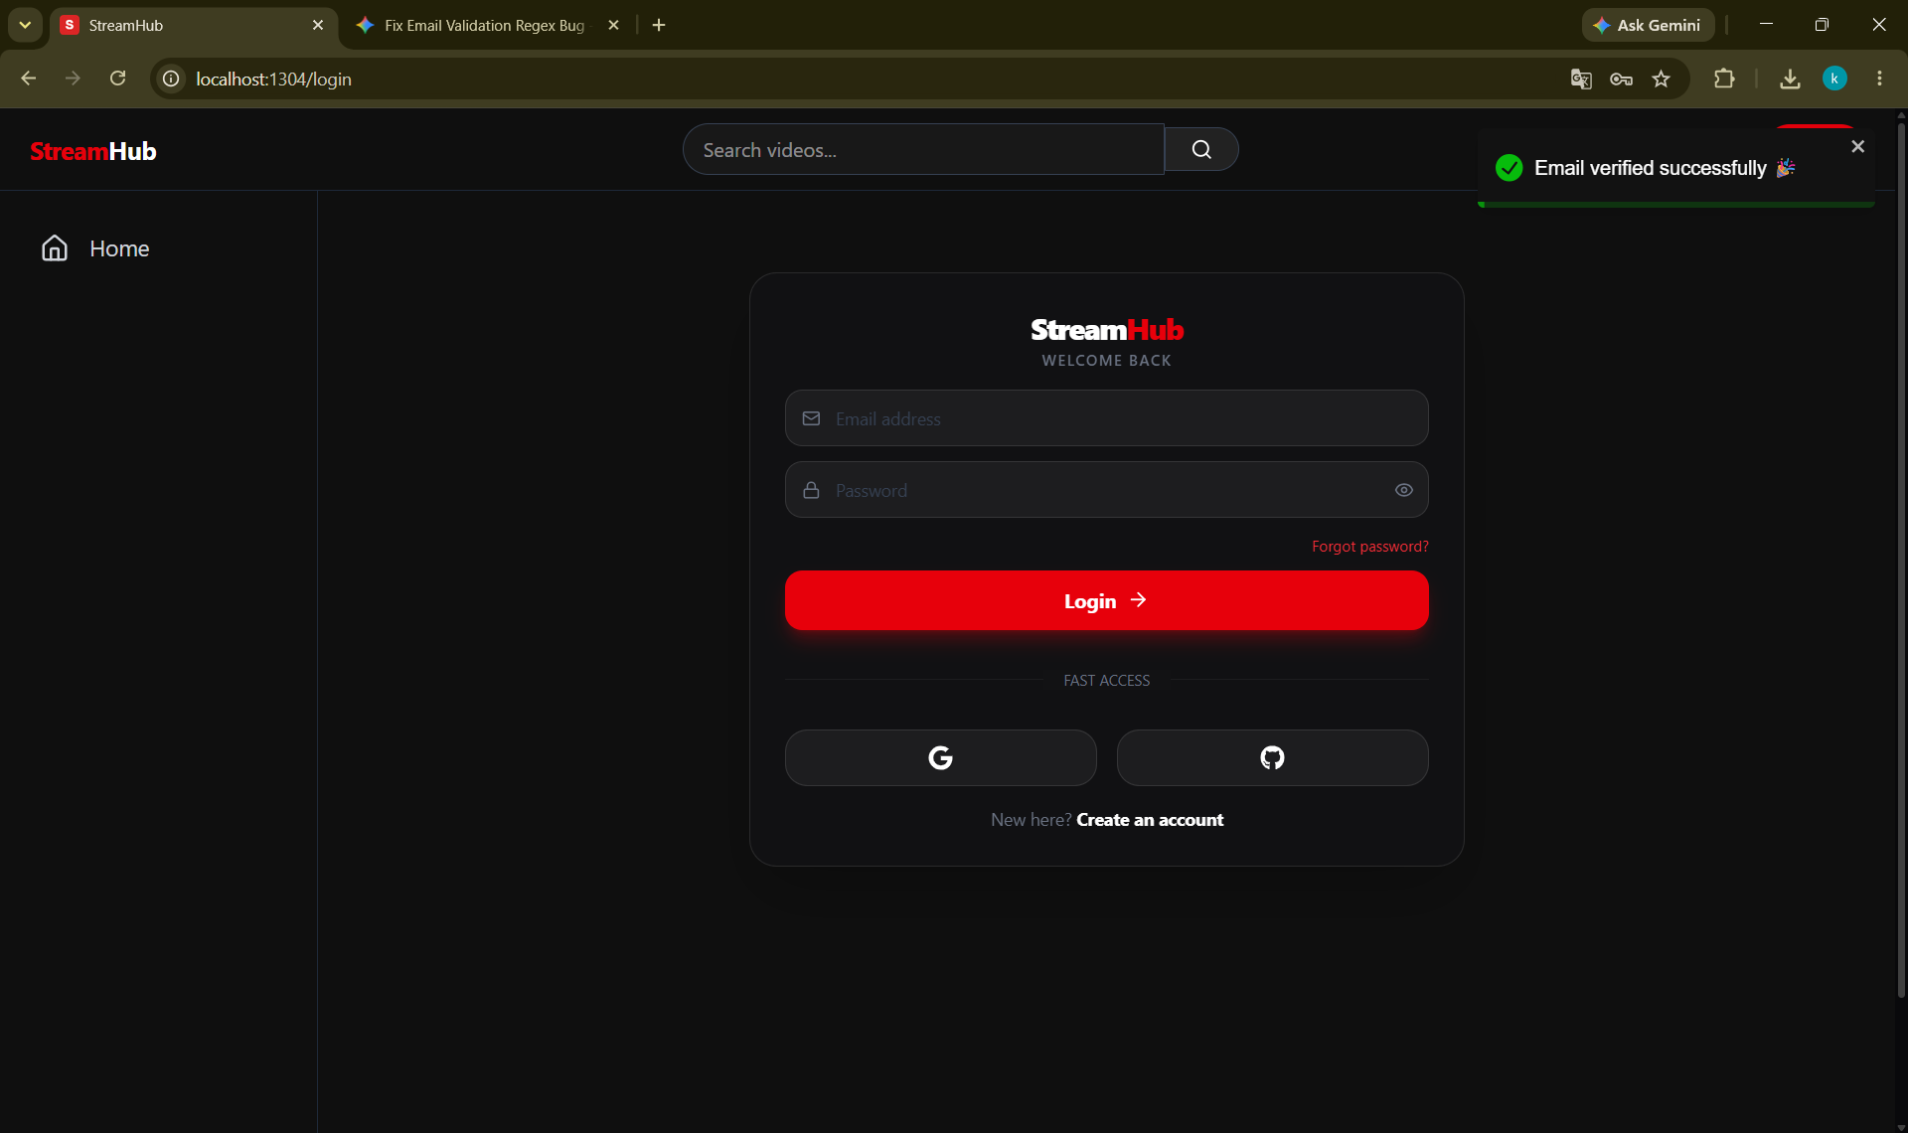
5.1.1 Output Testing
Email Verification Success

Slide 60
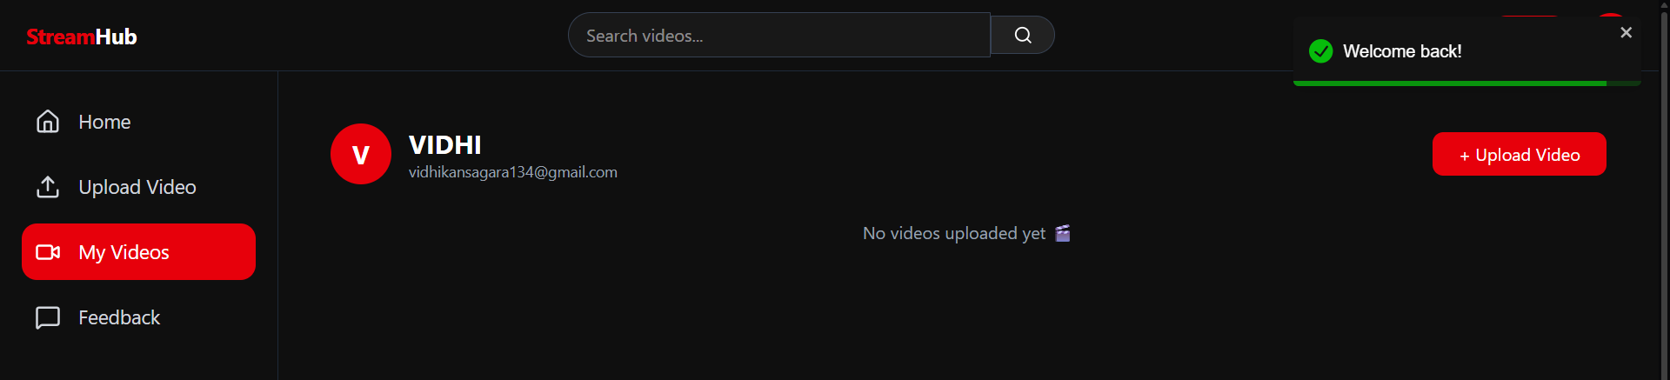
5.1.1 Output Testing
Login Success

Slide 61
5.1.1 Output Testing
Search Result

Slide 62
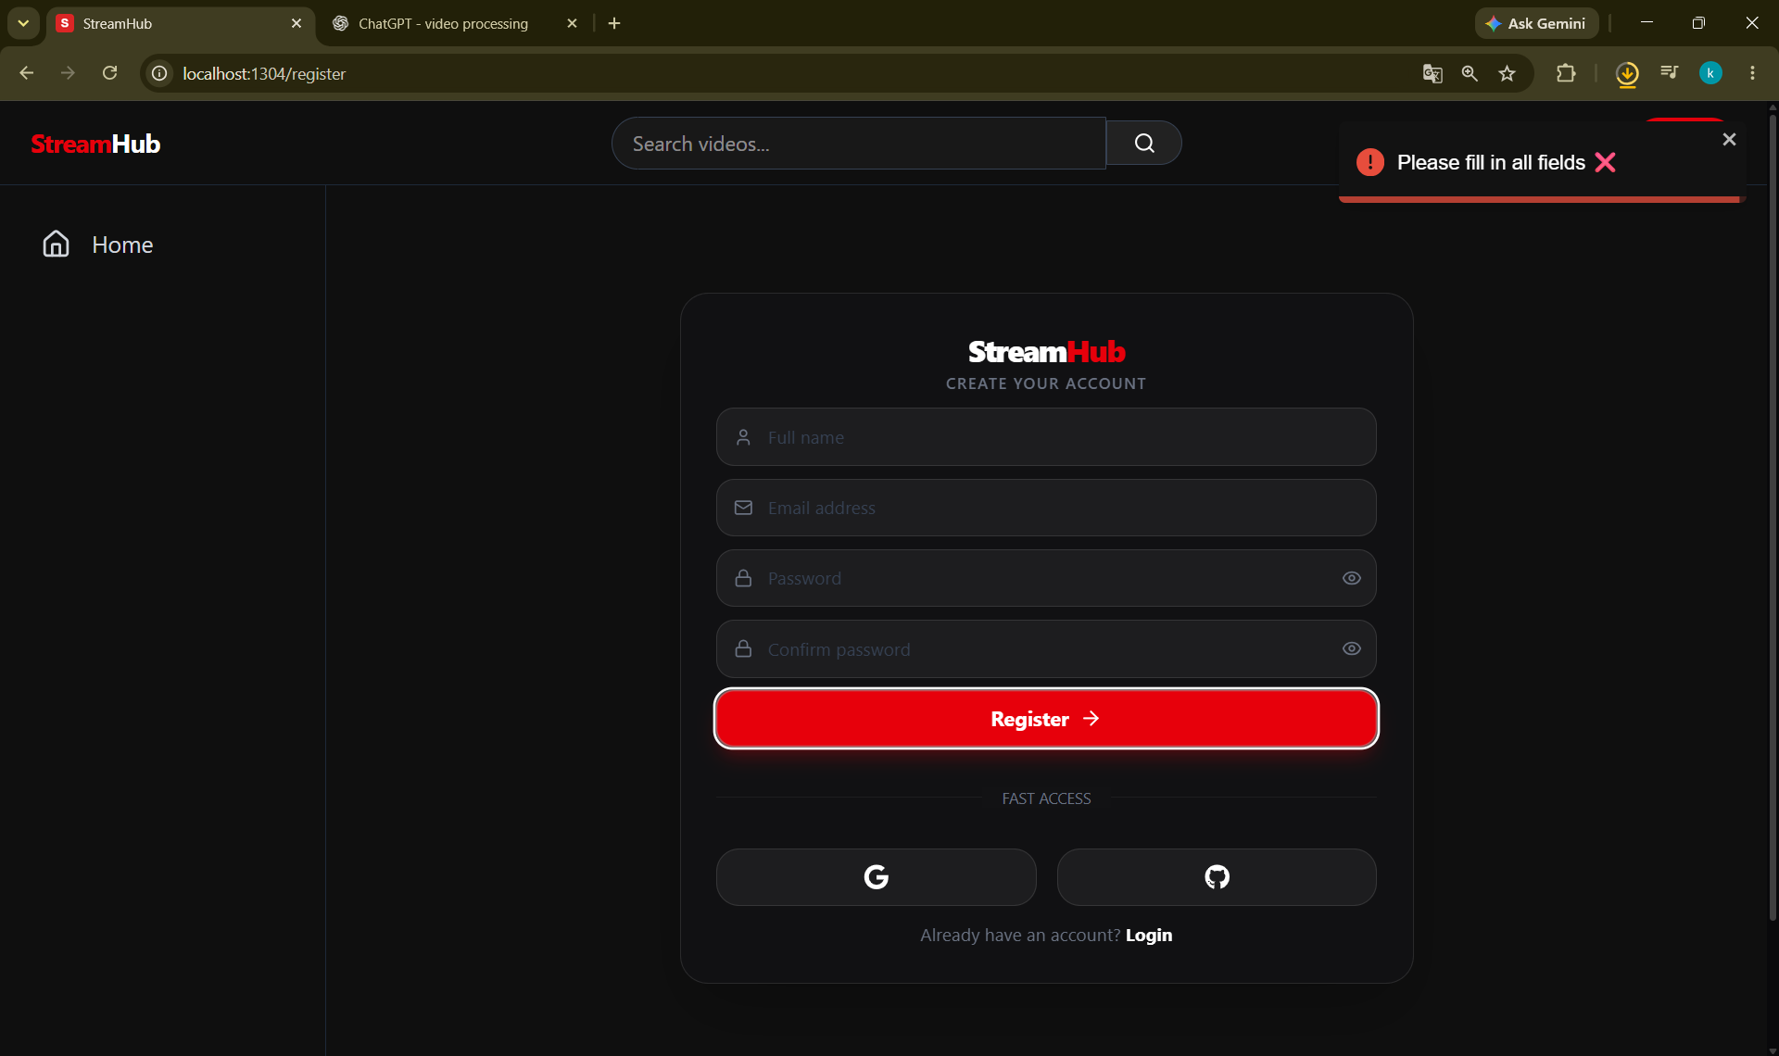
5.1.2 Validation & Verification Testing
Empty registration

Slide 63
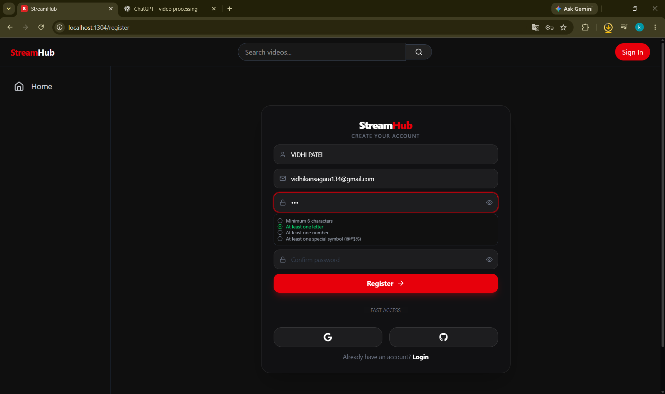
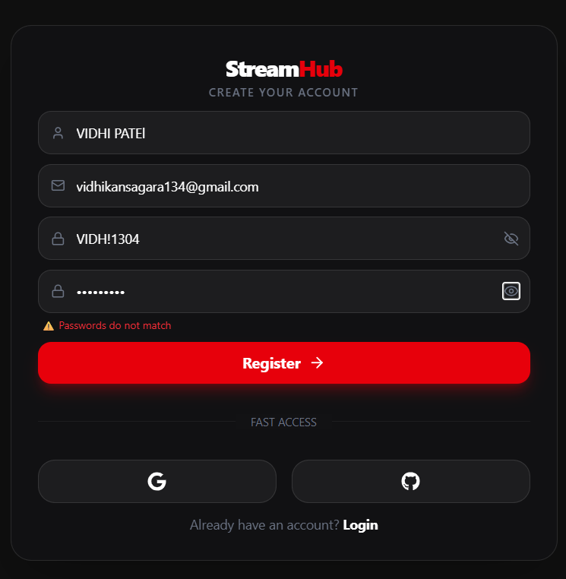
5.1.2 Validation & Verification Testing
Password validation
Password mismatch

Slide 64
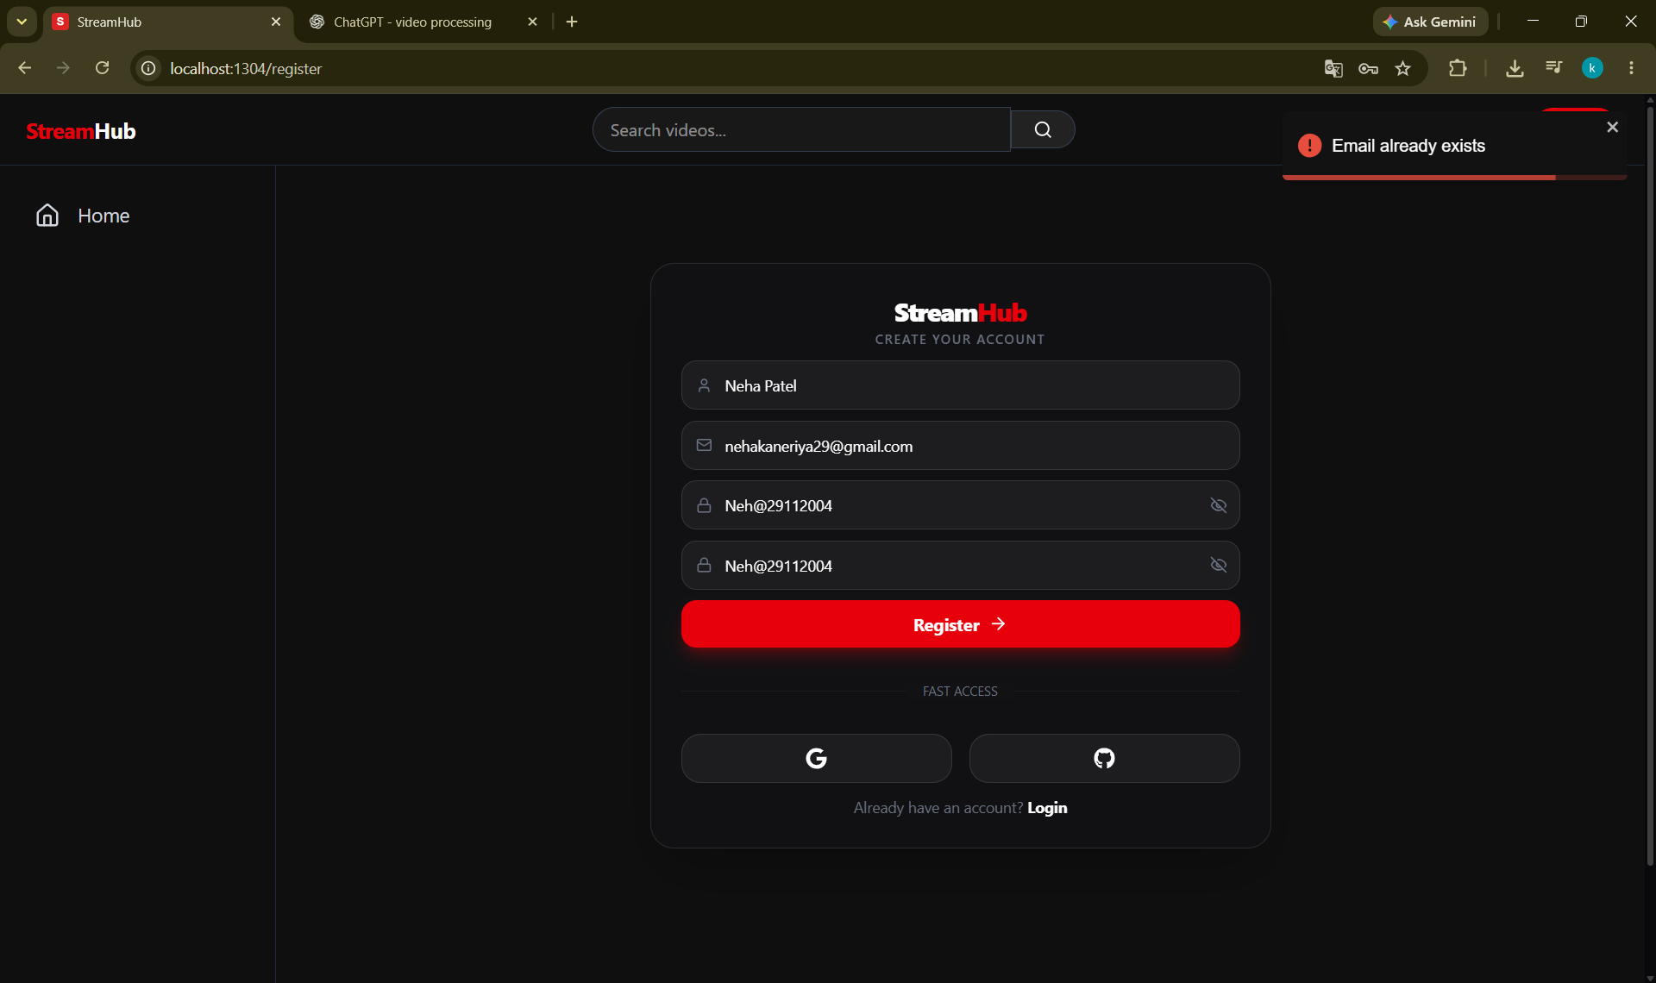
5.1.2 Validation & Verification Testing
Existing email

Slide 65
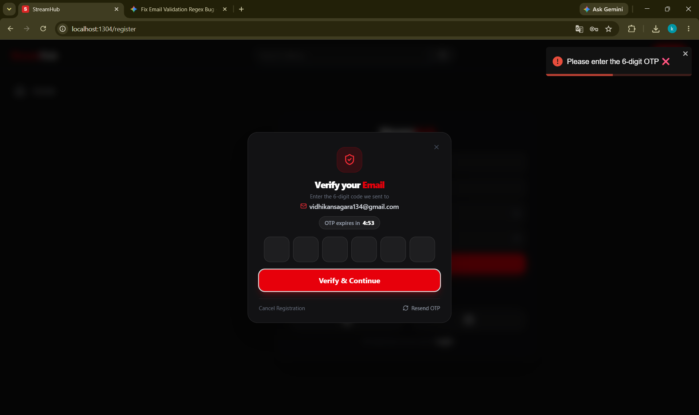
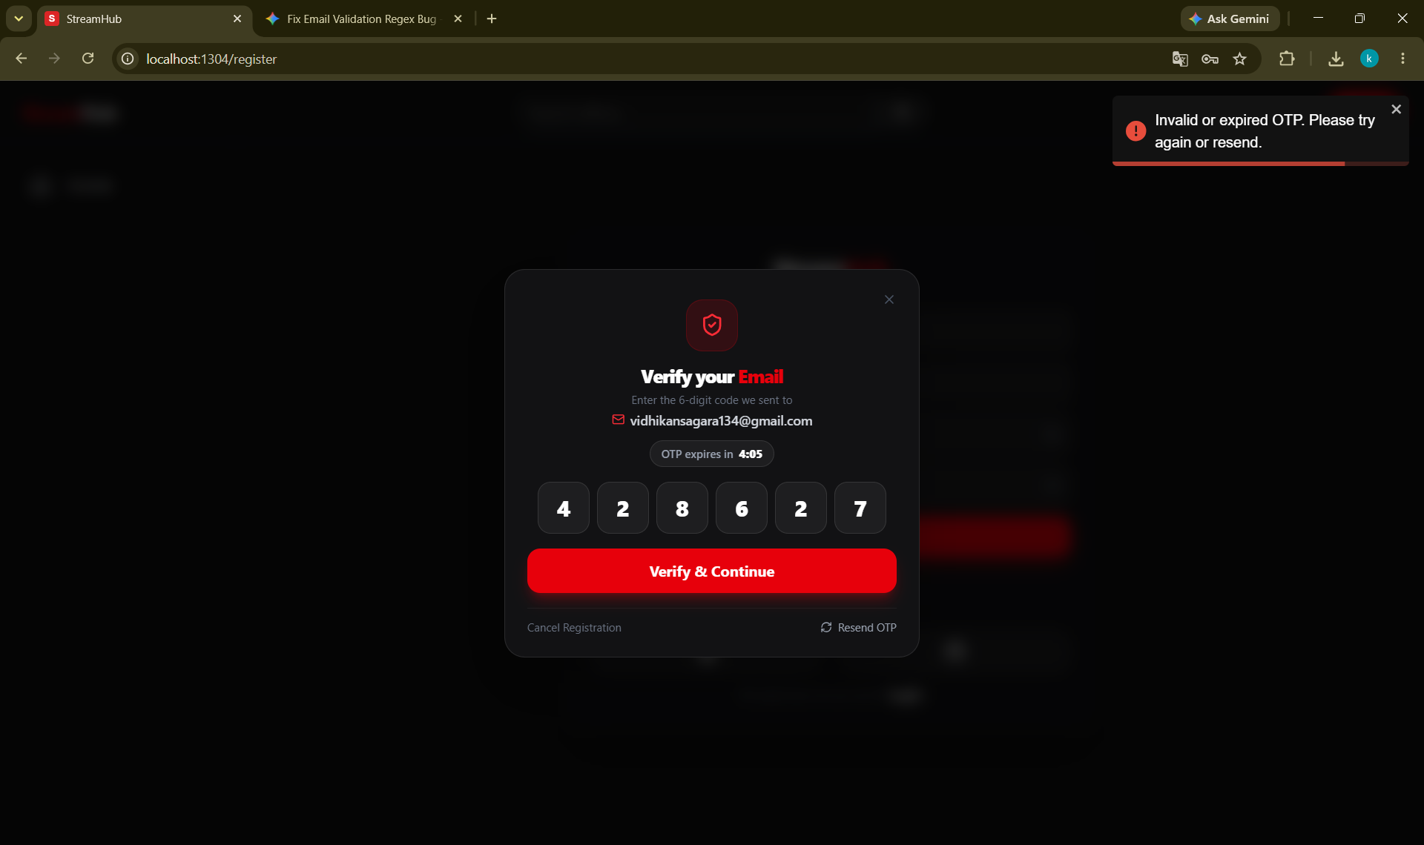
5.1.2 Validation & Verification Testing
Empty OTP
Wrong OTP

Slide 66
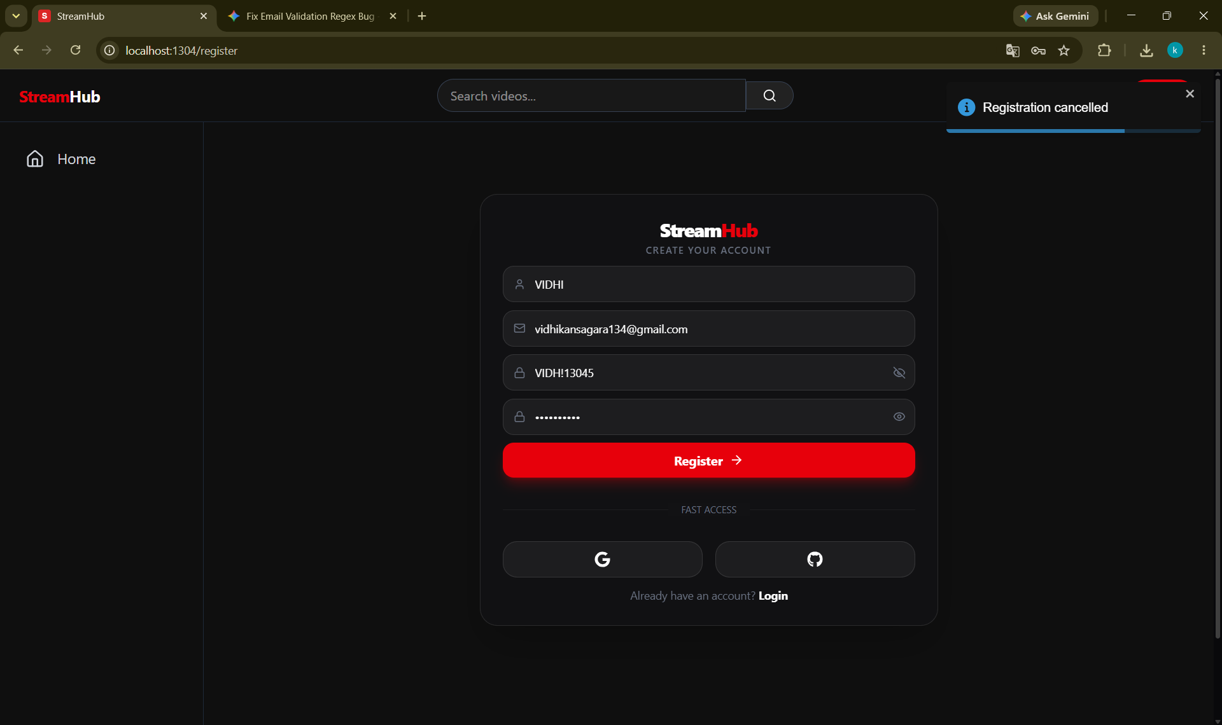
5.1.2 Validation & Verification Testing
Registration cancelled

Slide 67
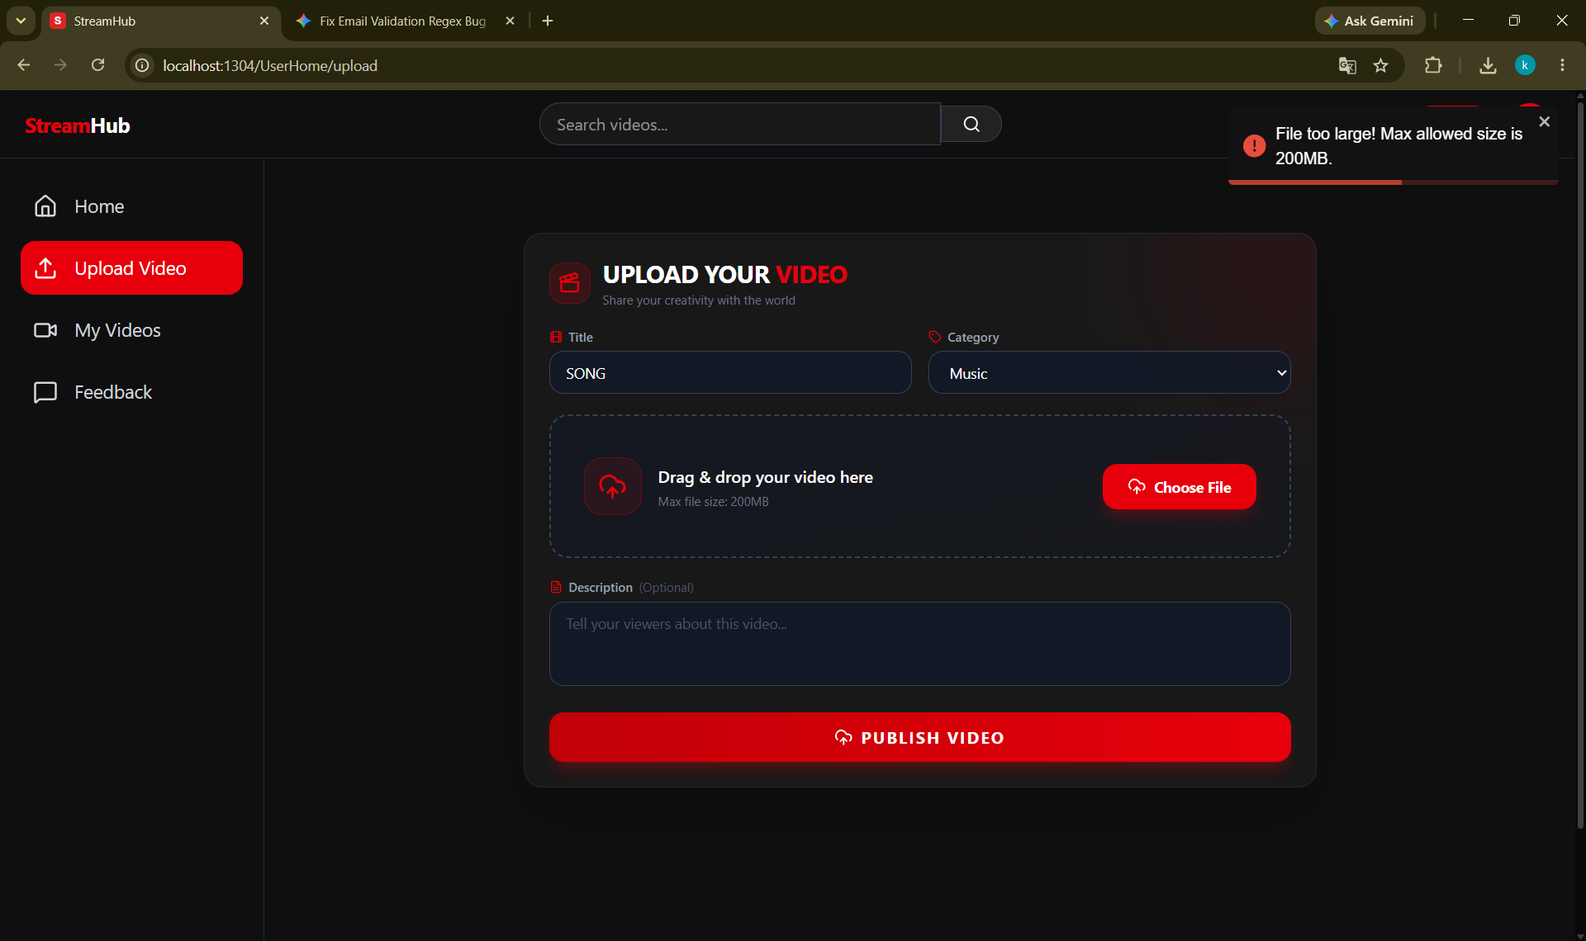
5.1.2 Validation & Verification Testing
File Too Large

Slide 68
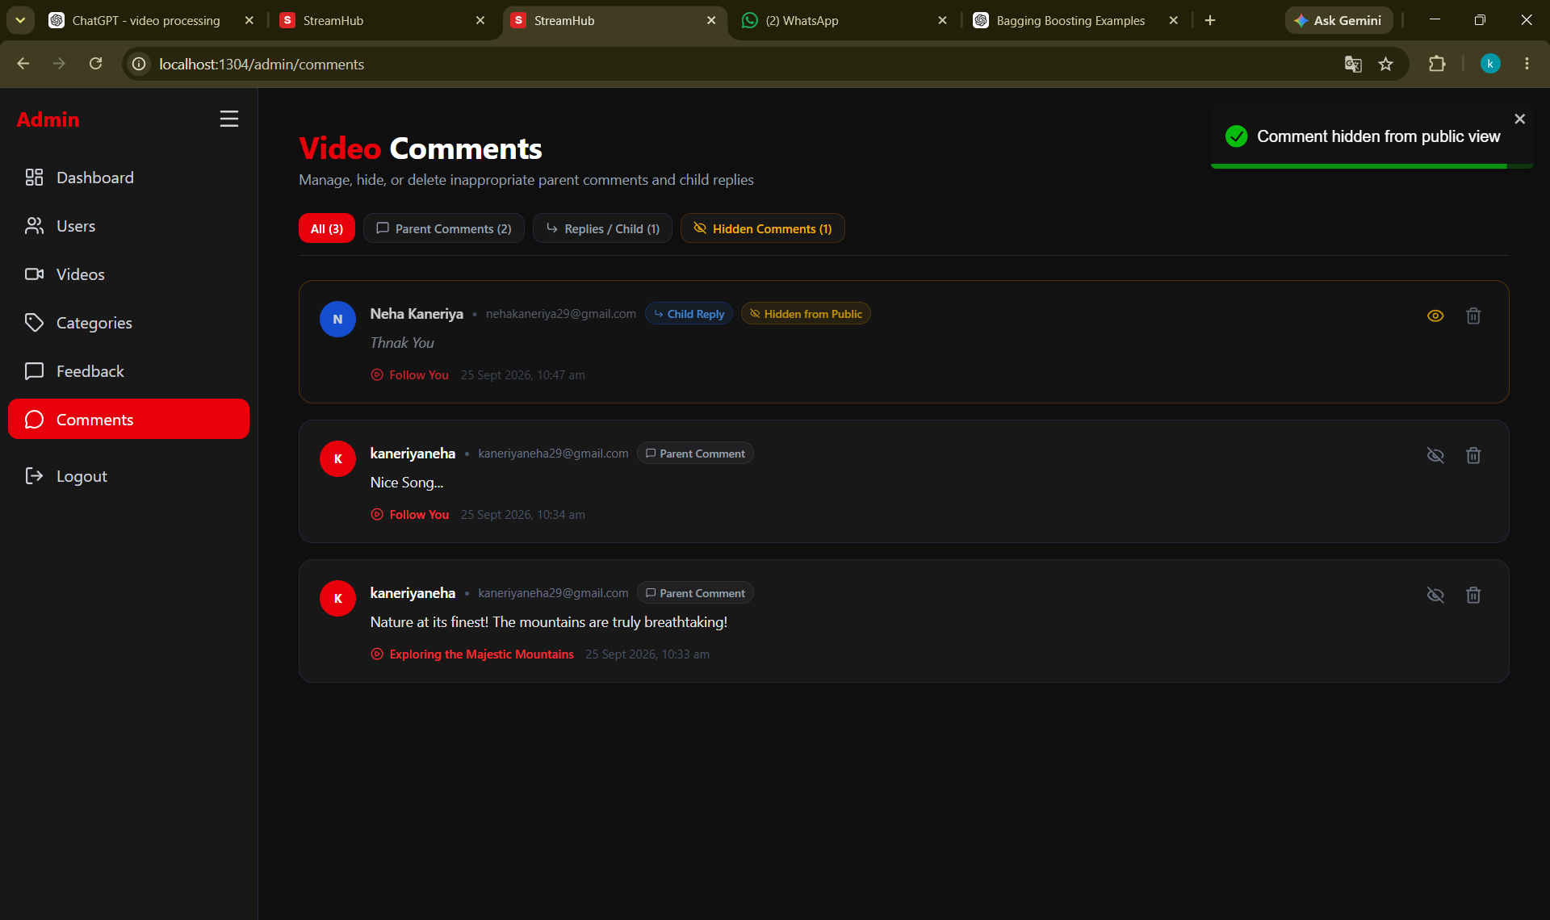
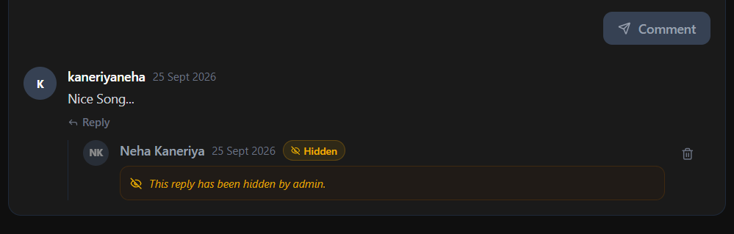
5.1.2 Validation & Verification Testing
Comment Hide

Slide 69
6. Conclusion and Future Enhancement
6.1 Conclusion
Technology
Security
Video Processing
Overall Outcome
React, TypeScript, Vite, Tailwind CSS, Java, Spring Boot and MySQL
JWT, refresh tokens, role-based authorization and OTP verification
FFmpeg and HLS for playlist and segment-based streaming
A structured foundation for a more advanced and scalable streaming platform

Slide 70
6. Conclusion and Future Enhancement
6.2 Future Enhancement
Scalable Media Storage & Delivery
Engagement and Creator Features
01
04
Replace local video storage with Amazon S3 or MinIO, along with CDN-based delivery.
Add likes, playlists, subscriptions, notifications, watch history and creator dashboards.
Asynchronous Video Processing
Accessibility and Internationalization
02
05
Move video processing to background jobs using message queues and worker services.
Add subtitles, captions, transcripts, keyboard-friendly controls, screen-reader support and multiple languages.
Advanced Search and Recommendations
Security, Reliability, and Monitoring
03
06
Add filters, tags, improved relevance and recommendations based on user interactions.
Add malware scanning, rate limiting, audit logs, backups, centralized logging, metrics and alerting.

Slide 71
7. Bibliography and References
BOOK REFERENCES
WEB REFERENCES
1. Herbert Schildt — Java: The Complete Reference
2. Craig Walls — Spring in Action
3. Elmasri & Navathe — Fundamentals of Database Systems
1. Spring Boot Documentation — https://docs.spring.io/spring-boot/documentation.html
2. React Documentation — https://react.dev/
3. MySQL Documentation — https://dev.mysql.com/doc/
4. FFmpeg Documentation — https://ffmpeg.org/documentation.html

