Slide 1

Child Adoption Portal
- Presented By
1 .Neha Katekar [Team Leader] - 210543181053
2. Komal Jagtap - 210543181032
3.Pranita Deshpande – 210543181021
4. Shikha Singh - 210543181098

Slide 2

Introduction
In the fast growing IT market, technologies are changing rapidly. Based on these technologies we are aiming to reduce manual process of Child Adoption.
Child Adoption Portal is web-based tool to reduce communication gap between officer and Applicant.

Slide 3
Objective
The main objective of this application is to make child adoption processing easy and fast.
This system will allow the applicant to apply for child adoption conveniently from any place and officer to approve/reject the adoption application based on the information given by the applicant.

Slide 4
Modules
Admin Module : Admin module to accept or reject the applicant request.
Applicant Module : Applicant module to submit their request for child adoption.

Slide 5
Application Flow
Admin :
Admin has right to perform operations on Agencies details.
Admin can add or update child details.
Admin can see the list of registered parents for adoption and can accept or reject the application.

Slide 6
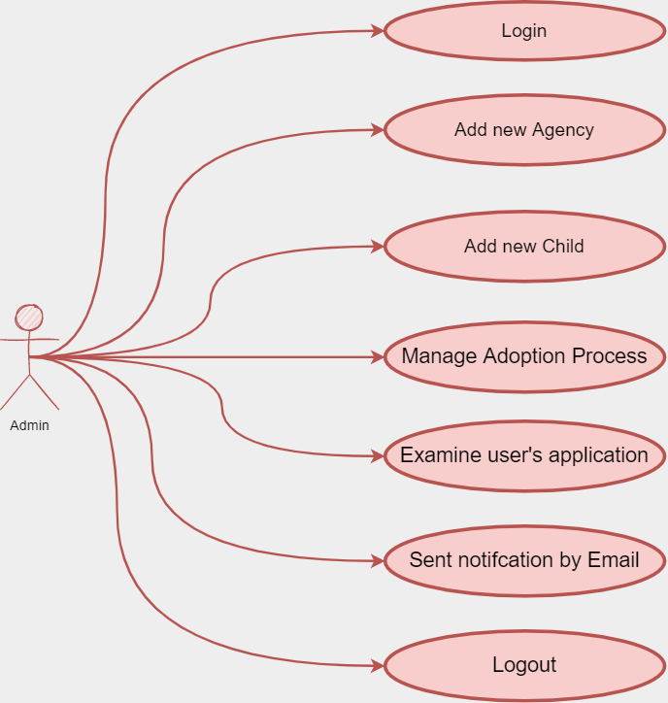
Admin-Application Flow

Slide 7
User-Application Flow
Applicant Flow:
User has to register himself and then can login to the Chil Adoption Portal.
After login dashboard page will be displayed having different options.
User can click on the ‘View Children’ button and can see the Children details
In the View Child details page, the User has to choose the child and then register for adopt that child.
User has to submit all information and document in registration form.
After Registration User will receive email on registered email-id.
If Applicant have not received any acceptance or rejection mail within 7 days from application date then he can contact adoption portal on their official email.
All the adoption related information and FAQ's are available on the site

Slide 8
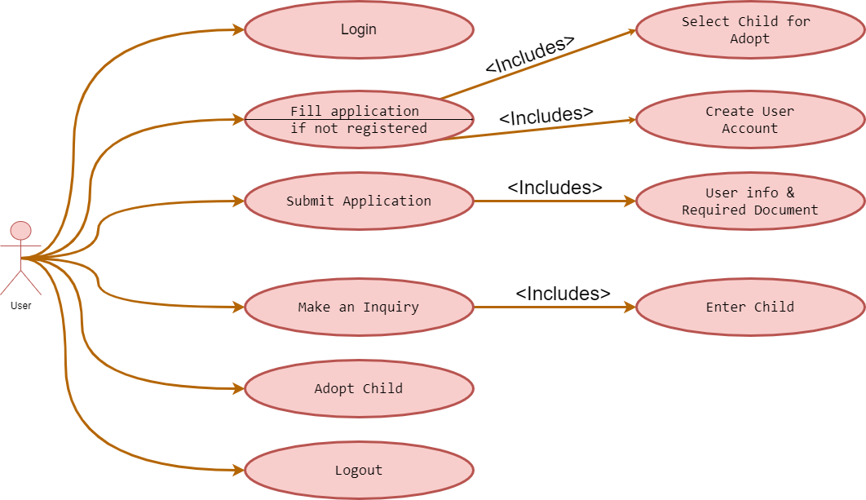
User-Application Flow

Slide 9
Tables
We have created database - ‘cdemo’.
There are 4 tables:
1. Agencies
2.Child
3.Registers
4.Users

Slide 10
Technologies Used
Front End : React js
Back End : Spring Boot
Database : MySQL

Slide 11
Advantages
Time Saving
Cost Effective
Reduced Manual Intervention

Slide 12
Future Scope
Status Tracking
Chat Portal
Feedback

Slide 13
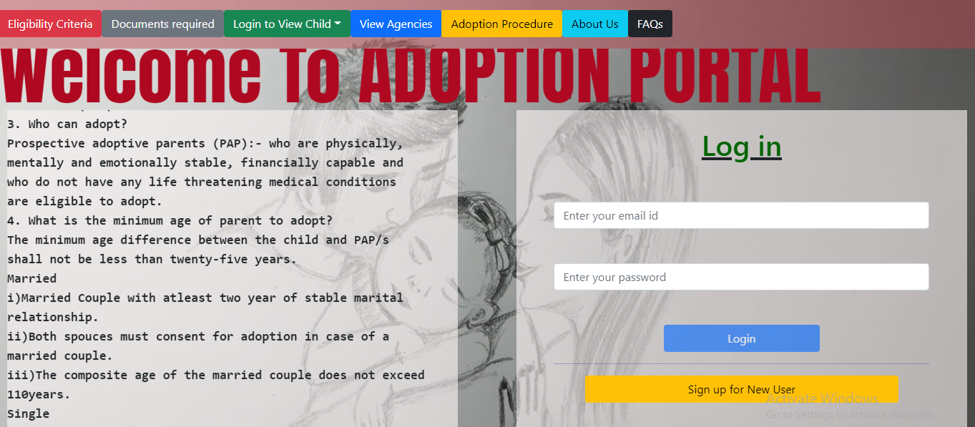
Home Page

Slide 14
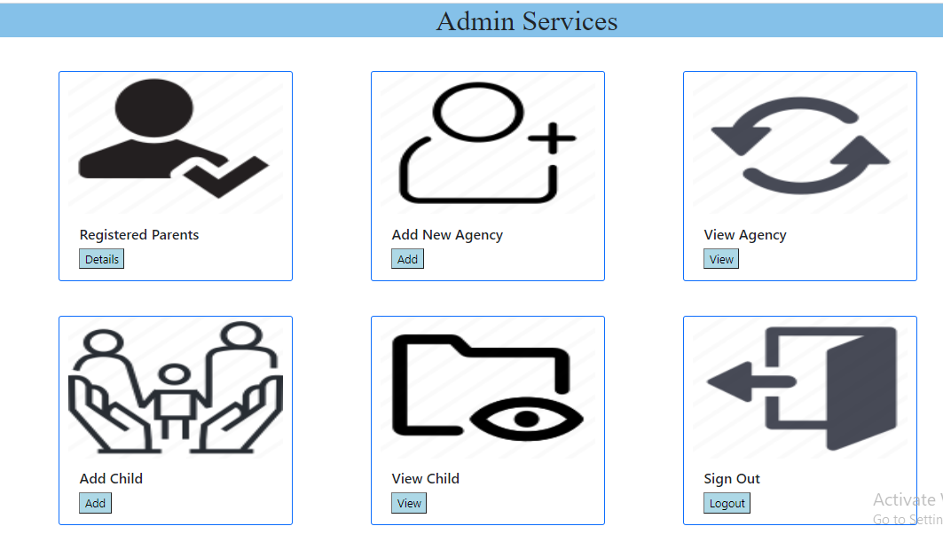
Admin Services

Slide 15
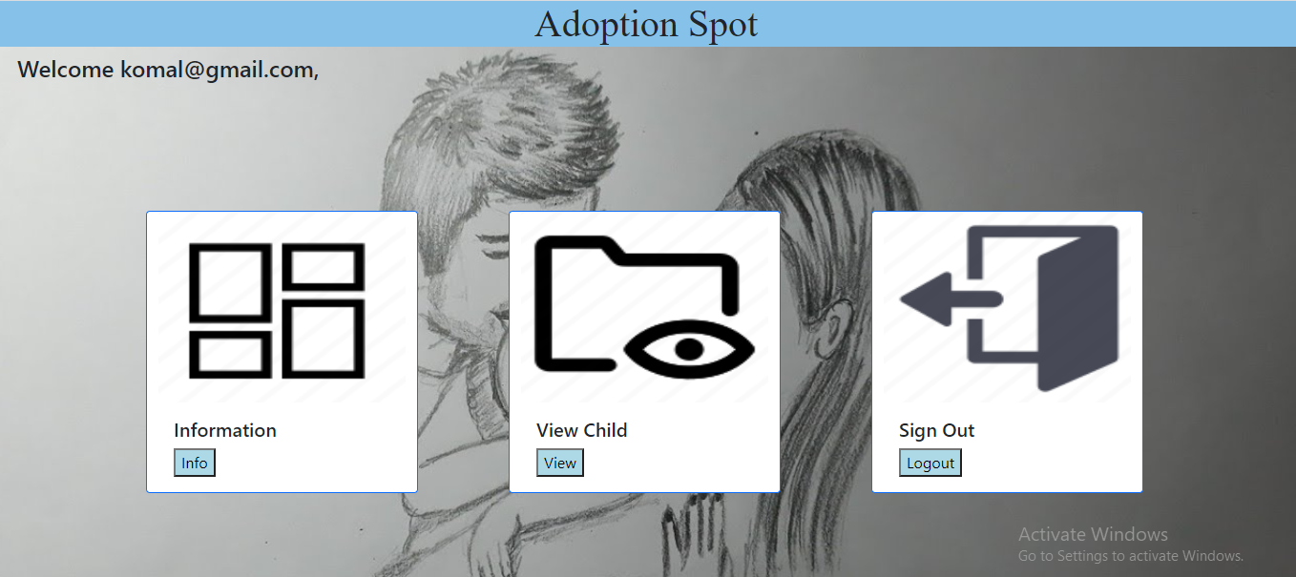
User Services

Slide 16
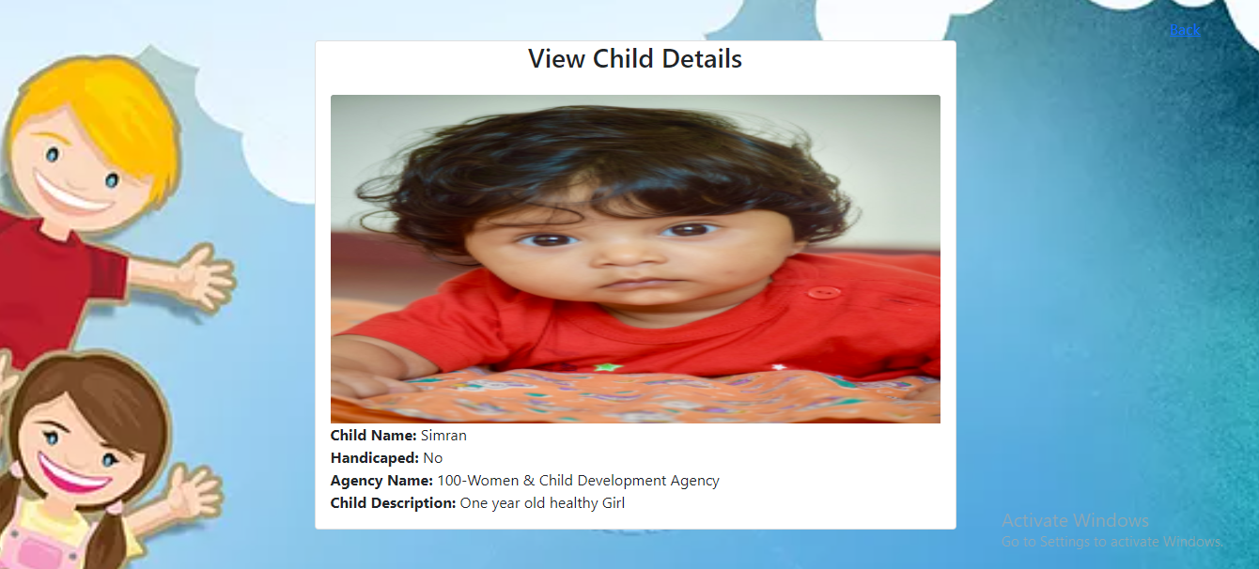
Child Details

Slide 17

Thank You

