Slide 1
Vision-Based Precision Pose Estimation
for Autonomous Formation Flying
Re-implementation of Punnoose (Stanford CS229, 2020) + a reprojection-refinement extension
UE24CS352A Machine Learning mini-project · Section J · Group 16 · Problem #9
Neha K S (PES1UG24CS581) · Mohith N (PES1UG24CS580)
Notes:
Introduce team and the problem number. One line: we rebuilt the paper's pipeline from scratch on synthetic data and added a refinement step the paper suggested as future work.

Slide 2
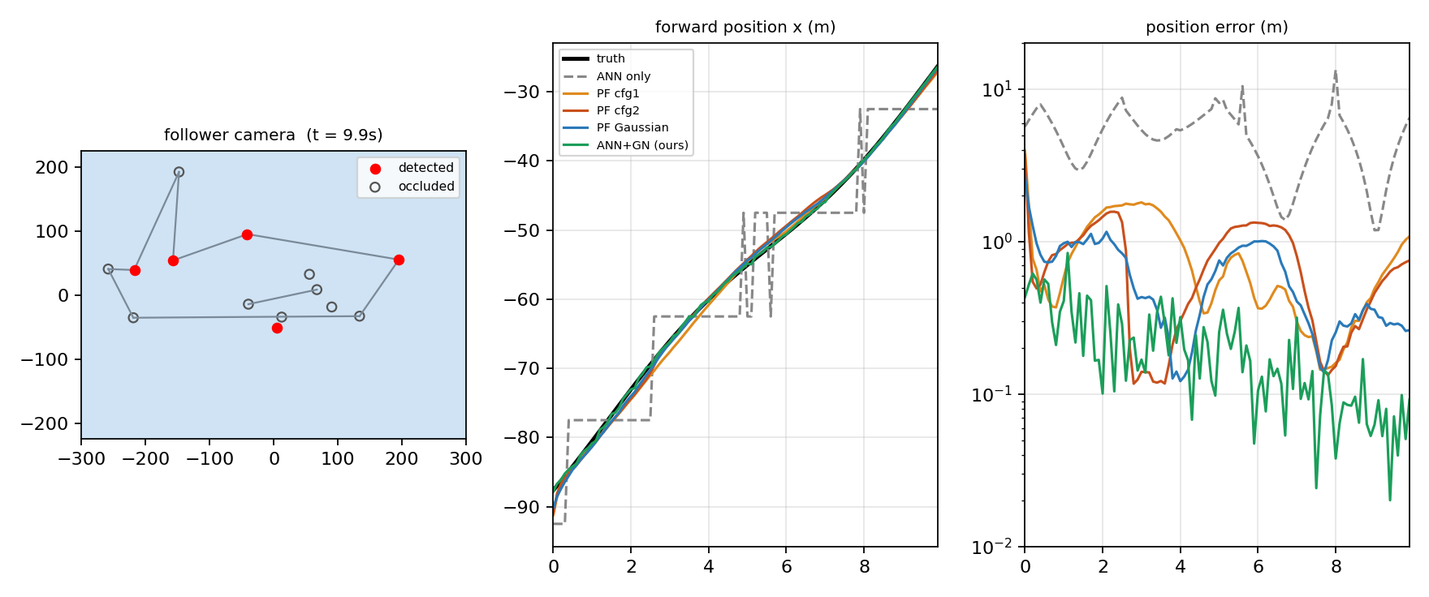
The problem: precise relative pose from one image
Follower camera (gimballed on the leader) sees 14 known aircraft features, some self-occluded
Goal: relative pose [x, y, z, roll] good enough for tight formation flight
GPS / INS too coarse; end-to-end regression gives no uncertainty and ignores dynamics
Paper's answer: ANN gives a coarse pose label, a particle filter refines it
Our demo: simulated camera view (red = detected feature, hollow = occluded), forward position over time, and position error of each estimator.
Notes:
GPS/INS is too coarse for tight formation. Pure CNN regression: no uncertainty, no dynamics, attitude parameterisation singularities. So hybrid: learned coarse label + Bayesian filter.

Slide 3
Pipeline
Particle filter
paper
Simulated detector
14 × [u, v, occluded]
42 inputs
ANN classifier
42-100-100-4800
ReLU · softmax · Adam
Coarse pose label
cell centre
(top-3 kept)
Gauss-Newton refinement
ours
4800 classes = x 10 × y 10 × z 8 × roll 6 (paper Table I); cells are 15 m × 10 m × 5 m × 15°
PF: init from ANN label + validation error pool; leader motion = uniform disturbance; resample floor(αN) weighted + rest from ANN label
Refinement: Levenberg–Marquardt on reprojection error over 4-DoF pose, started from the ANN's top-3 cells (paper's own future work)
Notes:
Walk left to right. Emphasise that the ANN output is a belief over 4800 cells and that both the PF and the refinement use it as initialisation.

Slide 4
Data: fully synthetic (the paper ships none)
300k
14
0.5 px
4800
training poses
(30k val · 30k test)
known aircraft features
per image
detector noise,
2% missed detections
pose classes
Pinhole camera 1280×960, f = 1600 px, gimballed to keep the leader at the centre
Self-occlusion: a feature is hidden when its outward normal faces away from the camera (stand-in for ray tracing)
Poses drawn uniformly in the Table-I box, range ≥ 15 m
Evaluation: 10 random 10 s approaches at 10 Hz, ~90 m → ~30 m behind the leader, leader manoeuvring
Notes:
Be upfront: synthetic data, simplified occlusion. The point is the algorithm, not photorealism.

Slide 5
ANN: a reliable coarse label
69.6%
96.0%
98.3%
test top-1 accuracy
(paper: 54%)
top-5 accuracy
within one neighbouring cell
Mean cell-centre error is still 5.6 m / 4.3° – precision is capped by the discretisation, not by classification
Misclassifications land in adjacent cells, so top-k labels make good initial guesses
Written in plain numpy (hand-coded backprop + Adam); 30 epochs ≈ 9 min on one CPU core
Notes:
Our top-1 is higher than the paper's 54% - our synthetic features are cleaner. 98% within one neighbouring cell matches the paper's observation that mistakes are adjacent.

Slide 6
Result: refinement beats the particle filter at low noise
Method | Pos (m) | Roll (°)
ANN only | 5.32 | 4.51
PF cfg 1 | 0.96 | 1.09
PF cfg 2 | 0.70 | 0.80
PF Gaussian | 0.62 | 0.96
ANN + GN (ours) | 0.25 | 0.18
Mean over 10 random 10 s approaches. PF cfg 1: N=1000, α=0.9 every 10 cycles; cfg 2: N=5000, α=0.9 every cycle (paper); Gaussian: N=2000, α=0.5.
Notes:
ANN-only 5.3 m. PF about 0.6-1 m. Refinement 0.25 m. Mention honest caveat: our PF helps far more than in the paper because our simulator is cleaner.

Slide 7
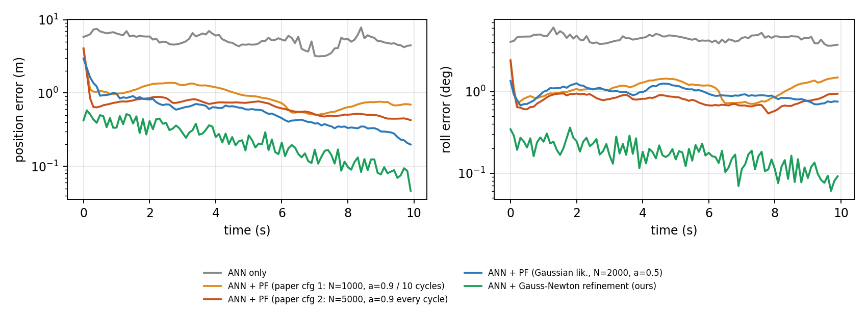
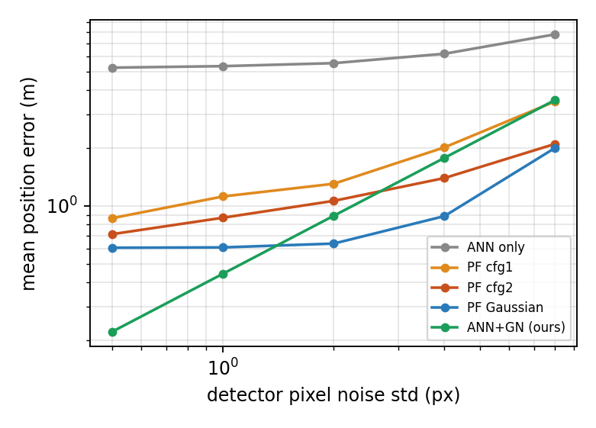
Over time and under noise
Refinement is best at 0.5–1 px noise (0.22 m at 0.5 px)
From ≈2 px the Gaussian PF wins: it averages over time, refinement is per-frame
Next step: feed the refinement into the PF as its measurement
ANN not retrained for the noise sweep (trained at 0.5 px).
Notes:
Left: refinement is lowest at every frame. Right: as detector noise grows, per-frame refinement degrades faster than the temporal PF - they cross near 2 px. Natural next step: use the refinement as the PF measurement.

Slide 8
Conclusions
ANN gives a robust coarse pose (70% exact, 98% within one cell) but is capped by discretisation
ANN-informed PF cuts error ~7× (5.3 → 0.6–0.7 m); unlike the paper's PF, ours clearly helps
Reprojection refinement reaches 0.25 m / 0.18° – the ANN works best as an initialiser
Per-frame refinement vs temporal PF: complementary → fuse them
Limitations
Synthetic data only · simplified normal-based occlusion and dynamics · feature detector (the paper's CNN) assumed, not built · absolute numbers not comparable with the paper
Notes:
Be ready for: why 4800 classes, why Adam, how the error pool is used, why our PF works better than the paper's, what the likelihood is, how occlusion is simulated.

Slide 9
Live demo & repository
$ python scripts/demo.py --seed 3 --live
$ python scripts/run_experiment.py --seeds 10
$ python tests/test_basics.py
poseest/ – aircraft + camera model, ANN, dynamics, particle filter, refinement
scripts/ – train_ann · run_experiment · noise_sweep · demo
artifacts/ – trained weights, error pool · results/ – figures, json, demo GIF
README with setup + run instructions · unit tests · 2-page write-up in docs/
Notes:
Run python scripts/demo.py --seed 3 live. Takes ~4 s.

