Slide 1

TEAM: Snack Overflow

Slide 2

Problem Statement
Traffic Analysis application using Social Media feed
Develop a model for extracting features from social media feeds like Twitter, Facebook, Traffic handles using Natural language processing tools.
Give traffic Authorities information about what exactly has happened at the location and depth of situation. (bridging the gap)
Notify the Users and NGOs about problems around them for voluntary help.
Update users when any problem has been attended to in a lucid format.
Reward them for helping by tweeting.

Slide 3
Problem Statement
Severity Of The Problem:
Whenever we talk about Pune’s traffic we hear words like chaotic, unsafe, infamous, etc.
The fatality rate is one person a day or 10 to 15 a week which is very high.
Thanks to very undisciplined traffic of city with zero traffic sense in the population.
Also People tend to Express on social media instead of contacting the Authorities
We are also responsible for this situation somehow.

Slide 4
Problem Statement
Most congested locations:
Usually locations where roads or infrastructure is under-construction are most jam-packed. Even areas near commercial zones of office areas are jammed with traffic especially during morning hours when everybody are in rush to reach office on time. Senapati Bapat Road, Hinjewadi, Hadapsar, Sinhagad Road, Kothrud, Koregaon Park, Pune Station area, Shivajinagar are mostly crowded.

Slide 5
Problem Statement
SUPPORTING DATA
Pune Ranks 3rd in Accidental deaths
PMC,PMPML face flak from activists
Traffic related twitter implementation
Safe Traffic Implementation using social media

Slide 6
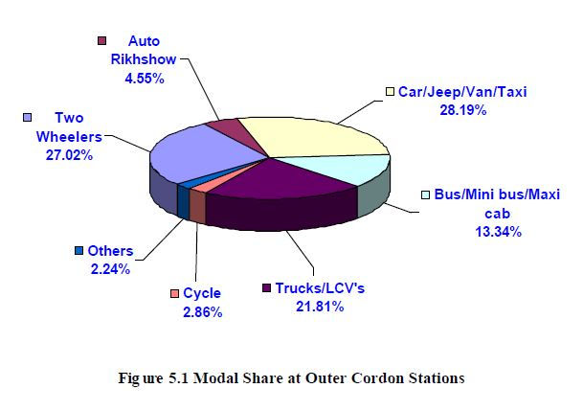
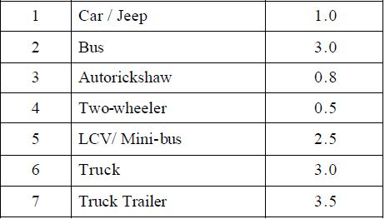
Problem Statement
Traffic Statistics in Pune (Study by IIT Bombay)
Fig. Passenger Car Units (PCU) values adopted for study

Slide 7
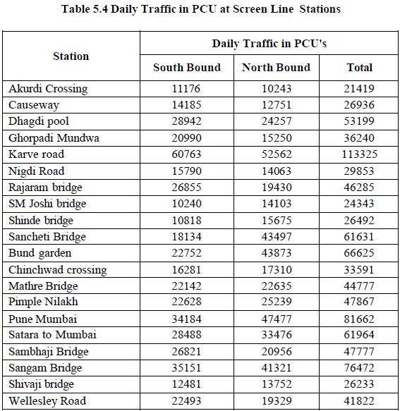
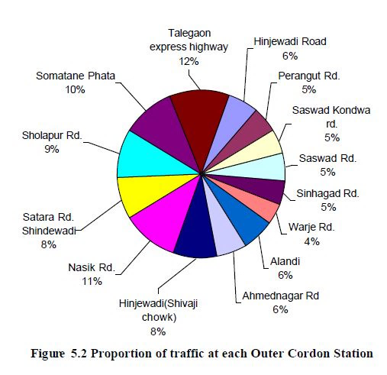
Problem Statement

Slide 8
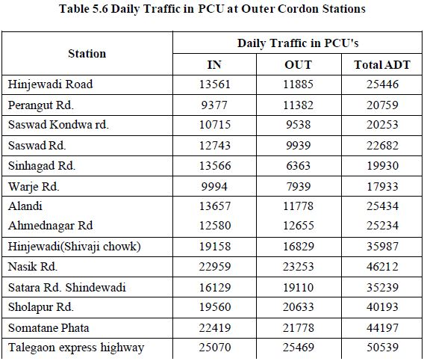
Problem Statement

Slide 9
Solution
Why the Solution?
Involves participation from both users and authorities.
No External Hardware required like sensors
Total control given to the user.
Advanced and in-depth analytics.
The proposed model is able to learn over time with data addition, hence improving accuracy.
There is no bottleneck to data, the more the data, the better the accuracy.
Model is highly scalable, as explained above.
User satisfaction is ensured by the use of a reward based systems.

Slide 10
Solution
Our Solution: TrafficAssist
We aim to solve this traffic problem in Pune by employing the use of Data Analytics and learning models. Our application involves the users to the highest degree, providing them with the center stage and absolute control. Using incoming feeds from social media and traffic related RSS feeds, websites and handles, our solution involves extracting features such as traffic conditions, locations, reason for the conditions from them and display it in a very lucid and user-friendly form. The proposed solution involves participation from both government/traffic personnel and authorities, as well as the general public.

Slide 11
Solution
Why the Solution?
Involves participation from both users and authorities.
Total control given to the user.
Advanced and in-depth analytics.
The proposed model is able to learn over time with data addition, hence improving accuracy.
There is no bottleneck to data, the more the data, the better the accuracy.
Model is highly scalable, as explained above.
User satisfaction is ensured by the use of a reward based systems.

Slide 12
Solution
Where to implement the solution
Our solution can be extended to any major city in addition to Pune.
There will be two interfaces, an app at the user end and a rendering for the authorities to monitor the data generated.
Our source of data is online feeds, which are universal in nature and can be filtered by location, type etc.
Can be used to map data from remote locations as well.

Slide 13
Solution
When will it be most effective
The accuracy and effectiveness of the application is directly linked with user involvement.
The more the involvement from user side, the more the data and better the learning curve of our model.
Higher involvement from the authority’s side will also contribute.

Slide 14
Solution
Who will benefit from the solution
Citizens of the city
Authorities (due to the automation component and ease of access)
Vendors (linked with the reward points system)

Slide 15
Solution
Implementation
The solution involves two major components- users and authorities.
There will be an app for the user.
Similarly, there will be a web app for the traffic authorities to view the analysis and generated content.
The vendors are also involved… But they are mainly linked with the reward point system.
Collaboration with transport giants like Uber, Ola.

Slide 16
Solution
Implementation – User
Scenario – User is stuck in a traffic jam
User opens our app, and is able to tweet about the traffic crisis.
Options for creating a profile and registering through Google+, Facebook, Twitter etc.
User is able to connect with other people, by viewing similar tweets in the area.
User can share the app among others.
Also, real time traffic updates can be viewed in the app, along with reasons for the same.

Slide 17
Solution
Implementation – Reward points
Reward points or hackos will be awarded to the user upon registering.
For every correct traffic update our application confirms, the top 10 users will be awarded hackos.
The hackos can be redeemed for discounts, for this collaboration with transport companies like Uber, Ola is required.
Reward points will act as incentive for user to use our app.

Slide 18
Solution
Implementation – Authorities
Traffic police and other agencies can register with us and monitor all the incoming data in real time.
No manual intervention from their end would be required. All alerts and updates will be automated, along with the recommended plan of action that can easily be preset.
Authorities can also thank users for their involvement directly, so as to attract more users.

Slide 19
Business :
An organization where goods or services are exchanged for money.
A business proposal is focused on how to approach the project, state value of the project. A revenue model has to be considered before any business model.
A revenue model is a framework for generating revenues. It identifies what value to offer, how to price the value, and who pays for the value. It is a key component of a company's business model.
A business model is the plan implemented to generate revenue and make a profit from operations.

Slide 20
Business :
Getting the right business model : Focusing on how the app fits into a business model or profitable portfolio of apps is what turns an app developer into an entrepreneur.
The key to successful app developing entrepreneurship is a variety of ideas, offerings and a commitment to constantly iterate on the app, and its business model .
Free Model : In terms of App development the free model is free to download and has no in-app purchases.
The free model can be turned into a premium model considering the value addition from free model to premium model.

Slide 21
Business:
Users which can benefit using TrafficAssist application:
Local users.
Traffic Management Authorities.
Ambulance.
E-commerce.
Garbage collection Authorities.
Railway and bus management Authorities.
Fire extinguisher.
Control Rooms.

Slide 22
Business :
Revenue Model in TrafficAssist Application:
The revenue can be obtained by advertisement .
Linking up with service provider companies.(Eg.Ola and Uber)
Changing from free to premium model.
Creating a minimum viable product.

Slide 23
Solution
Extension
Neural networks for traffic prediction using previous data.
Can be extended to avenues other than traffic like Malls etc.

Slide 24

Solution - Screenshots
Logo

Slide 25
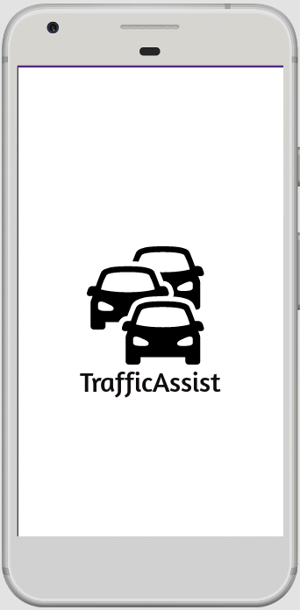
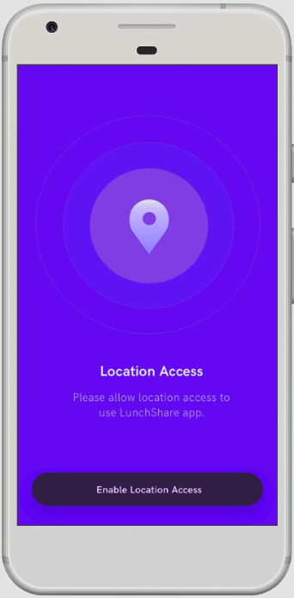
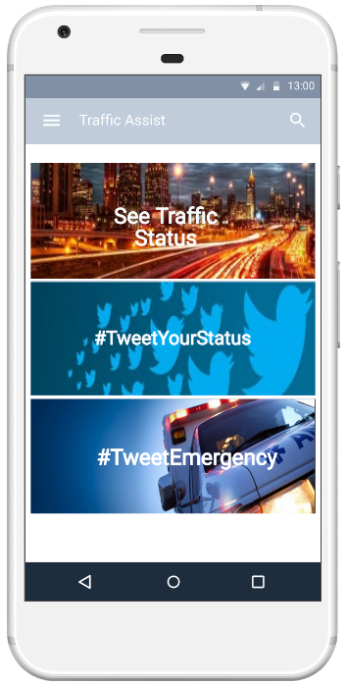
Solution - Screenshots

Slide 26
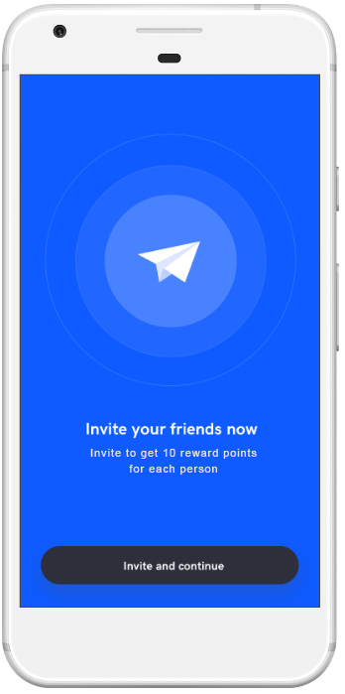
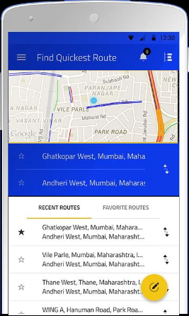
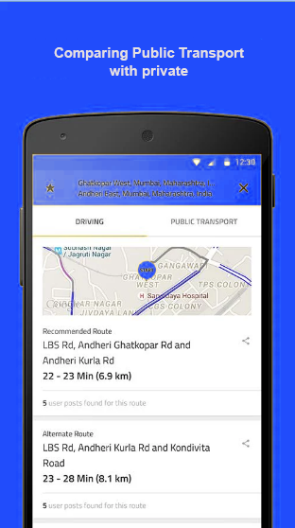
Solution - Screenshots

Slide 27
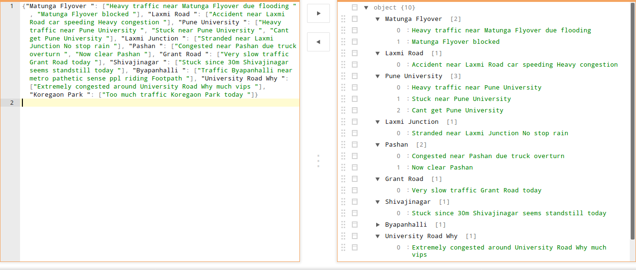
Solution - Code

Slide 28
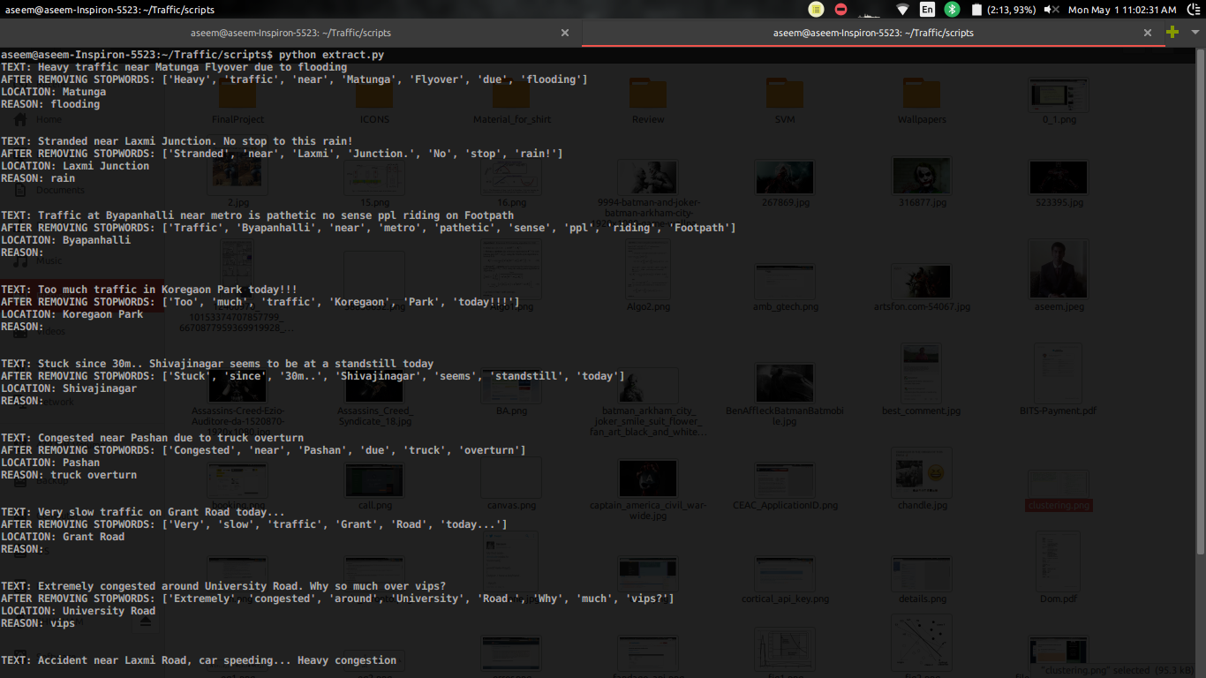
Solution - Code

Slide 29
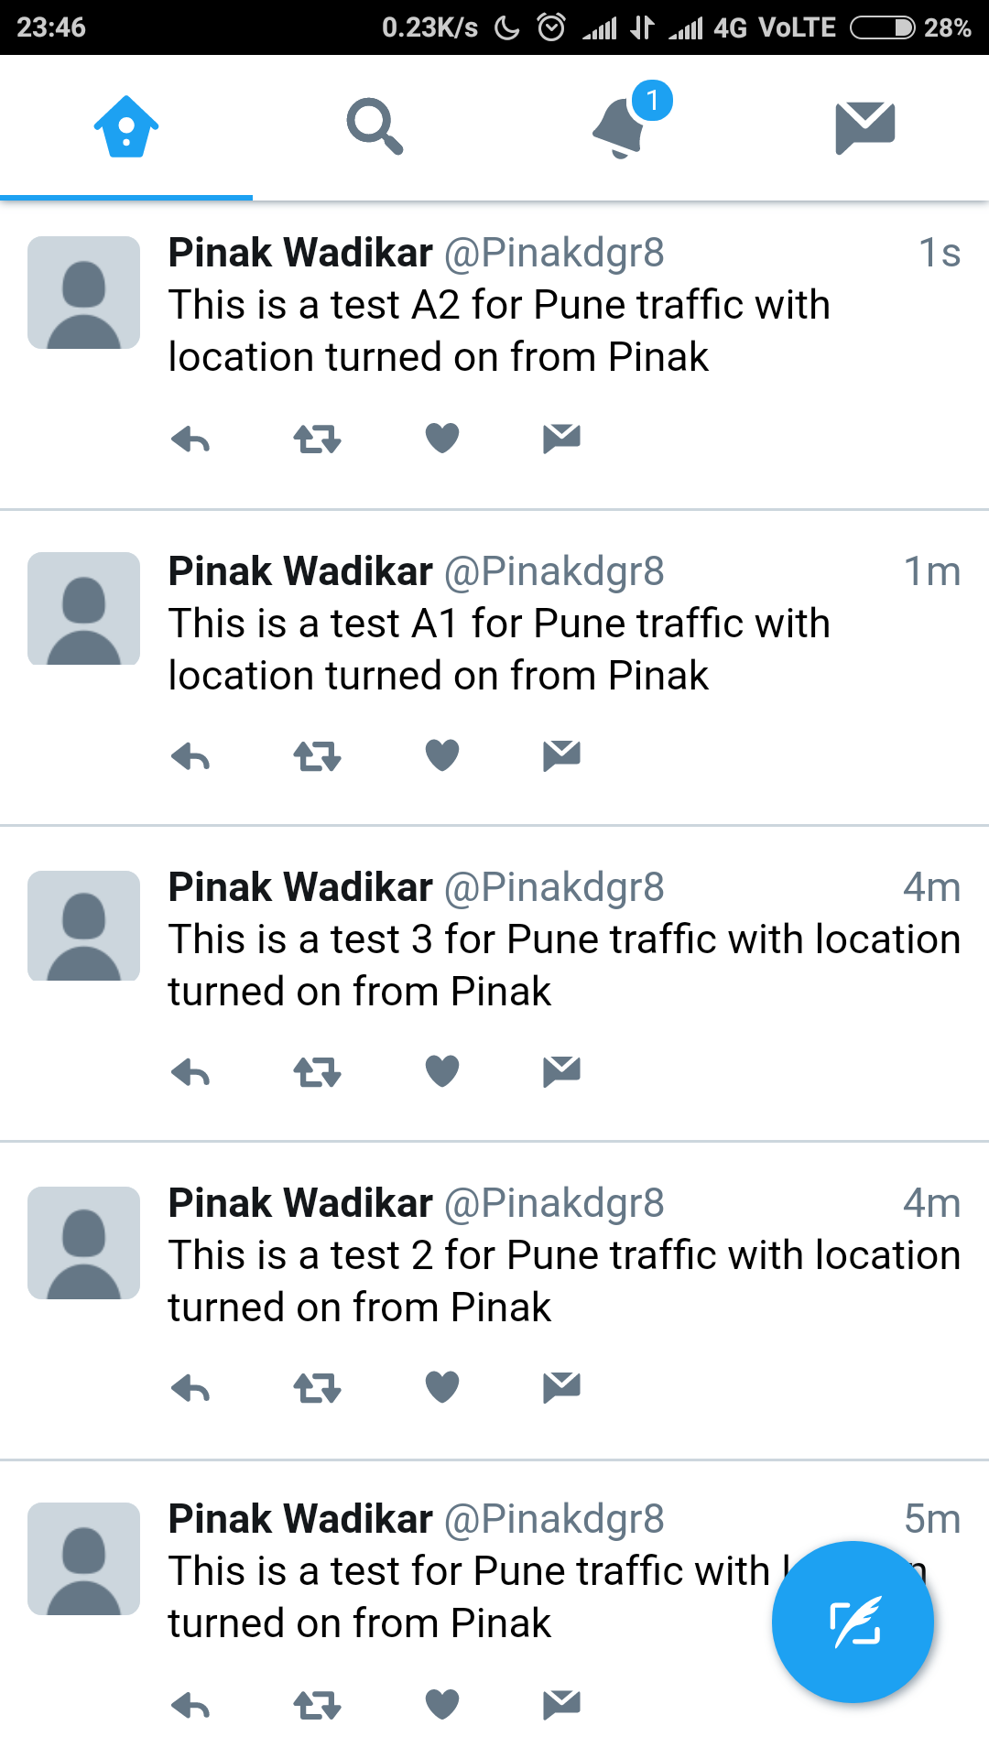
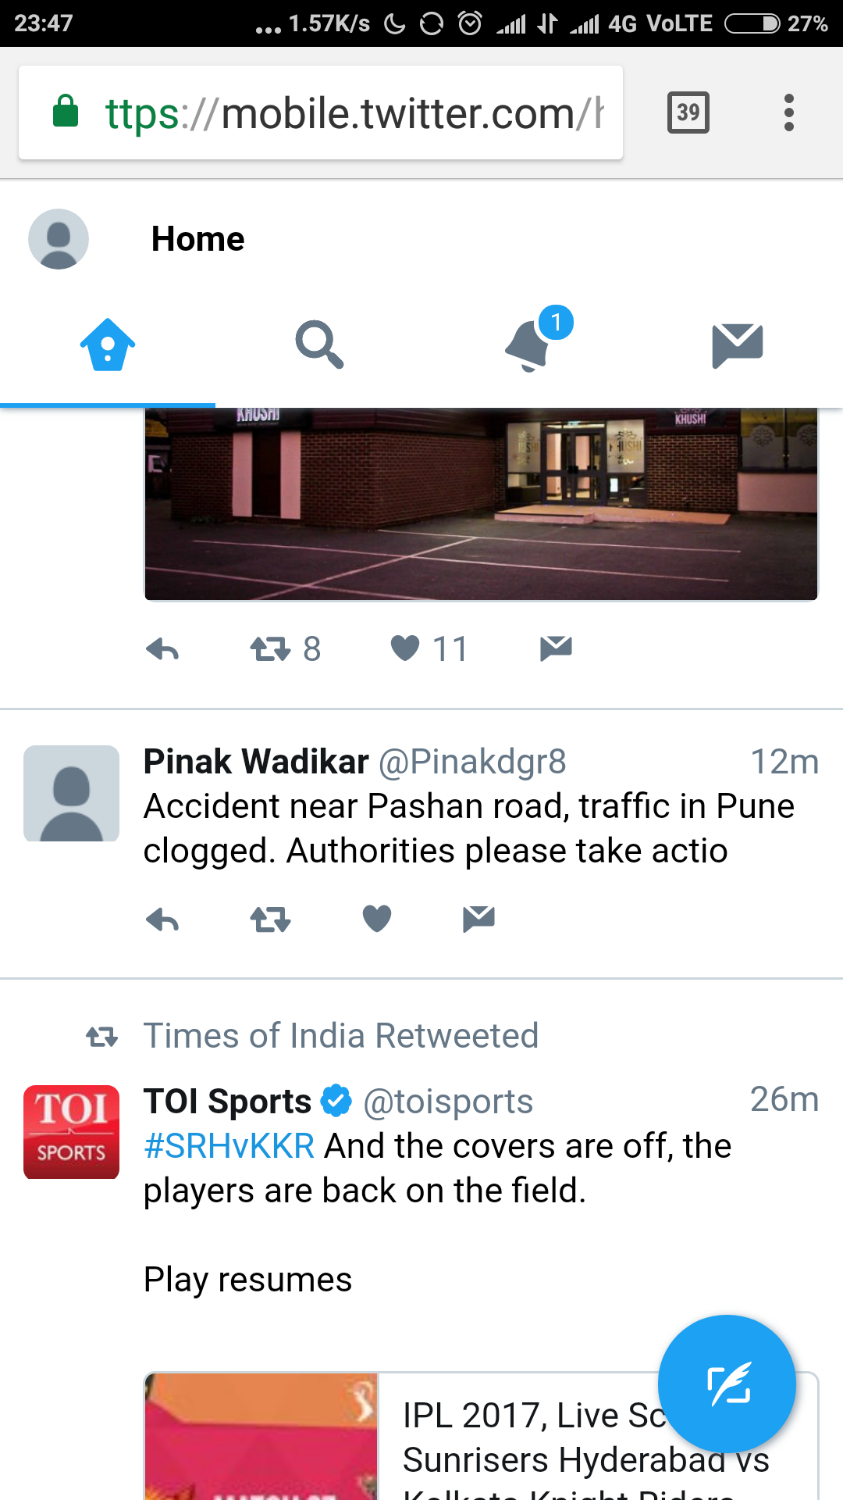
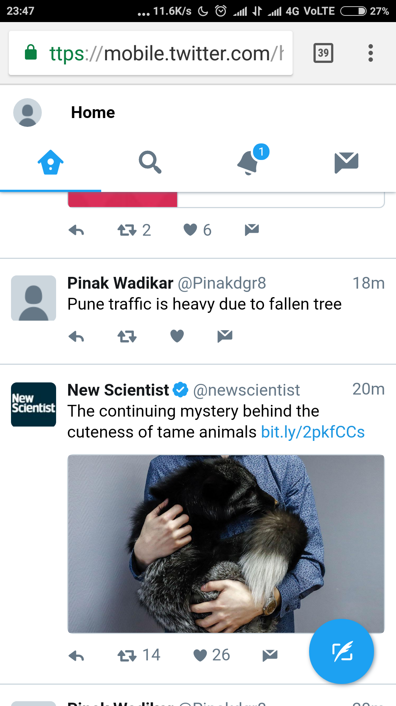

Slide 30
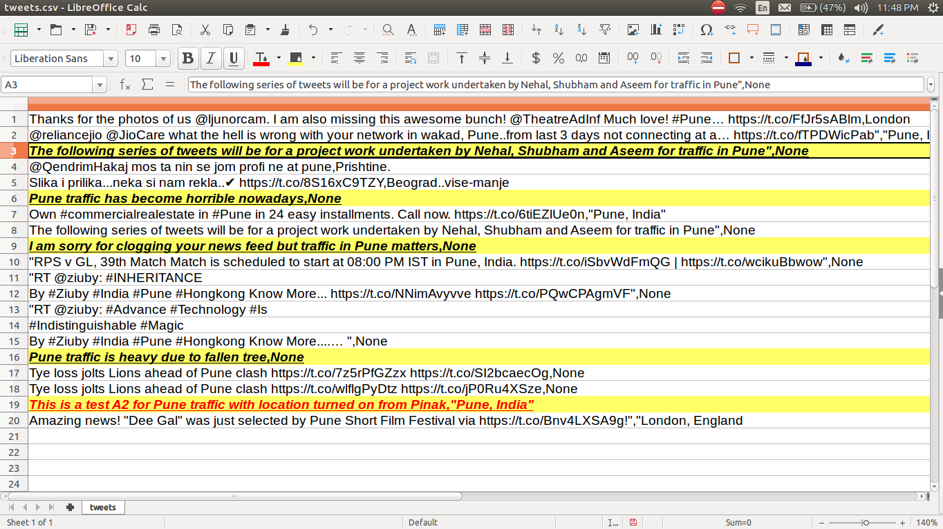

Slide 31
Solution - Webapp
DEMO ON SCREEN

Slide 32
Team
Pinak Wadikar Shubham Bidkar
Pune Institute of Computer Technology Pune Institute of Computer Technology
Interests : Core electronics, Robotics Interests : Analog electronics, Robotics
Nehal Borole Aseem Raina
Pune Institute of Computer Technology Pune Institute of Computer Technology
Interests : Algorithms, Data Structures, Robotics Interests : Data Science, Algorithms, Robotics

