Slide 1


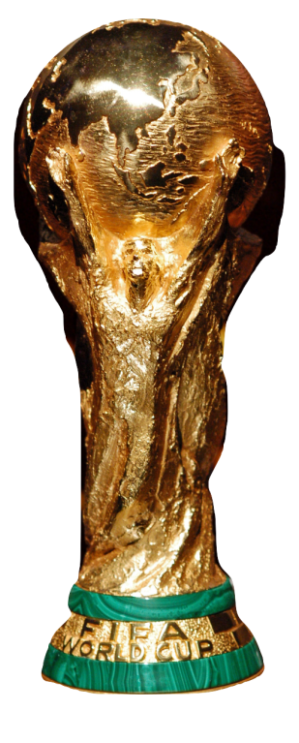


CROATIA
RUSSIA

Slide 2

LOS
ANGELES
PORTLAND
TIMBERS

