Slide 1
North South University
Hacknsu-04
Application name: MoveIt
Ahmed Ajmine Nehal 2013090642
Farhana Elias 2013820642

Slide 2

ABOUT MOVEIT
Database of all the routes and the Buses across the country.
An user can easily set their location and their desired destination, and it will provide them the bus information.
A system which will generate QR code for every single bus. These QR codes will be used to pay the bus fare using any mobile banking service.
A portal where any passenger can post their feedback like complaining about any Bus or bus driver or helper, also giving suggestions.
To ensure safety and security of passengers there is an alert system.

Slide 3

Features
A passenger can easily find the name of the Bus and also the Bus fare and required time to reach their desired destination. Bus routes will also be provided.
They can also find the bus stoppage or ticket counter location.
The Bus fare can be paid through a simple QR code scan.
A portal for the passengers to post any complaint or suggestion to make a better transport system.
SAFE and SECURE ride assurance. A QR code scan will give them all the information about the Bus (like Bus number, Bus name, Bus driver details), so that police can easily track the Bus and save the victim.

Slide 4
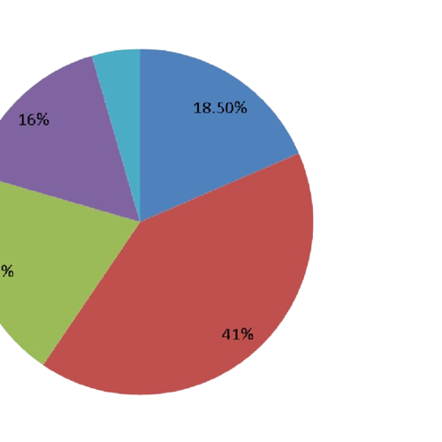
Impact of our application
It impacts our daily transportation.
it will be beneficial for hassle-less payment.
Passengers can quickly pay the money with the mobile banking service
It's also helpful for a safe ride.
It will be a better transport service for having feedback.

Slide 5
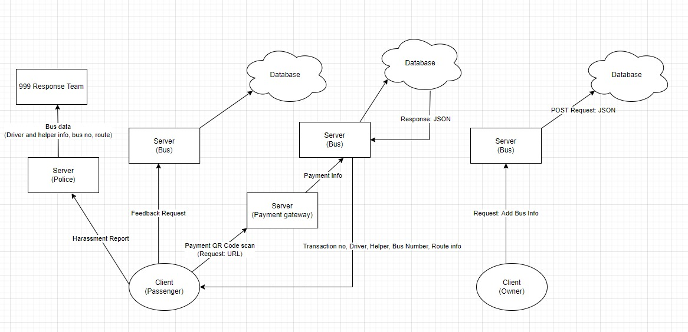
System Architecture

Slide 6









Tools and Technologies:
Frontend:
Programming Language: Java Script
Java Script Library: JQuery
Markup Language: HTML5
Style Sheet: CSS3
Framework: Bootstrap 5
Backend:
Programming Language: Java
Frameworks: Spring Boot, Spring Security, Spring Data JPA
Template Engine: Thymeleaf
Database: SQL, MySQL server

Slide 7
Prototype description:
An application with user registration and login systems
Passengers will get access to the feedback portal and payment system.
Bus owners will have access to the feedback portal and data entry system.
There is also a QR code generator for every bus. These QR codes will hold information of each bus and also it will redirect to the payment system.
There is an alert system, whenever a passenger will feel unsafe they can press the button and our server will send the bus information to the police station so police can easily track the bus and save the victim.

Slide 8
Conclusion
The problems we are solving can make the Bangladesh transport system more efficient. We are providing a hassle free payment system for the bus fares. Also, assuring safe and secure transportation. And better transport services for having feedback from the passengers. We can make our transport system more efficient using our solution. If we can get all the bus information of Bangladesh in our database we can easily make the Bangladesh transport system better, hassle free, safer.

Slide 9
Thank you.

