Slide 1
Banking database management
Damg6210: Data management database design Section 05
Neha Sarang Mehendale
NUID: 002415051
Spring 2024

Slide 2
Problem statement
Existing banking systems lack a robust database management system to efficiently handle banking operations.
Current systems lack the necessary structure and scalability to meet the growing demands of modern banking.
There is a need for a comprehensive Bank Database Management System (DBMS) to manage customer records, accounts, employee information, transactions, and loans efficiently.
The goal is to create a system that ensures data integrity, scalability, and improved efficiency for the bank's day-to-day operations.

Slide 3
Tables in the database
I have created the following tables in the database:
Branches: Store information about bank branches.
Employees: Store employee information and their association with branches.
Customers: Store customer information.
AccountTypes: Store types of accounts offered by the bank.
AccountStatus: Store status of accounts.
Accounts: Store information about customer accounts.
Transactions: Store transaction information.
Transfer: Store information about transfers between accounts.
TransactionFees: Store transaction fee information.
LoanTypes: Store types of loans offered by the bank.
Loans: Store information about customer loans.
LoanPayments: Store information about loan payments made by customers.
UserSessions: Store information about user sessions for banking transations
TransactionLogs: Store transaction logs for auditing purposes.

Slide 4
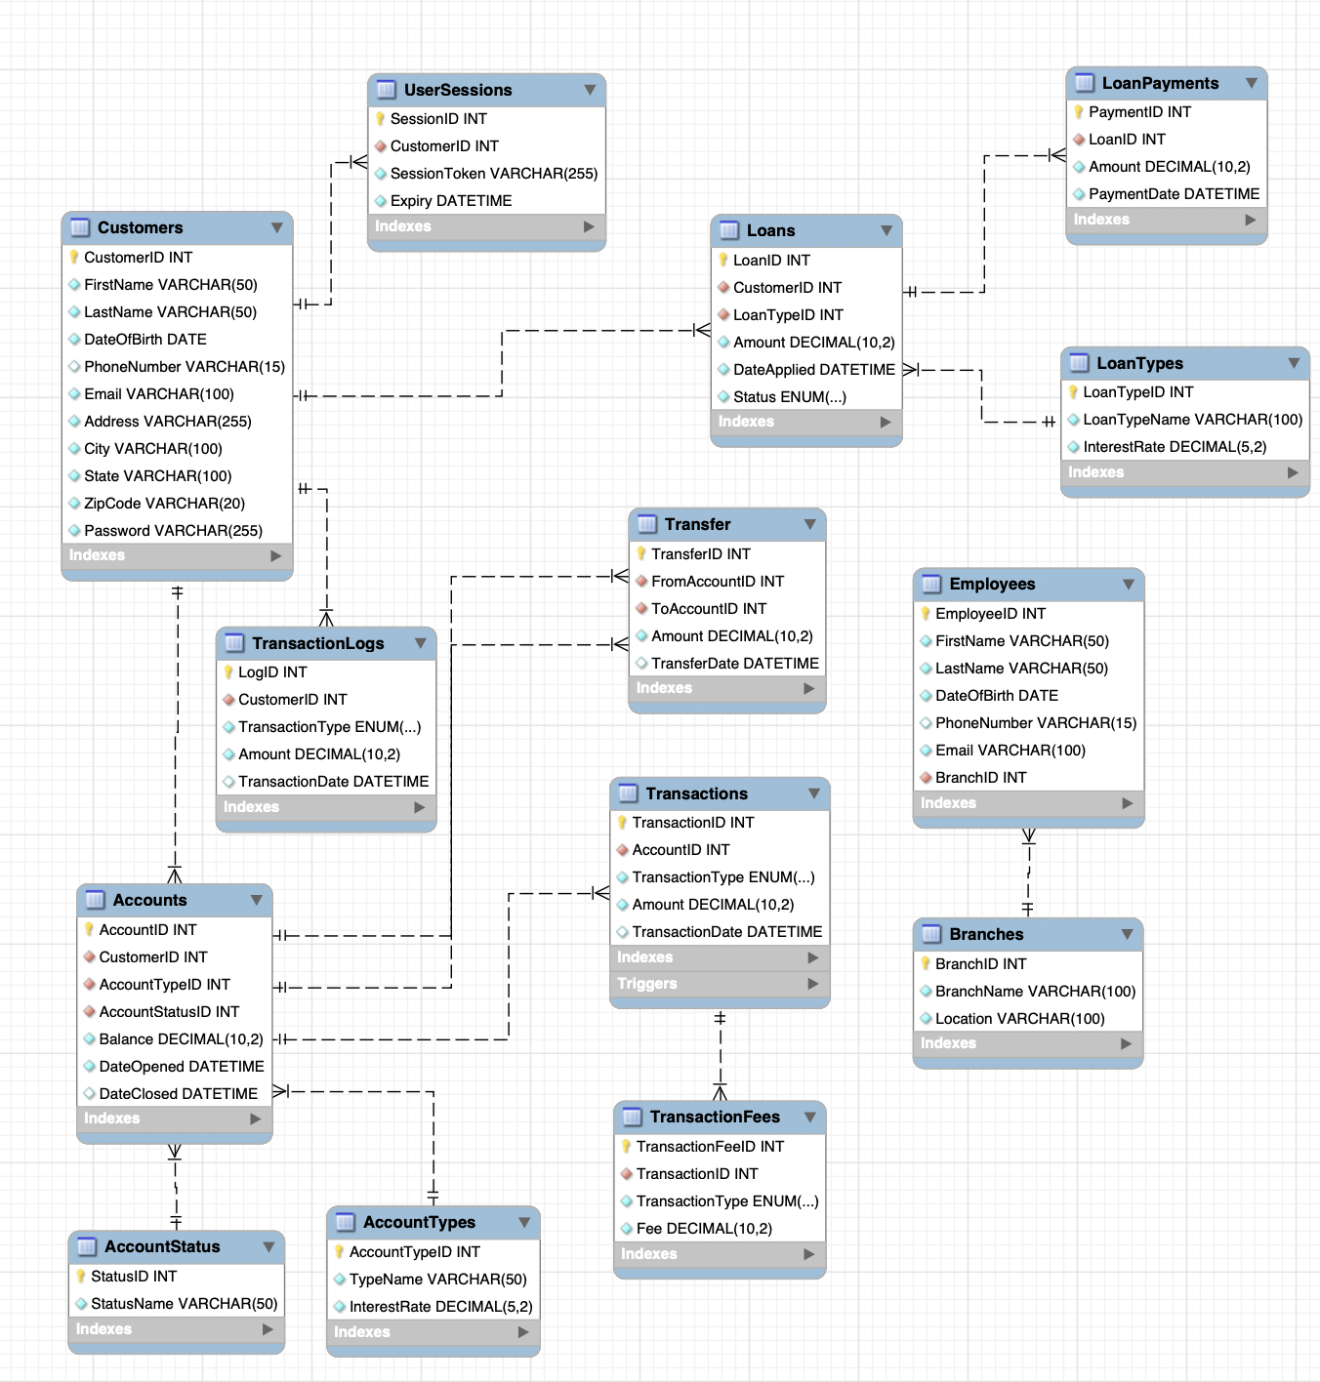
ER Diagram

Slide 5
Users of the system
Bank Employees:
Utilize the system to manage customer accounts, loans, and transactions.
Perform account management tasks such as creating new accounts, processing transactions, and managing loan applications.
Bank Customers:
Access their accounts, view transaction history, and make transactions.
Apply for loans, view loan status, and make loan payments.
System Administrators:
Manage system configurations and user privileges.
Monitor system performance, security, and database backups.
Auditors:
Review transaction logs and audit trails for compliance and regulatory purposes.
Ensure the integrity and security of the banking system.

Slide 6
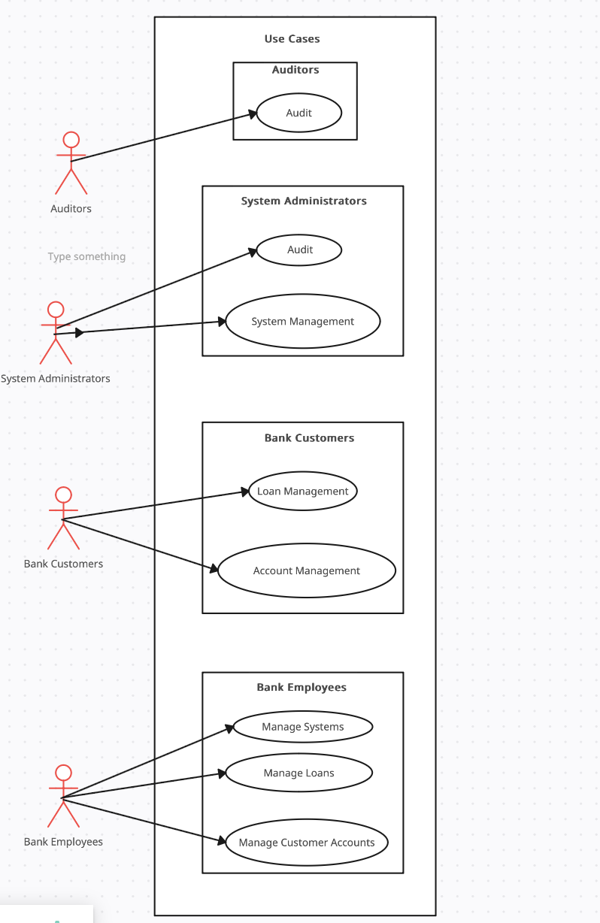
USE case Diagram

Slide 7
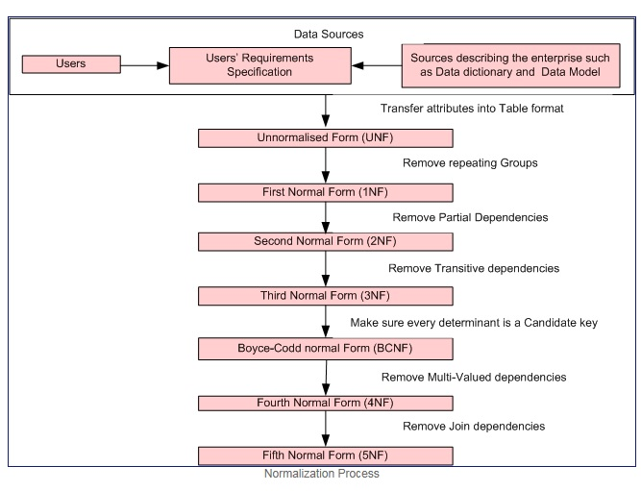
NORMALIZATION STEPS
All tables in the database are in the1st, 2nd, and 3rd Normal Forms, indicating that they are well-structured and free from data redundancy and other normalization issues.

Slide 8
CONCLUSION
The Bank Database Management System (DBMS) provides a robust platform for efficiently managing banking operations.
The system ensures data integrity, scalability, and improved efficiency for the bank's day-to-day operations.
By providing comprehensive features for managing customer accounts, loans, transactions, and employee information, the DBMS enhances the overall performance of the bank.

Slide 9
Future scope
Integration of additional features such as:
Online banking portal for customers.
Mobile banking applications for improved accessibility.
Advanced analytics for better decision-making and customer service.
Enhanced security measures to protect customer data and prevent fraud.
Integration with third-party services for expanded functionality.
Continuous system optimization and updates to adapt to the evolving needs of the banking industry.

Slide 10
Thank you

