Slide 1

Aadhaar Biometric Update Data Analysis Source: :https://www.data.gov.in/resource/aadhaar-biometric-monthly-update-data Dataset: Aadhaar Biometric Monthly Update Data Email: nehamadatha500@gmail.com
Biometric Update Dataset Analysis Using PySpark
Madatha Neha

Slide 2
Introduction
This presentation provides an analysis of the Biometric Update Data, covering:
Dataset Structure and Record Uniqueness
Age Group Distribution
Geographic Patterns across States and Districts
Monthly Registration Trends
Child-to-Adult Ratios
Population Targeting Insights
Policy and Planning Implications

Slide 3
Initial Analysis of the Dataset
The dataset contains detailed records of biometric registrations across various states and districts in India, spanning the months March to July 2025. The key columns include Date, State, District, Pincode, Bio_age_5_17, and Bio_age_17+. There are over 100,000 rows, with each representing a unique registration record for a specific district on a given date. Data completeness is strong, with minimal missing values, ensuring reliability for further exploration.
1. Structure and Uniqueness
The dataset comprises individual biometric registration events described by categorical and numerical features. Each row represents a unique record for a district on a specific date. States and districts are well represented, capturing a broad overview of biometric update activity. Columns are clearly defined, with unique values for districts, states, and pincodes, enabling accurate aggregation and analysis.
2. Age Group Distribution
Registrations are divided into two primary age groups: children (5–17 years) and adults (17+ years). Adults consistently account for the majority of the total population, while children make up a smaller but significant portion. Understanding this distribution helps identify districts with higher proportions of children or adults, which can inform targeted registration drives and demographic insights.

Slide 4
Initial Analysis of the Dataset
3. State-wise Representation
Records cover all major states and their districts, including Maharashtra, Bihar, Madhya Pradesh, Jharkhand, and others. Total biometric registrations differ by state and district, with some areas showing significantly higher update counts. This geographic diversity is essential for planning targeted registration drives and resource allocation for biometric services.
4. Age Group Trends
The dataset reveals differences in registration patterns between children (5–17 years) and adults (17+ years). Some districts show higher proportions of children, while others are dominated by adult registrations. These trends help in designing age-specific outreach programs and monitoring demographic coverage effectively.

Slide 5
Initial Analysis of the Dataset
5. Registration Severity Insights
Biometric registration counts per district vary widely, with some districts recording very high numbers while others have lower participation. Analyzing these numeric features allows assessment of coverage gaps and highlights areas that may need additional registration drives or awareness campaigns.
6. Monthly Trends
Analysis shows changes in registration activity from March to July, with certain months experiencing higher updates. These trends help identify seasonal patterns, plan resource allocation, and optimize outreach strategies for efficient biometric data collection.

Slide 6
Initial Analysis of the Dataset
7. Key Relationships
Age Group vs. Registration Count: Districts with higher adult populations (17+) generally show higher overall registration counts, but some districts have unusually high child (5–17) registrations.
State vs. Registration Volume: States like Maharashtra, Bihar, and Madhya Pradesh consistently record the highest total registrations.
District vs. Child-to-Adult Ratio: Certain districts show a higher proportion of children compared to adults, indicating areas where targeted outreach may be needed.

Slide 7
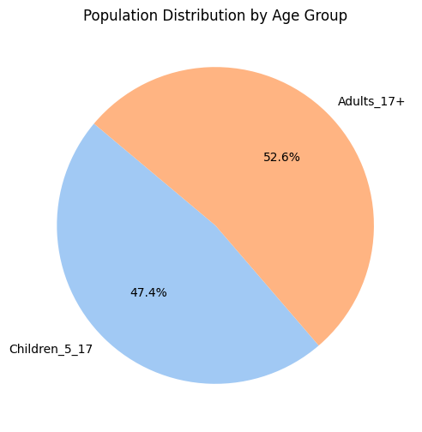
Population Distribution by Age Group
Adults (17+) slightly outnumber children (5–17), forming about 53% of the total population.

Slide 8
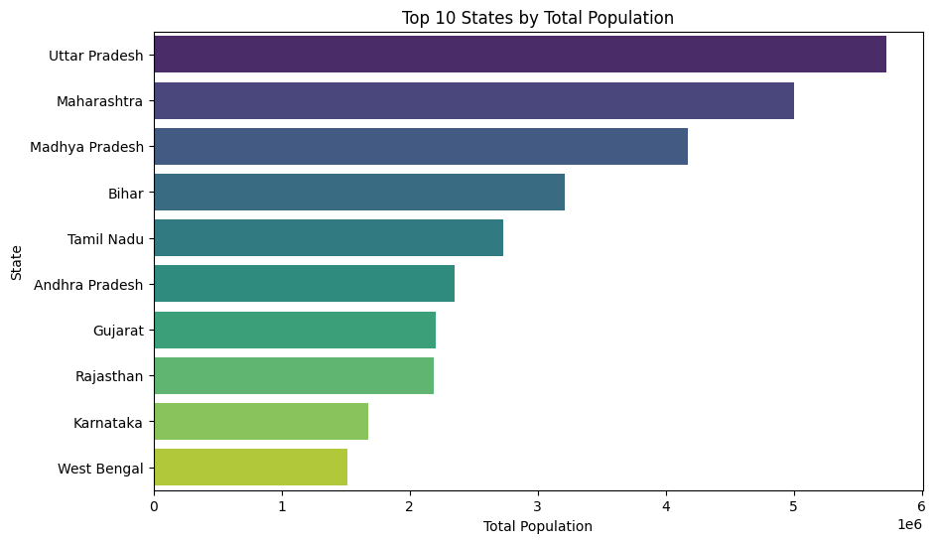
Top 10 States by Total Population
States like Maharashtra, Bihar, Madhya Pradesh, Uttar Pradesh, and West Bengal rank highest in total population, contributing the majority share of biometric registrations.

Slide 9
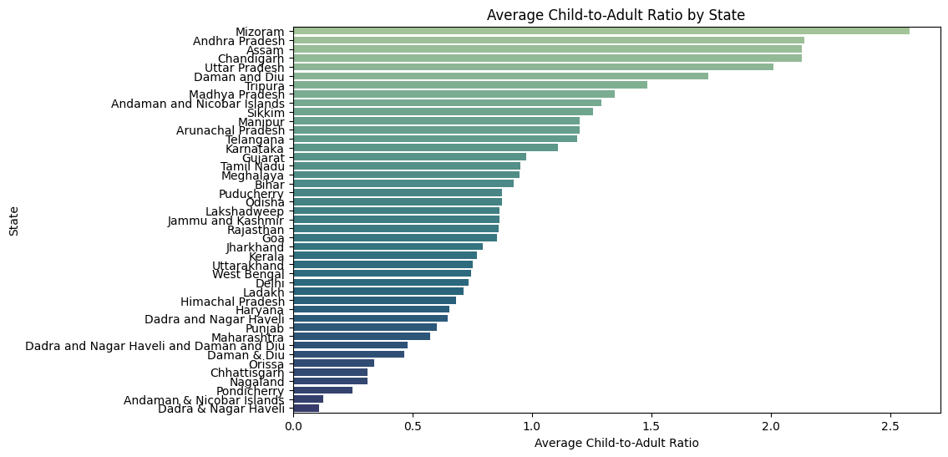
Average Child-to-Adult ratio by State
The ratio varies across states, with some states showing a higher proportion of children relative to adults, indicating younger population clusters.

Slide 10
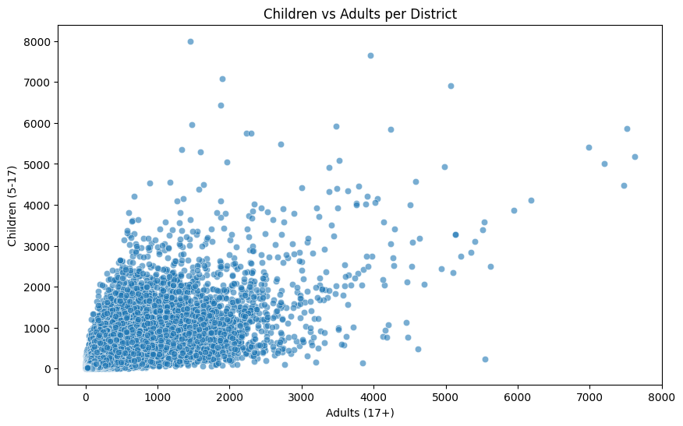
Children vs Adults per District
The scatter plot shows that most districts have higher numbers of children where there are more adults, but there is significant variation. This suggests the need for resource allocation and policies that address districts with both high and low child-to-adult ratios.

Slide 11
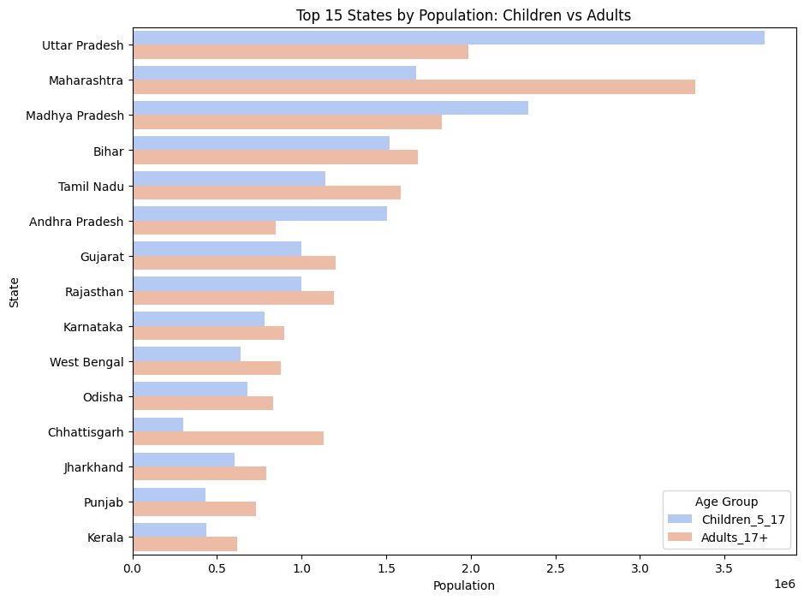
Top 15 States by Population: Children vs Adults
The chart shows that states with large populations have significant numbers of both children and adults. This indicates that both age groups need attention from policies and services.

Slide 12
Dataset Observation
Population Count Distribution: The number of individuals in each age group varies across districts, with most districts having moderate population counts for both children and adults.
High Population Districts: Districts with exceptionally high populations are less frequent but represent significant demographic weight and require focused attention.
Child-to-Adult Ratio Insights: While most districts have a balanced child-to-adult ratio, some show higher child populations, indicating areas needing targeted services for youth.
Population Severity & Resource Implications: The variation in population counts and ratios across districts suggests differing resource and infrastructure needs, from minor adjustments in smaller districts to substantial planning in high-population areas.

Slide 13
Conclusion
The Biometric Update dataset reveals significant demographic patterns, with adults (17+) forming the majority population across states. District-level variations highlight areas with higher child populations and differing child-to-adult ratios. This data provides critical insights for planning targeted services, resource allocation, and demographic monitoring to support effective governance and developmental initiatives.

