Slide 1

DATA ANALYSIS ON
INDIAN GOVERNMENT DATASET
DISTRICT-WISE TELE-LAW CASE REGISTRATION AND ADVICE ENABLED DATA FROM FY 2021-22 TO 2024-25
M. NEHA
2211CS010331
GROUP 4

Slide 2
CONTENT
Introduction
About the Dataset
Steps in the Research Process
Analyzing and Interpreting Data
Steps Involved in Data Analysis
Problems Identified in the Dataset
Data Visualization
Insights & Key Findings
Conclusion & Recommendations

Slide 3
INTRODUCTION
The Tele-Law program is an initiative by the Government of India to provide legal aid services to citizens, especially those in rural and marginalized communities, through Common Service Centers (CSCs). The program aims to ensure that justice is accessible and affordable for all by connecting individuals with legal experts via digital platforms.
This dataset provides district-wise details of case registrations and legal advice provided under the Tele-Law initiative from FY 2021-22 to 2024-25. It includes:
State-wise and district-wise case distribution
Gender-based and caste-based legal aid trends
Impact of CSCs on case registration volume

Slide 4
ABOUT THE DATASET
The dataset provides district-wise data on Tele-Law case registrations and advice-enabled services across Indian states and Union Territories (UTs) from FY 2021-22 to 2024-25.
Key Attributes:
Case Registration Details: Number of cases registered under the Tele-Law initiative.
Advice Enabled Services: Number of cases that received legal advice.
Geographical Distribution: State, district, and UT-based classifications.
Time Frame: Data spans multiple financial years to track trends.
Beneficiary Analysis: Identifying impacted communities and regions.
This dataset is crucial for evaluating the impact of legal aid services, identifying gaps in implementation, and suggesting improvements in policy-making.

Slide 5
STEPS IN RESEARCH PROCESS
The research process follows a structured approach:
Identifying the Research Problem:
Understanding accessibility and effectiveness of Tele-Law services.
Evaluating growth trends and service efficiency.
Literature Review:
Previous studies on Tele-Law effectiveness and government legal aid policies.
Reports from legal aid committees and non-profit organizations.
Defining Objectives & Hypotheses:
Identifying states/districts with highest and lowest adoption rates.
Assessing correlation between case registration and successful legal aid.

Slide 6
STEPS IN RESEARCH PROCESS
4.Selecting Research Methods & Tools:
Statistical analysis, visualization techniques, and data mining.
Tools: Python libraries such as pandas, NumPy, seaborn, and Matplotlib.
5.Data Collection:
The dataset from official government Tele-Law reports.
6.Analyzing & Interpreting Data:
Handling missing values, conducting Exploratory Data Analysis (EDA).
Identifying patterns, trends, and anomalies.

Slide 7
ANALYZING AND INTERPRETING DATA
Exploratory Data Analysis (EDA):
Used descriptive statistics to summarize case registration trends.
Histograms, box plots, and scatter plots to visualize distributions.
Missing Data Treatment:
Addressed missing values in critical fields such as district names, case numbers, and legal advice counts.
Standardization & Cleaning:
Corrected inconsistencies in categorical fields (state/district names).
Converted numerical fields to appropriate data types.
Duplicate Record Check:
Verified and removed redundant case records.
Outlier Detection:
Used box plots and statistical methods to identify anomalies in case counts.

Slide 8
PROBLEMS IDENTIFIED IN THE DATASET
The Tele-Law dataset contains certain data quality challenges:
Missing Values:
Some district-level records have incomplete case registration details.
Certain legal aid counts are not documented for specific years.
Inconsistent Data Types:
Some numerical attributes (e.g., case counts) stored as strings.
Data Standardization Issues:
Inconsistencies in state and district naming conventions.
Potential Duplicates:
Cases with similar IDs were detected, requiring further validation.

Slide 9
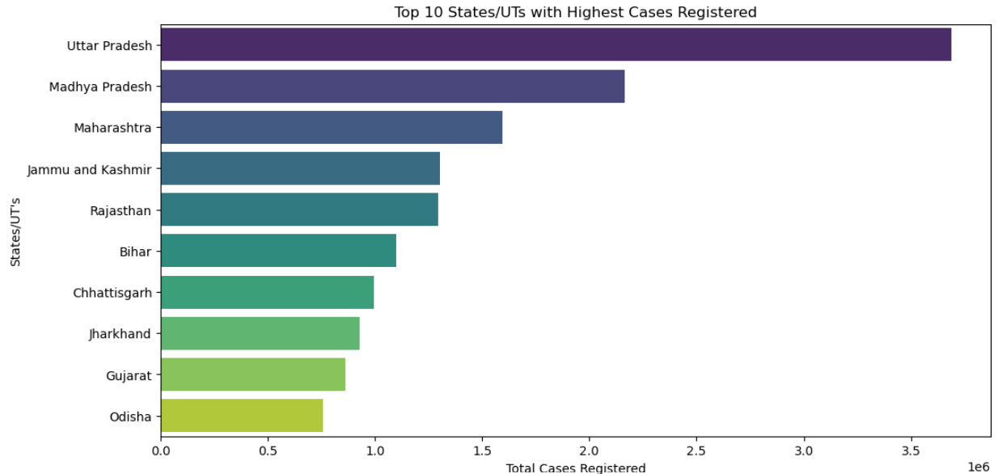
DATA VISUALIZATION
The top 10 districts with the highest registered cases were identified.
The highest case registrations were observed in districts with a higher number of CSCs.
This analysis helps in identifying high-demand regions for legal aid services.

Slide 10
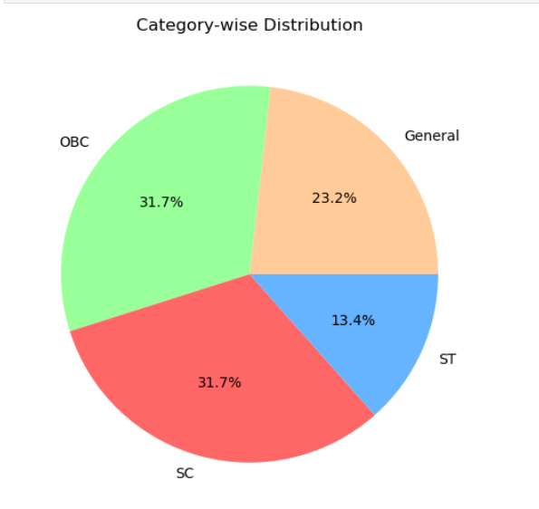
DATA VISUALIZATION
The distribution of case registrations among General, OBC, SC, and ST categories was analyzed.
The distribution of case registrations among General, OBC, SC, and ST categories was analyzed. It helps in understanding the reach of Tele-Law services among marginalized communities.

Slide 11
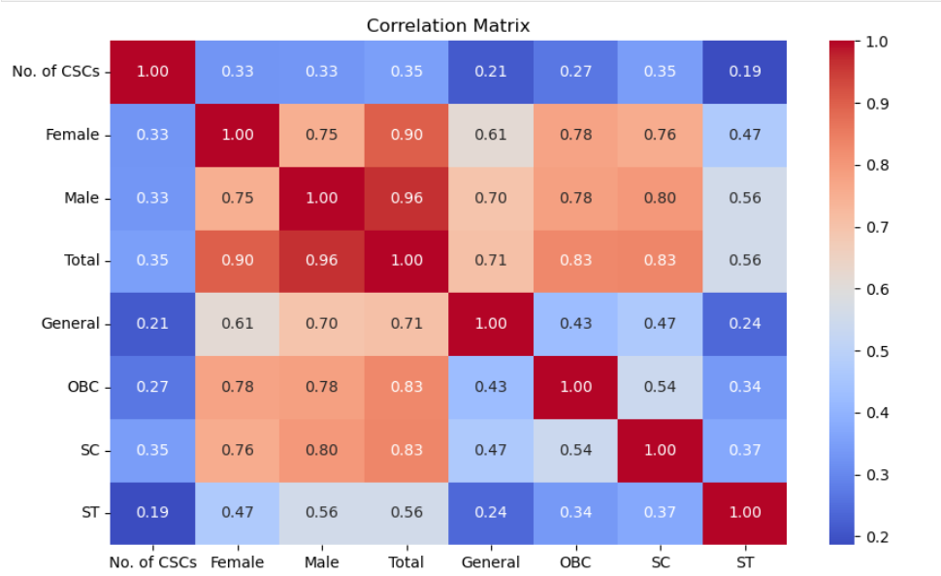
DATA VISUALIZATION
Correlation Analysis using Heatmap
The correlation matrix reveals a strong relationship between gender-wise case registrations but a weak correlation between the number of CSCs and total registrations.

Slide 12
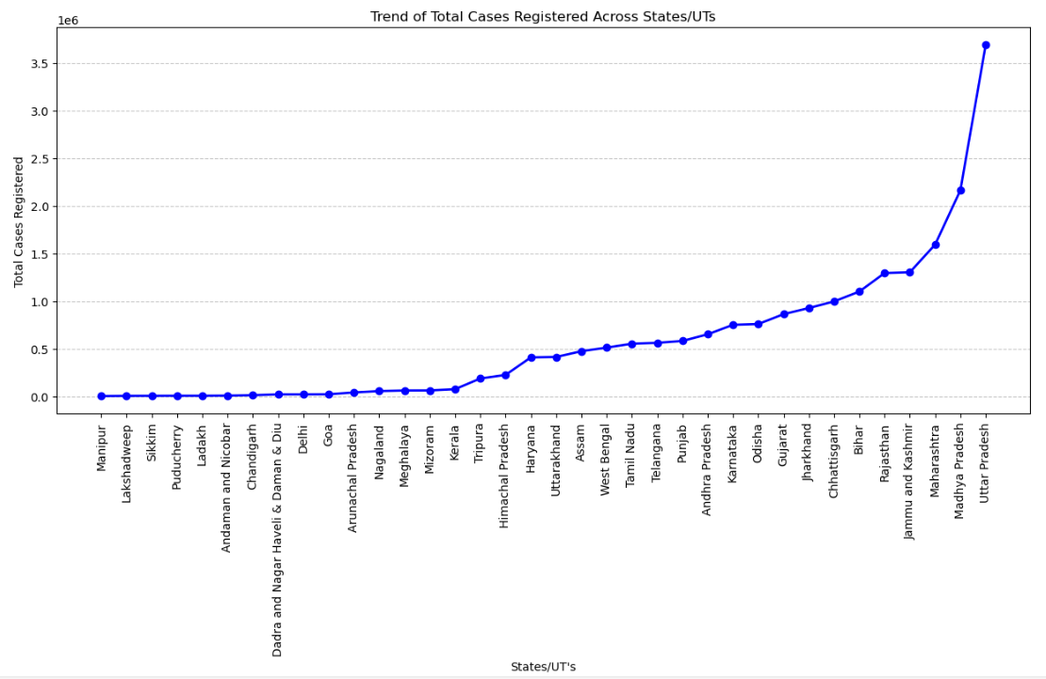
DATA VISUALIZATION
Uttar Pradesh has the highest number of total registered cases, with a steep rise compared to other states/UTs.

Slide 13
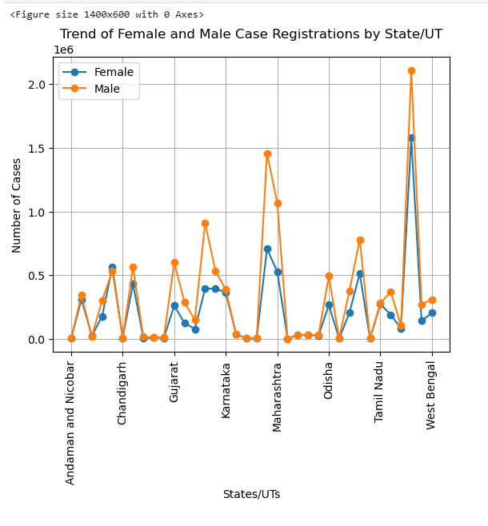
DATA VISUALIZATION
Male case registrations generally surpass female case registrations across most states/UTs, with significant peaks in Maharashtra and Tamil Nadu.

Slide 14
INSIGHTS & KEY FINDINGS
Districts with the highest number of cases tend to have a higher number of CSCs.
The number of registered cases varies significantly across states and districts.
Gender and caste-based analysis highlight accessibility and inclusivity of Tele-Law services.

Slide 15
CONCLUSION & RECOMMENDATIONS
The Tele-Law program has been effective in reaching various communities.
More CSCs can be established in low-coverage areas to enhance accessibility.
Awareness programs can help increase female participation in legal aid services.

