Slide 1
Restaurant Booking System
Experience culinary excellence. Reserve your table and indulge in an unforgettable dining experience crafted with passion.

Slide 2
Project Objective
Design and implement a Restaurant Booking System
Allow customers to book tables, make payments, generate bills, and receive receipts
Provide a simple and user-friendly interface

Slide 3
Project Description
Manage table reservations efficiently
View available tables and book a table
Select payment method and calculate total bill including GST
Generate receipt after booking
Suitable for small restaurants and academic mini projects

Slide 4
Functional Requirements: Table Management
Total tables: 5 (Table 1 to Table 5)
Show available and booked tables
Prevent double booking

Slide 5
Functional Requirements: Booking Module
Input customer name
Select table number
Generate unique booking ID
Store booking details

Slide 6
Functional Requirements: Billing Module
Base amount per table: ₹500
GST: 5%
Automatically calculate Base Amount, GST Amount, and Total Amount

Slide 7
Functional Requirements: Payment Module
Payment methods: Cash, Card, UPI
Payment status: Paid (simulation only)

Slide 8
Functional Requirements: Receipt Generation
Display receipt after successful booking
Include restaurant name, booking ID, customer name, table number, amounts, payment method and status
Options to print or download receipt

Slide 9
Functional Requirements: Booking Management
View all bookings
Cancel booking and free table
Simple admin control (no authentication)

Slide 10
Book Table Page
Customer name input
Table selection dropdown
Payment method selection
Bill summary display
Confirm booking button

Slide 11
Receipt Page
Receipt card layout
Print and download options

Slide 12
View Bookings Page
Booking details in table format
Cancel booking option

Slide 13
Technologies Used
Frontend: HTML, CSS, JavaScript
Backend: Python
Payment: Simulation only

Slide 14
User Interface Design
Clean and simple layout
Responsive design
Card-based UI
Color indicators: Green (Available), Red (Booked)

Slide 15
Validation & Error Handling
Mandatory customer name
Prevent booking of already reserved tables
Display success and error messages

Slide 16
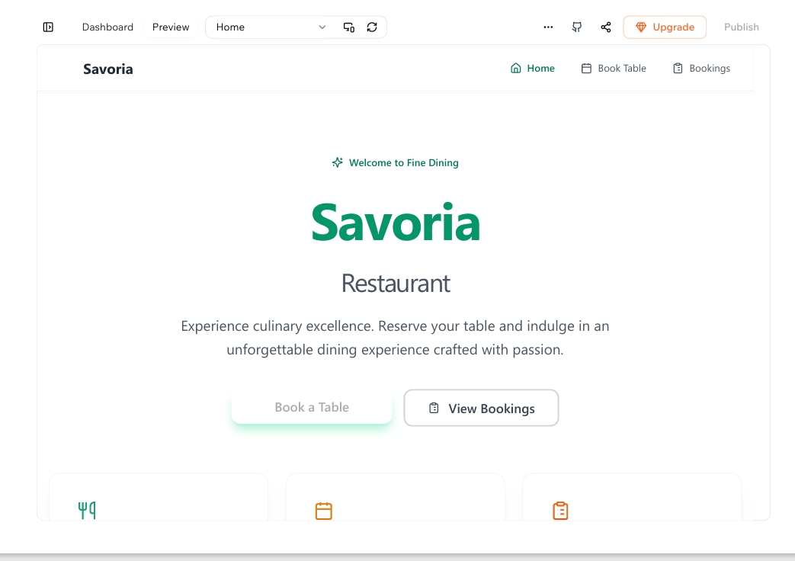

Slide 17
Expected Output
Successful table booking
Automatic bill calculation
Receipt generation
Booking management

Slide 18
Conclusion
Demonstrates use of basic programming concepts
Practical understanding of real-world booking systems
Ideal for academic mini project submission

Slide 19
THANK YOU

