Slide 1

S7 PROJECT MID REVIEW
Causal Consistency as a Defense: Detecting Provenance Graph Poisoning
Github: https://github.com/nehamanoj1105/causal-provenance-tamper-detection
Guided by: Devi Rajeev
Neha Manoj - AM.SC.U4CYS23030

Slide 2


Outline
  Introduction
  Problem Definition
  Literature Review Summary
  Research Gap
  Methodology
  Design/ Architecture
  Algorithms (if any)
  Result Analysis.
  Project Time Line (Plan)
  Reference
2
Causal Provenance Graph Tamper Detection

Slide 3
INTRODUCTION
  Provenance graphs record a system's audit trail nodes are processes, files, and network sockets; edges are the reads, writes, spawns, and connects between them. It's the primary evidence used to reconstruct what happened during an attack.
  Provenance-based intrusion detection (PIDS) assumes this graph is trustworthy but once an attacker has privileged access, the graph itself can be edited: events deleted, forged, reordered, or reattached to fake dependencies.
  This project treats that as a separate problem from intrusion detection: verify the integrity of the evidence itself, before any downstream detector consumes it.
  Approach: 15 deterministic causal/semantic OS invariants (a rule engine), benchmarked head-to-head against a GraphSAGE GNN baseline on synthetic graphs and real DARPA Transparent Computing (TC E3) audit data.
3

Slide 4
Problem Definition
Motivation
    Forensic reconstruction, root-cause analysis, and every ML-based provenance detector all assume the provenance graph is ground truth an assumption never tested against an adversary with write access to the log.
Problem Statement
    Given a provenance graph that may have been tampered with (edge deletion, insertion, reordering, or dependency forgery possibly hidden further with mimicry noise), can we flag exactly which edges are inconsistent with valid OS causal/semantic behavior?
Objectives
    Formalize the OS-level causal and semantic invariants a genuine provenance graph must satisfy
    Build a deterministic rule engine that scores invariant violations, and compare it against a learned GraphSAGE baseline
    Evaluate both on synthetic poisoning and real DARPA TC E3 traces, under mimicry noise and at scale (up to 1,000,000 edges)
4

Slide 5
Literature Review Summary
Year | Approach | Key Contribution | Demerit | Dataset | Metric
2020 | Unicorn [22] | Graph-kernel embeddings summarize whole-system provenance for real-time APT detection | Graph-level detection is coarse; hard to localize root cause within thousands of events | DARPA TC | Detection / similarity score
2022 | ThreaTrace [20] | Node-level GNN classification for finer-grained host threat tracing | Still trusts the input graph; vulnerable to neighborhood-mimicry camouflage | DARPA TC | Precision / Recall / F1
2023 | Mimicry study [5] | Formalized adversarial mimicry attacks against GNN-based provenance detectors | Showed close to 100% detection evasion by diluting node embeddings with benign noise | DARPA TC | Detection evasion rate
2024 | FLASH [6] | Sequence + graph representation learning for provenance intrusion detection | Representation learning is a black box; no per-edge violation explanation | DARPA TC E3 | F1 / Precision-Recall
2024 | Kairos [4] | Practical whole-system provenance intrusion detection & investigation | Assumes the provenance graph handed to it is already untampered | DARPA TC E3 | F1, false-positive rate
2025 | ProvX [16] | Counterfactual subgraph explanations for a GNN's malicious prediction | Explains the detector's decision, not whether the input graph was tampered with | DARPA TC | Explanation fidelity
2025–26 | Causal Rule Engine (ours) | 15 deterministic causal/semantic OS invariants; explainable per-edge violation score | Cannot catch an attack that preserves every one of the 15 invariants | Synthetic + DARPA TC E3 | Precision/Recall/F1/ROC-AUC, runtime & memory
5

Slide 6
Research Gap
  Rule/specification systems (Holmes, Sleuth, Poirot, RapSheet) need constant manual upkeep and can't generalize to new attacks, and none of them ask whether the log they're checking is itself intact.
  Statistical detectors (NoDoze, PrioTracker, ProvDetector) look at shallow topological signals and inherit high false-positive rates from benign-but-rare system behavior.
  GNN-based detectors (Unicorn, FLASH, ThreaTrace, MAGIC, ShadeWatcher) learn what “normal” looks like from neighborhood embeddings exactly what an adversary exploits: mimicry noise dilutes those embeddings, with NDSS’23 work showing close to 100% detection evasion.
  Every one of these systems: rule-based, statistical, or learned, assumes the provenance graph handed to it is already trustworthy. None verify that its causal structure (who spawned what, what read/wrote what, in what order) is still internally consistent.
  Gap: a deterministic, explainable layer that checks provenance graph integrity itself, before any downstream detector consumes it, and that keeps working even when mimicry noise breaks GNN-based approaches.
6

Slide 7
Methodology
Category | Details
Datasets | DARPA TC Engagement 3 : TRACE (1r), CADETS (3), ClearScope (5m), THEIA (6r); 50,000-edge evaluation subgraphs (full scenarios range 297K–18.2M edges) + parametric synthetic graphs (80 nodes / 179 edges, seed 42)
Graph schema | Directed multigraph nodes: process / file / network socket; edges: read, write, execute, connect, spawn, delete
Detection methods | Deterministic Causal Rule Engine (15 invariants) vs. GraphSAGE baseline (2-layer, PyTorch Geometric)
Technology stack | Python 3, PyTorch + PyTorch Geometric, NetworkX, scikit-learn, pandas / NumPy, fastavro (CDM parsing)
Training config | 30 epochs, fixed seed 42, decision threshold swept 0.05–1.00 (step 0.05), τ* = 0.70
Evaluation metrics | Precision, Recall, F1, Accuracy, Specificity, FPR, ROC-AUC, PR-AUC, MCC (13 metrics total)
Scale / profiling | Runtime, RSS/peak memory, and throughput benchmarked from 10,000 up to 1,000,000 edges
Testing | 103 unit tests (pytest): CDM parsing, poisoning-injection correctness, metrics math
7

Slide 8
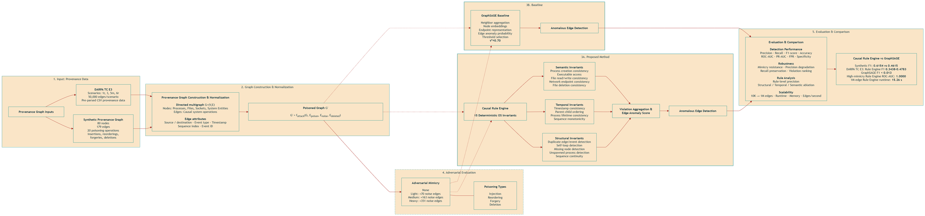
Design/ Architecture
Novelty: a deterministic, explainable integrity layer sits before any learned/GNN detector : it verifies the causal & semantic consistency of the graph itself, not just anomalous behavior.
8

Slide 9
Algorithms (if any)
Rule Engine : 15 deterministic invariants
    Structural (6): duplicate edges/events, self-loops, missing nodes, unspawned processes, sequence gaps
    Temporal (4): timestamp bounds, parent→child spawn ordering, process-activity ordering, sequence monotonicity
    Semantic (5): spawn/execute/read-write/connect/delete edges must target the right node type
    An edge is flagged anomalous if it violates ≥ 1 rule; violation score = number of rules broken
GraphSAGE baseline (learned)
    2-layer inductive GNN over node neighborhoods (PyTorch Geometric), weighted loss for class imbalance, 30 epochs, seed 42
    Decision threshold swept 0.05 → 1.00 in steps of 0.05; τ* = 0.70 chosen by best validation F1
Train / test protocol
    Clean graph = benign baseline; held-out poisoned graph (deletion, insertion, reordering, dependency forgery) with ground-truth labels = test set
9

Slide 10
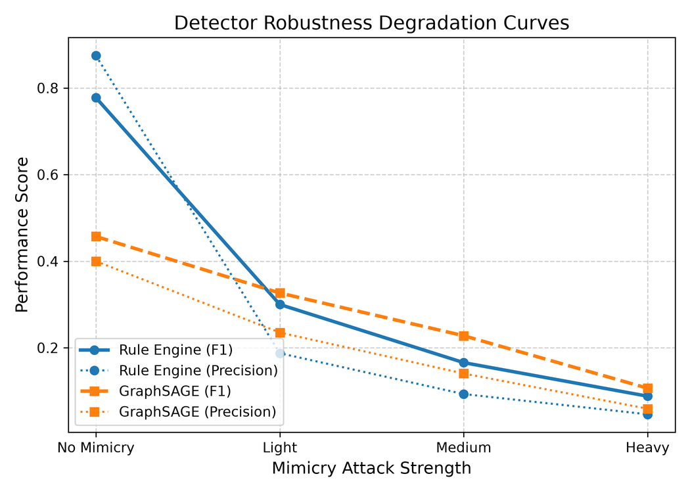
Result Analysis
Benchmark | Detector | Prec. | Recall | F1
Synthetic | Rule Engine | 0.7273 | 0.5333 | 0.6154
Synthetic | GraphSAGE (default) | 0.5455 | 0.4000 | 0.4615
Synthetic | GraphSAGE (τ*=0.70) | 0.7000 | 0.4667 | 0.5600
DARPA TC E3 (4 scen. avg) | Rule Engine | 0.25–0.53 | 0.40–0.60 | 0.34–0.48
DARPA TC E3 (4 scen. avg) | GraphSAGE | 0.002–0.007 | 0.27–0.53 | 0.003–0.013
Heavy mimicry (synthetic) | Rule Engine | 0.0464 | 0.9000 | 0.0882
Heavy mimicry (synthetic) | GraphSAGE | 0.0593 | 0.5333 | 0.1067
Both detectors degrade under mimicry : Rule Engine keeps its edge
ROC-AUC stays 1.0000 for the Rule Engine even under heavy mimicry; scales to 1M edges in 15.26s / 364 MB.
10

Slide 11
Project Time Line (Plan)
Current Status
    Provenance graph pipeline complete end-to-end (schema, CDM parser, synthetic + DARPA TC E3 loader)
    15-rule causal/semantic rule engine and GraphSAGE (PyTorch Geometric) baseline both implemented and evaluated
    Full evaluation suite done: synthetic benchmark, 4-scenario DARPA cross-dataset comparison, rule ablation, adversarial-mimicry robustness, scalability to 1,000,000 edges
    103 unit tests passing; results written up as a conference paper (ICMLDE / Procedia Computer Science)
Future Plan
    Wire up raw binary CDM (.bin) ingestion so the parser runs on real Theia log files, not just pre-parsed CSVs
    Explore a joint hybrid inference mode that combines GraphSAGE embeddings with rule-violation scores
    Feed this module into the larger a provenance-integrity system (post-quantum signing + Merkle anchoring).
11

Slide 12
Reference
  [1] A. Goyal, G. Wang, A. Bates, “R-CAID: Embedding Root Cause Analysis within Provenance-Based Intrusion Detection,” IEEE S&P, 2024.
  [4] Z. Cheng et al., “Kairos: Practical Intrusion Detection and Investigation using Whole-System Provenance,” IEEE S&P, 2024.
  [5] A. Goyal, X. Han, G. Wang, A. Bates, “Mimicry Attacks against Provenance Graph Host Intrusion Detection Systems,” NDSS, 2023.
  [6] M. U. Rehman, H. Ahmadi, W. U. Hassan, “FLASH: Intrusion Detection via Provenance Graph Representation Learning,” IEEE S&P, 2024.
  [14] B. Jiang et al., “ORTHRUS: High-Quality Attribution in Provenance-Based Intrusion Detection Systems,” USENIX Security, 2025.
  [16] W. Wu et al., “ProvX: Counterfactual-Driven Attack Explanations for Provenance-Based Detection,” arXiv:2508.06073, 2025.
  [20] S. Wang et al., “ThreaTrace: Detecting and Tracing Host-Based Threats through Provenance Graph Learning,” IEEE TIFS, 2022.
  [22] X. Han, T. Pasquier, A. Bates, J. Mickens, M. Seltzer, “Unicorn: Runtime Provenance-Based Detector for APTs,” arXiv:2001.01525, 2020.
  [30] W. Hamilton, Z. Ying, J. Leskovec, “Inductive Representation Learning on Large Graphs (GraphSAGE),” NeurIPS, 2017.
  N. Manoj, D. Rajeev, “Causal Consistency as a Defense: Detecting Provenance Graph Poisoning,” ICMLDE, Procedia Computer Science, 2025.
  [32] N. Manoj, “Causal Provenance Graph Tamper Detection Framework,” GitHub repository, 2026.
12

