Slide 1
OMGT2145 Professional Logistics Practice Toll CUSTOMISED Solutions – Mars DISTRIBUTION CENTRE Group A6
Neha Mansinghka 3471739
Hanbo Guo 3440647
Han Zhang 3426650
Jiao Lei 3372523

Slide 2
INTRODUCTION
TOLL GROUP
TOLL GLOBAL LOGISTICS
CUSTOMISED SOLUTIONS
Australia & New Zealand
MARS DISTRIBUTION CENTRE
Source: Toll Annual Report 2013

Slide 3

INTRODUCTION
Mars Incorporated:
1954 2nd-Largest Confectionery
21 manufacturing sites worldwide, 5 in Australia
Relationship between Mars Inc. and Toll
Truganina DC: Customized solution for Mars Inc.
Monthly meetings for KPIs
Production plan, sales or promotions are shared
(Mars Inc.) 90KM, 5 shuttles (Toll)
Ballarat Truganina DC
(Manufacturing) (Warehouse)
Source:<http:/mars.com/global/index.aspx> viewed 26 May 2014

Slide 4
FLOW OF PRODUCTS
Raw Materials
Raw Materials
Imports & Local
Truganina
DC
Ballarat
Production Plant
Finished
Goods
Finished
Goods
Local
& Export
Truganina
DC
Ballarat
Production Plant
Source: Briefing given by Toll Customised Solutions / RMIT Visit to Mars DC - 23 May 2014

Slide 5
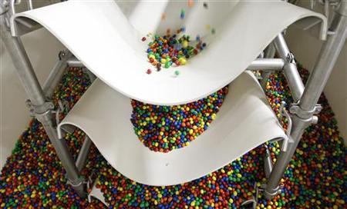
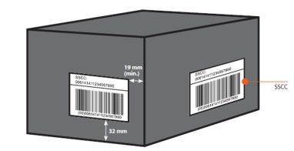
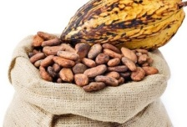


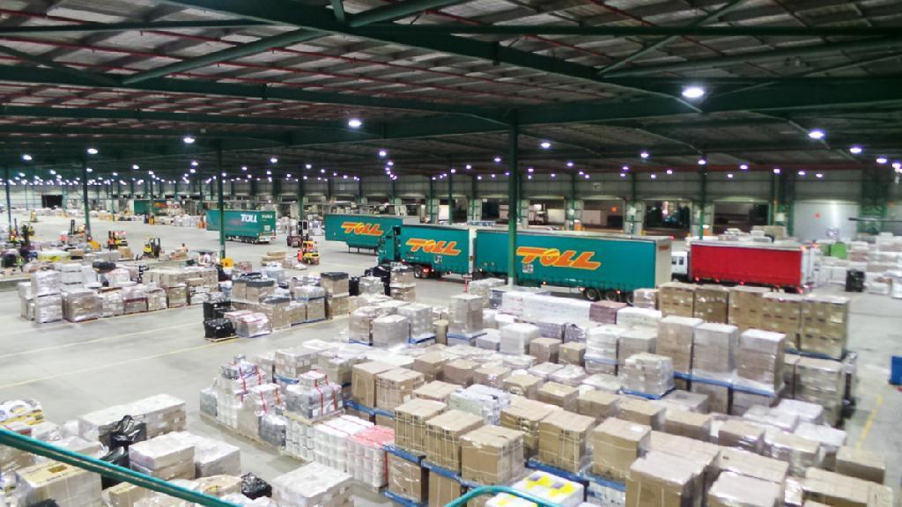
Truganina DC
Pallets & Wrapped
Overseas
Forklift
Label printer & WMS (Tolas)
Raw Warehouse
Manufacturing Plant
Raw materials
SSCC label
Ballarat
Source: Briefing given by Toll Customised Solutions / RMIT Visit to Mars DC - 23 May 2014

Slide 6
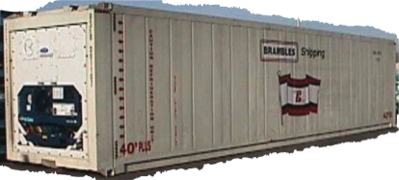
Ballarat
Manufacturing Plant
Truganina DC - Satellite Storage System
Local
Customers
Ballarat
Manufacturing Plant
Truganina DC-
Refrigerated Container
Export
Source: Briefing given by Toll Customised Solutions / RMIT Visit to Mars DC - 23 May 2014

Slide 7
TRUGANINA DC SKETCH
OTHER CLIENTS
SELECTIVE RACKING
27 Aisles
IMPORT
SATELLITE STORAGE SYSTEM
(19 degrees, 40 pallets deep)
EXPORT
UNLOADING
QUARANTINE
PICK DESK
RAWS ROOM / WAREHOUSE
BATTERY ROOM
Source: Briefing given by Toll Customised Solutions / RMIT Visit to Mars DC - 23 May 2014

Slide 8
SATELLITE STORAGE SYSTEM
http://www.youtube.com/watch?v=md3eJ8HOgs8&list=PL381D2CB5436E3042

Slide 9
TRUGANINA DC KPIs
KPIs | Wednesday |  | Thursday
 | PLANNED | ACTUAL | PLANNED | ACTUAL
Pallets Received | 500 | 590 | 500 | 587
Pallets Putaways | 400 | 594 | 400 | 566
Pallet Transfers | 0 | 21 | 0 | 54
Import 20’ container | 1 | 2 | 2 | 2
Import 40’ container | 1 | 1 | 0 | 0
RWS Plts. Despatched | 200 | 212 | 200 | 201
FG Plts. Despatched | 128 | 128 | 414 | 414
FG Cont. Plts. Despatched | 155 | 155 | 153 | 153
Export 20’ container | 0 | 0 | 0 | 0
Export 40’ container | 2 | 2 | 3 | 3
Pick Accuracy – 99.96% (not 100%)
Source: Briefing given by Toll Customised Solutions / RMIT Visit to Mars DC - 23 May 2014

Slide 10
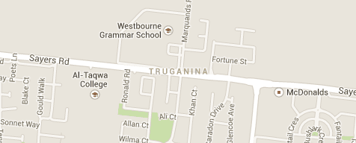
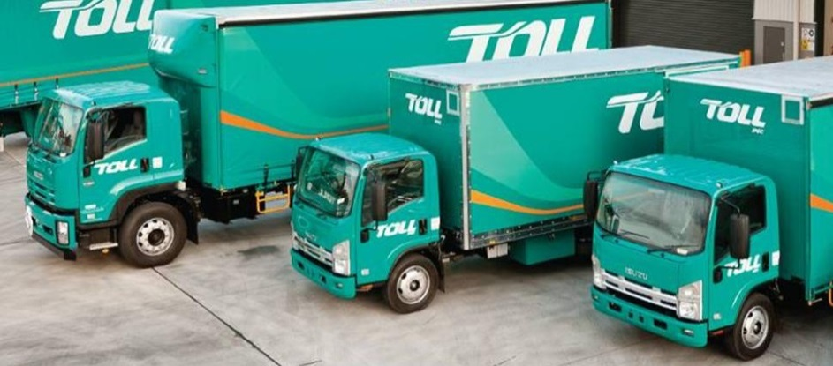
ADDITIONAL POINTS OF INTEREST
Why Truganina?
Deliveries – Inbound and Outbound
Source: Briefing given by Toll Customised Solutions / RMIT Visit to Mars DC - 23 May 2014

Slide 11

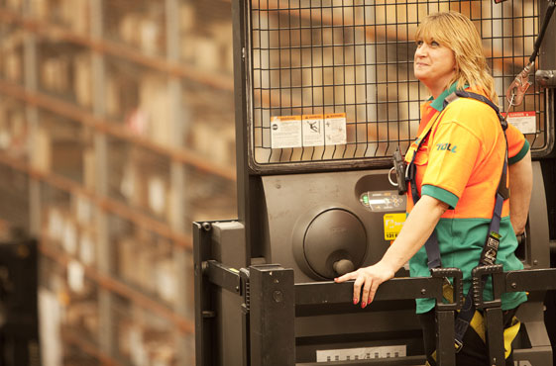
CULTURE at TOLL
Safety
Teamwork
Continuous Improvement
Think Tank
Source: Briefing given by Toll Customised Solutions / RMIT Visit to Mars DC - 23 May 2014, http://www.tollgroup.com/warehousing-and-storage viewed 26 May 2014, http://store.metmuseum.org/content/ebiz/themetstore/invt/80010981/80010981_01_l.jpg viewed 26 May 2014

Slide 12
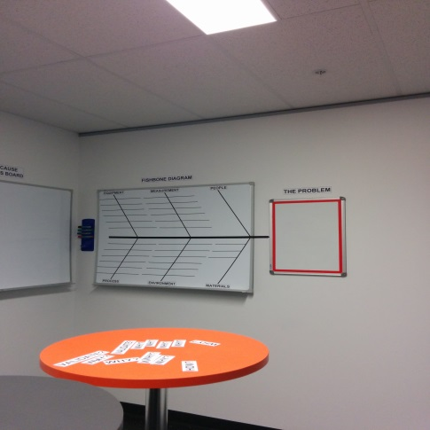
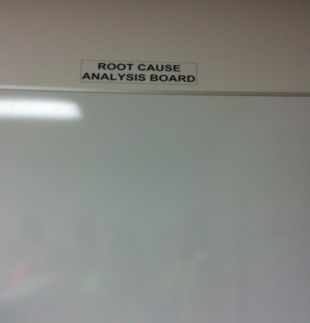
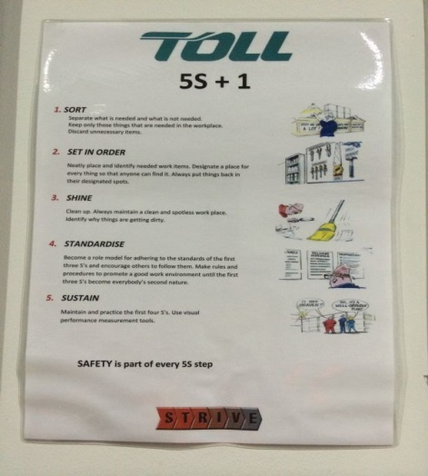
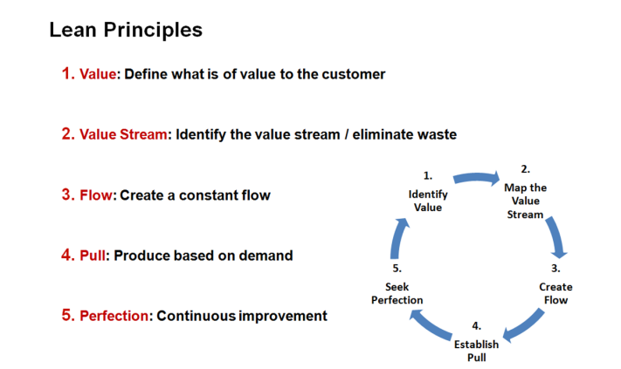
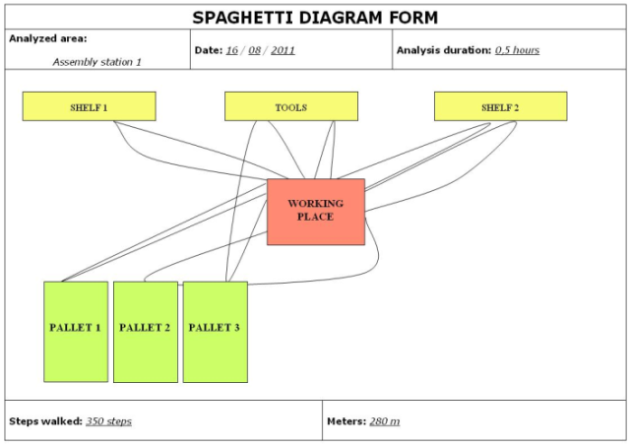
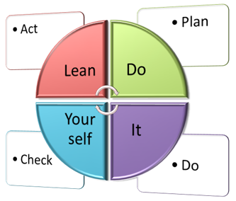
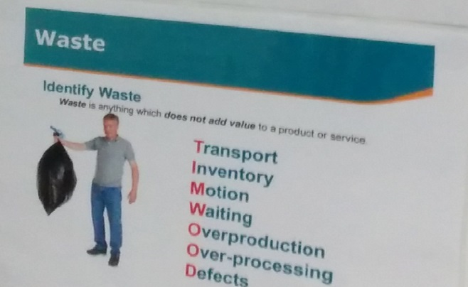
LEAN PRINCIPLES & TOOLS AT TOLL
Source: Briefing given by Toll Customised Solutions / RMIT Visit to Mars DC - 23 May 2014, http://www.diylean.com/images/DIY%20PDCA%20Image.png viewed 26 May 2014, http://4.bp.blogspot.com/-FQQDZKWcL0U/TrxC4SaUWEI/AAAAAAAAC5o/C__2K61AZq0/s1600/spaghetti.JPG viewed 26 May 2014, http://www.symbolbv.com/bestanden/Images%20UK/Lean%20Principles.png viewed 26 May 2014

Slide 13
QuIZ
4000
19
7
15
40

Slide 14
QUESTIONS?

