Slide 1
Portland State University | CS536 Data Engineering | Spring 2026
TriMet Bus Data Pipeline
Real-Time GPS & Passenger Data Collection, Processing & Visualization
Team This & That
Vinodh Raju | Neha Marlady
Professor: Bruce Irvin | TA: Arpita Palakshappa Mudegoudar

Slide 2
What is TriMet?
TriMet
BreadCrumbs
Stop Events
Portland's public transit agency serving the greater Portland metropolitan area with buses, light rail (MAX), and commuter rail (WES).
GPS location data recorded every few seconds from each bus. Contains latitude, longitude, speed, and timestamp — tracking exact bus positions.
Passenger data recorded at each bus stop. Contains boardings (ons), alightings (offs), dwell time, and on-time status for every stop.
Presented by: Vinodh Raju
2

Slide 3
System Architecture
Data Source
Publisher VM
Google Pub/Sub
Analysis VM
TriMet API
busdata.cs.pdx.edu
222 vehicles
Shazam group
us-west1 Oregon
publisher.py
se_publisher.py
Cron: 2:10 AM
bc_topic
se_topic
analysis_sub
backup_sub
se_analysis_sub
se_backup_sub
europe-west1
analysis.py
se_analysis.py
PostgreSQL DB
breadcrumbs
→
→
→
↓
Backup VM
asia-east1 Taiwan
backup.py
se_backup.py
.gz files
VMs start 1:45 AM — stop 3:00 AM (automated schedule)
Presented by: Vinodh Raju
3

Slide 4
Data Description
47.6M
1.4M
BreadCrumb Records
StopEvent Records
47,671,016 total stored
1,402,735 total stored
~750K
~90K
Daily BreadCrumbs
Daily StopEvents
Avg weekday pipeline run
Avg weekday pipeline run
Total Database Size: 3.7 GB | BreadCrumb: 3.4 GB | StopEvent: 267 MB
Presented by: Neha Marlady
4

Slide 5
Visualization 1
Route 20 — Busiest Stops
Which stops along Portland's busiest route have the most passenger boardings?
SQL Query
SELECT bc.trip_id, SUM(se.ons) as total_ons
FROM breadcrumb bc
JOIN stopevent se ON bc.trip_id = se.trip_number
WHERE se.route_number = 20
ORDER BY total_ons DESC LIMIT 1;
Presented by: Neha Marlady
5

Slide 6
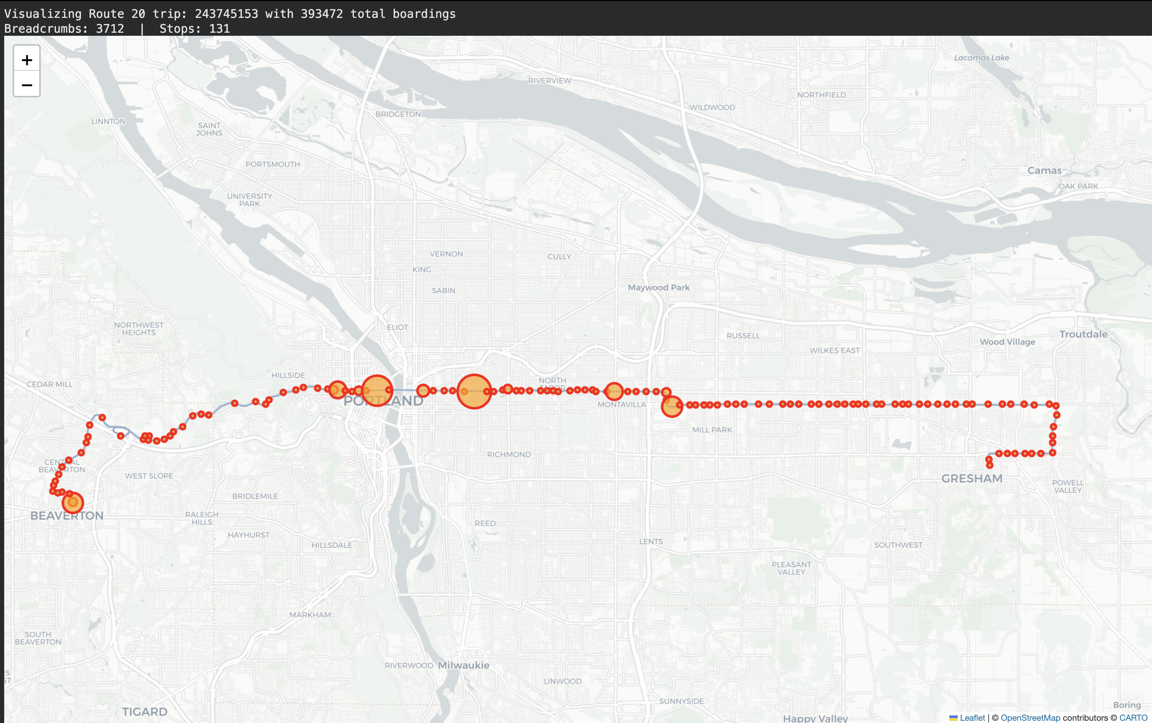
Route 20 — Stops Sized by Boardings
393,472
131
Beaverton → Gresham
Total Boardings
Stops Plotted
Route Corridor
Route 20 runs from Beaverton to Gresham — Portland's longest east-west bus route.
Each circle is a stop. Bigger = more boardings.
Key insight: Downtown Portland and the Lloyd District have the largest circles — the system's highest-demand stops.
6

Slide 7
Visualization 2
High-Speed Bus Locations
Where are Portland buses traveling at their fastest speeds across the entire network?
SQL Query
SELECT latitude, longitude, speed, vehicle_id
FROM breadcrumb
WHERE speed > 15
ORDER BY speed DESC LIMIT 2000;
Presented by: Vinodh Raju
7

Slide 8
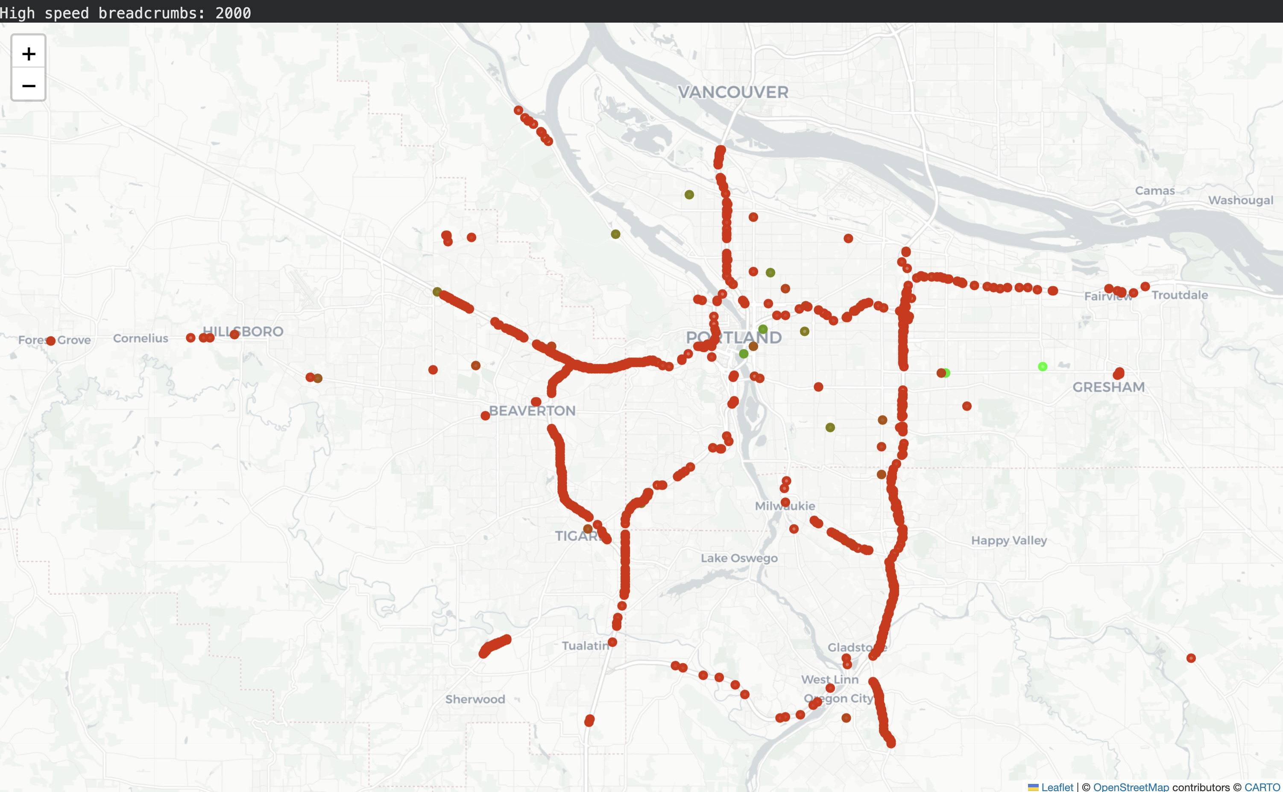
High-Speed Bus Locations Across Portland
2,000
> 15 m/s
39 m/s
GPS Points
Min Speed (34 mph)
Max Speed (87 mph)
Green = fastest • Red = slower (> 15 m/s threshold)
The map reveals Portland's entire road network — just from bus speed data.
You can clearly see:
I-205 corridor (east side)
Barbur Blvd (southwest)
Broadway & Steel Bridges
Major arterials radiating from downtown
8

Slide 9
Challenges & How We Solved Them
01
Trip ID Mismatch
Problem: StopEvent trip_number (small sequential) didn't match BreadCrumb trip_id (large unique ID) — join returned 0 results.
Solution: Fixed se_publisher.py to extract the real PDX_TRIP ID from HTML <h2> tags.
02
Disk Space
Problem: PostgreSQL ran out of temp space when running large JOIN queries across 30M+ breadcrumb records.
Solution: Expanded analysis-test VM disk from 10GB to 20GB via GCP Console.
03
Queue Contamination
Problem: Leftover messages from test runs mixed with new data, causing BC_STORED to be inconsistent.
Solution: Purge all Pub/Sub subscriptions before running fresh pipeline tests.
Presented by: Vinodh Raju
9

Slide 10
Lessons Learned
Data Integration is Hard
Separate Concerns
Validate Early
Joining two datasets requires careful key matching. Always verify that shared keys actually refer to the same entities before building queries.
Keeping BreadCrumb and StopEvent pipelines separate made debugging much easier. A bug in one pipeline didn't break the other.
Running validation before storage saved significant time. Invalid records were caught and logged rather than causing silent DB errors.
Systemd for Reliability
Visualization Reveals Patterns
Clean Up Test Data
Running programs as systemd services meant automatic restart on failure and proper logging — essential for overnight automated runs.
Maps from GPS data revealed Portland's road network structure — insights not obvious from raw numbers alone.
Leftover messages in Pub/Sub queues contaminated production runs. Always purge queues before clean pipeline tests.
Presented by: Neha Marlady
10

Slide 11
Thank You!
We would like to thank:
TriMet
Prof. Bruce Irvin
Portland State University
For sharing real-world GPS and passenger data from the Portland transit system
For designing this project and providing guidance throughout the semester
CS536 Data Engineering — Spring 2026
Team Shazam • Vinodh Raju & Neha Marlady • Portland State University • 2026

