Slide 1
Lesson 18 - Error and Exception Handling
Notes:
Welcome to Lesson 18 of the Foundations of Programming in Python course (FOPPY).
Error and exception handling is a critical aspect of programming that ensures your Python applications can gracefully manage and respond to unexpected conditions. By effectively handling errors, you can prevent your program from crashing and provide meaningful feedback to users, improving the overall robustness and reliability of your code.
In Python, errors and exceptions are a natural part of running programs. They occur when something goes wrong during execution, such as trying to divide by zero, accessing a file that doesn’t exist, or handling invalid input. Python provides a structured approach to deal with these issues through its exception handling mechanism, allowing you to catch and manage errors as they occur.
This lesson will cover the essentials of error and exception handling in Python. We will explore the types of errors you may encounter, how to use try, except, else, and finally blocks to handle exceptions, and the importance of creating and raising custom exceptions for specific error conditions. By mastering these concepts, you will be equipped to write more resilient and user-friendly Python programs.
Let’s dive into the details of handling errors and exceptions in Python and learn how to manage unexpected situations effectively.

Slide 2
Introduction to Error and Exception Handling
Definition: The process of responding to and managing errors that occur during the execution of a program.
Why It’s Important:
Prevent Crashes: Handle errors gracefully to prevent program crashes.
Improve User Experience: Provide meaningful feedback to users when something goes wrong.
Debugging: Easier to identify and fix issues in code.
Notes:
Error and Exception Handling is a crucial aspect of programming that ensures a program can gracefully handle unexpected situations, preventing it from crashing or producing incorrect results. In Python, errors and exceptions are used to signal that something has gone wrong, and exception handling allows developers to manage these situations effectively.
Key Concepts:
Errors vs. Exceptions:
Errors are problems in the code that prevent the program from running. For example, syntax errors (like missing a colon) are errors.
Exceptions are runtime errors that occur during the execution of a program. For example, dividing a number by zero will raise a ZeroDivisionError exception.

Slide 3
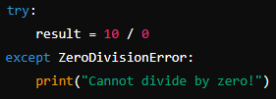
What is an Exception?
Definition: An exception is a type of runtime error that can be caught and handled to prevent the program from crashing.
Common Exceptions:
ZeroDivisionError: Occurs when dividing by zero.
TypeError: Occurs when an operation is performed on an inappropriate type.
FileNotFoundError: Raised when trying to access a file that doesn’t exist.
IndexError: Raised when trying to access an invalid index of a list or array.
Notes:
Exceptions are runtime errors that occur during the execution of a program. For example, dividing a number by zero will raise a ZeroDivisionError exception.
Common Types of Exceptions:
ZeroDivisionError: Raised when attempting to divide by zero.
TypeError: Raised when an operation is performed on an inappropriate type.
ValueError: Raised when a function receives an argument of the right type but an inappropriate value.
IndexError: Raised when trying to access an index that is out of range in a list or other indexable objects.
KeyError: Raised when trying to access a dictionary with a key that does not exist.

Slide 4
Types of Errors
Syntax Errors: Occur when the Python parser encounters an incorrect statement.
Runtime Errors: Occur during the execution of a program, leading to the program’s termination.
Logical Errors: The program runs without crashing but produces incorrect results due to flawed logic.
Notes:
In programming, errors are issues that prevent a program from running correctly. Python categorizes these errors primarily into two broad types: Syntax Errors and Exceptions (or Runtime Errors). Here's a breakdown of these error types:
1. Syntax Errors
Syntax errors occur when the Python interpreter encounters code that does not conform to the rules of the Python language. These errors are detected before the program runs, during the parsing stage, and they prevent the program from being executed.
Common Syntax Errors:
Missing Colon (:): Forgetting to add a colon at the end of control flow statements (if, for, while, def, class, etc.).
Indentation Errors: Incorrect indentation of code blocks.
Mismatched Parentheses: Forgetting to close parentheses, brackets, or braces.
Invalid Syntax: Using invalid syntax that Python doesn’t understand..
2. Exceptions (Runtime Errors)
Exceptions are errors that occur during the execution of a program. Unlike syntax errors, exceptions do not prevent a program from being parsed. Instead, they cause the program to terminate abruptly if not properly handled.
Common Types of Exceptions:
NameError: Raised when a local or global name is not found. This happens when trying to use a variable or function that has not been defined.
TypeError: Raised when an operation or function is applied to an object of inappropriate type.
IndexError: Raised when trying to access an index that is out of range in a sequence (e.g., a list or string).
KeyError: Raised when trying to access a dictionary with a key that doesn’t exist.
ValueError: Raised when a function receives an argument of the correct type but an inappropriate value.
AttributeError: Raised when an attribute reference or assignment fails. This happens when trying to access or assign an attribute that doesn’t exist in an object.
ZeroDivisionError: Raised when attempting to divide a number by zero.
FileNotFoundError: Raised when trying to open a file that does not exist.
ImportError: Raised when an import statement fails to find the module definition or when a from ... import ... statement fails to find a name that is to be imported.
IOError: Raised when an I/O operation (like reading or writing a file) fails for an I/O-related reason, such as “file not found” or “disk full”. Note that FileNotFoundError is a subclass of IOError.
RuntimeError: Raised when an error does not fall into any other category.
3. Logical Errors (Bugs)
Logical errors occur when the program runs without crashing, but it produces incorrect results. These errors are often the most difficult to detect and debug because the program does not raise any exceptions or errors, but the logic is flawed.
Examples of Logical Errors:
Incorrect Calculations: Performing incorrect calculations due to a wrong formula or operator.
Incorrect Conditional Statements: Using incorrect conditions that lead to unexpected behavior.

Slide 5
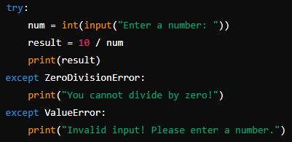
Try and Except Blocks
Purpose: Handle exceptions to prevent the program from crashing and allow for custom error messages or actions.
Notes:
The try, except, else, and finally Blocks:
try block: This block contains the code that might raise an exception. Python will try to execute this block, and if an exception occurs, it will immediately jump to the except block.
except block: This block contains code that will run if an exception occurs in the try block. You can specify the type of exception to catch specific errors.
else block: This block will run if no exceptions were raised in the try block. It is useful for code that should only run if the try block succeeds.
finally block: This block will always run, regardless of whether an exception occurred or not. It’s typically used for cleanup actions, like closing files or releasing resources.

Slide 6
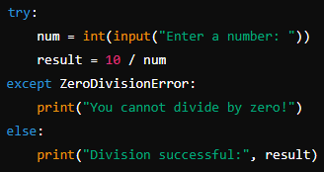
Else and Finally Blocks
Else Block: Executes if no exceptions are raised in the try block.
Notes:
In Python's exception handling mechanism, the else and finally blocks provide additional control over how code is executed when exceptions occur or do not occur. Here's a detailed look at how they work and their purposes:
else Block
The else block is used to specify code that should be executed if no exceptions are raised in the try block. It allows you to run code that should only execute when the try block succeeds without errors.
Purpose:
To execute code that should run only when no exceptions occur in the try block.
To separate the logic that handles errors from the logic that handles successful execution.
Usage:
It is placed after all except blocks.
If an exception occurs, the else block is skipped.
If no exceptions occur, the else block is executed.
finally Block
The finally block is used to specify code that should be executed regardless of whether an exception occurs or not. It is often used for cleanup actions, such as closing files, releasing resources, or performing other important finalization tasks.
Purpose:
To ensure that certain code runs no matter what happens in the try block.
To handle cleanup operations that should be executed even if an error occurs.
Usage:
It is placed after the try, except, and else blocks.
The finally block always executes, whether an exception was raised or not.

Slide 7
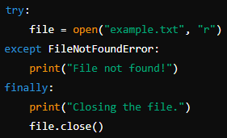
Else and Finally Blocks
Finally Block: Executes no matter what, even if an exception was raised. Typically used for cleanup actions.
Notes:
In Python's exception handling mechanism, the else and finally blocks provide additional control over how code is executed when exceptions occur or do not occur. Here's a detailed look at how they work and their purposes:
else Block
The else block is used to specify code that should be executed if no exceptions are raised in the try block. It allows you to run code that should only execute when the try block succeeds without errors.
Purpose:
To execute code that should run only when no exceptions occur in the try block.
To separate the logic that handles errors from the logic that handles successful execution.
Usage:
It is placed after all except blocks.
If an exception occurs, the else block is skipped.
If no exceptions occur, the else block is executed.
Example:
python
Copy code
try:
number = int(input("Enter a number: "))
result = 100 / number
except ZeroDivisionError:
print("Error: Cannot divide by zero!")
except ValueError:
print("Error: Invalid input! Please enter an integer.")
else:
print(f"The result is {result}")
In this example:
If the user enters a valid number and it's not zero, the else block is executed, printing the result.
If there is a ZeroDivisionError or ValueError, the else block is skipped, and the appropriate except block is executed.
finally Block
The finally block is used to specify code that should be executed regardless of whether an exception occurs or not. It is often used for cleanup actions, such as closing files, releasing resources, or performing other important finalization tasks.
Purpose:
To ensure that certain code runs no matter what happens in the try block.
To handle cleanup operations that should be executed even if an error occurs.
Usage:
It is placed after the try, except, and else blocks.
The finally block always executes, whether an exception was raised or not.
Example:
python
Copy code
try:
file = open('example.txt', 'r')
data = file.read()
except FileNotFoundError:
print("Error: File not found!")
else:
print(f"File contents: {data}")
finally:
file.close()
print("File closed.")
In this example:
The try block attempts to open and read a file.
If the file is not found, a FileNotFoundError is caught and handled.
If no error occurs, the file's contents are printed.
Regardless of whether an error occurred or not, the finally block ensures that the file is closed and a message is printed.
Combining else and finally
You can use both else and finally together to handle both success and cleanup scenarios:
python
Copy code
try:
number = int(input("Enter a number: "))
result = 100 / number
except ZeroDivisionError:
print("Error: Cannot divide by zero!")
except ValueError:
print("Error: Invalid input! Please enter an integer.")
else:
print(f"The result is {result}")
finally:
print("This will always execute.")
In this example:
The else block is executed if no exception occurs.
The finally block is executed regardless of whether an exception occurs or not.
Summary
else Block:
Executes code if no exceptions are raised in the try block.
Helps in separating successful execution logic from error handling.
finally Block:
Executes code regardless of whether an exception is raised or not.
Useful for cleanup tasks like closing files or releasing resources.

Slide 8
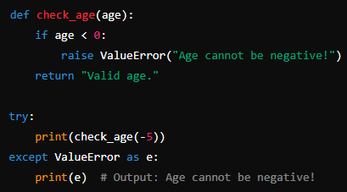
Raising Exceptions
Purpose: Force an exception to occur using the raise keyword when a certain condition arises.
Notes:
Raising Exceptions in Python allows you to signal that an error or unexpected situation has occurred in your code, which can then be handled using exception handling mechanisms (try, except, etc.). Raising exceptions is a way to enforce certain conditions and manage error states that your program may encounter.
Syntax for Raising Exceptions
You use the raise statement to trigger an exception. The basic syntax is: raise ExceptionType("Optional message")
ExceptionType: The type of exception you want to raise. This can be a built-in exception class (like ValueError, TypeError, etc.) or a custom exception class you define.
"Optional message": An optional message that provides more details about the exception.

Slide 9
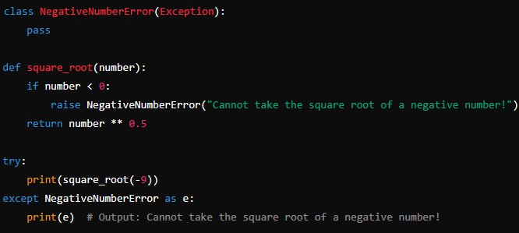
Custom Exceptions
Purpose: Define your own exception types by subclassing Python’s built-in Exception class.
Notes:
Custom Exceptions in Python allow you to create your own exception types to handle specific error conditions or to provide more detailed error messages in your applications. This can make your code more readable and maintainable by clearly defining what kind of errors might occur and how they should be handled.
Creating Custom Exceptions
Defining a Custom Exception To create a custom exception, you define a new class that inherits from the base Exception class (or one of its subclasses).
Adding Initialization and Custom Messages
You can add an __init__ method to customize the exception, including the ability to pass a message or additional attributes.
Using custom exceptions helps in making your code more organized, readable, and easier to debug, as it allows you to handle errors in a structured and meaningful way.

Slide 10
Best Practices
Use Specific Exceptions: Catch specific exceptions rather than using a generic except.
Avoid Empty Except Blocks: Always provide some handling logic or a message in an except block.
Clean Up Resources: Use finally blocks or with statements to ensure resources like files or network connections are properly closed.
Document Exceptions: Clearly document which exceptions your code might raise and why.
Notes:
When working with custom exceptions in Python, adhering to best practices ensures that your error handling is effective, maintainable, and intuitive. Here are some best practices for defining and using custom exceptions:
1. Use Descriptive Names
Choose meaningful names: Your custom exception classes should have names that clearly indicate the type of error they represent.
2. Inherit from Built-in Exceptions
Subclass appropriately: Typically, custom exceptions should inherit from the Exception class or one of its built-in subclasses, such as ValueError, TypeError, or RuntimeError, depending on the context.
3. Include Informative Messages
Provide clear error messages: Include a message that describes the error condition when raising the exception. This helps in understanding what went wrong.
4. Document Your Exceptions
Use docstrings: Add docstrings to your custom exception classes to document their purpose and usage. This improves code readability and helps other developers understand what the exception represents.
5. Avoid Overusing Custom Exceptions
Use only when necessary: Create custom exceptions only for situations where standard exceptions are not sufficient to express the error condition. Overusing custom exceptions can complicate error handling unnecessarily.
6. Be Consistent with Exception Hierarchy
Organize exceptions logically: If you have multiple related custom exceptions, use an inheritance hierarchy to group them logically. This makes it easier to handle related exceptions with a single except block.
7. Avoid Catching Generic Exceptions
Catch specific exceptions: When handling exceptions, catch specific exceptions rather than the base Exception class. This helps in responding to particular error conditions appropriately and avoids masking unexpected issues.
8. Use Exceptions for Exceptional Cases
Reserve exceptions for exceptional conditions: Exceptions should be used to handle cases that are truly exceptional and not part of the regular control flow. Avoid using exceptions for routine logic handling.
9. Implement __str__ or __repr__ Methods if Needed
Customize exception string representation: If your custom exception needs to provide a more detailed or formatted message, override the __str__ or __repr__ methods.
10. Ensure Exception Instances are Serializable
Ensure exceptions are serializable: If you need to serialize exceptions (for logging or transmission), make sure that your custom exceptions can be serialized. This often means including only serializable attributes in the exception.

