Slide 1
Lesson 3- Lists
Notes:
Welcome to Lesson 3 of the Foundations of Programming in Python course (FOPPY).
Lists are an essential data type in Python that allow us to store and manage collections of items. They are versatile and can hold elements of various types, including numbers, strings, and other lists. Understanding how to work with lists is crucial for effective data manipulation and organization.
Python provides powerful tools for working with lists, including indexing, slicing, and various built-in methods. Lists are mutable, meaning you can modify them after creation by adding, removing, or changing elements.
In this lesson, we’ll explore the fundamentals of lists, focusing on how to access elements, modify their contents, and use common list operations to handle and manipulate data efficiently. Let’s dive into the details of the list data type.

Slide 2
Introduction to Lists
Lists are ordered, mutable collections of items.
Can store different data types (integers, strings, etc.).
Syntax: list_name = [item1, item2, item3, ...]
Notes:
Mutable: Can be changed after creation (add, remove, modify elements).
my_list = [1, "two", 3.0, True]
my_list[0] = 100
print(my_list) # Output: [100, 'two', 3.0, True]
Ordered: Maintains the order of elements.
my_list = [1, "two", 3.0, True]
print(my_list) # Output: [1, 'two', 3.0, True]
Indexable: Can access elements by their index.
print(my_list[0]) # Output: 1
Heterogeneous: Can store elements of different data types.
my_list = [1, "two", 3.0, True]
Iterable: Can iterate over elements.
for item in my_list:
print(item)
Lists are versatile and can hold ordered collections of items. Their mutability allows for adding, removing, and changing items, making them suitable for dynamic data that can grow or shrink. Lists are also indexed and sliced, making them convenient for sequential data access and manipulation.

Slide 3

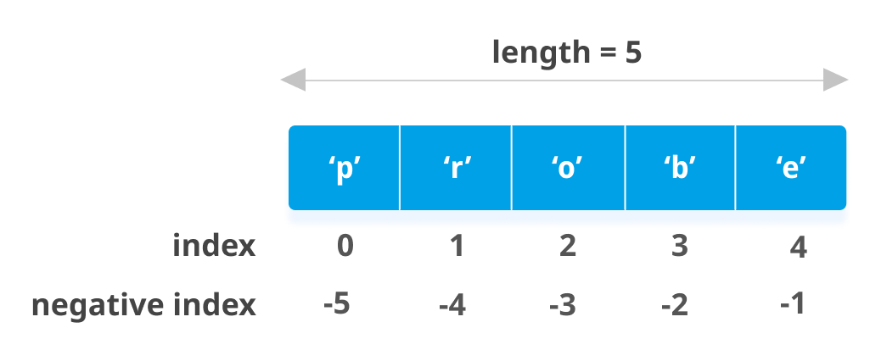
Indexing in Lists
Access elements using index positions.
Positive indexing starts from 0; negative indexing starts from -1.
right
left
Notes:
Sequential Position: Each item in a list has a unique position or index.
Zero-Based Indexing: Indexing usually starts at 0 (first item is at index 0).
Positive Indexing: Use the index number to access elements from the left. (e.g., index 2 is the third item).
Negative Indexing: Use the index number to access elements from the right (-1 is the last item).
Index Bounds: Accessing an index outside the valid range usually causes an error.
Mutability: You can modify items by changing their values at specific indices if the list is mutable.

Slide 4

Slicing in Lists
Extract sublists using slicing.
Syntax: list_name[start:end:step]
Notes:
Subsequence Extraction: Slicing creates a new list from a portion of the original list.
Syntax: Slicing uses the format [start:stop:step]:
Start: Index where the slice begins (inclusive).
Stop: Index where the slice ends (exclusive).
Step: Interval between elements (optional).
Defaults:
Omitting start defaults to the beginning of the list.
Omitting stop defaults to the end of the list.
Omitting step defaults to 1 (contiguous elements).
Negative Indices: Can be used for slicing from the end of the list.
Immutable: Slicing does not modify the original list; it produces a new one.
Empty Slice: If start equals stop, the result is an empty list.
my_list = [‘a’, 123, ‘hello’, ‘23’, ‘hi’, [1, 2], 23]
print(my_list[1:4]) # Output: [123, ‘hello’, ‘23’]
print(my_list[:2]) # Output [‘a’, 123]
print(my_list[2:]) # Output [‘hello’, ‘23’, ‘hi’, [1, 2], 23]
print(my_list[-3:]) # Output [ ‘hi’, [1, 2], 23]
print(my_list[2:6:2]) # Output [‘hello’,‘hi’, 23]

Slide 5
Inbuilt Functions for Lists
append(item): Adds an item to the end of the list.
extend(iterable): Extends the list by appending elements from an iterable.
insert(index, item): Inserts an item at a specified index.
remove(item): Removes the first occurrence of an item from the list.
pop([index]): Removes and returns the item at the specified index (or the last item if no index is provided).
index(item[, start[, end]]): Returns the index of the first occurrence of an item (optional start and end arguments define the search range).
count(item): Returns the number of occurrences of an item in the list.
sort(key=None, reverse=False): Sorts the list in place (optional key function and reverse order).
reverse(): Reverses the list in place.
copy(): Returns a shallow copy of the list.
Notes:
Read the text in slide.
Now let’s talk about some of them.

Slide 6

append()
The append() method adds a single element to the end of the list. It modifies the list in place and increases its length by one.

Slide 7

remove()
Syntax : list.remove(value)
The remove() method removes the first occurrence of a specified value from the list. If the value is not found, it raises a ValueError.
Notes:
The remove function in Python is used to delete the first occurrence of a specified value from a list.
The syntax is list.remove(value).
value: The item to be removed from the list. The function removes the first instance of this value found in the list.
First Occurrence: remove searches the list for the first occurrence of the specified value and removes it. The search starts from the beginning of the list.
No Return Value: The function does not return the removed item; it only modifies the list.
Value Not Found: If the specified value is not present in the list, remove raises a ValueError.
List Modification: The remove method modifies the original list by removing the specified item. The size of the list decreases by one, and the indices of subsequent elements shift to the left.
remove only removes the first match; if the value appears multiple times, only the first one is removed.
If you need to remove all occurrences of a value, you would need to use a loop or a list comprehension to repeatedly call remove until all instances are gone.

Slide 8
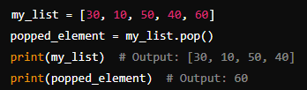
pop()
Syntax : list.pop([index])
The pop() method removes and returns the last element of the list. If the list is empty, it raises an IndexError. You can also specify an index to pop an element at a specific position.
Notes:
The pop function in Python is used to remove and return an element from a list.
The syntax is list.pop([index])
index (optional): Specifies the position of the item to be removed. If not provided, the function removes and returns the last item in the list.
With Index: When an index is provided, pop removes the item at that index and returns it. This shifts any subsequent elements one position to the left.
Without Index: If no index is specified, pop removes and returns the last item in the list.
Return Value: The function returns the item that was removed from the list.
Index Out of Range: If the provided index is out of range (i.e., negative beyond the start or positive beyond the end), it raises an IndexError.
List Modification: The pop method modifies the original list by removing the specified item. The size of the list decreases by one.

Slide 9

sort()
Syntax : list.sort(key=None, reverse=False)
The sort() method sorts the elements of the list in ascending order by default. It modifies the list in place.
Notes:
The sort function in Python is used to arrange the elements of a list in a specified order.
The syntax is list.sort(key=None, reverse=False)
Parameters:
key (optional): A function that takes a single argument and returns a value used for sorting purposes. The list elements are sorted based on the values returned by this function. For example, key=len would sort strings by their length.
reverse (optional): A boolean value. If True, the list is sorted in descending order. If False (the default), it is sorted in ascending order.
Behavior:
In-Place Sorting: The sort method sorts the list in place, meaning it modifies the original list rather than creating a new sorted list. The original list’s order is changed.
Sorting Order: By default, sort arranges elements in ascending order. If reverse=True, it arranges elements in descending order.
Return Value: The sort method does not return a value. It performs the sorting operation directly on the list.
Stable Sorting: The sort method is stable, meaning that it preserves the relative order of elements with equal keys.
Key Points:
In-Place: Since sort modifies the original list, it doesn’t create a new list.
Mutable Lists: The sort method works only on mutable lists (i.e., lists that can be modified in place).

Slide 10

reverse()
Syntax : list.reverse()
The reverse() method reverses the order of elements in the list in place. It does not sort the elements but simply reverses their order.
Notes:
The reverse function in Python is used to reverse the order of elements in a list.
The syntax is list.reverse()
Parameters:
None: The reverse method does not take any parameters.
Behavior:
In-Place Reversal: The reverse method reverses the order of the elements in the list directly. It modifies the original list rather than creating a new reversed list.
No Return Value: The function does not return a value; it returns None. The list is modified in place.
List Modification: The original list is changed such that the first element becomes the last, the second element becomes the second-to-last, and so on.
Key Points:
In-Place Operation: Since reverse modifies the original list, it doesn’t create a new list. The change is applied directly to the list it is called on.
Mutability: The reverse method works only on mutable lists (i.e., lists that can be changed in place).

Slide 11

len()
Syntax : len(list)
The len() function returns the number of elements in the list. It is not a list method but a built-in Python function.
Notes:
The len function in Python is used to determine the number of items in an object.
The syntax is len(list)
Parameters:
object: The object whose length or number of items you want to find. This can be a list, tuple, string, dictionary, or other data structures that have a defined length.
Behavior:
Number of Items: The len function returns the count of items or elements in the provided object.
Supported Types: It works with various data types including:
Lists: Returns the number of elements in the list.
Tuples: Returns the number of elements in the tuple.
Strings: Returns the number of characters in the string.
Dictionaries: Returns the number of key-value pairs in the dictionary.
Sets: Returns the number of elements in the set.
Return Value: The function returns an integer representing the length of the object.
Key Points:
Versatility: len can be used with any object that has a length or size defined.
O(1) Operation: The len function is efficient and runs in constant time, meaning it returns the length without iterating over the elements.

