Slide 1
Lesson 6 - Set
Notes:
Welcome to Lesson 6 of the Foundations of Programming in Python course (FOPPY).
Sets in Python are unordered collections of unique elements. Unlike lists and tuples, sets do not preserve the order of elements, and they automatically eliminate duplicates. They are particularly useful for performing mathematical set operations like union, intersection, and difference.
Sets are mutable, meaning you can add or remove elements after creating a set. They are often used to check for membership, remove duplicates from a sequence, and perform efficient set operations.
In this lesson, we will delve into the world of sets, exploring how to create sets, add and remove elements, perform set operations, and understand their applications in various programming scenarios. Let's uncover the power of sets in Python!

Slide 2
Introduction to Sets
Sets are unordered collections of unique elements.
Useful for membership tests, removing duplicates.
Syntax: set_name = {item1, item2, item3, ...}
Example: my_set = {1, 2, 3, 3} (Results in {1, 2, 3})
Notes:
What is a Set?
A set in Python is a collection of unique and unordered elements. Unlike lists or tuples, sets do not allow duplicates. Think of a set as a shopping list where you only write down each item once, regardless of how many you need.
Key Characteristics of Sets
Unordered: Elements have no specific position within a set.
Unique: Duplicate elements are automatically removed.
Mutable: You can add or remove elements after creating a set.

Slide 3
Sets Operations
Union: Combines elements from two sets into a new set.
Intersection: Returns elements present in both sets.
Difference: Returns elements present in one set but not in another.
Symmetric Difference: Returns elements present in either set, but not both.
Notes:
Set Operations
Sets support various operations:
Union: Combines elements from two sets into a new set.
Intersection: Returns elements present in both sets.
Difference: Returns elements present in one set but not in another.
Symmetric Difference: Returns elements present in either set, but not both.

Slide 4

Set Operations
Union: Combines elements from both sets.
Notes:
In set theory, the union of two sets is a new set that contains all unique elements from both sets. Python provides a convenient way to perform this operation using the | operator.
The syntax is set1 | set2.
The order of elements in the resulting set is arbitrary.
Duplicate elements are automatically removed.
The union() method can also be used to achieve the same result: union_set = set_a.union(set_b)

Slide 5
Set Operations
Intersection: Common elements in both sets.
Difference: Elements in one set but not the other
Notes:
The intersection of two sets is a new set containing only the elements that are present in both sets. Think of it as the overlap between two groups.
The syntax is set1 & set2
The order of elements in the resulting set is arbitrary.
The intersection() method can also be used: intersection_set = set_a.intersection(set_b)
The difference between two sets is a new set containing elements that are in the first set but not in the second set.
The syntax is set1 - set2.
The order of sets matters in the difference operation.
The difference() method can also be used: difference_set = set_a.difference(set_b)

Slide 6
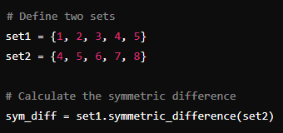
Set Operations
Symmetric Difference: The symmetric difference of two sets is a new set containing all elements that are in either set, but not in both
Notes:
The symmetric difference of two sets is a new set containing all elements that are in either set, but not in both.
The syntax is set1 ^ set2
The order of sets doesn't matter in the symmetric difference operation.
The symmetric_difference() method can also be used: symmetric_difference_set = set_a.symmetric_difference(set_b)
We can use it to,
Finding elements that are exclusive to either set.
Comparing two sets to identify differences.

Slide 7
Set Methods
add(): Adds an element to the set.
remove(): Removes the specified element from the set. Raises a KeyError if the element is not present.
pop(): Removes and returns an arbitrary element from the set. If the set is empty, it raises a KeyError.
clear(): Removes all the elements from the set
update(): Adds elements from an iterable (e.g., another set, list) to the set.
Notes:
Read the slide.

Slide 8
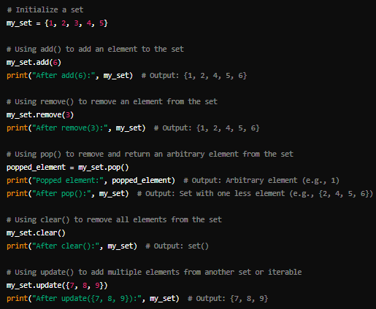
Notes:
Read the slide.

Slide 9

Membership Test
Test if an element is in a set using the in keyword.
Syntax : element in set
Notes:
A membership test in Python determines whether a specific element is present within a set. It's a straightforward operation that returns a Boolean value (True or False).
The syntax is element in set.
Membership testing is efficient in sets due to their underlying implementation.
It can be used in conditional statements to make decisions based on element presence.

Slide 10

Set Comprehensions
Similar to list comprehensions, but for sets.
Syntax : {expression for item in iterable if condition}
Notes:
Set comprehensions provide a concise way to create sets in Python. They are similar to list comprehensions but result in a set, which means elements are unique and unordered.
The syntax is {expression for item in iterable if condition}
expression: The value to be included in the set.
item: The variable representing each element in the iterable.
iterable: The source of elements (list, tuple, string, etc.).
condition (optional): A filtering condition for elements.
Set comprehensions are efficient for creating sets from other iterables.
The if clause is optional.
Duplicate elements are automatically removed.
The order of elements in the resulting set is arbitrary.

Slide 11
When to Use Sets
Useful when you need to store unique items.
Efficient for checking membership, removing duplicates.
Notes:
When to Use Sets
Removing duplicates: Quickly eliminate duplicate elements from a list.
Membership testing: Efficiently check if an element is present in a collection.
Mathematical set operations: Perform calculations like union, intersection, and difference.
Data structures: Used as keys in dictionaries due to their hashability.

