Slide 1
Lesson 1: Introduction and Python Data Types
Notes:
Python is a high-level, interpreted programming language known for its readability and simplicity.
In this lesson we will be talking about Python’s core data structures: Strings, Lists, Dictionaries, Tuples and Sets etc.
We’ll explore each data structure's characteristics, how to use them, and when to choose one over the other.

Slide 2

Python's Dynamic Nature: Dynamic Typing
Dynamic Typing:
Python is a dynamically typed language, meaning you don't need to declare variable types explicitly.
Variables can change type as needed, depending on the value assigned.
Example: You can assign an integer to a variable and later assign a string to the same variable without any errors.
Notes:
In Python, you don't need to declare the data type of a variable when you create it. The type is determined automatically at runtime based on the value assigned.
Example: You can assign an integer to a variable and later assign a string to the same variable without any errors.

Slide 3
Python's Dynamic Nature: Type Inference
Type Inference:
Python automatically infers the type of a variable at runtime based on the value assigned.
This flexibility allows for quicker coding and fewer lines of code.
Pros and Cons:
Pros: Easier and faster coding, flexible code that adapts to different types.
Cons: Potential for runtime errors if not carefully managed, harder to debug when types change unexpectedly.
Notes:
While Python's dynamic typing offers flexibility, it also comes with certain disadvantages:
Runtime Errors:Type-related errors are not caught at compile-time, meaning they only surface during execution. This can lead to unexpected crashes or bugs that might be difficult to diagnose, especially in large codebases.
Less Explicit Code: The lack of explicit type declarations can make code harder to understand and maintain. Other developers (or even the original author later on) may find it challenging to determine what type of data a variable is expected to hold without additional context or comments.
Increased Testing Burden: Since type-related errors aren't caught by the language, there is a greater reliance on thorough testing to catch potential issues. Developers need to write more unit tests to ensure that type mismatches do not cause problems in the application.

Slide 4
Data Types in Python
Strings
Dictionary
List
Tuples
Set
Notes:
Python provides a variety of built-in data types that are used to store different kinds of data. Here are some of the most important ones:
String (str): Represents sequences of characters enclosed in single, double, or triple quotes.
List (list): Ordered, mutable sequences of items. Items can be of different types.
Tuple (tuple): Ordered, immutable sequences of items. Items can be of different types.
Dictionary (dict): Unordered, mutable collections of key-value pairs.
Set (set): Unordered, mutable collections of unique items.

Slide 5
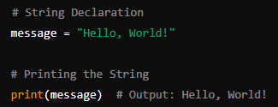
Strings
Definition: A sequence of characters enclosed within quotes.
Examples: "Hello", 'Python', "1234"
Usage: Used for storing text, characters, and numbers as text.
Notes:
Immutable: Cannot be changed after creation.
Ordered: Maintains the order of characters.
Indexable: Can access elements by their index.
Iterable: Can iterate over characters.
Methods: Extensive built-in methods like .lower(), .upper(), .split(), .find(), etc.
Used for storing and manipulating text data.
Common in scenarios where you need to perform operations on individual characters or substrings.

Slide 6
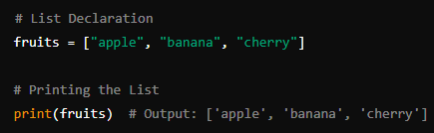
Lists
Definition: An ordered collection of items (which can be of different types).
Examples: [1, 2, 3], ["apple", "banana", "cherry"], [1, “cat”, 2]
Usage: Used for storing multiple items in a single variable.
Notes:
Mutable: Can be changed after creation (add, remove, modify elements).
Ordered, Indexable: Maintains the order of elements. Can access elements by their index.
Heterogeneous: Can store elements of different data types.
Iterable: Can iterate over elements.
Lists are versatile and can hold ordered collections of items. Their mutability allows for adding, removing, and changing items, making them suitable for dynamic data that can grow or shrink. Lists are also indexed and sliced, making them convenient for sequential data access and manipulation.

Slide 7
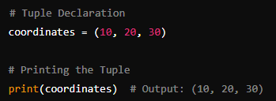
Tuples
Definition: An ordered, immutable collection of items.
Examples: (1, 2, 3), ("apple", "banana", "cherry")
Usage: Used when you want a collection of items that should not change.
Notes:
Immutable: Cannot be changed after creation.
Ordered, Indexable: Maintains the order of elements. Can access elements by their index.
Heterogeneous: Can store elements of different data types.
Iterable: Can iterate over elements.
Tuples are used when you need a group of values that should remain constant throughout the program. Their immutability ensures that the data cannot be altered, making them ideal for storing fixed configurations, coordinates, or function return values. They are also faster and more memory-efficient compared to lists due to their immutability.

Slide 8
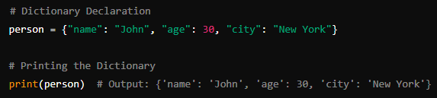
Dictionary
Definition: A collection of key-value pairs.
Examples: {"name": "John", "age": 30}
Usage: Used for storing data in key-value pairs for quick lookups.
Notes:
Mutable: Can be changed after creation (add, remove, modify key-value pairs).
Unordered: The order of elements is not guaranteed in older versions, but as of Python 3.7+, dictionaries maintain insertion order.
Key-Value Pairs: Elements are stored as key-value pairs.
Keys: Must be unique and immutable (e.g., strings, numbers, tuples).
Values: Can be of any data type.
Dictionaries are used when there is a need to map unique keys to values, providing fast access to data. Their ability to quickly retrieve values based on keys makes them ideal for situations where you need to look up, update, or store data associated with unique identifiers. Their mutable nature allows for dynamic modifications.

Slide 9
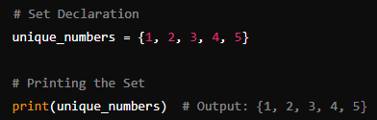
Set
Definition: An unordered collection of unique items.
Examples: {1, 2, 3}, {"apple", "banana", "cherry"}
Usage: Used for storing unique items and performing set operations like union and intersection.
Notes:
Mutable: Can be changed after creation (add, remove elements).
Unordered: Does not maintain order.
Unique Elements: Does not allow duplicate elements.
Iterable: Can iterate over elements.
Sets are designed to store unique elements, automatically removing duplicates. They are ideal for situations where you need to ensure that all items are distinct, such as in data deduplication or when performing operations like union or intersection. Their ability to perform fast membership tests makes them useful in algorithms where you need to frequently check if an item exists in a collection.

