Slide 1
Lesson 2: Strings in Python
Notes:
Welcome to the lesson 2 of the foundations of programming in python course (foppy).
Strings are a crucial part of programming because they allow us to work with text.
Understanding how to access, modify, and format strings is key to effectively handling text data.
Python provides powerful tools for string manipulation, such as indexing, slicing, f-strings, and various string methods.
Let’s look at strings data type in detail.

Slide 2
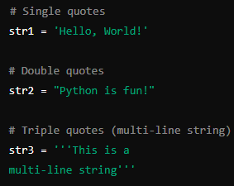
What is a String?
A string is a sequence of characters enclosed within quotes.
Strings can be created using single (' '), double (" "), or triple quotes (''' ''' or """ """).
Notes:
A string is a sequence of characters that is used to represent and store text in a programming language.
Strings are always enclosed within quotation marks, which can be single, double, or triple.
They are immutable, meaning once a string is created, its content cannot be altered.
Strings maintain the order of the characters, so each character has a specific position or index that can be used to access it.

Slide 3
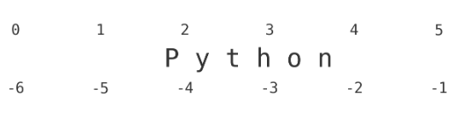
String Indexing
Strings are indexed from left to right, starting at 0, and from right to left, starting at -1.
Indexing allows access to individual characters within the string.
Notes:
Indexing refers to accessing individual characters in a string using their position.
In Python, the first character of a string is at position 0.
You can also access characters from the end of the string, starting from -1 for the last character.

Slide 4
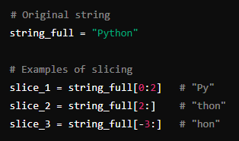
Understanding String Slicing
Slicing allows extracting a portion of the string.
Syntax: string[start:end:step]
Omitting start begins at the start, omitting end continues to the end.
Negative indexing or stepping is also allowed.
Notes:
Slicing is a technique to extract a part or segment of a string.
You can specify the starting and ending positions of the slice, and you can even skip characters by specifying a step.
If you leave out the start position, slicing begins at the start of the string. Similarly, if you omit the end position, slicing goes till the end of the string.
Slicing can also be done in reverse by using negative indices.

Slide 5
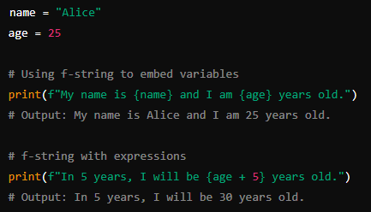
Using f-strings
f-strings are used to format strings by embedding expressions inside string literals.
Begin with f followed by a string in quotes, with expressions inside {}.
Notes:
f-strings are a way to format strings in Python, allowing you to insert or embed expressions and variables directly within the string.
They start with the letter 'f' before the string, and any variables or expressions you want to include are placed inside curly braces {}.
This makes it easy to combine text with dynamic data in a readable and concise way.

Slide 6
Common String Methods
len(): Returns the length of the string.
upper(): Converts all characters in the string to uppercase.
lower(): Converts all characters in the string to lowercase.
strip(): Removes any leading and trailing whitespace from the string.
replace(old, new): Replaces all occurrences of a substring (old) with another substring (new).
split(delimiter): Splits the string into a list of substrings based on the specified delimiter.
join(iterable): Joins the elements of an iterable (e.g., a list) into a single string, with a specified separator.
find(substring): Searches for the first occurrence of a substring within the string and returns its index, or -1 if not found.
Notes:
Read what’s written in the slide.
Now, let’s go over some of them.
# Functions: Standalone, used globally, and do not depend on any object.
# Methods: Associated with objects, used to interact with or manipulate that specific object.

Slide 7
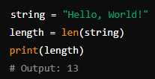
len()
Returns the length of the string.
Notes:
returns the length of the string

Slide 8

upper()
Converts all characters to uppercase.
Notes:
does not affect the original string as strings are immutable. just returns the uppercased version of the original string without changing the original string.

Slide 9
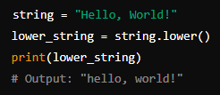
lower()
Converts all characters to lowercase.
Notes:
does not affect the original string as strings are immutable. just returns the lowercased version of the original string without changing the original string.

Slide 10

replace()
Replaces a substring with another substring.
Notes:
does not affect the original string as strings are immutable. just returns the modified version of the original string without changing the original string.

