Slide 1
Lesson 14: Statements
Notes:
In Python, a statement is a unit of code that performs an action. Python has various types of statements, each serving different purposes in program flow and logic.

Slide 2
Types of Statements
Conditional statement
Loop statement
Import statement
Exception handling
With statement
Pass statement
Assert statement
Return, yield, and break statements
Notes:
Read slide

Slide 3
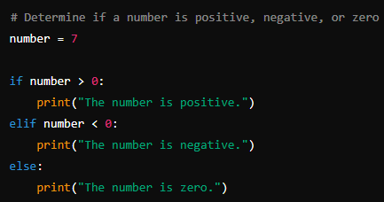
Conditional Statements
if – elif – else
if: Executes a block of code if its condition is true (e.g., if x > 10:)
elif: Checks another condition if the previous ones are false (e.g., elif x == 10:)
else: Executes a block of code if all previous conditions are false (e.g., else:)
Notes:
if-elif-else
Used for decision making in the code.

Slide 4
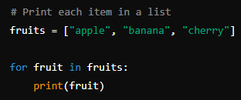
Loop Statements
For Loops
Iterates over a sequence (e.g., for i in range(5):)
Common uses: iterating over lists, tuples, strings
Notes:
for loop
Used for iterating over a sequence or other iterable objects.

Slide 5
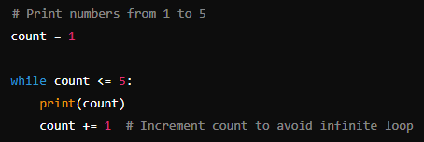
Loop Statements
While Loops
Repeats a block of code as long as its condition is true (e.g., while x < 10:)
Important: ensure the condition eventually becomes false to avoid infinite loops
Notes:
while loop
Executes a set of statements as long as a condition is true.

Slide 6
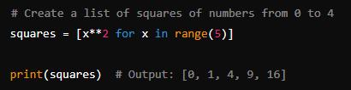
Loop Statements
List Comprehension
A concise way to create lists (e.g., [x for x in range(10) if x % 2 == 0])
More readable and often more efficient than traditional loops
Notes:
List comprehension is a concise way to create lists in Python. It provides a shorter syntax when you want to create a new list based on the values of an existing list or iterable.

Slide 7
Import Statements
Import is a statement in Python used to bring external modules or specific attributes from modules into your current Python script or interactive session.
It allows you to access and use code that's defined in other files or built-in libraries.
Notes:
The import statement is used to bring external modules or specific attributes from modules into your Python script.

Slide 8
Exception handling statements
(try, except, finally)
Used to manage errors and unexpected situations in code.
The try block contains code that may raise an exception, while except blocks handle specific exceptions.
Notes:
Exception statements are used for handling errors and exceptional situations in Python programs.
The try block contains the code that might raise an exception.
The except block specifies how to handle the exception. You can have multiple except blocks to handle different types of exceptions.
The finally block contains code that will be executed regardless of whether an exception occurred or not. It's typically used for cleanup operations.
Key Points
The try block is executed first.
If an exception occurs in the try block, the appropriate except block is executed.
If no exception occurs, the else block (if present) is executed.
The finally block is always executed, regardless of whether an exception occurred or not.
You can have multiple except blocks to handle different types of exceptions.
The finally block is often used for cleanup operations (e.g., closing files, releasing resources).
If an exception is not caught by any except block, it will propagate up to the calling code.

Slide 9
With Statements
Provides a clean way to manage resources like file handles or network connections.
It ensures resources are properly closed or released after use.
Notes:
The with statement is used for resource management. It ensures that a resource is properly acquired and released.

Slide 10
Pass Statements
A no-operation statement used as a placeholder where syntax requires a statement but no action is needed.
Notes:
The pass statement is a null operation. It's used as a placeholder where syntax requires a statement, but no action is required.

Slide 11
Assert Statements
Used for debugging and testing.
It checks if a condition is true and raises an AssertionError if it's false.
Notes:
The assert statement is used for debugging purposes. It checks if a given condition is True, and if not, it raises an AssertionError.

Slide 12
Return, yield, and break Statements
Return: A statement used in functions to end the function's execution and optionally send a value back to the caller. It immediately exits the function.
Yield: A statement used in generator functions to produce a series of values over time. It pauses the function's execution and returns a value, maintaining the function's state for the next call.
Break: A statement used within loops (for or while) to immediately terminate the loop's execution and transfer control to the next statement after the loop.
Notes:
The return statement is used to exit a function and optionally return a value.
The yield statement is used in generator functions to define an iterator. It pauses the function's execution and returns a value to the caller, but retains enough state to resume where it left off.
The break statement is used to exit a loop prematurely, before its normal completion.

