Slide 1

TradeSTREAM
TEAM MEAMBERS
Neha Nayak - E22CSEU1518
Ayush Kumar – E22CSEU1517
Devansh Mehrotra – E22CSEU0780

Slide 2
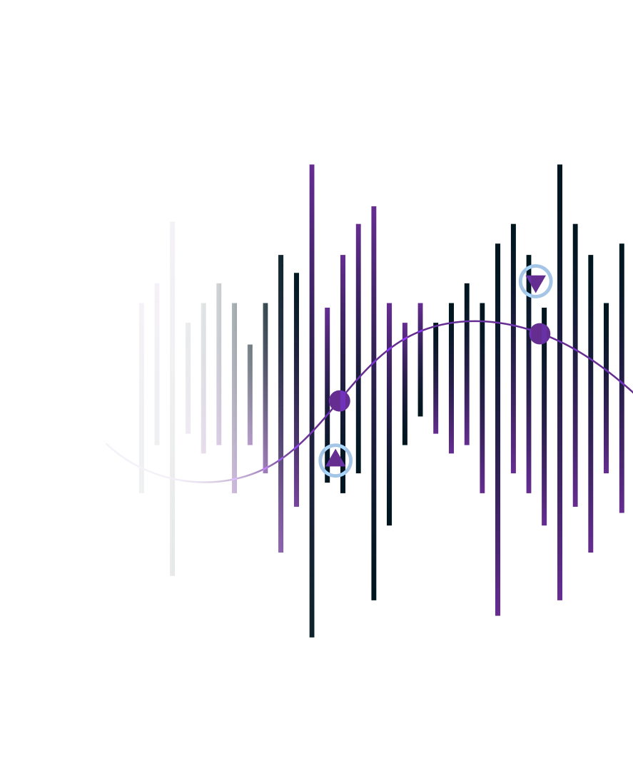
Table of contents
01
04
02
05
03
Abstract
Results
Introduction
Conclusion
Method

Slide 3
Abstract
The Comprehensive Stock Analysis Project is a data-driven research endeavour designed to provide a thorough examination of financial markets, stock performance, and investment strategies. This project aims to assist investors, financial professionals, and enthusiasts in making informed decisions by leveraging advanced data analytics and machine learning techniques.
Purpose: To provide a thorough examination of financial markets, stock performance, and investment strategies.
Target Audience: Investors, financial professionals, and enthusiasts seeking data-driven insights.
-TradeSREAM

Slide 4
Introduction
Project Overview: The Stock Analysis Project is a data-driven initiative designed to provide in-depth insights into financial markets and stock performance.
Navigating Complexity: In today's fast-paced financial landscape, stock markets are more complex than ever. Investors and professionals face a deluge of data and rapidly changing market dynamics.
Data-Driven Solutions: To thrive in this environment, data is an indispensable asset. This project aims to harness the power of data and advanced analytics to help users make informed investment decisions.
Empowering Decision-Making: The ultimate goal is to empower users to seize opportunities, manage risks, and enhance their financial well-being through well-informed investment choices.
Key Components: The project encompasses data collection, preprocessing, descriptive analysis, predictive modeling, fundamental analysis, sentiment analysis, portfolio optimization, risk assessment, and investment recommendations.

Slide 5
Objectives
Our aim
The goal
The aim of the Comprehensive Stock Analysis Project is to empower investors and financial professionals with data-driven insights, predictive models, and recommendations to make informed decisions, optimize portfolios, and manage risks in the stock market.
The goal of the Comprehensive Stock Analysis Project is to be a trusted resource that empowers users with actionable insights, helping them make informed investment decisions, optimize portfolios, and manage risks effectively in the stock market.

Slide 6
MODELS
Data Collection Model:
This model focuses on gathering data from various sources such as stock exchanges, financial news, and economic indicators.
Data Preprocessing Model:
Cleaning and transforming raw data to ensure consistency and reliability for analysis. Techniques like missing data handling, data normalization, and outlier detection are included.
Risk Assessment Model:
Quantifying and assessing various types of risks, including market risk, sector-specific risk, and company-specific risk, to inform investment decisions.
Libaries Used:
We imported required libraries i.e., yfinance, pandas, numpy, streamlit
Etc.
Sentiment Analysis Model:
Applying Natural Language Processing (NLP) techniques to analyze news articles, social media data, and other textual sources to gauge market sentiment and its impact on stock prices.

Slide 7
RESULTS
Data-Driven Insights: Users will gain access to a wealth of data-driven insights into the stock market, including historical trends, correlations, and market sentiment. These insights can inform investment strategies and decisions.
Fundamental Analysis:
Evaluation of company-specific financial metrics to assess stock valuations, aiding in identifying undervalued or overvalued stocks.
Predictive Power: The project's predictive modeling capabilities can help users forecast stock prices and identify potential trading opportunities, aiding in better timing for buying or selling stocks.
Actionable Recommendations:
Investment recommendations, including buy, hold, or sell signals, to guide users in optimizing their stock portfolios and aligning with their investment objectives.
Risk Management:
Quantification and assessment of market, sector, and company-specific risks, helping users develop effective risk mitigation strategies.

Slide 8
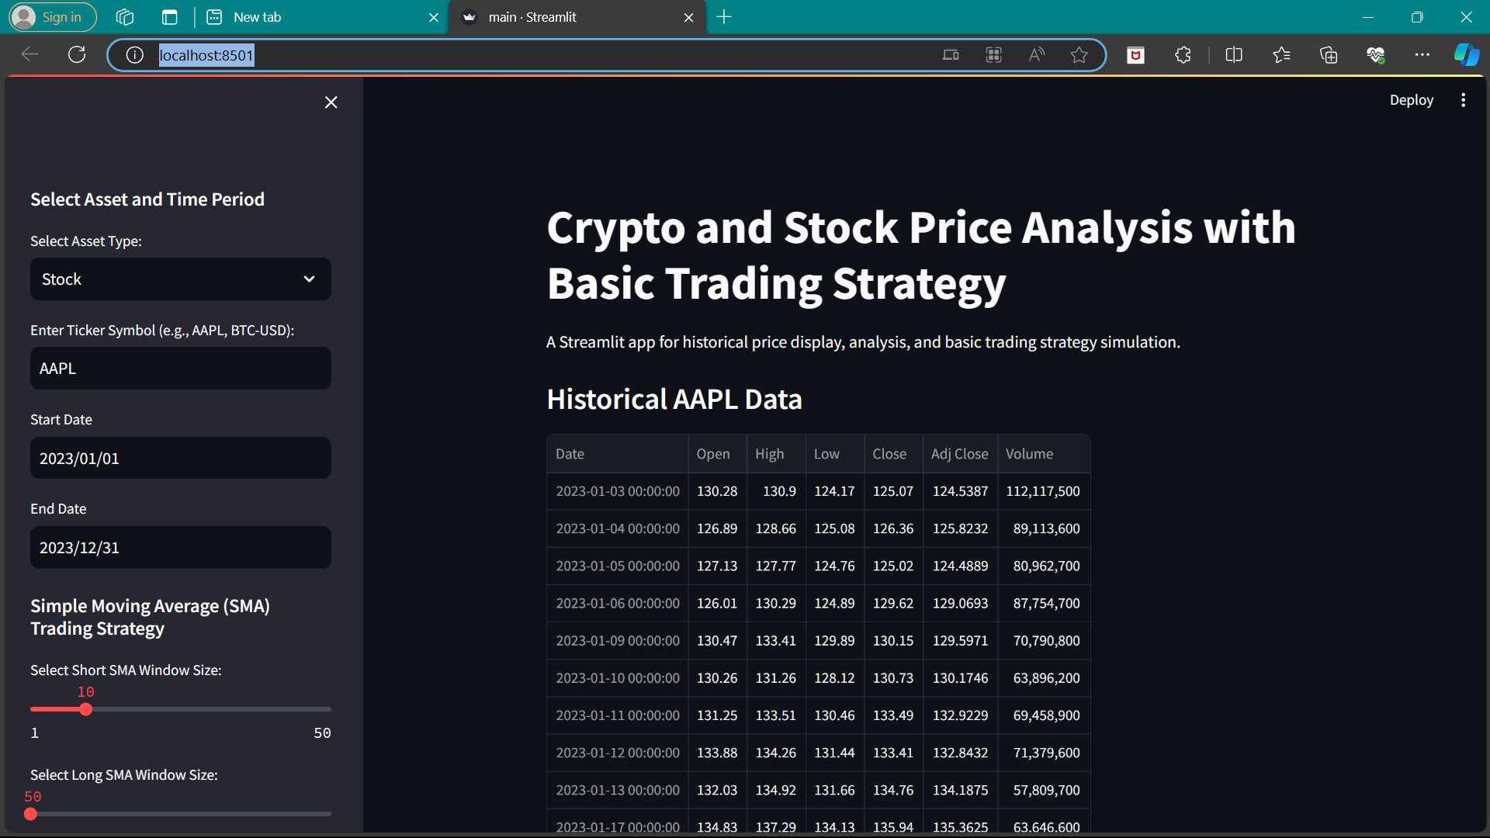
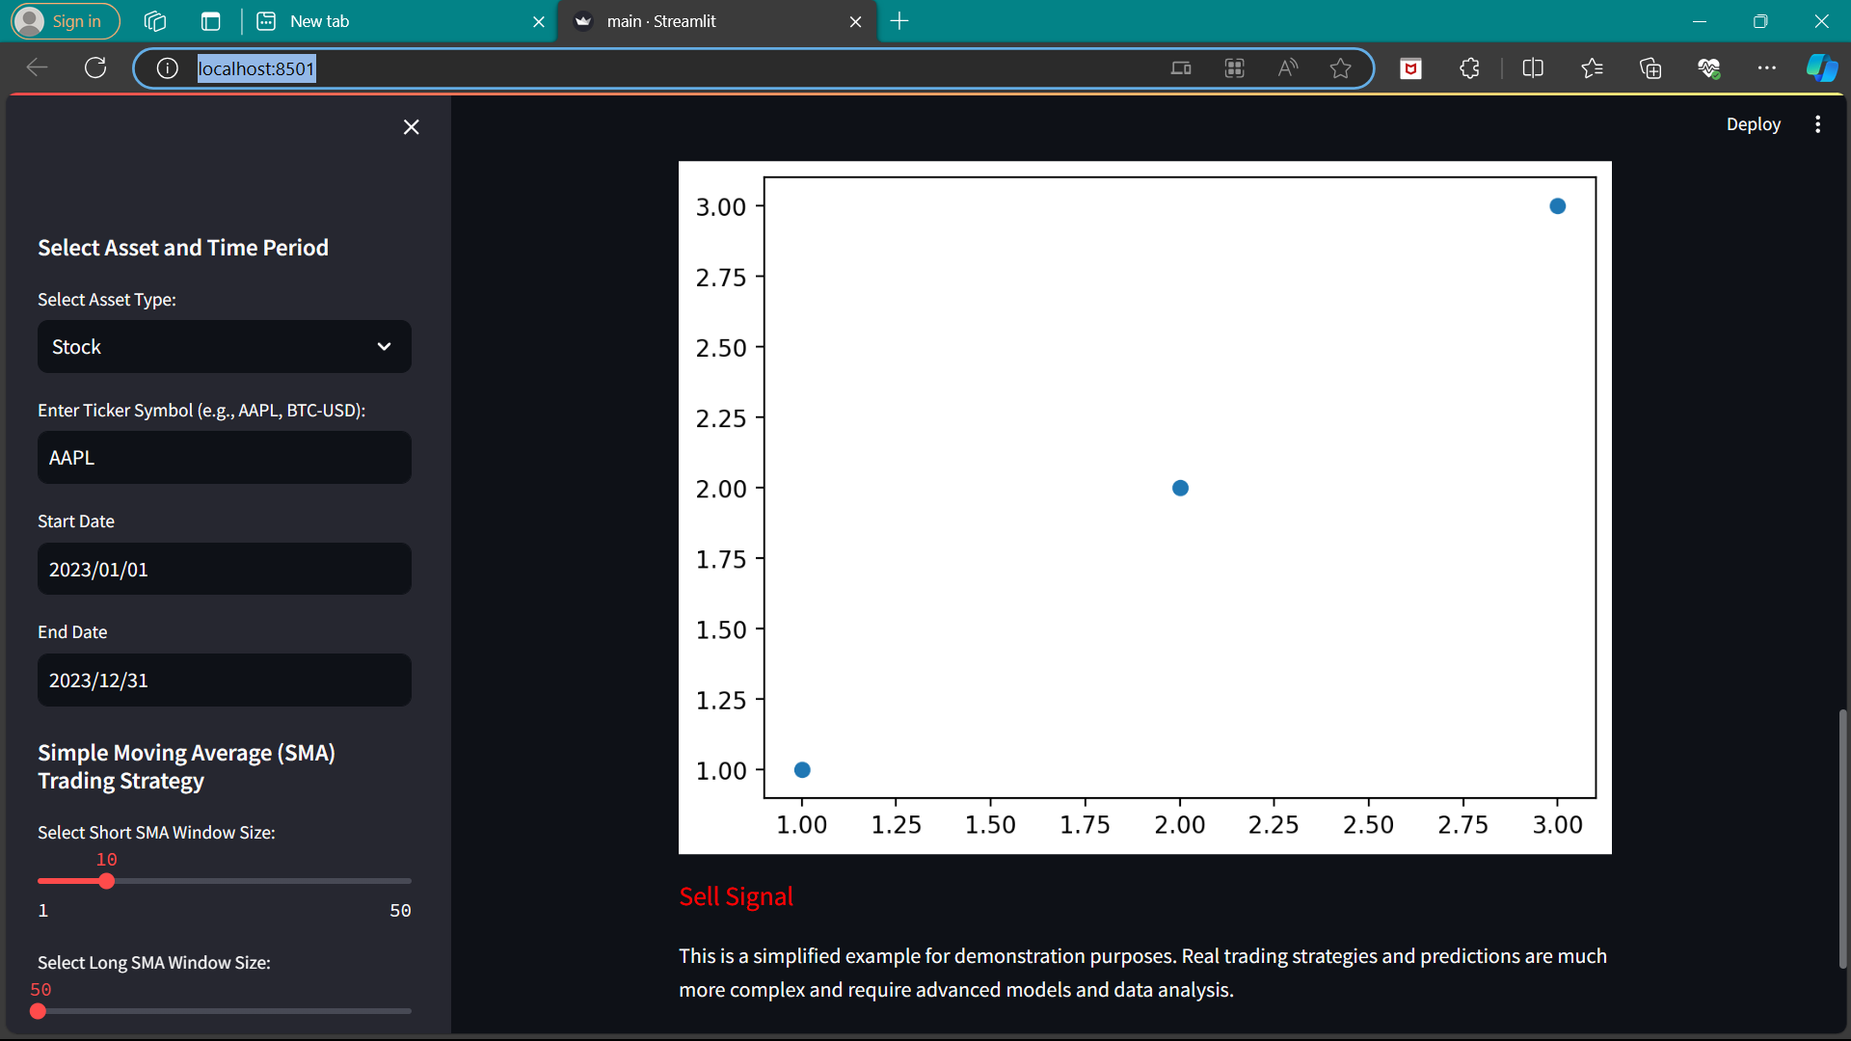
Easily Analysis and show data about history and predict future
Easily Analysis and tell is the time to sell or buy

Slide 9
CONCLUSION
The Comprehensive Stock Analysis Project represents a valuable resource for investors and financial professionals seeking to navigate the complexities of the stock market. Through robust data-driven insights, predictive modeling, fundamental analysis, sentiment analysis, portfolio optimization, risk assessment, and actionable recommendations, this project equips users with the tools they need to make informed investment decisions.
In an ever-evolving financial landscape, the ability to harness data for better decision-making is paramount. This project serves as a beacon of knowledge, providing a holistic approach to stock market analysis. It empowers users to seize opportunities, manage risks, and enhance their financial well-being through well-informed investment choices.
As the financial world continues to evolve, the Comprehensive Stock Analysis Project stands ready to adapt and provide users with the essential insights required for successful investing. With its multi-faceted approach and data-driven foundation, it is positioned to make a meaningful impact on the investment landscape, fostering financial growth and prosperity for its users.

Slide 10
Thanks!

