Slide 1
MINOR
PROJECT
GROUP 15

Slide 2

Department of Computer Science and Engineering
CREDIT CARD FRAUD DETECTION
Project Developed by: Group 015
NEHA KUMARI (0126CS191064)
PARIDHI SHRIVASTAVA (0126CS191070)
RITIKA MAKHIJA
TANUSHA THAKUR
(0126CS191091) (0126CS191115)

Slide 3
CONTENTS :
INTRODUCTION
ABSTRACT
PROBLEM STATEMENT
PROPOSED IDEA
FRAUD DETECTION PROCESS
TECHNOLOGY PLATFORM OVERVIEW
OBJECTIVE
MODULES
DATABASE
VISUALIZATION OF DATA
ALGORITHM USED
TECHNICAL REQUIREMENT
FUTURE ENHANCEMENTS
ADVANTAGES
DEPLOYMENT
RESULT AND CONCLUSION

Slide 4
Illegal use of credit card or it’s information without the
knowledge of the owneris referred to as credit card fraud.
It is an active research topic unfortunately with very few data
available.
Size , balance , dynamic nature of CC fraud data real challenges .
We need a fast , efficient and possibly transparent ML model to detect
fraud.

Slide 5

Due to cashless transaction everyone uses ATM cards nowadays and credit card for transaction so , incrementation in fraudulent activities.
Billions of loss dollars are caused every year by fraudulent credit card transactions.The design of efficient fraud detection algorithms rely on advanced machine learning techniques to assist fraud investigators.

Slide 6
The Credit Card Fraud Detection Problem includes modeling past credit card transactions with the knowledge of the ones that turned out to be a fraud.
This model is then used to identify whether a new transaction is fraudulent or not. Our aim here is to detect 100% of the fraudulent transactions while minimizing the incorrect fraud classifications.

Slide 7

It is important that credit card companies are able to recognize fraudulent credit card transactions so that customers are not charged for items that they did not purchase.
The dataset contains transactions made by credit cards in September 2013 by European cardholders.
This dataset presents transactions that occurred in two days, where we have 492 frauds out of 284,807 transactions. The dataset is highly unbalanced, the positive class (frauds) account for 0.172% of all transactions.

Slide 8
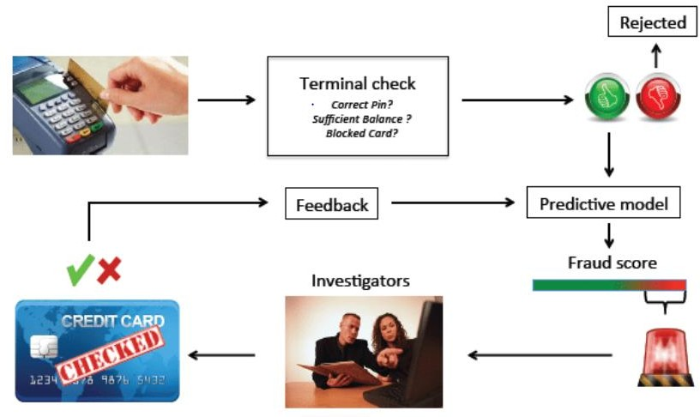

Slide 9
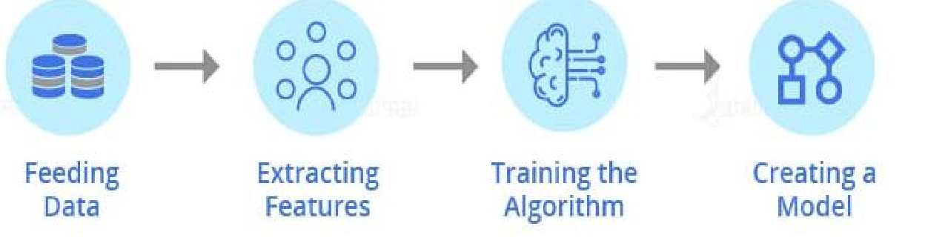
MACHINE LEARNING
It is the scientific study of algorithms and static models that computer system use in order to make.
Machine Learning is the field of study that gives computers the capability to learn without being explicitly programmed.
ML is one of the most exciting technology.
As it is evident from the name, it gives the computer that makes it more similar to humans: The ability to learn.
Machine learning has been widely used in data mining, computer vision, natural language processing, biometrics, search engines, medical diagnostics, detection of credit card fraud etc.

Slide 10



Python is a general purpose, dynamic, high-level, and interpreted programming language. It supports Object Oriented programming approach to develop applications.
It is simple and easy to learn and provides lots of high-level data structures.Python is easy to learn yet powerful and versatile scripting language, which makes it attractive for Application Development.
Python supports multiple programming pattern, including object- oriented, imperative, and functional or procedural programming styles.

Slide 11



Detect the fraudulent transactions.
Minimization of credit card fraud.
Analysis of multiple machine learning algorithms.
Better performance and accuracy

Slide 12

Frame the problem.
Exploratory data analysis.
collect the raw data.
download data from kaggle
import the libraries pandas,numpy,sklearn etc.
Read data
Visualize data
Normalize data
process the data for analysis. 2.min-max normalization data.
Split to train data.
Split dataset to input and output variables(x and y).
Model building and comparison.

Slide 13



The dataset contains transactions, that occurred in two days, made by credit cards in September 2013 by European cardholders.
284,807 Transactions
492 Frauds
0.172% Fraud rate
148,562 EUR lost due to fraud on test dataset

Slide 14
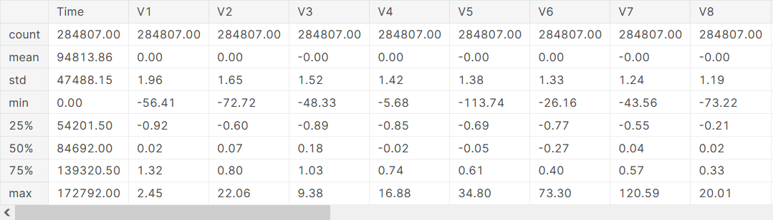
DATABASE
Raw attributes
Other attributes: Amount,class

Slide 15
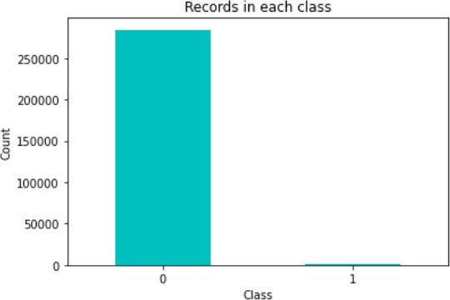
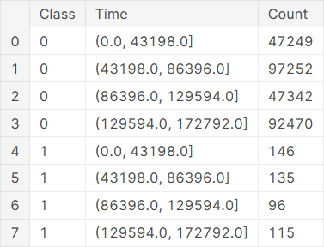
Records each class have
Records in each class during all the time

Slide 16
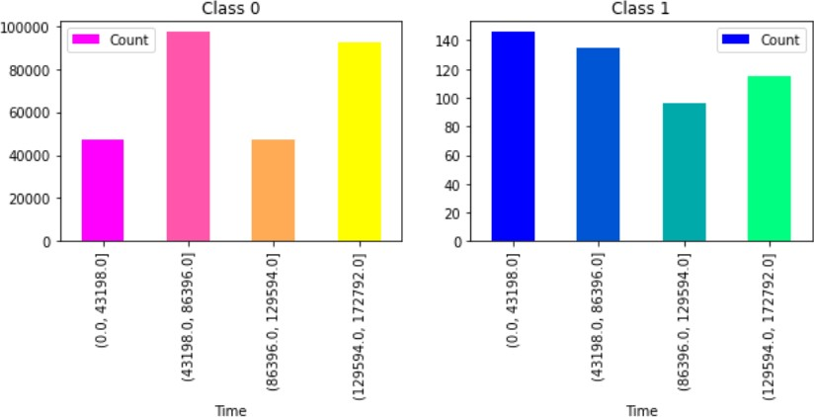

Slide 17
ALGORITHM USED :
Logical Regression –
Easy to implement , and historically used for fraud detection.
It is used in statistical software to understand the relationship between the dependent variable and one or more independent variables by estimating probabilities using a logistic regression equation.
It uses logistic (sigmoid) function to find the relationship between variables. The sigmoid function is an S-shaped curve that can take any real-valued number and map it to a value between 0 and 1.

Slide 18

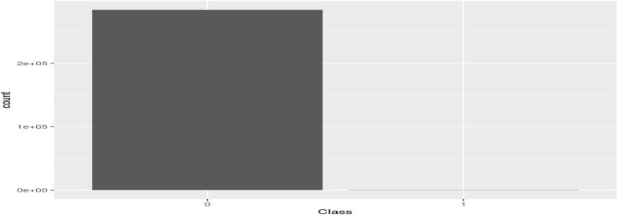
The data is highly skewed.
Normal Machine Learning algorithms would give 99%+Accuracy.
But we can get 99.8% accuracy even if we classify all Frauds as Legitimate.
Authentic Fraud
Fig 1. Highly Unbalanced data

Slide 19
HARDWARE REQUIREMENTS –
RAM – 4GB and Higher.
Processor – Intel i3 and above.
Hard Disk – 500 GB : Minimum.
SOFTWARE REQUIREMENTS –
OS : Windows or Linux.
Python IDE : python 3.7
Jupyter Notebook.
Setup tools and pip to be installed for 3.7 and above.
Language : Python and Machine Learning.

Slide 20
ADVANTAGES :
Reduction in number of fraud transaction.
User can safely use his credit / debit card for online transaction.
Added layer of security.

Slide 21
FUTURE ENHANCEMENTS
While we couldn’t reach out goal of 100% accuracy in fraud detection, we did end up creating a system that can, with enough time and data, get very close to that goal.
As with any such project, there is some room for improvement here. The very nature of this project allows for multiple algorithms to be integrated together as modules and their results can be combined to increase the accuracy of the final result. This model can further be improved with the addition of more algorithms into it. However, the output of these algorithms needs to be in the same format as the others. Once that condition is satisfied, the modules are easy to add as done in the code. This provides a great degree of modularity and versatility to the project. More room for improvement can be found in the dataset. As demonstrated before, the precision of the algorithms increases when the size of dataset is increased. Hence, more data will surely make the model more accurate in detecting frauds and reduce the number of false positives. However, this requires official support from the banks themselves

Slide 22
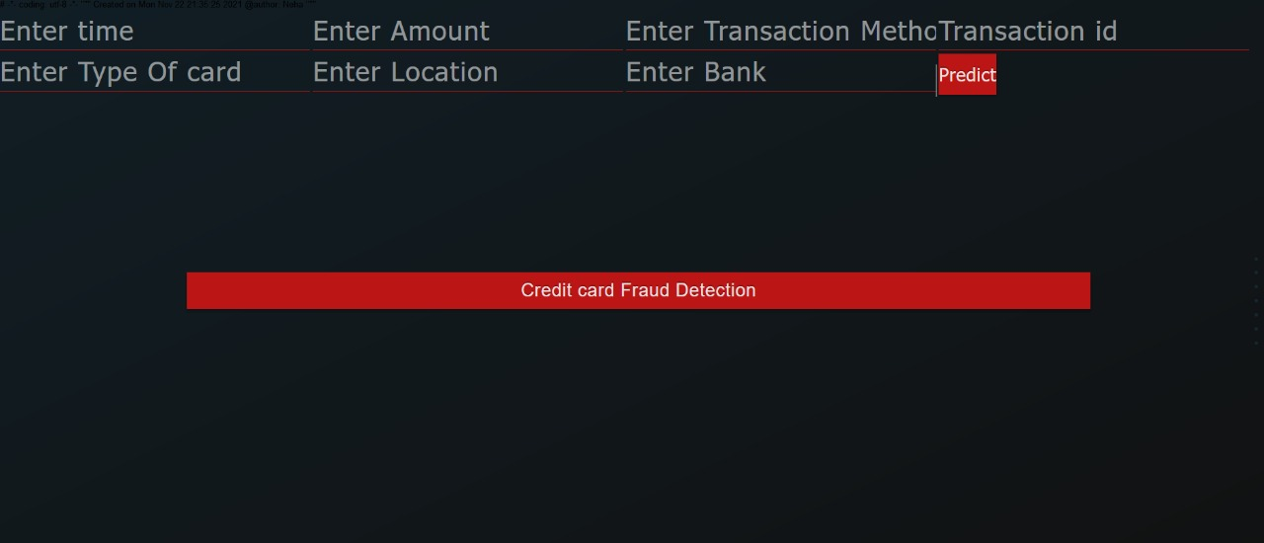
DEPLOYMENT
Screenshot -1

Slide 23
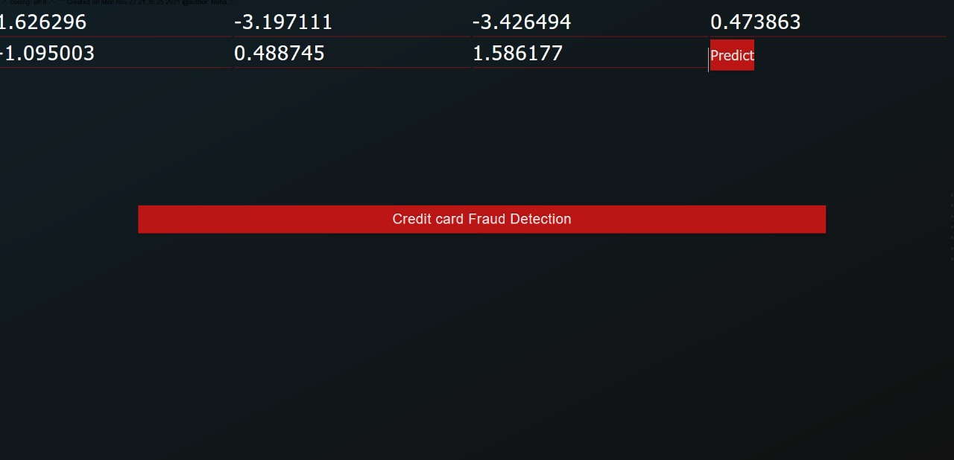
Screenshot -2

Slide 24
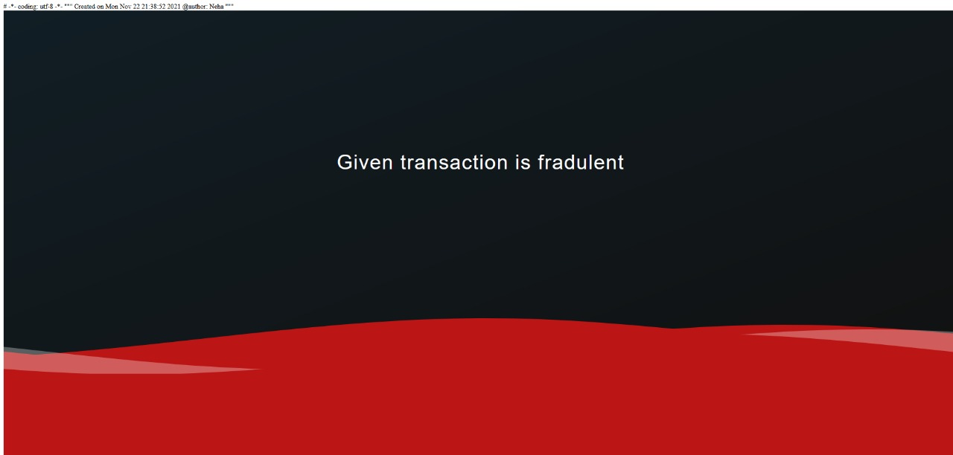
Screenshot -3

Slide 25
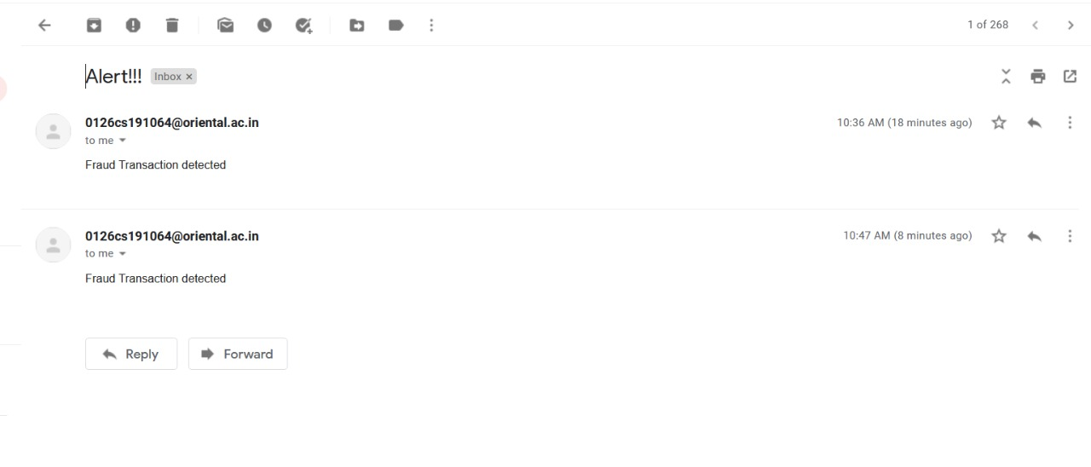
Screenshot -4 [Email sent from the bank]

Slide 26
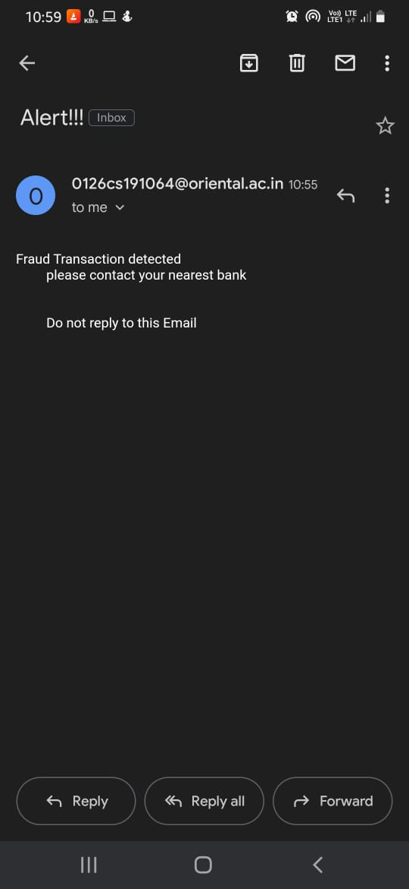
Screenshot -4 [Email received by the customer]

Slide 27
RESULT AND CONCLUSION:
Fraud detection system have become essential for banks and financial institution, to minimize their losses.
However, there is lack of published literature on credit card fraud detection techniques, due to unavailable credit card transaction dataset for researches.
We designed a system to detect fraud incredit card transaction.This system is capable of providing most of the essential features required to detect fraudulent and legitimate transactions.
The dataset available on day to day processing may become outdated, it is necessary to have updated data for effective fraud behaviour identification.

