Slide 1
Amazon Product Insights
Curated for Business Decisions
June 2025

Slide 2
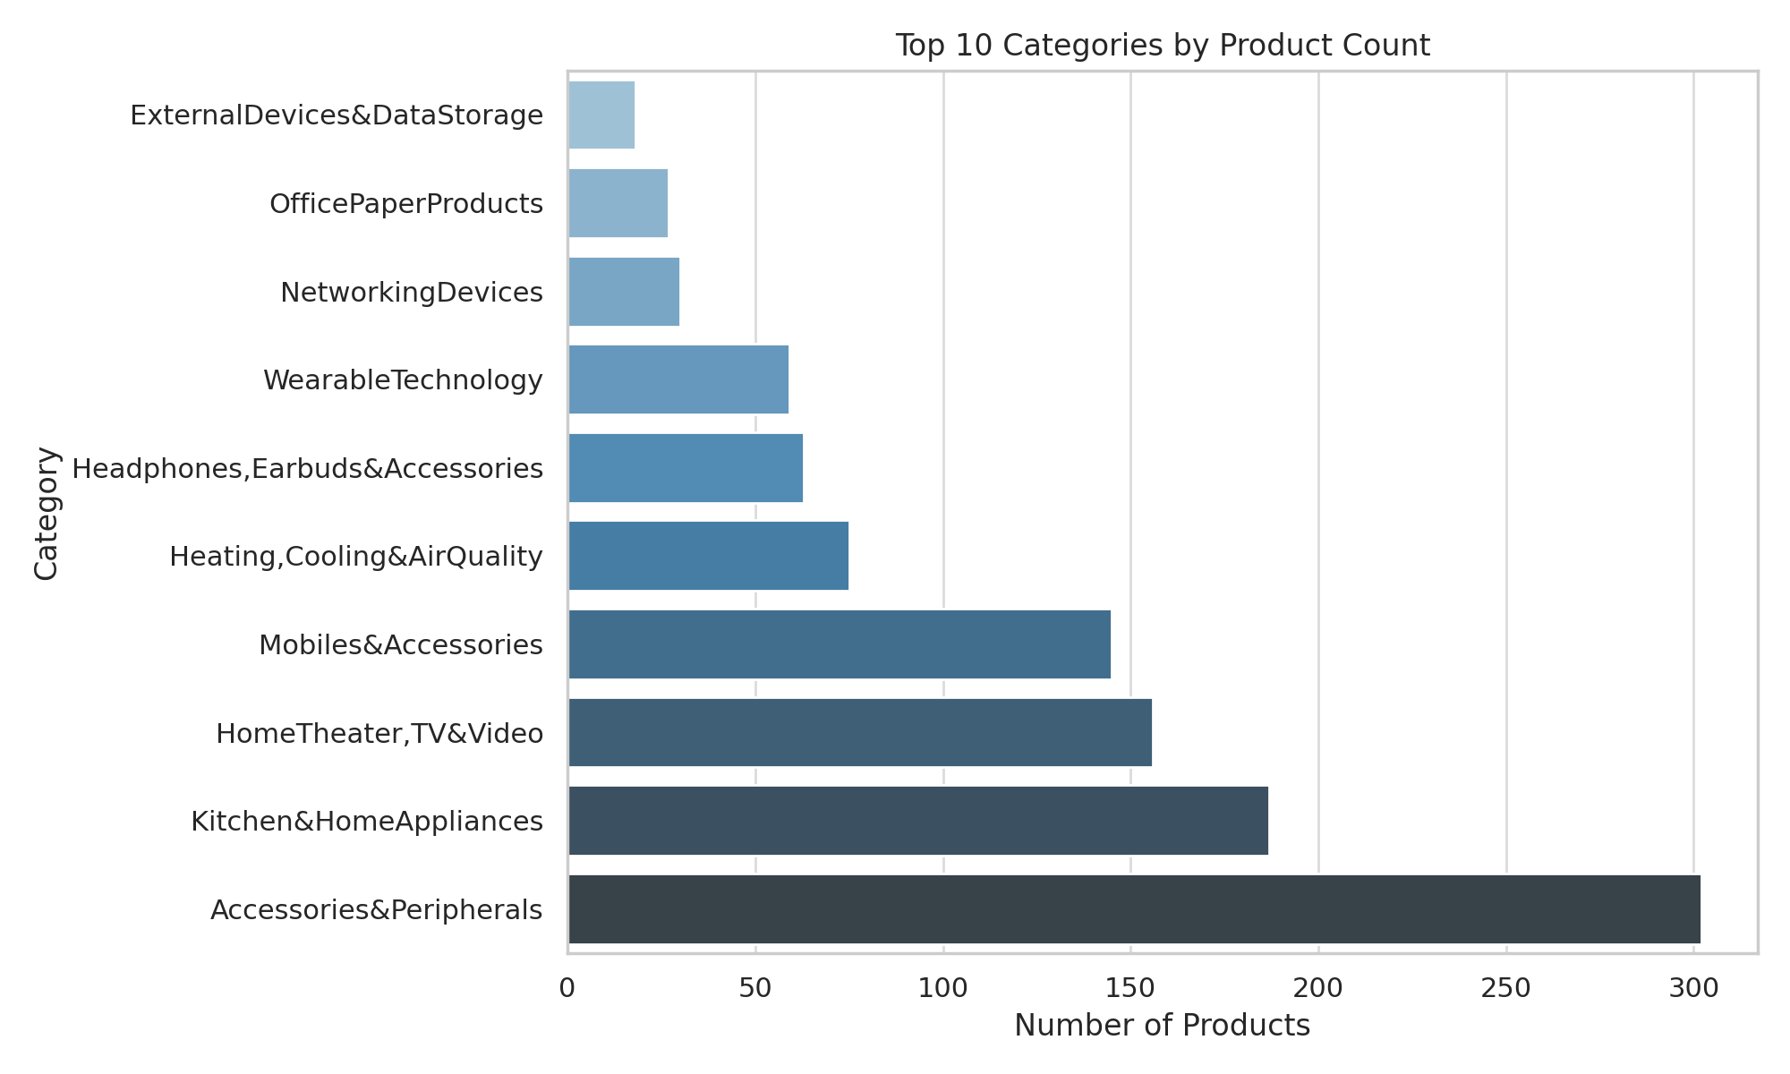
Dominant Product Categories
Key takeaway:
Accessories alone make up over a quarter of listings – competition is fiercest in low‑ticket add‑ons.

Slide 3
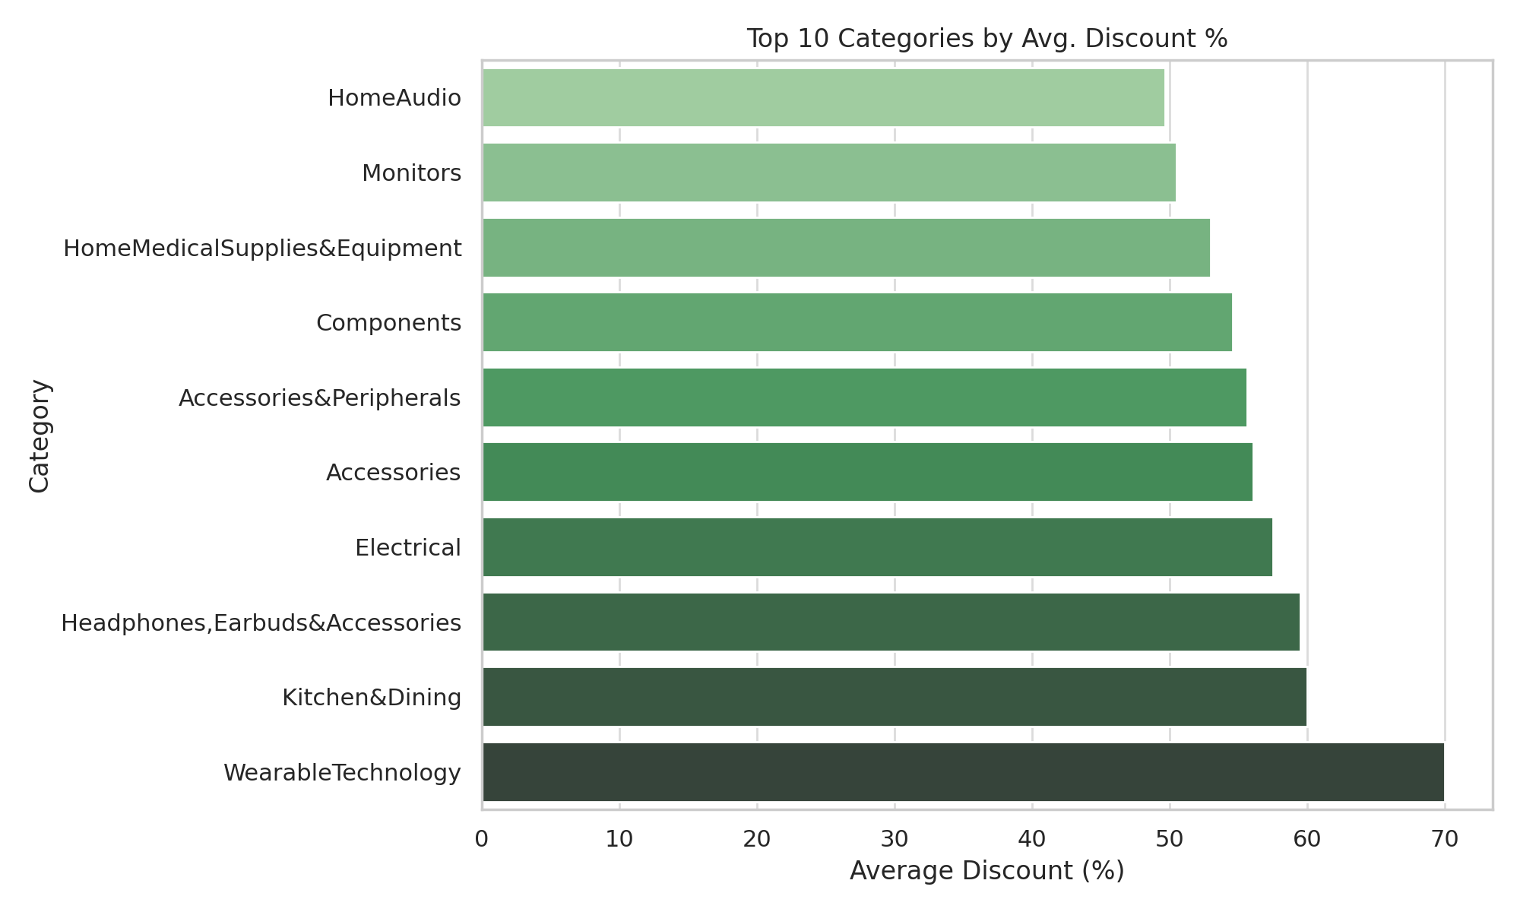
High Discount Zones
Key takeaway:
Wearables see the deepest average markdown (~70%), signalling a price‑led adoption push.

Slide 4
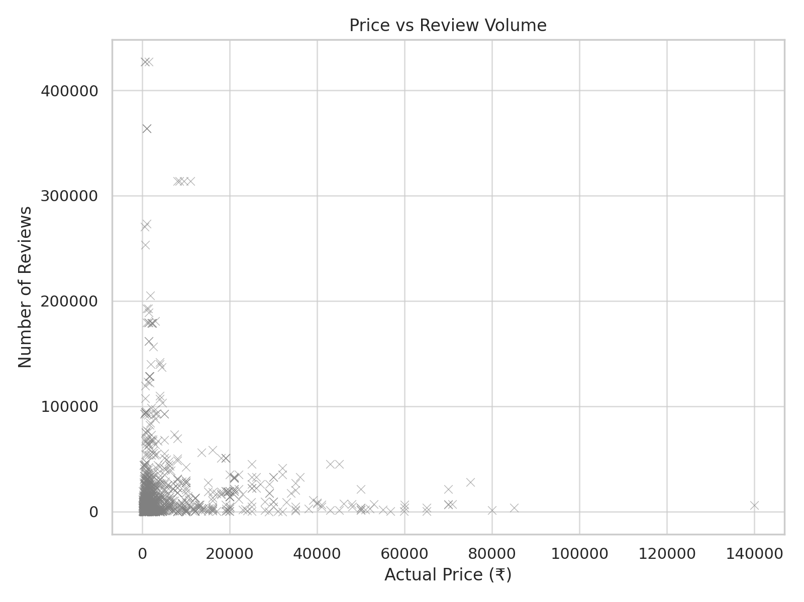
How Price Affects Engagement
Key takeaway:
Price has virtually no correlation with review buzz (ρ ≈ -0.04); perceived utility, not tag price, fuels engagement.

Slide 5
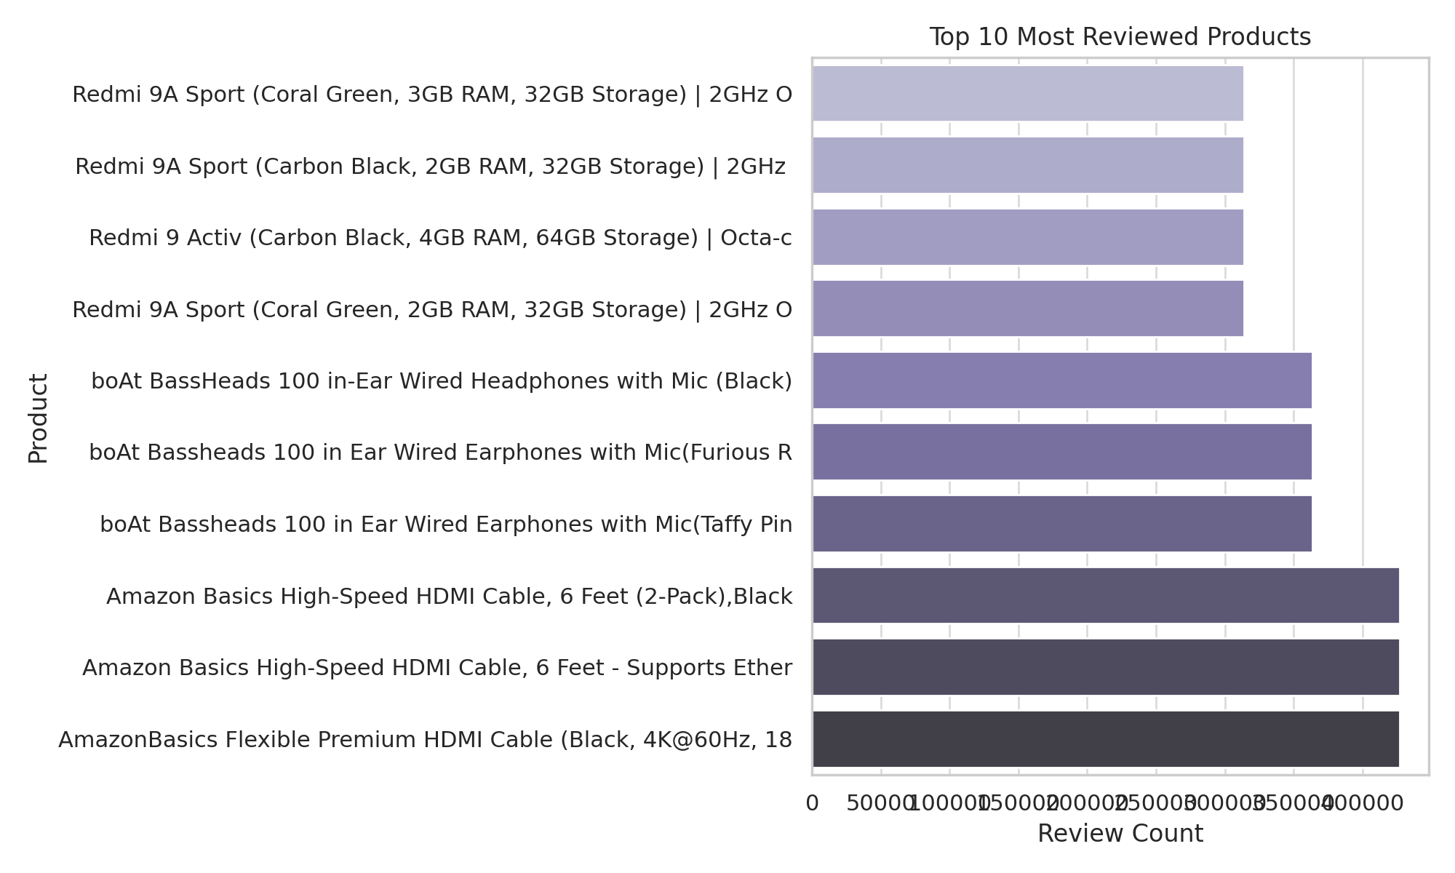
Top Performing SKUs by Engagement
Key takeaway:
Cheap, high‑utility items (e.g., HDMI cables) dominate the ‘voice of the customer’, spotlighting cross‑sell potential.

Slide 6
Summary: What You Should Know
📦 Accessories dominate the catalog — focus on pricing strategy here.
💸 Wearables are being pushed via high discounts — potential overstocking or strategic loss-leading.
📈 High review volume is mostly price-insensitive — signals brand affinity or utility.
🎯 Engagement hotspots are simple, cheap electronics — expand low-cost value offerings.

