Slide 1

Music Composer Classification Using LSTM and CNN Models
AAI-511 Module 7 Project
July 2025

Slide 2
Introduction
Classifying classical music by composer blends musicology and deep learning. Each composer has a distinctive style shaped by melodic patterns, harmonies, rhythms, and expressive choices. Using symbolic music data (MIDI), these stylistic traits can be analyzed for automated composer attribution.
This project focuses on four major composers — Bach, Beethoven, Chopin, and Mozart — chosen for their historical influence and the availability of high-quality MIDI files.
We compare three deep learning architectures:
LSTM – captures long-term temporal dependencies in note sequences
CNN – detects local temporal-spatial patterns
CNN-LSTM hybrid – combines CNN feature extraction with LSTM sequence modeling
The goal is to identify which model best distinguishes composers and to gain insights for future music classification research.

Slide 3

Dataset
• 400 MIDI files (100 per composer)
• Extracted features: pitch, duration, velocity
• Balanced classes
• Padded sequences for model input

Slide 4
Data Preprocessing
• Feature extraction with PrettyMIDI and Music21
• Standardized sequence length
• Train/test split for evaluation

Slide 5
Model Architectures
1. LSTM: 128 units → Dropout → Dense layers
2. CNN: Conv1D + MaxPooling → Dense layers
3. CNN-LSTM: Conv1D + MaxPooling → LSTM → Dense

Slide 6
Training Setup
• Epochs: 15
• Batch size: 32
• Optimizer: Adam
• Loss: Categorical crossentropy

Slide 7
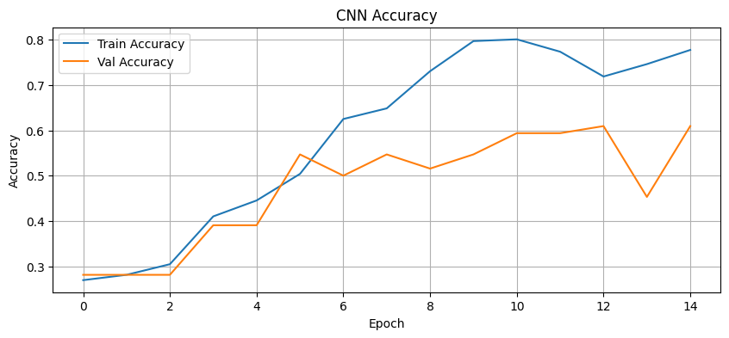
Results - LSTM
Validation Accuracy ≈ 64%
Balanced performance across classes.

Slide 8
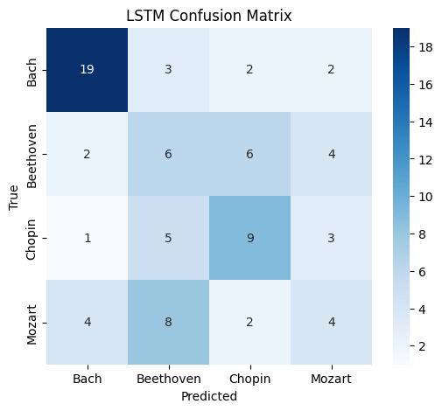
Results - CNN
Slightly lower accuracy than LSTM.

Slide 9
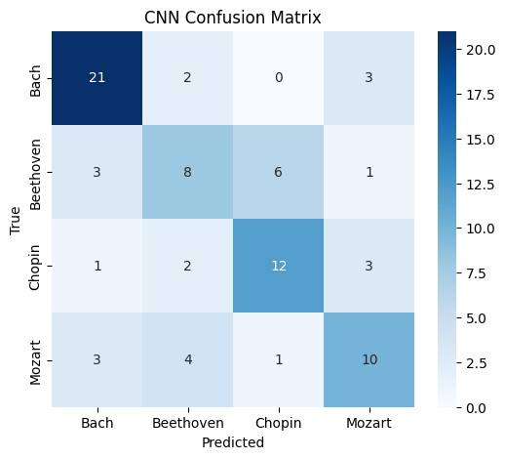
Results - CNN-LSTM
Accuracy ≈ 1%
Severe underfitting due to limited features.

Slide 10
Discussion
• LSTM outperforms CNN for sequential music data.
• Rich features (pitch, duration, velocity) are crucial.
• CNN-LSTM failed with reduced features.
• Small dataset limits generalization.

Slide 11
Conclusion & Future Work
• LSTM effective for composer classification from MIDI.
• Include more data for improved generalization.
• Explore transformer architectures.
• Data augmentation for symbolic music.

