Slide 1
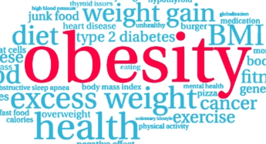

Obesity Prediction using Machine Learning
Leveraging lifestyle data to estimate obesity levels and support public health initiatives.
AAI 510 IN2 Module 7
Team 4
Neha Pandey, Aksdeep Singh, Sanjay Kumar

Slide 2

Introduction
Obesity is a global concern linked to chronic diseases.
This study uses real and synthetic data to predict obesity levels.
Goal: identify key factors and build accurate models.

Slide 3
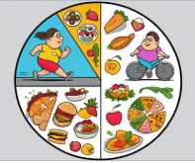
Problem Statement
Obesity influenced by genetics, environment, behavior.
Challenge: predict obesity using lifestyle data.
Dataset: mix of real and synthetic data from Kaggle.

Slide 4

Strategy
1. Develop Predictive Models
2. Identify Key Predictors
3. Enhance Public Health Strategies
4. Validate Model Robustness
5. Contribute to Personalized Healthcare

Slide 5
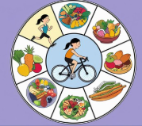
Methodology: Data Exploration
Dataset includes Height, Weight, Gender, lifestyle factors.
Add BMI as engineered feature
Target: 7 obesity levels.
Balanced class distribution with synthetic data handling.

Slide 6
Data Summary
To uncover patterns, trends, and anomalies that inform model building and feature engineering.
Dataset Summary
Rows: 2117,17
Features: Demographics, health metrics, lifestyle habits
Target: Obesity Level (categorical)
Variable Types
Numerical: Age, Weight, Height, Calories, BMI
Categorical: Gender, Activity Level, Obesity Class
Data Quality Checks
No major missing values
Outliers in calorie intake and BMI
Balanced class distribution?

Slide 7
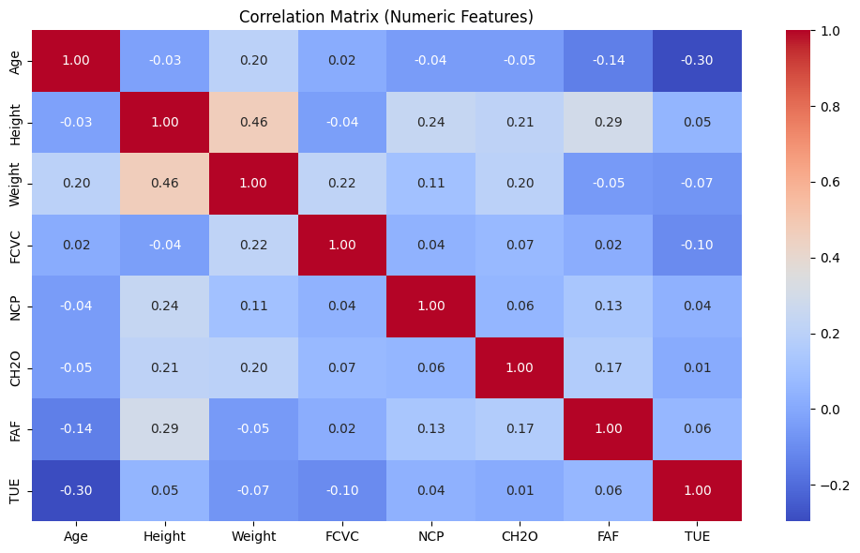
Key Findings from EDA
Feature Distributions
BMI and Weight are right-skewed
Calorie intake shows wide variance
Age mostly concentrated in young adults
Feature Relationships with Obesity
BMI: Strong positive correlation with obesity
Physical Activity: Inversely related
Fast Food & Screen Time: Mixed signals; possible nonlinear pattern
Correlation Insights
Strong correlation: Weight ↔ BMI ↔ Obesity
Low correlation: Sleep time, screen time

Slide 8
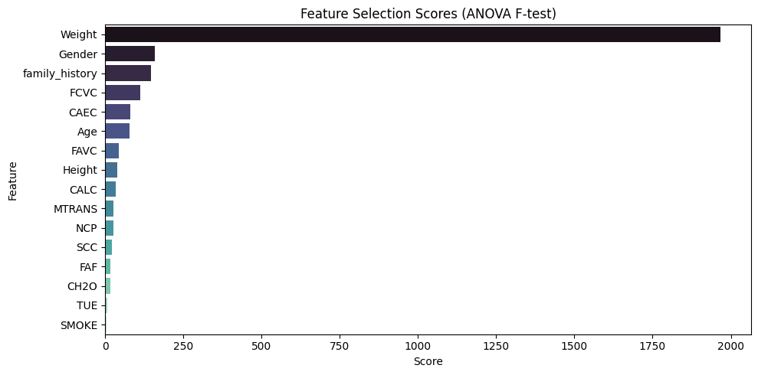
Features selected
Feature | Description
Weight | Body Weight (in kilograms)
Gender | Biological sex (Male / Female)
family_history | Family history of overweight (Yes / No)
FCVC | Frequency of vegetable consumption (Scale: 1–3)
CAEC | Consumption of food between meals (Never / Sometimes / Always)
Age | Age of the individual (in years)
FAVC | Frequent consumption of high-calorie food (Yes / No)
Height | Body Height (in meters)
CALC | Alcohol consumption frequency (Never / Sometimes / Frequently)
MTRANS | Mode of transportation (e.g., Walking, Car, Public Transport)

Slide 9
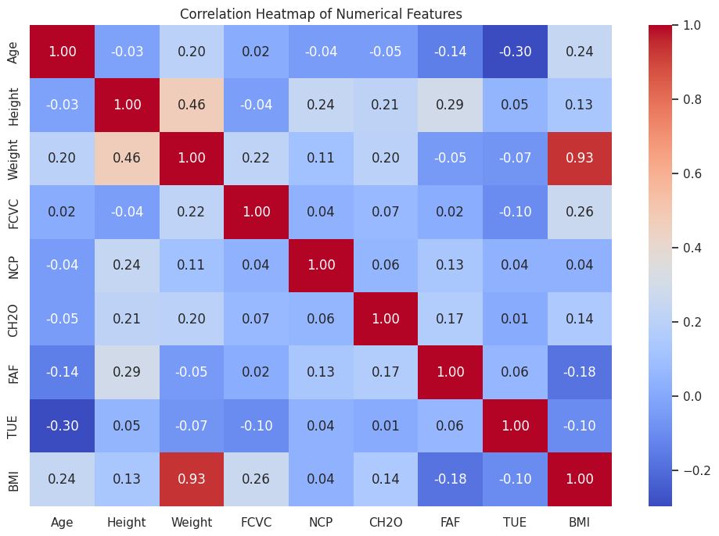
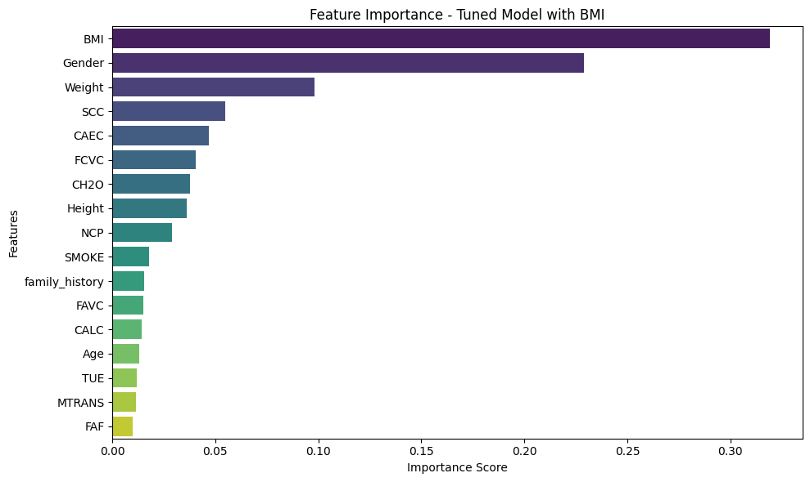
Feature EngIneering
Introduced BMI(Weight/Height2)
Observed that high BMI has high correlation with Obesity

Slide 10
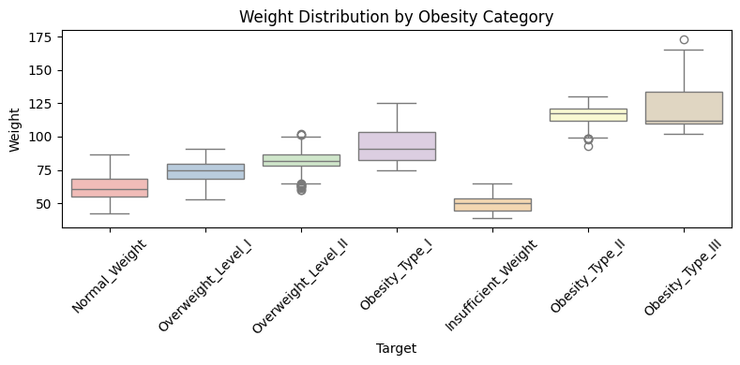
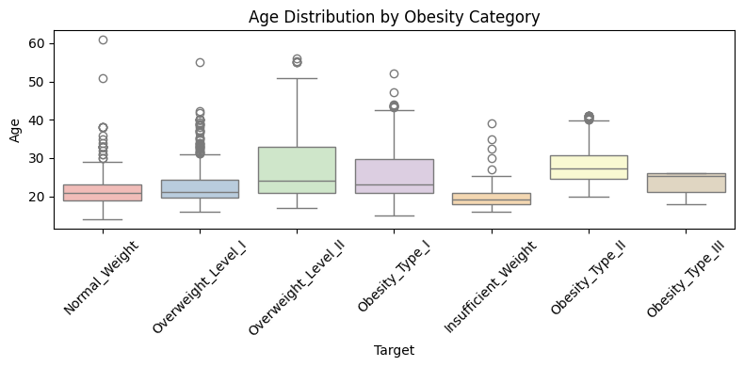
Take Aways
High BMI and low activity are strong obesity indicators
Feature scaling needed for skewed data

Slide 11
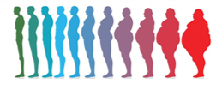
Baseline Model: XGBoost
Preprocessing with encoded features.
80-20 split, stratified.
Accuracy ~95.51% with minor misclassifications.

Slide 12
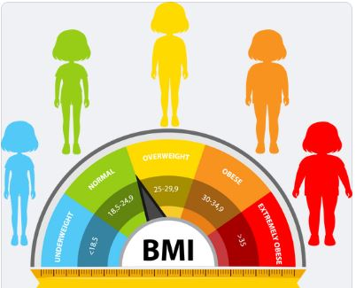
Tuned XGBoost Model
Added BMI feature.
Hyperparameter tuning with Grid Search (216 combinations).
Accuracy ~98.58%, high precision/recall across classes.

Slide 13
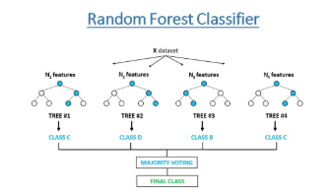
Random Forest Comparison
200 trees, max depth 10.
Accuracy ~96–97%.
More misclassifications than tuned XGBoost.

Slide 14

Model Evaluation
Tuned XGBoost outperforms others.
Confusion matrices show fewer errors.
BMI, Weight, Height most important features.

Slide 15
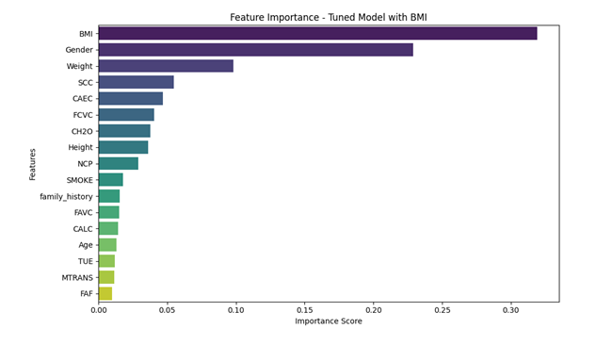
Visualizations
• Confusion Matrices
• Feature Importance
• Accuracy Comparison
• Classification Heatmaps
• BMI Distribution
• PCA/UMAP Plots

Slide 16
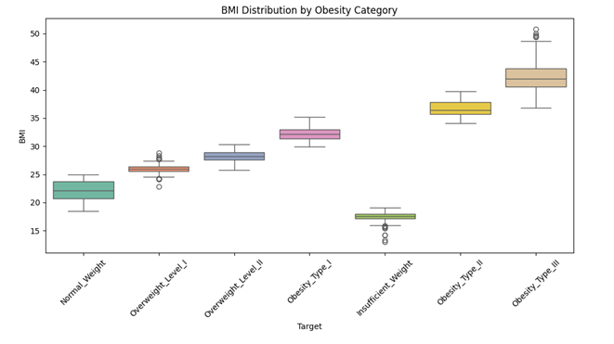
Visualizations
• Confusion Matrices
• Feature Importance
• Accuracy Comparison
• Classification Heatmaps
• BMI Distribution Box-plot
• PCA/UMAP Plots

Slide 17
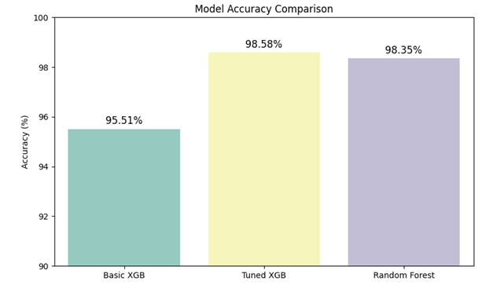
Results Summary
• Tuned XGBoost ~98.58%
• BMI dominant predictor
• Strong class separability (PCA/UMAP)
• Robust and generalizable models

Slide 18
Practical Applications
• Clinical Decision Support
• Health Apps
• Public Health Policy
• Personalized Healthcare
• Corporate Wellness

Slide 19
Challenges and Enhancements
• Validate with real data
• Prevent overfitting
• Add SHAP for explainability
• Explore LightGBM, neural networks

Slide 20
Conclusion
High-accuracy models and impactful insights.
Supports public health and personalized care.
Future-ready for research.

