Slide 1
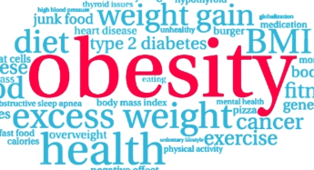

Obesity Prediction using Machine Learning
Leveraging lifestyle data to estimate obesity levels and support public health initiatives.
AAI 510 IN2 Module 7
Team 4
Neha Pandey, Aksdeep Singh, Sanjay Kumar

Slide 2

Introduction
Obesity is a global concern linked to chronic diseases.
This study uses real and synthetic data to predict obesity levels.
Goal: identify key factors and build accurate models.

Slide 3
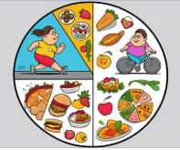
Problem Statement
Obesity influenced by genetics, environment, behavior.
Challenge: predict obesity using lifestyle data.
Dataset: mix of real and synthetic data from Kaggle.

Slide 4

Strategy
1. Develop Predictive Models
2. Identify Key Predictors
3. Enhance Public Health Strategies
4. Validate Model Robustness
5. Contribute to Personalized Healthcare

Slide 5

Methodology: Data Exploration
Dataset includes Height, Weight, Gender, lifestyle factors.
Target: 7 obesity levels.
Balanced class distribution with synthetic data handling.

Slide 6
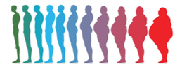
Baseline Model: XGBoost
Preprocessing with encoded features.
80-20 split, stratified.
Accuracy ~95.51% with minor misclassifications.

Slide 7
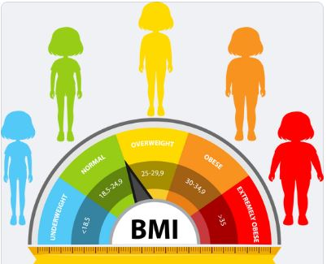
Tuned XGBoost Model
Added BMI feature.
Hyperparameter tuning with Grid Search (216 combinations).
Accuracy ~98.58%, high precision/recall across classes.

Slide 8
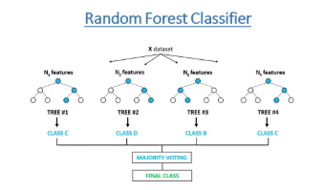
Random Forest Comparison
200 trees, max depth 10.
Accuracy ~96–97%.
More misclassifications than tuned XGBoost.

Slide 9

Model Evaluation
Tuned XGBoost outperforms others.
Confusion matrices show fewer errors.
BMI, Weight, Height most important features.

Slide 10
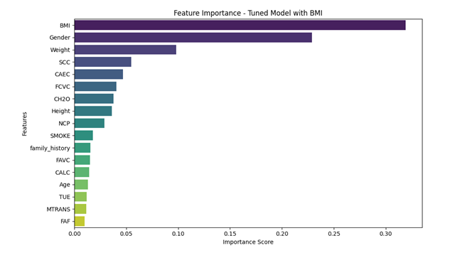
Visualizations
• Confusion Matrices
• Feature Importance
• Accuracy Comparison
• Classification Heatmaps
• BMI Distribution
• PCA/UMAP Plots

Slide 11
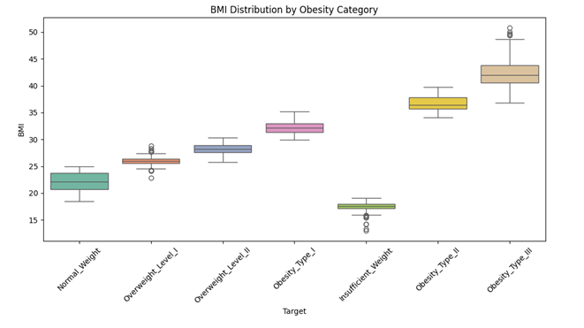
Visualizations
• Confusion Matrices
• Feature Importance
• Accuracy Comparison
• Classification Heatmaps
• BMI Distribution Box-plot
• PCA/UMAP Plots

Slide 12
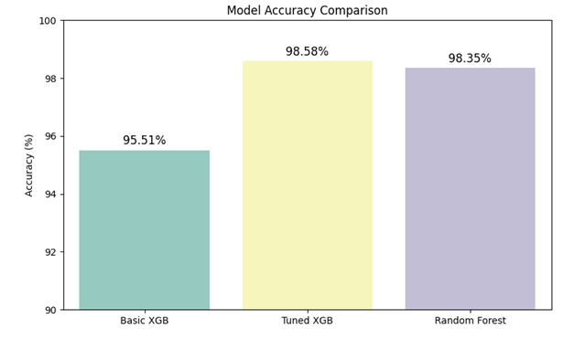
Results Summary
• Tuned XGBoost ~98.58%
• BMI dominant predictor
• Strong class separability (PCA/UMAP)
• Robust and generalizable models

Slide 13
Practical Applications
• Clinical Decision Support
• Health Apps
• Public Health Policy
• Personalized Healthcare
• Corporate Wellness

Slide 14
Challenges and Enhancements
• Validate with real data
• Prevent overfitting
• Add SHAP for explainability
• Explore LightGBM, neural networks

Slide 15
Conclusion
High-accuracy models and impactful insights.
Supports public health and personalized care.
Future-ready for research.

