Slide 1

Global Superstore: Profit Analysis
-Neha Patange
Sinhgad Academy of Engineering

Slide 2

PROBLEM STATEMENT
We have a dataset from a superstore containing various parameters, including customer details, sales data, regional information, types of items purchased, and the corresponding profit for each item.
Our goal is to maximize profits by identifying and prioritizing the more profitable items. We aim to enhance the production and distribution of these high-profit items. Additionally, we need to develop a strategy to address intermediate profit levels and reduce the production of less profitable items.

Slide 3
Project Overview:
For the global supermarket we need to
Increase profit
Increase production of most soled and profitable products
Decrease less sold and less profitable products
Reduce the discount
Find strategies to tackle less profit and intermediate sales problems.
This approach aims to significantly enhance overall profitability while optimizing resource allocation across the product range.

Slide 4

WHO ARE THE END USERS?
The Superstore:
- More Profit generated
- Less discount to less profitable/sold products result in less loss
- Production extended hence sales increase
The Customers:
- Increased production hence more availability of products
- Optimized price hence affordable
-Tailored product selection and production hence required products are always available.

Slide 5
Project Description:
Sales vs City
Maximum and Minimum Sales by City
- The city with the maximum sales is New York City, with sales amounting to 256K. Other cities with notable sales over 112K include Los Angeles, Manila, Seattle, and San Francisco.
- The city with the minimum sales is Abilene, with other cities like Elyria, Jupiter, and Pensacola also having sales less than 2.21K.
Sales vs Ship Mode
Profit Relation to Shipping Mode
- The Standard Class shipping mode yields the highest profit, totalling to 890.6K or 60.69% of the profits. It is followed by Second Class shipping at 19.94%.
- The Same Day shipping mode results in the least profit, contributing only 5.19%, followed by First Day shipping at 14.18%.
Sales vs Customer Segment
Major Customer Segments
- The major customer segments identified are Consumer, Corporate, and Home Office.
Highest and Lowest Sales by Customer Segment
- The Consumer segment accounts for the highest sales, totaling to 6.51M or 51.48%.
- The Home Office segment has the lowest sales at 2.31M or 18.27%.
- The Corporate segment falls in the intermediate range with 3.82M or 30.25% of the sales.

Slide 6
Customer Segment vs Profit
Highest and Lowest Profit by Customer Segment
- The Consumer segment provides the highest profit at 749.24K.
- The Home Office segment generates the lowest profit at 277.00K.
- The Corporate segment yields an intermediate profit of 441.21K.
Customer Segment vs Product Category
Profit vs Product Category
- The Technology sector generates the highest profit at 663.78K, representing 45.23% of total profits.
- The Furniture sector produces the least profit at 285.08K, which is 19.43% of total profits.
- The Office Supplies category earns an intermediate profit of 518.6K, accounting for 35.34% of total profits.

Slide 7

Methodology:
Getting data.
Selecting the important datasets.
Loading data in Power Bi report.
Extracting data.
Cleaning dataset
Finding relationship between different aspects in the data set.
Plotting the relationship with appropriate visuals.

Slide 8
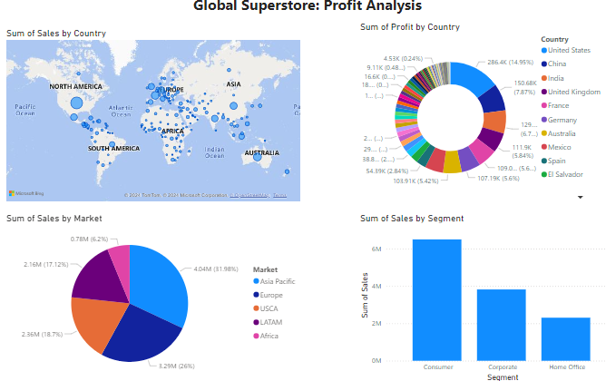
RESULTS:
Click here

Slide 9
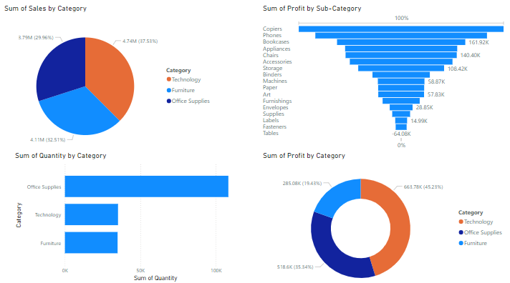

Slide 10
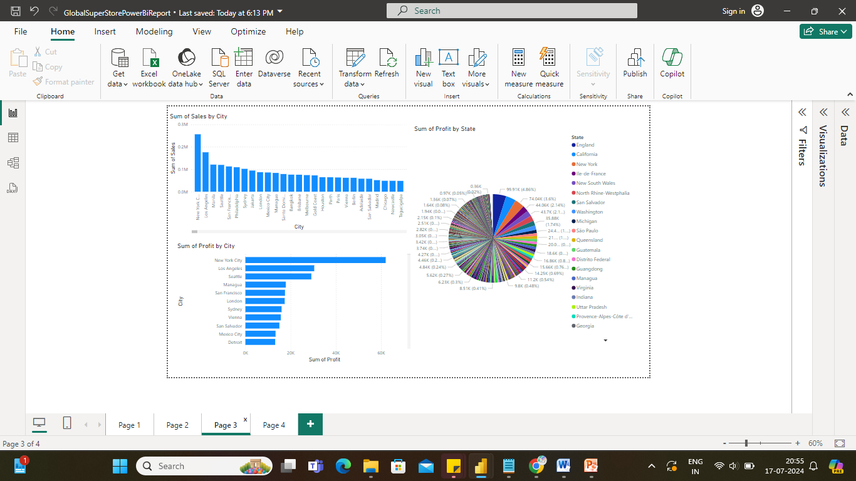

Slide 11
Thank you ☺
.
.

