Slide 1


Emergency-Room Triage & Patient Priority System
A Java-based Patient Priority Management System
S. Neha Patnaik – 2620040133
Yuthikhaa Bellamkonda – 2620040055
Section 2

Slide 2


What is Emergency-Room Triage?
The Problem
The Solution
Emergency rooms receive patients with different urgency levels
Treating patients by arrival order delays critical cases
Manual prioritization becomes difficult under high load
A structured, automated priority system
Java-based program to organize patients
Assigns priority based on clinical values
Displays patients in treatment order

Slide 3
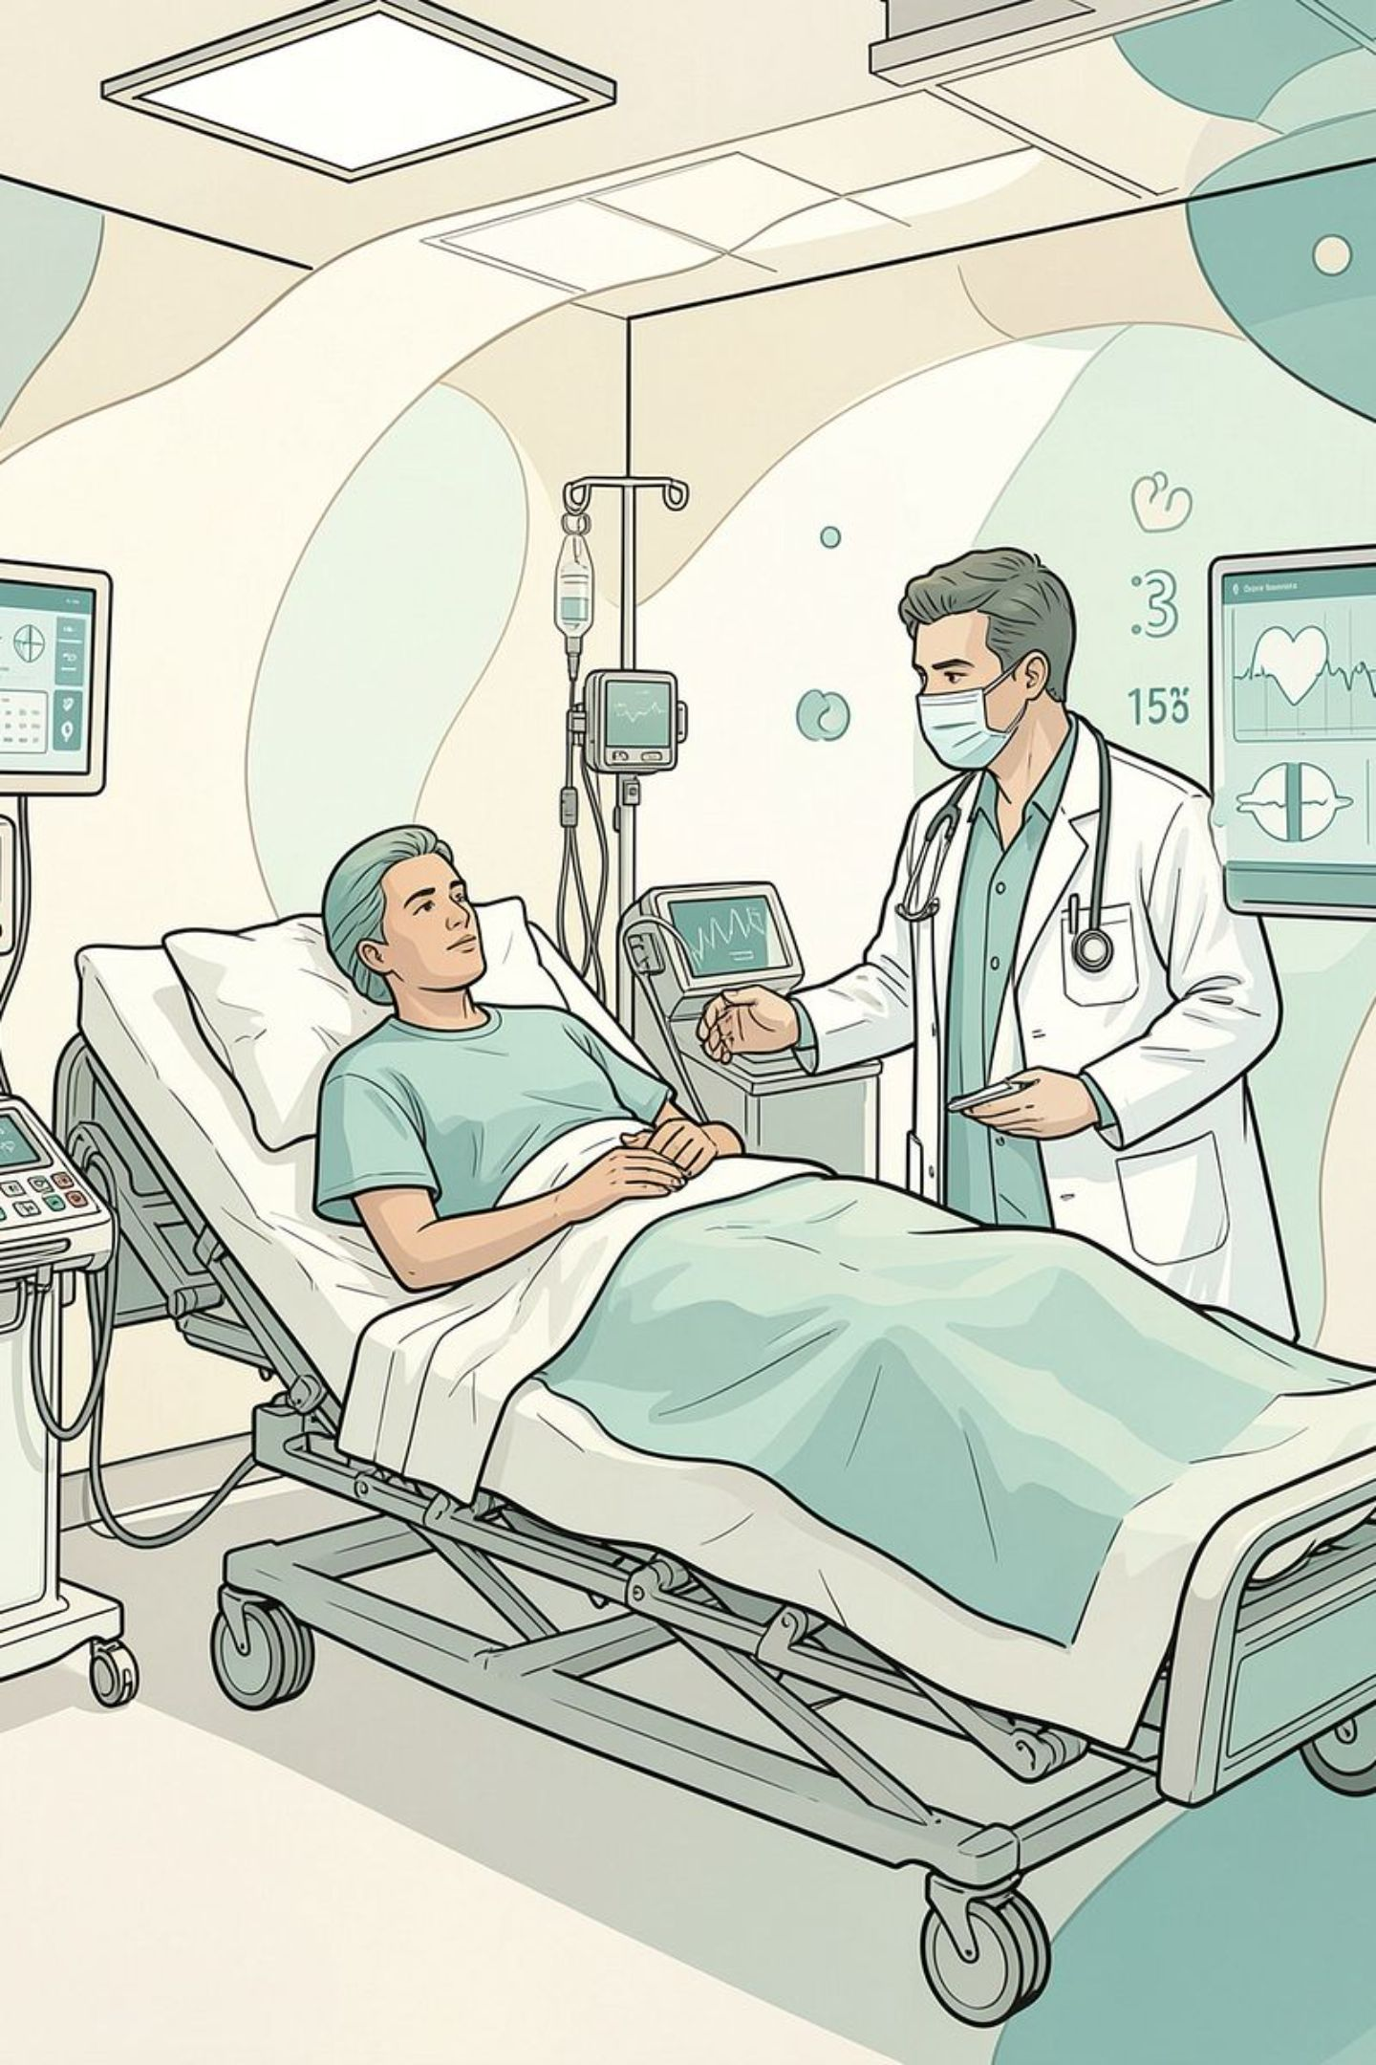





Project Objectives
Our system is designed to achieve the following core objectives:
Register Patient Information
Accept Clinical Values
Capture patient name, age, and clinical data
Input heart rate and oxygen level
Calculate Priority Automatically
Categorize Patients
Organize into Emergency, Urgent, and Non-Urgent
Apply predefined rules to assign priority level
Display Results
Show organized patient information and statistics

Slide 4






System Workflow
Patient Registration
Data Input
Priority Calculation
Capture name and age
Enter heart rate and oxygen level
Apply rules to determine priority
Patient Categorization
Display Results
Emergency Alert
Assign to Emergency/Urgent/Non-Urgent
Show organized patient list
Notify staff for priority of one patient

Slide 5






Advantages
Simple and Easy to Use
Faster Priority Assignment
Reduces Confusion
Menu-driven interface requires minimal training
Automated calculation reduces manual work
Clear, organized patient categorization
Organized Information
Educational Value
Menu-Driven Interaction
All patient data stored and displayed systematically
Demonstrates automated triage logic using basic Java
User-friendly console interface

Slide 6

Limitations
Console-Based Interface
Fixed Patient Capacity
No Data Persistence
Limited by array size
Patient data is not permanently stored
No graphical user interface
Simplified Rules
Not a Clinical Protocol
Manual Data Entry
Uses basic predefined priority rules
Does not represent a complete medical triage protocol
Requires user to input all information

Slide 7







Future Scope
FUTURE ENHANCEMENTS
Graphical User Interface
Database Integration
Secure Patient Records
Replace console with a modern GUI
Store patient records permanently
Implement data security and privacy
Extended Parameters
Advanced Triage Rules
Reports and Dashboards
Include more clinical measurements
Implement more sophisticated priority algorithms
Generate analytics and visualizations
Hospital System Integration
Connect with existing hospital infrastructure

Slide 8
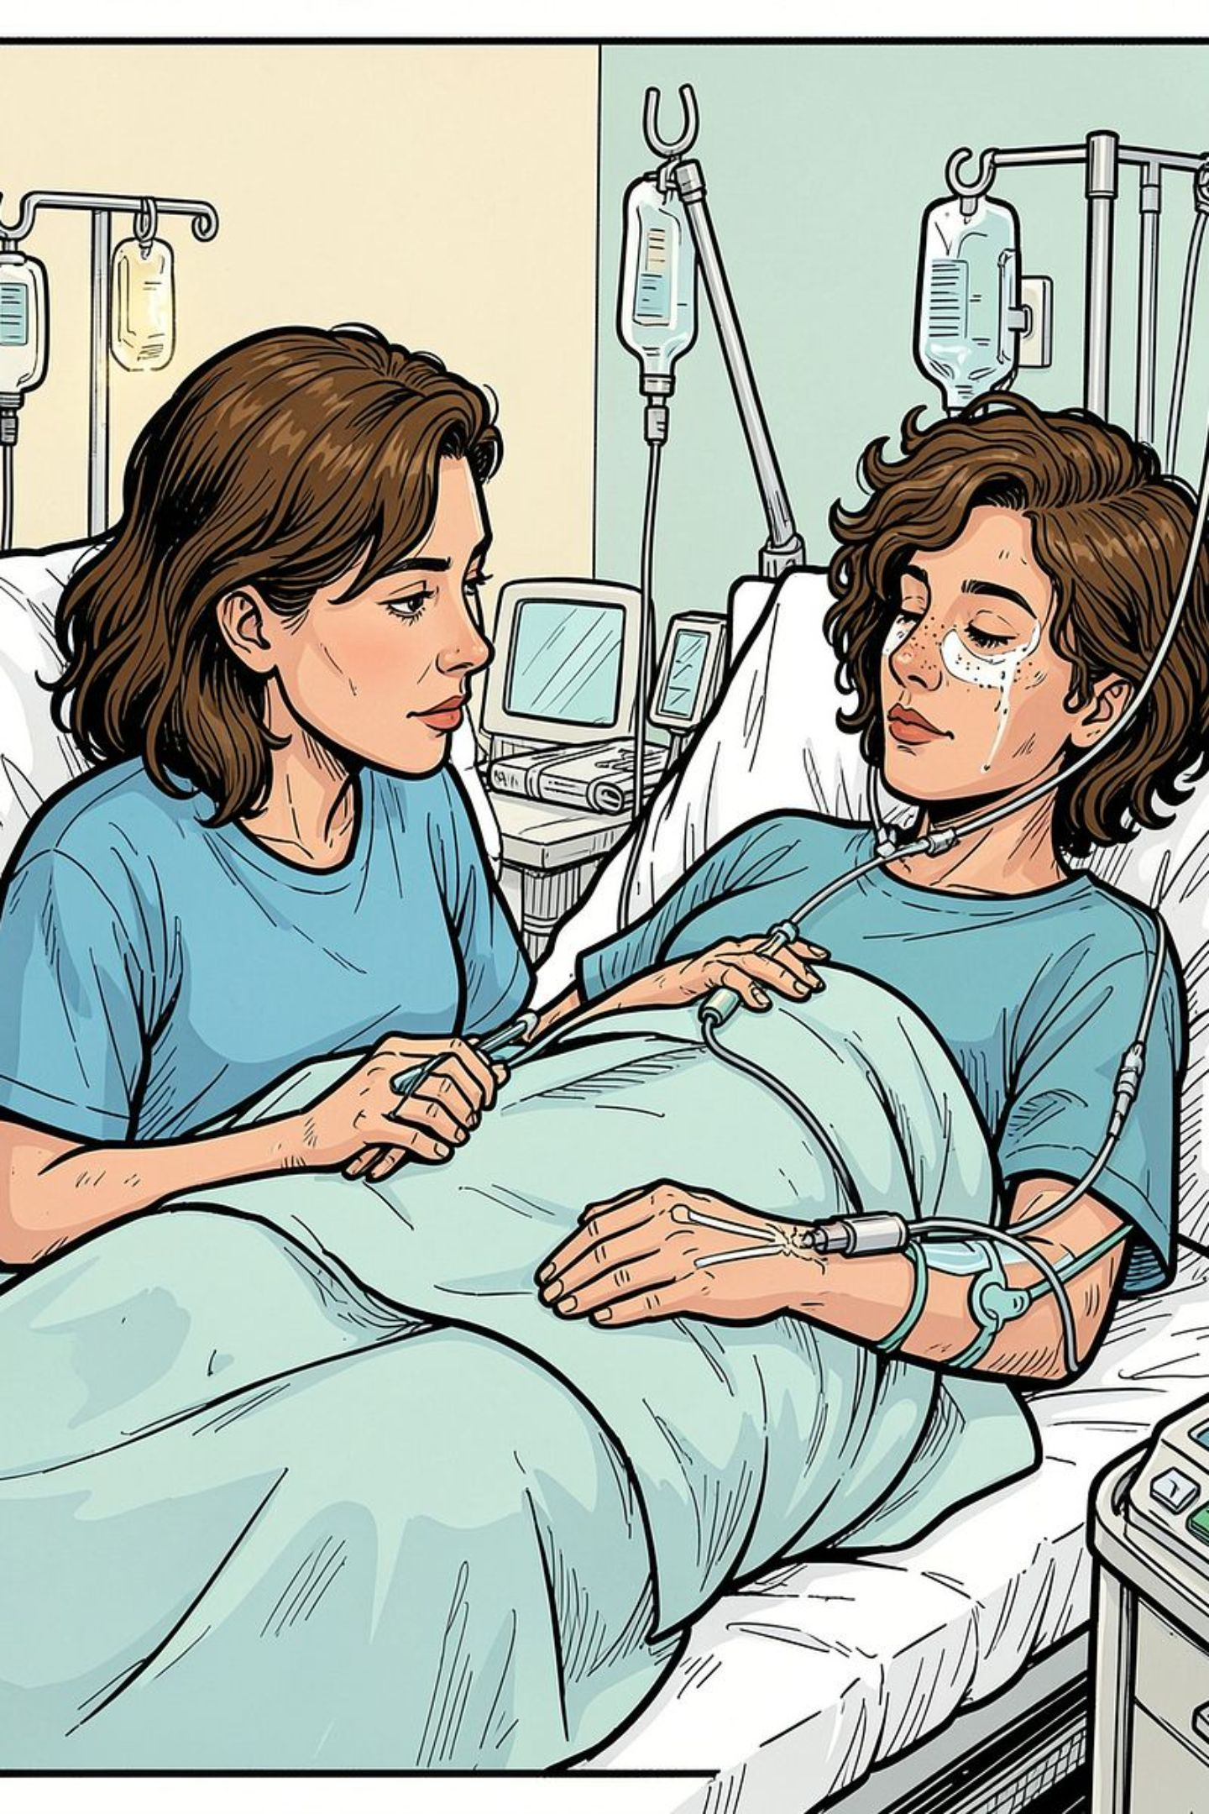
Project Development
Development Approach:
Designed the menu-driven program
Created arrays to store patient information
Created methods for separate tasks
Implemented priority calculation using conditions
Used loops for displaying and processing records
Used a 2D array for department-related data
Tested the program using different patient inputs

Slide 9
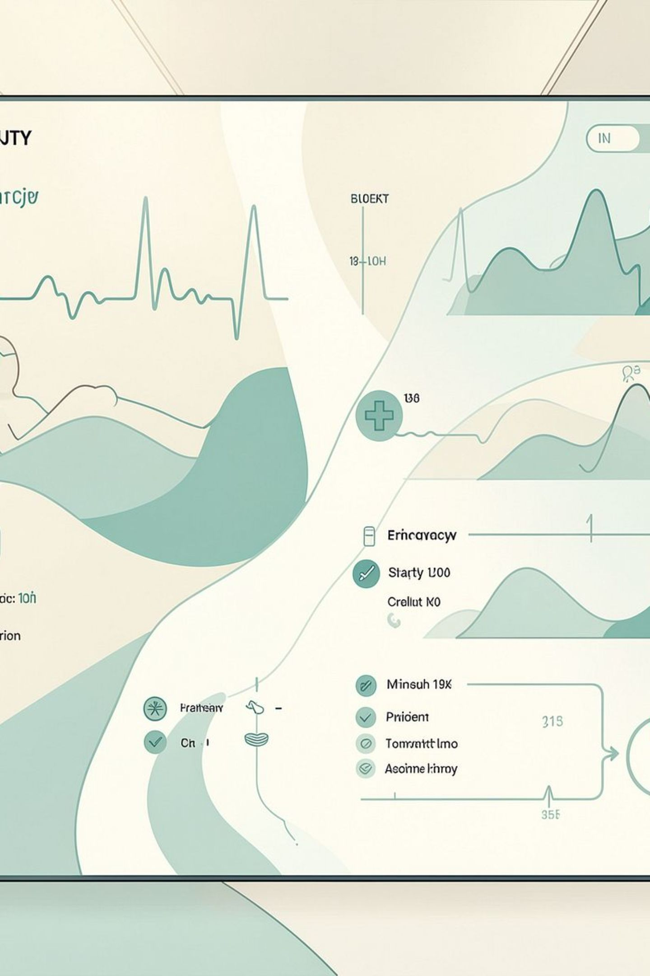



Course Outcomes (COs)
Programming Fundamentals
Problem Solving
Use of conditions, loops and methods to implement the triage logic.
Application of Java syntax, variables, data types, operators and input handling.
Data Organization
Use of 1D arrays and 2D arrays to store and process project data.

Slide 10

Topics & Concepts Covered
Variables & Data Types
Scanner
Operators
if / else-if / else
switch-case
for loop
do-while loop
break
Methods
Method Overloading
1D Arrays
2D Arrays

