Slide 1
Scalability of Spectral Clustering
Course: CSE-5095-Big Data Analytics
Prof. Fei Wang
- Neha Gadigi & Spandana Vallabhaneni
Date

Slide 2
Introduction
Clustering :
method of grouping a set of objects.
Similar objects into one group
Dissimilar objects into different groups
Unsupervised learning – No predefined classes
Traditional clustering algorithms work well only on convex shape data.
Spectral clustering works well on non-convex shaped data
Pair wise similarity.
Notes:
Becomes challenging because the data is not labeled.
Convex shaped data as they take into account only the affinity towards some center points.

Slide 3
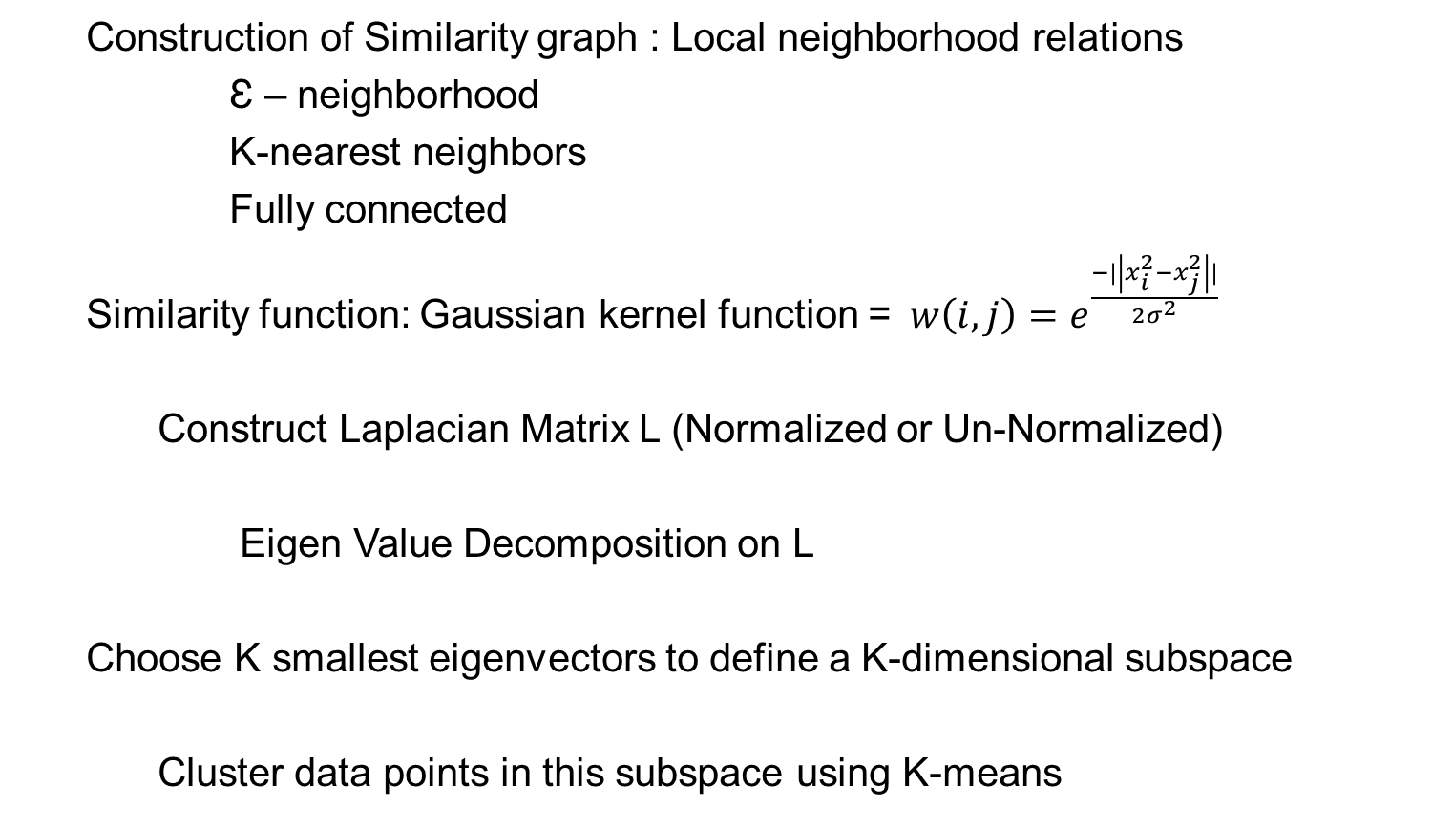
General Spectral Clustering
Construction of Similarity graph : Local neighborhood relations
Ɛ – neighborhood
K-nearest neighbors
Fully connected
Similarity function: Gaussian kernel function =$w\left(i,j\right)=e^{\frac{−|\left|x_{i}^{2}−x_{j}^{2}\right||}{2σ^{2}}}$
Construct Laplacian Matrix L (Normalized or Un-Normalized)
Eigen Value Decomposition on L
Choose K smallest eigenvectors to define a K-dimensional subspace
Cluster data points in this subspace using K-means
Notes:
Becomes challenging because the data is not labeled.
Convex shaped data as they take into account only the affinity towards some center points.

Slide 4
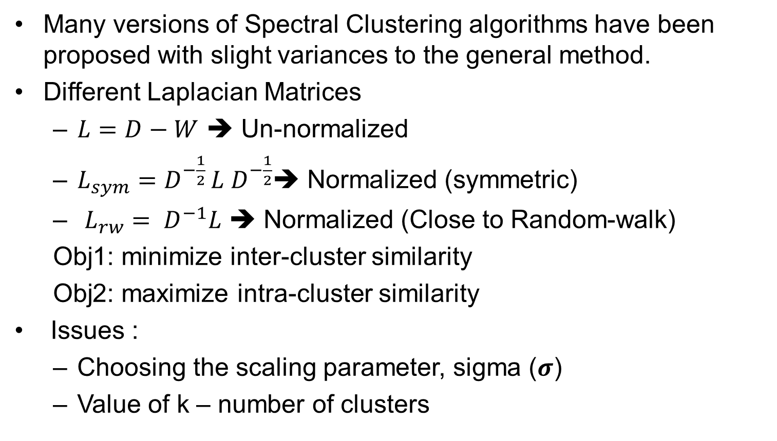
Spectral Clustering
Many versions of Spectral Clustering algorithms have been proposed with slight variances to the general method.
Different Laplacian Matrices
$L=D−W$ ➔ Un-normalized
$L_{sym}=D^{−\frac{1}{2} }L{ D}^{−\frac{1}{2}}$➔ Normalized (symmetric)
$L_{rw}={ D}^{−1}L$ ➔ Normalized (Close to Random-walk)
Obj1: minimize inter-cluster similarity
Obj2: maximize intra-cluster similarity
Issues :
Choosing the scaling parameter, sigma ($σ$)
Value of k – number of clusters
Notes:
storing the large similarity matrix consumes a lot of memory
Maybe replace between-cluster with inter-cluster and
Within-cluster with intra-cluste
We discuss which one is better Lsym or Lrw and why?
Here we discuss about how changing the sigma helps

Slide 5
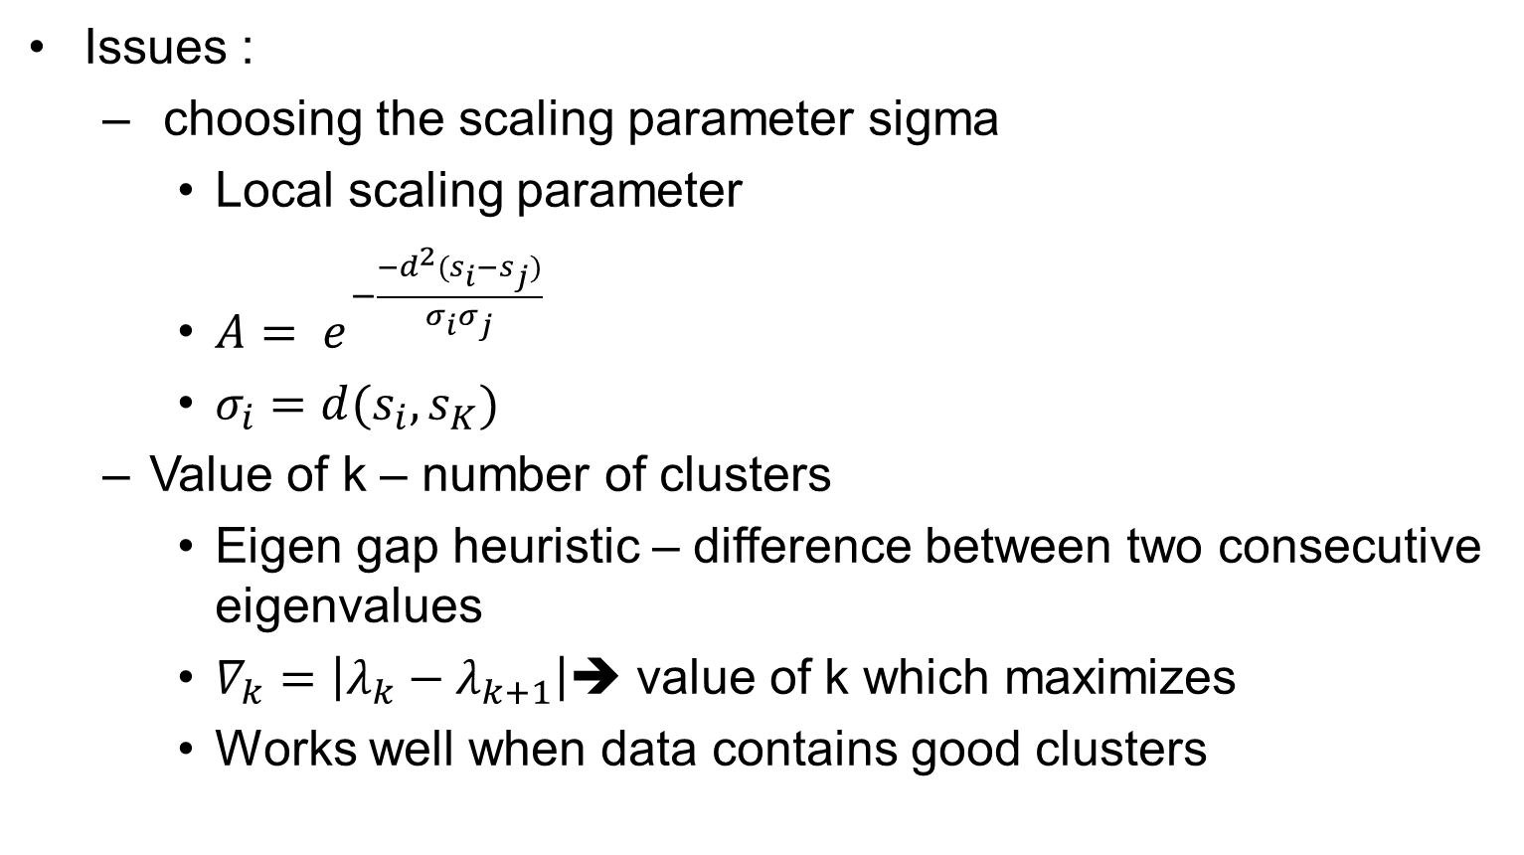
Spectral Clustering
Issues :
choosing the scaling parameter sigma
Local scaling parameter
$A= e^{−\frac{−d^{2}(s_{i}−s_{j})}{σ_{i}σ_{j}}}$
$σ_{i}=d(s_{i},s_{K})$
Value of k – number of clusters
Eigen gap heuristic – difference between two consecutive eigenvalues
$∇_{k}=\left|λ_{k}−λ_{k+1}\right|$➔ value of k which maximizes
Works well when data contains good clusters
Notes:
storing the large similarity matrix consumes a lot of memory
Most stable clustering is generally given by the value k that maximizes the expression

Slide 6

Scalability
Fails to work efficiently on large datasets
Construction of similarity matrix and storing it : Memory inefficient${O(n}^{2}).$
Eigen Value Decomposition :
Computationally expensive ${O(n}^{3}).$
Notes:
storing the large similarity matrix consumes a lot of memory.
Thus, when provided with a large data set, spectral clustering fails to perform efficiently.

Slide 7
Scalability Approaches
Goal: How many data points can it scale up to on a single machine.
Basic Approaches:
Sample-out p points as representive data points (p << n ).
Zero out some elements in the similarity matrix - Sparse
Call sparse Eigen solver – calculate k largest or smallest eigenvectors.
Lanczos method: It is direct method used to compute k outermost eigen values and eigenvectors approximately.
Arnoldi Iterative: An iterative method used to find out most useful eigenvalues and eigenvectors with limited number of operations.
Iterative methods: procedure which generates a sequence of improving approximate solutions.

Slide 8
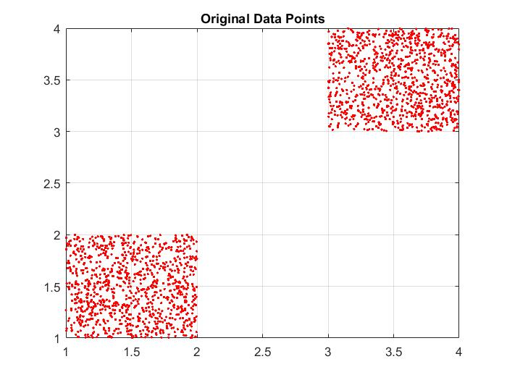
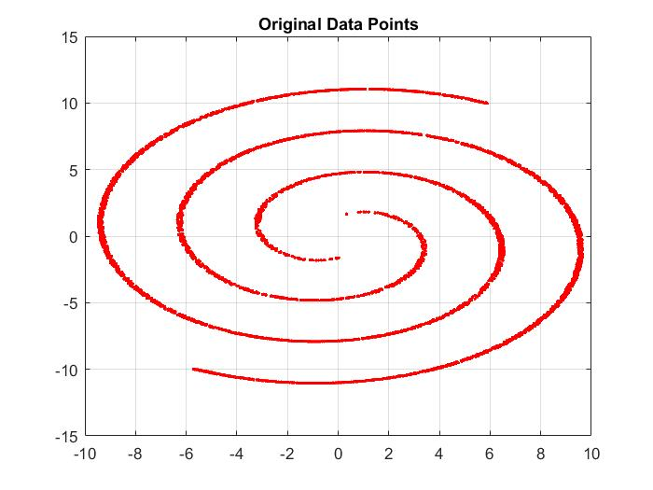
Tools and Data
Matlab R2015 a
Processor specifications: Intel®Core™ i7-3540M CPU @ 3.00GHz 3.00 GHz, RAM: 8.00 GB System type: 64-bit Operating System.
Synthetic Data

Slide 9

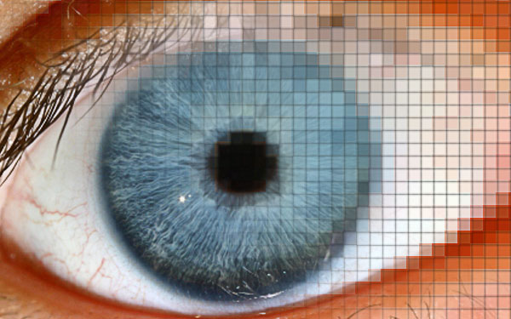
Data
Real Data - Images
Points = 6,670 Points = 82,893
Pixel = 130 * 132 Pixel = 600 * 375
Points = 461,847
Pixel = 5464*8192

Slide 10

NJW Algorithm
Ng, Jordan and Weiss : $L_{sym}=D^{−\frac{1}{2} }L{ D}^{−\frac{1}{2}}$
Experimentation results on synthetic dataset:
Data points | Time | Comment
1000 | 2mins | Successful
5000 | 3.35 mins | Successful
10000 | 85% memory used & 40% CPU 25 minutes | Successful
20000 |  | System crash

Slide 11
Parallel and Distributed Spectral Clustering (PSC)
Parallel and Distributed Spectral Clustering:
Construct sparse similarity matrix using k-nearest neighbors
Call Sparse Eigen Solver – Arnoldi Factorization(eigs())
Cluster using k-means
Reason for using the above:
Efficient construction of similarity matrix by dividing the data matrix into blocks and process the blocks sequentially, which alleviates the memory use
Its an NJW algorithm, just using a sparse similarity matrix and sparse eigensolver improved the scalability.
Results on Synthetic data:
Scaled up to 290,000 points – 3hours.
Notes:
Maybe a quick sentence about Arnoldi factorization being used in eigs(in matlab)

Slide 12
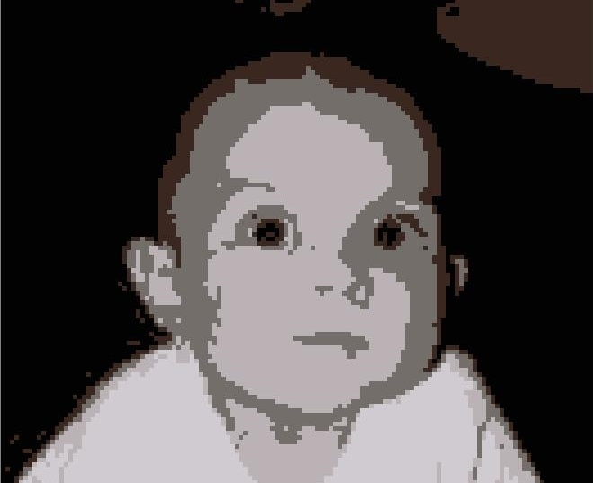

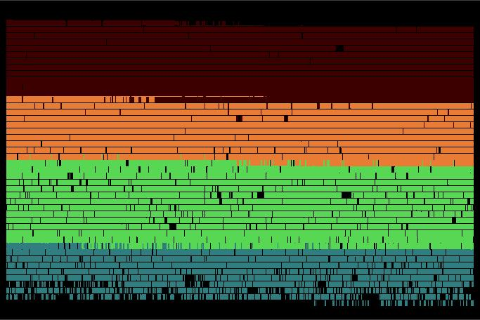
Results
Scenario | After clustering | Data points | No. of unique data points | Simulation time | No. of clusters
 |  | 17,160 | 6,670 | 8 sec | 5
 |  | 225,000 | 82,893 | 9 mins | 5
 |  | 44,761,088 | 461,847 | 7Hrs (aprox) | 5

Slide 13
Landmark Based Spectral Clustering
p data points(p<<n) are chosen as landmarks and represent the original data points as linear combinations of landmark.
Algorithm:
Construct affinity matrix between data points and the chosen landmark points(using k-means or random sampling)
Carry out Eigen value decomposition
Cluster the data points in subspace using k-means
Scales linearly with size of the problem.

Slide 14
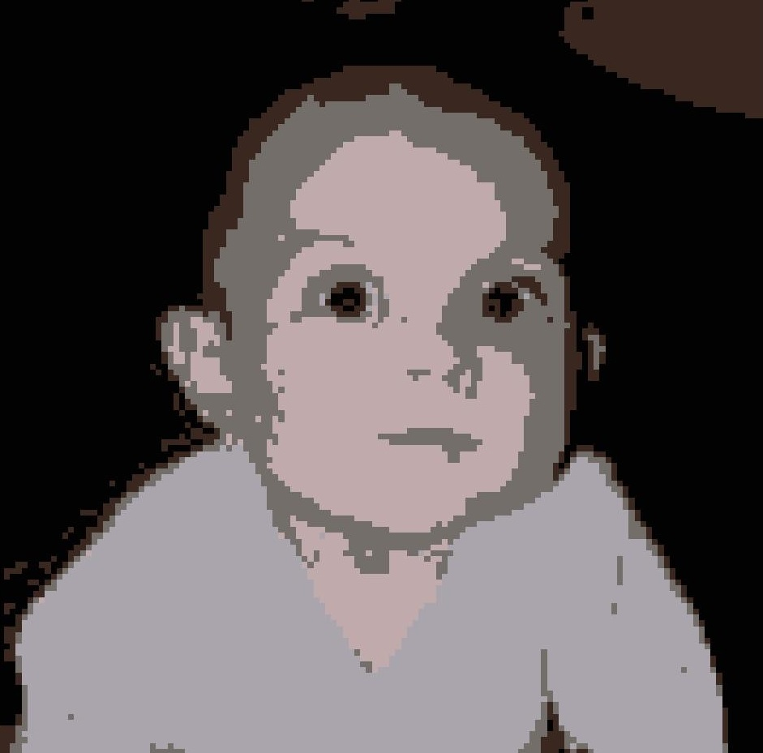
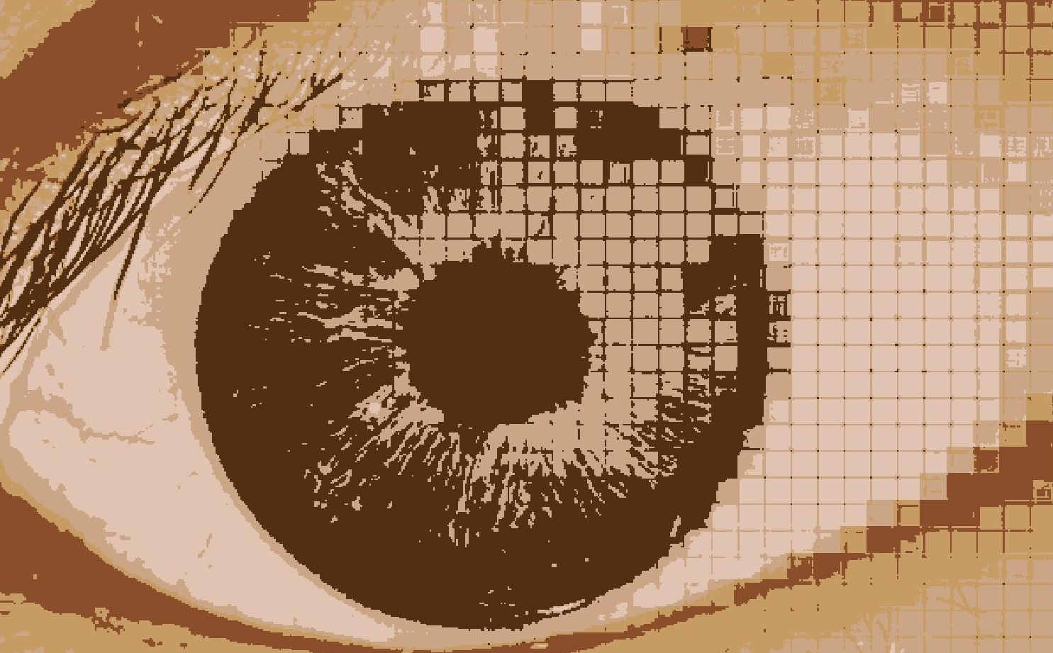
Results (Landmark Based SC using k-means)
Scenario | After clustering | No. of unique data points | Simulation time | No. of clusters
 |  | 6,670 | 1.4 sec | 5
 |  | 82,893 | 14 sec | 5
 |  | 461,847 | Out of memory issue | 5

Slide 15
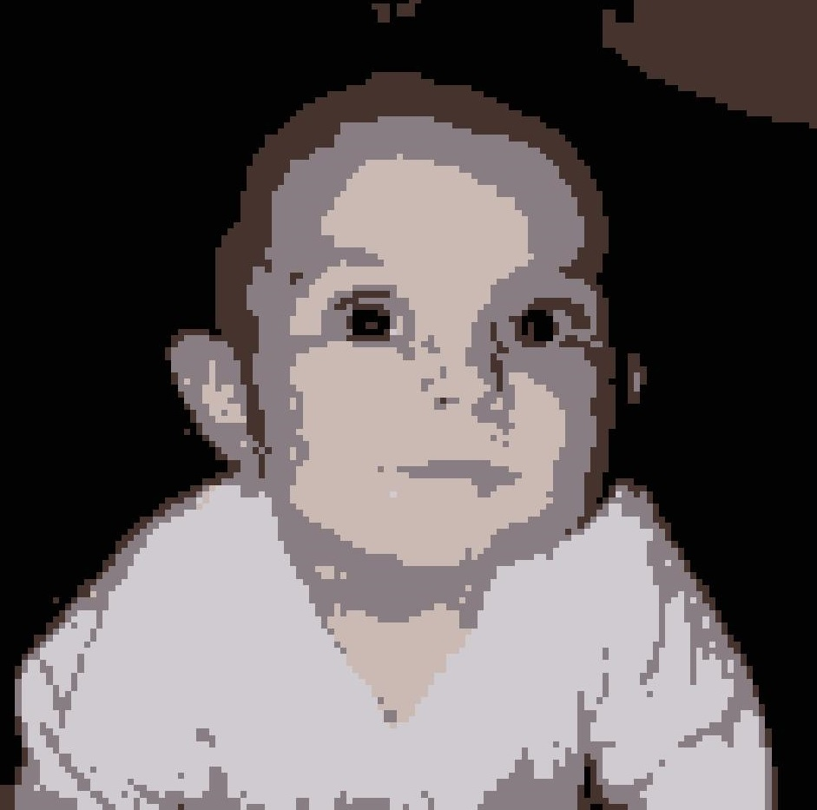
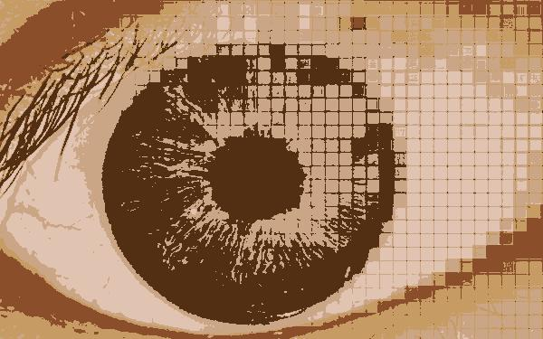
Results (Landmark Based SC using Random Sampling)
Scenario | After clustering | No. of unique data points | Simulation time | No. of clusters
 |  | 6,670 | 2 sec | 5
 |  | 82,893 | 30 sec | 5
 |  | 461,847 | Out of memory issue | 5

Slide 16
Comparison of Results
Data points | Parallel SC | LSC using K-means | LSE using random sampling
6,670 | 8 seconds | 1.4 seconds | 2 seconds
82,893 | 9 minutes | 14 seconds | 30 seconds
461,847 | 7 hours | Out of memory | Out of memory
LSC failed as the system ran out of memory while constructing pairwise distances using k-means, k-means suffered from the scalability of large dataset that was used.
Future Work:
To work on k-means issue in LSC by dividing the construction of pairwise distance matrix into blocks as the time taken by LSC to cluster points is far less when compared to PSC.

Slide 17
Conclusion
Efficiently constructs the similarity matrix by dividing the dataset into blocks which alleviates the memory use.
Sparsify the similarity matrix and it requires less memory to store.
Call a sparse Eigen solver.
We applied Parallel Spectral Clustering and Landmark based spectral clustering on both synthetic data as well as images.
Compared the performance of two algorithms.
Disadvantages of Approximation techniques:
Approximation techniques have risk of loss of data associated with them.
Trade-off between Scalability of clustering and quality of clustering

Slide 18
QUESTIONS!!

