Slide 1
Amazon Reviews Rating Prediction
TEAM : Nayana D V and Neha Rajkumar

Slide 2
Agenda
Introduction
Problem Definition
Existing Solution
Proposed Solution
Dataset Description
Which Software tools we used ?
Data Mining Task
Which model we used and why ?
Steps
Demo
Results
Conclusion
What did we learn ?
Future Work
References

Slide 3
Introduction
Tremendous growth of e-commerce websites
Amazon is the world's largest online retailers where millions of customers purchase and review products on its website
User-supplied product reviews helps improve the online shopping experience by providing information to consumers and feedback to manufacturers.

Slide 4
Problem Definition
Predicting user ratings is one of the core issues in recommendation systems.
These ratings are of high importance for the marketing and the sales departments to improve the quality of the product.
Many Amazon users do not rate the reviews and some do not give the correct rating for the reviews given.
Need to enhance the accuracy of the rating prediction by using machine learning methods.

Slide 5
Existing Solution
The most popular system for rating prediction is collaborative filtering [1].
Helps to predict the expected rating a user may give to an item he/she hasn't rated yet.
Memory-based and model-based (e.g. matrix factorization) [2] are the two most popular methods for collaborative filtering.
However, both systems take a sparse user-product rating matrix as an input and may fail to capture the quality of the users and their reviews.

Slide 6
Proposed Solution
Aim of our project is to build a classifier which can predict what rating a user will provide according to his review.
Perform sentiment analysis by extracting the emotions from the reviews and calculate the positive and negative score.
Based on these features we apply different machine learning models to improve the accuracy of predicting ratings.

Slide 7
Dataset Description
We focused on a subset of Amazon.com product review data, which we obtained from http://snap.stanford.edu/data/web-Amazon-links.html
Used the dataset of Jewelry sold through Amazon.
Dataset was in row format which could not be loaded into Weka or Hive.
Pre-processing was performed to remove duplicated entries.
For few instances rating and review text had junk values.

Slide 8
Fields in the Dataset

Slide 9




Which Software tools we used ?
Sentiment Analysis : R and Tableau
Classifications : Weka and Orange

Slide 10
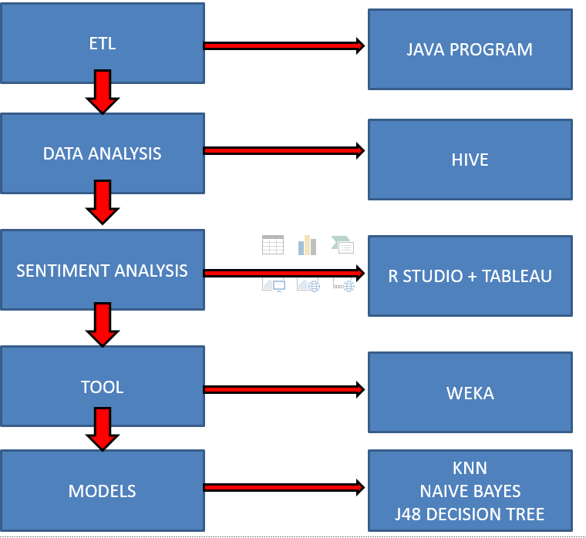
Data Mining Task

Slide 11
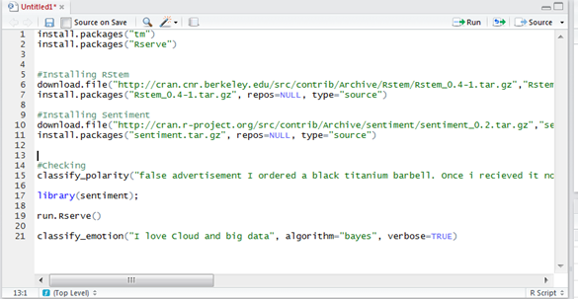
Sentiment Analysis in R

Slide 12
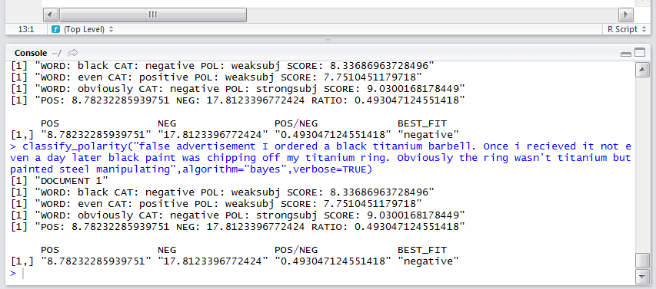
“false advertisement I ordered a black titanium barbell. Once i received it not even a day later black paint was chipping off my "titanium ring." Obviously the ring wasn't titanium but painted steel manipulating …”

Slide 13
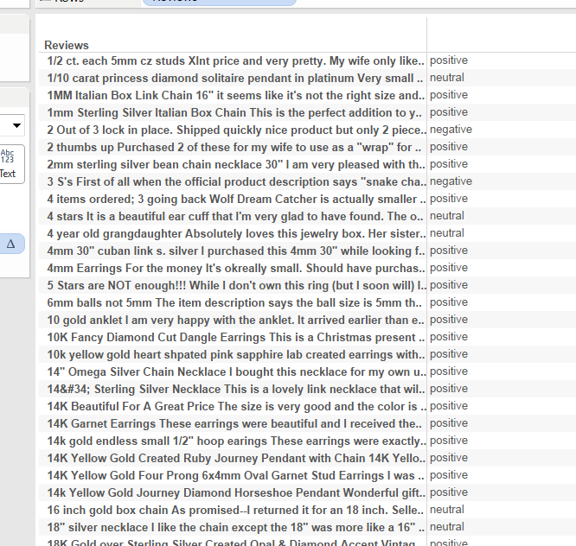
R & Tableau

Slide 14
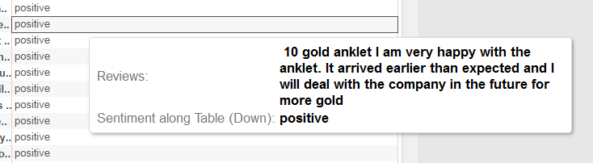
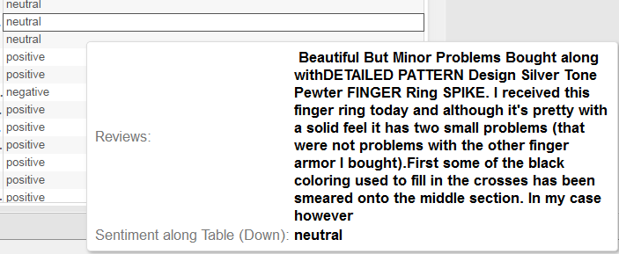
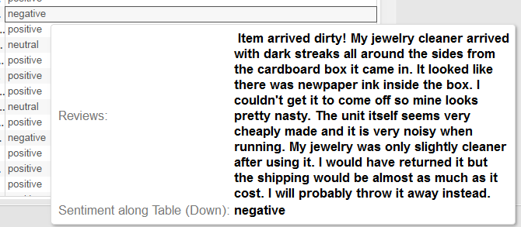

Slide 15
Sentiment Rating
Assign 5 to Positive rating , 1 to negative rating and 3 to neutral rating.
Gap = Review rating – Sentiment rating
Gap <= 2 are considered useful in the dataset
Ignore Gap > 2 reviews
Resultant dataset helps in predicting the rating more accurately

Slide 16
Features
Features that exist in the original dataset do not have a direct correlation in predicting the rating
Average Rating: Average of ratings given by all users for a product
AverageRating= ((ΣRatings for ProductID = x)/Number of users who rated ProductID = x)
Calculate the positive and negative score for each review

Slide 17
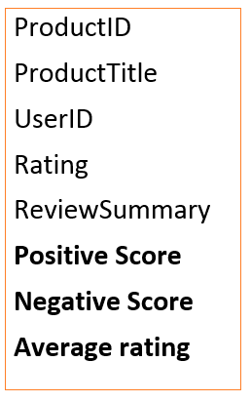
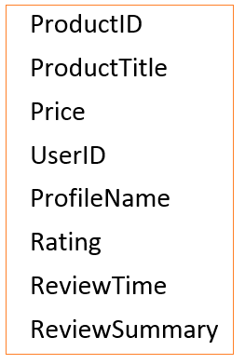

Original Features Derived Features
Features

Slide 18
Which model we used and why ?
Naive Bayes
J48 Decision Trees
K-Nearest Neighbors

Slide 19
Naive Bayes
Bayes's rule:
P(H | E) = ( P(E | H) x P(H) ) / P(E)
The basic idea of Bayes's rule is that the outcome of a hypothesis or an event (H) can be predicted based on some evidences (E) that can be observed.
From Bayes's rule, we have
(1) A priori probability of H or P(H): This is the probability of an event before the evidence is observed.
(2) A posterior probability of H or P(H | E): This is the probability of an event after the evidence is observed.
Useful for predicting ratings based on the average rating.

Slide 20
J48 Decision Tree
Generate a decision tree which are used for classification
The training data is a set S = s_1, s_2 ..of already classified samples.
Each sample s_i consists of a p-dimensional vector which represents attributes or features of the sample.
At each node of the tree, algorithm chooses attribute that most effectively splits its set of samples into subsets.
Are suitable for predicting rating as it classifies according to 1, 2, 3, 4 or 5 rating

Slide 21
K- Nearest Neighbor
Neighbourhood models base the prediction on the similarity amongst items or users.
It decreases the noise and improves the quality of predictions and recommendations.
They store all the training instances while learning : Useful for solving the Amazon rating prediction since if all the training instances are stored, it is easier to find the nearest neighbor.
To classify a new instance, k-NN searches training set for one that is most like it.

Slide 22
Steps
1: Perform Sentiment Rating
2 : Measure the gap
3: Identify the features
4: Compute the average rating
5: Form training set

Slide 23
6: Form testing set
7: Run the algorithms on training set
8: Validate the results on test set
9: Improve the accuracy by changing the attributes
10: Measure the performance of the system

Slide 24
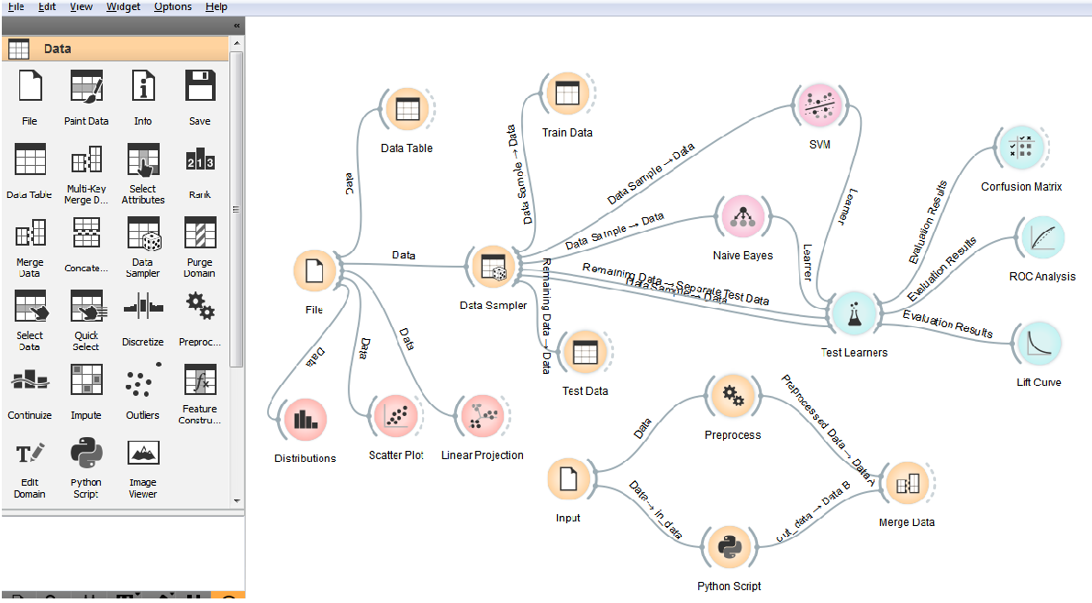
Orange Model

Slide 25
Demo

Slide 26
Results
MODEL | ACCURACY [256 ROWS] | ROC CURVE
NAIVE BAYES | 73.08% | 92%
K-NEAREST NEIGHBOUR | 76.47% | 81.9%
J48 DECISION TREE | 67% | 80.7%

Slide 27
Conclusion
Only small amount of training data is essential to do classification.
Deriving new features played an important role in predicting the rating.
Among the different models which we experimented on, we obtained the best result for Naïve Bayes model with accuracy 73.08% .

Slide 28
What did we learn ?
Application of Machine learning algorithms for predicting user reviews.
Hands on Machine Learning tools like Weka, RStudio
Importance of adding relevant features for analysis
Understanding different parameters in algorithms and interpreting results

Slide 29
Future Work
Include review length which can improve the accuracy
More features can be added which can improve the training set
Other definitions of user status can be explored to improve our model and reduce learning errors

Slide 30
References
[1] Paul Resnick, Hal Varian. Recommender systems, “Recommender Systems”, Communications of the ACM,1989.
[2] F. Ricci, L. Rokach, B. Shapira, and P. B. Kantor,”Recommender Systems” Handbook,Springer, 2011.
[3] Naïve Bayes classifier - http://en.wikipedia.org/wiki/Naive_Bayes_classifier
[4] KNN classifier - http://en.wikipedia.org/wiki/K-nearest_neighbors_algorithm
[5] J48 Decision tree –
http://www.academia.edu/4375403/Decision_Tree_Analysis_on_J48_Algorithm_for_Data_Mining

Slide 31
Thank you !!

Slide 32
Questions ?

