Slide 1
CSCE 5290 - Natural Language Processing Increment-2 Optical Character Recognition & Sentiment Analysis
Team - 11:
Keerthana Pinikeshi (11448714)
Lahari Kunduru (11445208)
Neha Kalluri (11445206)

Slide 2
Objectives:
Our project is to build a real-world OCR model to recognize text in images. We have also discovered that most OCR products extract words one by one and combine them for the whole text. Hence, we are going to build the OCR Model for extraction of the single word.
In order to build the OCR model, we have some objectives to follow :
1. Data collection
2. Data Cleaning
3. Data Preprocessing
4. Model Building
5. Evaluation of results

Slide 3
Features:
We need a sizable dataset because we are training the OCR model from scratch. For model training, we would like to select a dataset with at least 100,000 image samples. The raw text is what this feature largely includes. This text is a review or a statement, and we must determine the message's emotional tone. Modules required for this project are :
Tensorflow
Keras
Numpy
Opencv
Matplotlib Etc.

Slide 4
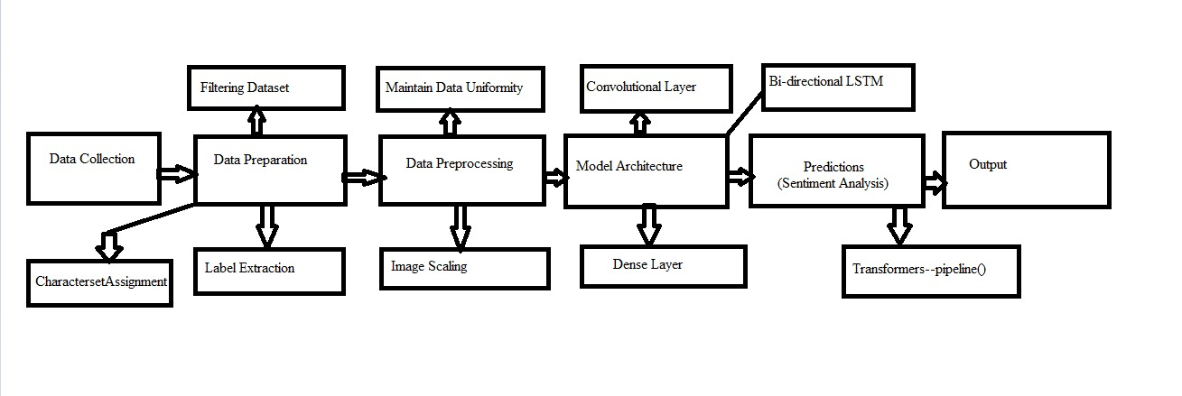
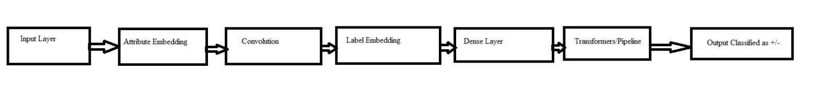
Model Workflow:
Project Architecture:

Slide 5
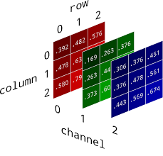
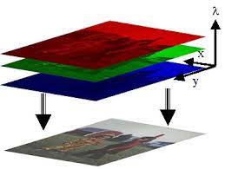
Dataset Description:
The Dataset we used has a huge number of gray scale word level images.
This data is massive, and it necessitates a significant amount of time and space complexity.
As a result, we downloaded the entire dataset and filtered approximately 150,000 images. We are training and testing with the same dataset. We must convert the given image into a multidimensional numpy array because we are dealing with an image dataset here.
RGB Image Representation in Numpy array

Slide 6
Analysis of Data:
1) Convolution:
The convolution is an operation that mainly helps to understand the shapes in the given image. In simple words it will remove the unnecessary objects in the image and focuses more on the character/ Object in the image.
2) Recurrent neural network:
Popular and widely used networks when it comes to dealing with NLP tasks. Recurrent neural network basically focus on both previous and upcoming characters (Bi directional LSTM).
3) Transformers for Sentiment Analysis:
Transformers library consists of around thirty pretrained models which we can use for text classification, text summarization, sentiment analysis.
Firstly, we need to install the transformers package and then we need to import the pipeline() class.
Here, we are using pipeline() class for sentiment analysis and the text provided to this will be classified as either positive or negative class and it also gives the confidence score.

Slide 7
Implementation:
We mainly have 4 Modules.
1) Loading dataset into Google Colab : we have filtered approximately 150,000 images and created a Zip File for those images, upload it to drive and we can access it by mounting the google drive using google colab.
2) Data Preprocessing: some necessary prepossessing steps required to get the important variables like label, array representation of the image, input length , padding the label etc.
3) Model Building:
In our model we have used the 7 convolution layers and 2 bi-directional LSTM layers. Convolutional layers are capable of extracting various image features such as edges, textures, objects, and scenes.
Batch Normalization helps to speed up training by halving the epochs and provides some regularization, reducing generalization error.

Slide 8
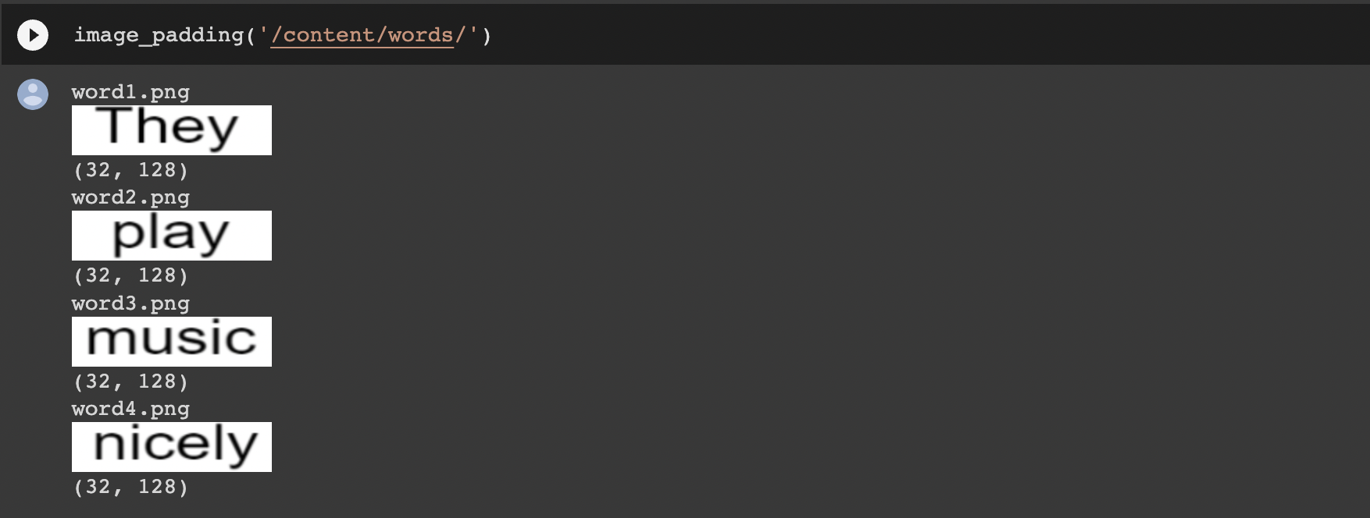
Implementation:
4) Sentiment Analysis:
In Sentimental Analysis, we have taken a few images as our dataset with sentences in it. Then we divide the sentence to words based on the pixel distance.
As our model checks for padding of 128x32, we then convert out cropped images of individual words to the images having padding as 128x32 and then adjust the dimensions.
. Then, we are passing these sentences to pretrained sentiment analysis models which doesn’t require train data. We are classifying the sentence provided in the image is either classifies as positive or negative. Here, the sentence we took They play music nicely is classified as positive with confidence score as 0.99

Slide 9
Preliminary Results :
OCR :
At the final output Layer, each character has been predicted from the character set={abcde…ABCD…0123...} we declared in code and the one which has the highest probability (greatest number) has been predicted/ chosen.
Some of the examples of the images like scabbed, Scrooges, middleton which have been correctly predicted as the same text as in the image are shown in the next slide.
Using Model Training most of the predictions were correct but there were also some wrong predictions like KICKOFF has been predicted as KICKOFE.

Slide 10
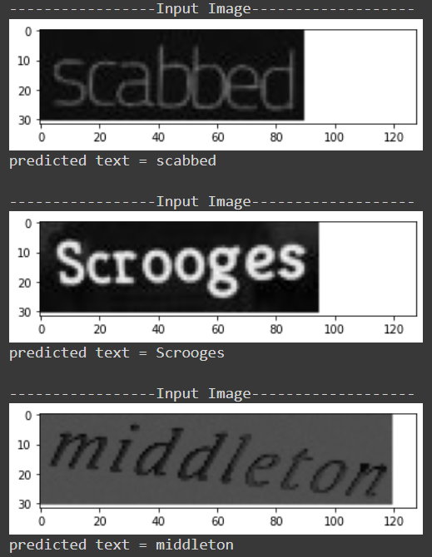
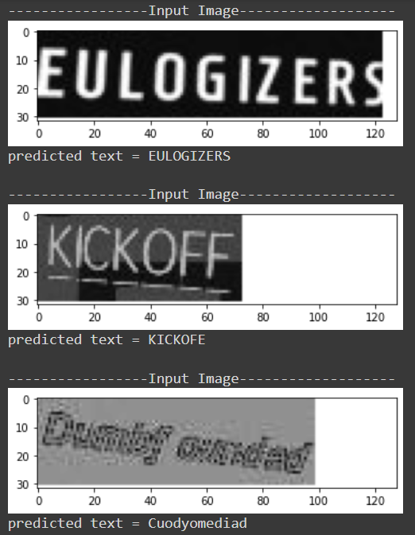

Slide 11
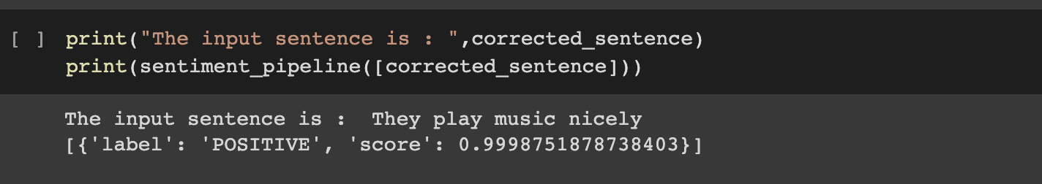
Sentiment analysis results:
The words in the images been predicted when passed to our model and if any spelling mistakes, using the word correction methods those were re-corrected.
Below is the first example of sentiment analysis, our sentence is “They play music nicely”. After implementing the sentiment Analysis, we classified it to be a positive sentence. It also provided us with the confidence score of the text as 0.99.

Slide 12
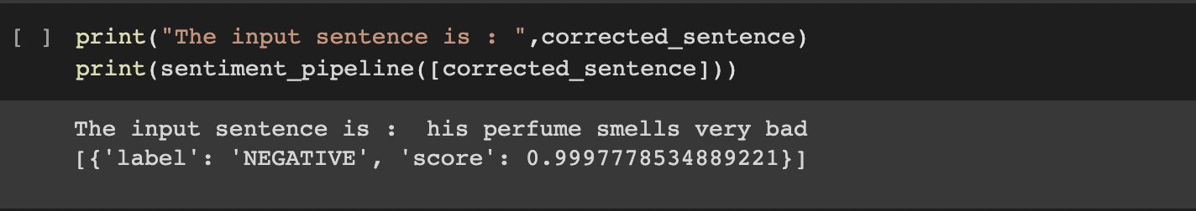
Sentiment analysis results:
The second example of sentiment analysis is “his perfume smells very bad”.
For this example after implementing the sentiment Analysis, it was classified as a negative sentence and provided us with the confidence score of the text as 0.99.

Slide 13
Thank You

