Slide 1

SYSTEM CALLS
An Interface Between User Programs and the Operating System
Operating Systems Project
Student: [Your Name] | Roll No.: [Your Roll Number]
Department: Computer Science & Engineering (CSE)
College: [Your College Name]

Slide 2
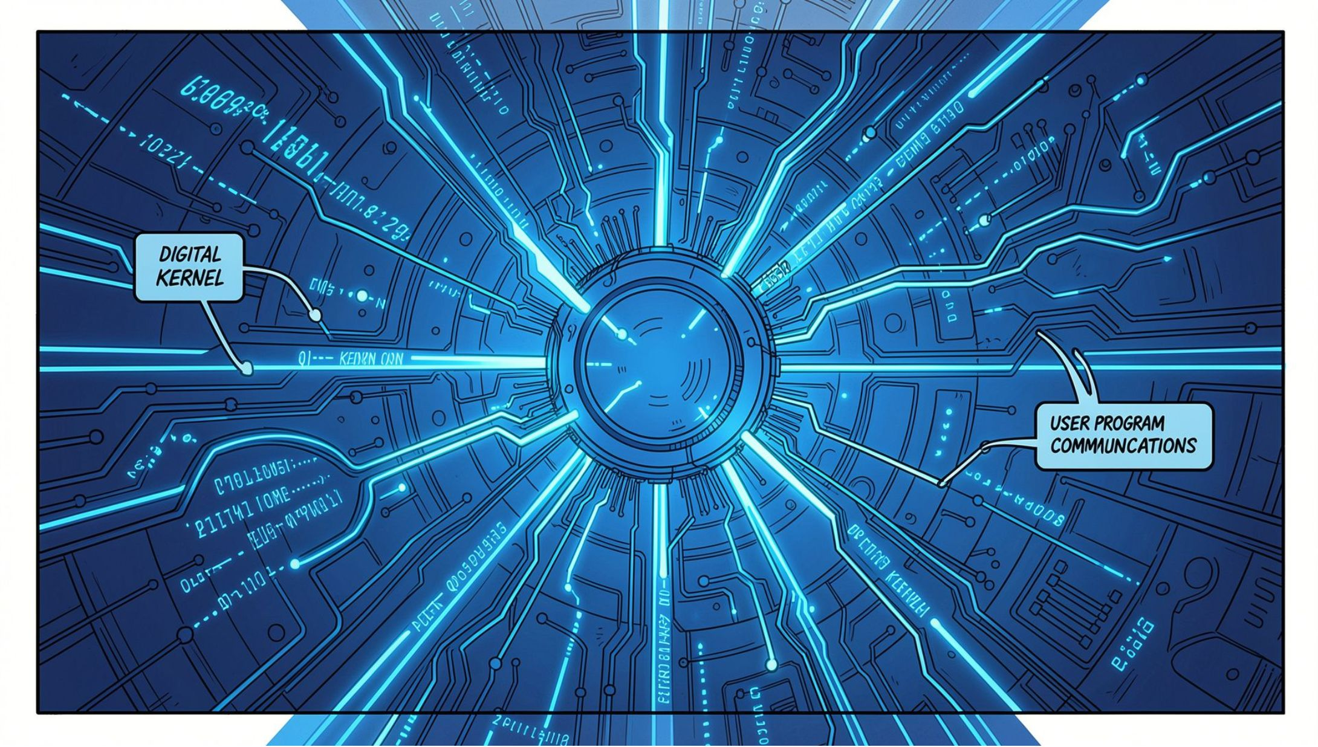

Abstract
System calls are an important part of an Operating System — they provide the critical interface between user applications and the operating system kernel. Application programs cannot directly access many system resources, so they rely on system calls to request services safely and efficiently.
This project explains the concept, working, and types of system calls, covering major categories such as process control, file management, device management, information maintenance, communication, and protection.
Main Objective: Understand how applications interact with the operating system and how system calls manage resources in a controlled, efficient manner.

Slide 3
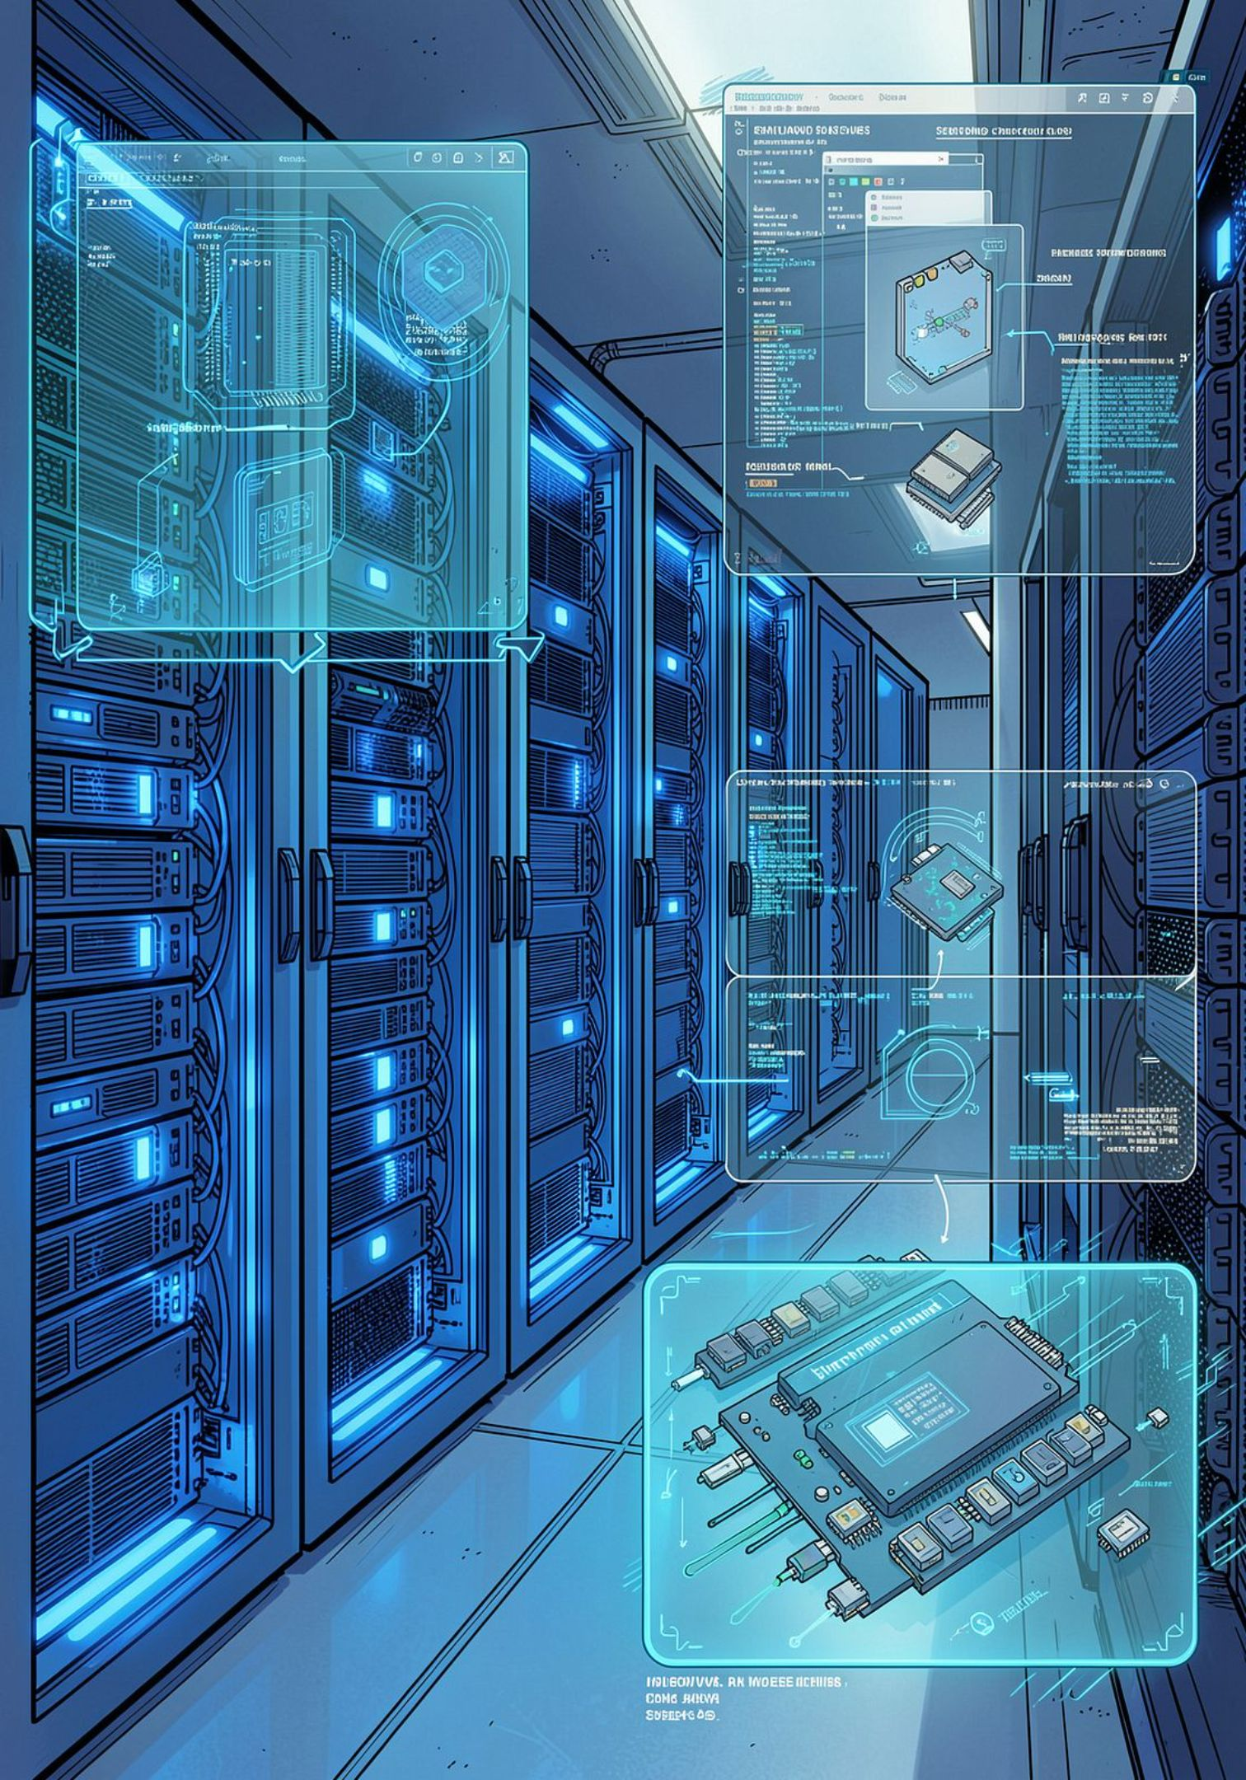
Introduction
What is an Operating System?
Why Applications Need the OS
Software that manages hardware resources
Provides services to user applications
Controls access to system resources
Direct hardware access is restricted
OS ensures security and resource sharing
OS provides standardized interfaces
System Calls: The Bridge
Act as interface between user programs and OS
Allow programs to request OS services safely

Slide 4


What is a System Call?
Definition
Process Management
File Operations
A system call is a programmatic way in which a computer program requests a service from the operating system kernel.
Opening, reading, writing data
Creating & terminating processes
Key Characteristics
Provides controlled access to system resources
Switches execution from User Mode to Kernel Mode
Returns results back to the user program
Communication
Memory
IPC & networking
Allocating & freeing memory

Slide 5






Why Do We Need System Calls?
Access OS Services
Process Control
Programs need services only the OS can provide — CPU scheduling, memory, and I/O
Create, manage, and terminate processes across multitasking environments
File Management
Security & Controlled Access
Create, read, write, and delete files through standardized operations
Prevent unauthorized access and enforce isolation between programs
Hardware Resource Management
Efficiency
Control access to CPU, memory, disk, and I/O devices efficiently
Optimize resource utilization across multiple running programs

Slide 6
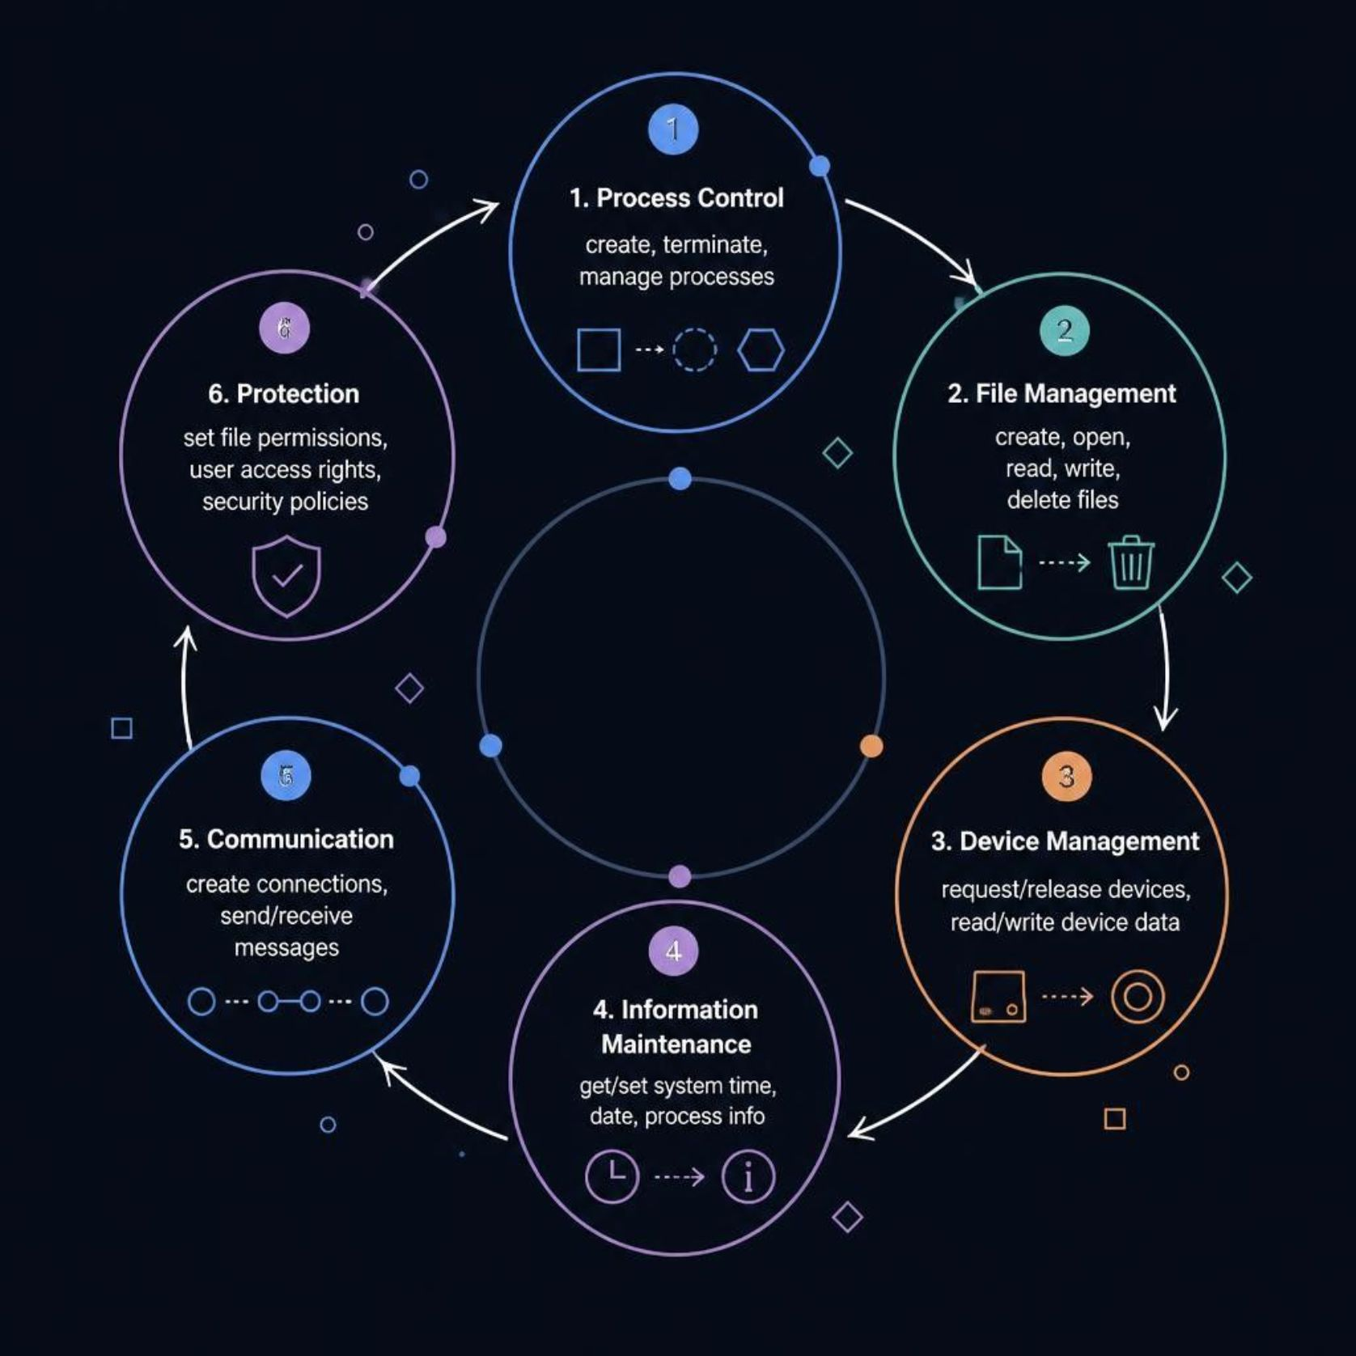
Types of System Calls
System calls are categorized based on the services they provide to user programs:
01
Process Control
Create, terminate, and manage processes
02
File Management
Create, open, read, write, and delete files
03
Device Management
Request and release devices, read/write data
04
Information Maintenance
Get/set system time, date, and process info
05
Communication & Protection
IPC messaging, permissions, and security policies

Slide 7

Process Control System Calls
System calls that manage process creation, execution, and termination:
fork()
exec()
wait()
Create a new child process as a copy of the parent
Load and execute a new program in the current process
Parent waits for child process to complete
exit()
getpid()
Terminate the current process cleanly
Retrieve the process ID of the current process
Example Scenario: A shell uses fork() to create a new process, exec() to run a command, and wait() to wait for completion before returning to the prompt.

Slide 8
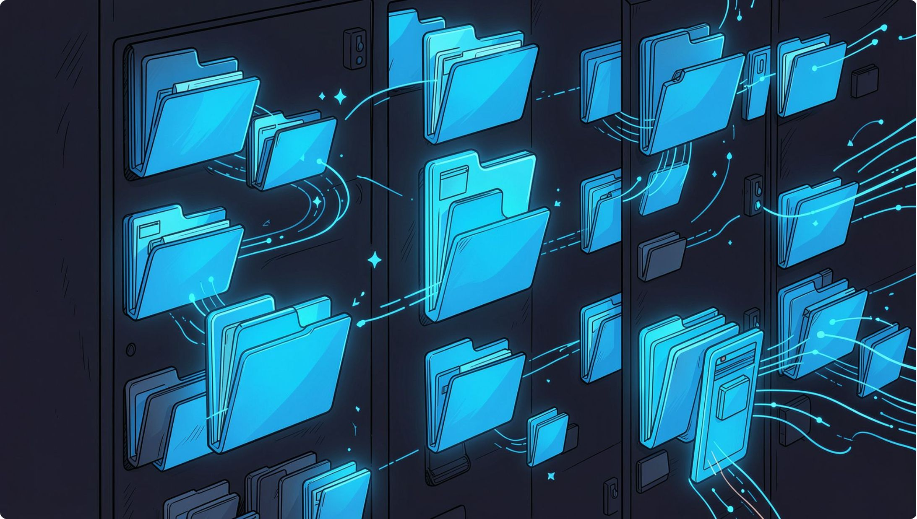


File Management System Calls
Common File Operations
open()
Open a file for reading or writing
read() / write()
Read data from or write data to a file
close()
Close an open file and release resources
create() / delete()
Create a new file or remove an existing one
seek()
Move the file pointer to a specific position
Typical Read Sequence: open() → read() → close()

Slide 9


How a System Call Works
Step-by-step flow from a user program request to kernel execution and back:
Switch to Kernel
Identify Service
Kernel Process
User Request
Invoke Call
Key Point: Mode switching between User Mode and Kernel Mode is what ensures security and controlled access to all system resources.

Slide 10

Advantages & Applications
Advantages of System Calls
Real-World Applications
Security
Resource Management
Operating Systems
File Systems
Controlled access to all system resources
Core functionality of any modern OS
All file operations depend on system calls
Efficient allocation and sharing of CPU, memory, and I/O
Device Drivers
Networking
Process Management
IPC
Hardware interaction and control
Socket operations and network communication
Enable safe communication between processes
Create and manage multiple concurrent processes
Conclusion: System calls are the fundamental mechanism through which software communicates with hardware — the backbone of every operating system.

