Slide 1

Stack

Slide 2


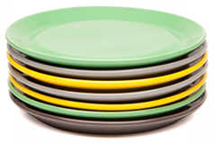
The last element to be added is the first to be removed (LIFO: Last In First Out).
Plates Pennies Books

Slide 3
Stack is a linear data structure.
Stack can be defined as a collection of homogeneous elements, where insertion and deletion operations takes place at only one end called TOP.
The insertion operation is termed as PUSH and deletion operation is termed as POP operation.
The PUSH and POP operations are performed at TOP of the stack.
An element in a stack is termed as ITEM.
The maximum number of elements that stack can accommodate is termed as SIZE of the stack.
Stack Pointer ( SP ) always points to the top element of the stack.
Stack follows LIFO principle. i.e. Last In First Out i.e. the element which is inserted last into the stack will be deleted first from the stack.

Slide 4

Understanding Stack: PUSH
cd 4
cd 2
cd 3
cd 1
cd 5

Slide 5
Understanding Stack: POP
cd 5
cd 4
Last In First Out
LIFO
cd 3
cd 2
cd 1

Slide 6

ARRAY REPRESENTATION OF STACKS
A | B | C | D | E
0 | 1 | 2 | 3 | TOP=4 | 5 | 6
Through this top, one can do pop or push operation

Slide 7
OPERATIONS ON A STACK
Push Operation
1 | 2 | 3 | 4 | 5
0 | 1 | 2 | 3 | TOP=4 | 5 | 6
Figure: Stack
1 | 2 | 3 | 4 | 5 | 6
0 | 1 | 2 | 3 | 4 | TOP=5 | 6
Figure: Stack after Insertion

Slide 8
Algorithm to insert an element in a stack
MAX-1=3
3
25
TOP->
MAX=4
2
68
Algorithm Push(VALUE)
Step 1: IF TOP == MAX-1
PRINT OVERFLOW
[END OF IF]
Step 2: SET TOP = TOP + 1
Step 3: SET STACK[TOP] = VALUE
Step 4: END
1
95
0
10
THIS IS OVERFLOW CONDITION

Slide 9
Pop Operation
1 | 2 | 3 | 4 | 5
0 | 1 | 2 | 3 | TOP=4 | 5 | 6
Figure: Stack
1 | 2 | 3 | 4
0 | 1 | 2 | TOP=3
Figure: Stack after Deletion

Slide 10
Algorithm to delete an element from a stack
3
25
TOP->
2
68
Step 1: IF TOP == -1
PRINT UNDERFLOW
[END OF IF]
Step 2: SET VAL = STACK[TOP]
Step 3: SET TOP = TOP - 1
Step 4: END
1
95
0
10
-1

Slide 11
Algorithm to delete an element from a stack
THIS IS UNDERFLOW CONDITION
3
2
Step 1: IF TOP == -1
PRINT UNDERFLOW
[END OF IF]
Step 2: SET VAL = STACK[TOP]
Step 3: SET TOP = TOP - 1
Step 4: END
1
0
-1
TOP->

Slide 12

Peek Operation
Outputs the value in the
top =4 which is 5

Slide 13
Peek element from a stack
3
25
TOP->
2
68
Step 1: IF TOP == -1
PRINT Empty
ELSE
PRINT STACK[TOP]
Step 3: END
1
95
0
10
-1

Slide 14

LINKED REPRESENTATION OF STACK

Slide 15


OPERATIONS ON A LINKED STACK
Push Operation

Slide 16
Push: Inserting a Node at the Beginning of a Linked List
98
10
20
 | NULL
30
new_node
top
Algorithm
  Step 1: SET new_node = (struct node*) malloc(sizeof(struct Node)
  Step 2: SET new_node →DATA = VAL
  Step 3: SET new_node->next=top
  Step 4: SET top=new_node
  Step 5: EXIT

Slide 17


Pop Operation

Slide 18
pop: Deleting the First Node from a Singly Linked List
10
20
30
40
50
 | X
top
ptr
Algorithm
  Step 1: IF top = NULL
  write UNDERFLOW
  Go to Step 5
  [END OF IF]
  Step 2: SET ptr = top
  Step 3: SET top = top→next
  Step 4: FREE ptr
  Step 5: EXIT

Slide 19
APPLICATIONS OF STACKS
Stacks can be easily applied for a simple and efficient solution like….
Reversing a list
Parentheses checker
Conversion of an infix expression into a postfix expression
Evaluation of a postfix expression
Conversion of an infix expression into a prefix expression
Evaluation of a prefix expression
Recursion
Tower of Hanoi

Slide 20


Slide 21
Evaluation of Arithmetic Expressions
Infix, prefix, and postfix notations are three different but equivalent notations of writing ALGEBRAIC EXPRESSIONS.
In Infix notation, the operator is placed in-between the operands. For example, A+B
In Postfix notation, operators are placed after the operands. For example, AB+
In Prefix notation, operators are placed before the operands. For example, +AB
operator
Operand1 A + B Operand2

Slide 22
Convert the following infix expressions into postfix expressions
(a) (A–B) * (C+D)
Solution
[AB–] * [CD+]
AB–CD+*
(b) (A + B) / (C + D) – (D * E)
Solution
[AB+] / [CD+] – [DE*]
[AB+CD+/] – [DE*]
AB+CD+/DE*–

Slide 23
Convert the following infix expressions into postfix expressions
(A+B)*(C/D)
A*(B*C+D*E)+F
A+(B*C+D)/E
A+(B*C+D)/E+F*G
(A+B)*C+(D-E)/F+G

Slide 24
Algorithm to convert an infix notation to postfix notation
Step 1: Add ) to the end of the infix expression
Step 2: Push ( on to the stack
Step 3: Repeat until each character in the infix notation is scanned
        IF a ( is encountered, push it on the stack
        IF an operand (whether a digit or a character) is encountered,
        add it postfix expression.
        IF a ) is encountered, then
          a. Repeatedly pop from stack and add it to the postfix expression until a
          ( is encountered.
          b. Discard the ( . That is, remove the ( from stack and do not
          add it to the postfix expression
          IF an operator is encountered, then
            a. Repeatedly pop from stack and add each operator (popped from the stack) to the
            postfix expression which has the same precedence or a higher precedence
            b. Push the operator to the stack
        [END OF IF]
Step 4: Repeatedly pop from the stack and add it to the postfix expression until the stack is empty
Step 5: EXIT

Slide 25
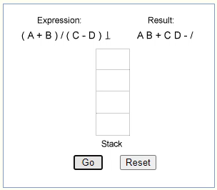
Conversion of an Infix Expression into a Postfix Expression
#include <stdio.h>
#include <conio.h>
#include <ctype.h>
#include <string.h>
#define MAX 100
char st[MAX];
int top = –1;
void push(char st[], char);
char pop(char st[]);
void InfixtoPostfix(char source[], char target[]);
int getPriority(char);

Slide 26
int main()
{
char infix[100], postfix[100];
clrscr();
printf("\n Enter any infix expression : ");
gets(infix);
strcpy(postfix, "");
InfixtoPostfix(infix, postfix);
printf("\n The corresponding postfix expression is : ");
puts(postfix);
getch();
return 0;
}

Slide 27
void InfixtoPostfix( char source[] , char target[] )
{
int i=0, j=0;
char temp;
strcpy( target , "“ );
while( source[i] != '\0‘ )
{
if( source[i] == '(‘ )
{
push( st, source[i] );
i++;
}

Slide 28
else if ( source[i] == ')‘ )
{
while( ( top != –1 ) && ( st[ top ] != '(‘ ) )
{
target[ j ] = pop( st );
j++;
}
if ( top == –1 )
{
printf ( "\n INCORRECT EXPRESSION“ );
exit ( 1 );
}
temp = pop( st );//remove left parenthesis
i + +;
}

Slide 29
else if( isdigit( source[ i ] ) || isalpha( source[ i ] ) )
{
target[ j ] = source[ i ];
j + +;
i + +;
}
else if ( source[ i ] == '+' || source[ i ] == '–' || source[ i ] == '*' ||
source[ i ] == '/' || source[ i ] == '%‘ )
{
while( ( top != –1 ) && ( st[ top ] != '(‘ ) && ( getPriority( st[ top ] )
> getPriority( source[ i ] ) ) )
{
target[ j ] = pop( st );
j++;
}
push( st, source[ i ] );
i++;
}

Slide 30
else
{
printf("\n INCORRECT ELEMENT IN EXPRESSION");
exit(1);
}
}
while( ( top != –1 ) && ( st[ top ] != '(‘ ) )
{
target[ j ] = pop( st );
j++;
}
target[ j ]='\0';
}

Slide 31
int getPriority(char op)
{
if(op=='/' || op == '*' || op=='%')
return 1;
else if(op=='+' || op=='–')
return 0;
}
Higher priority *, /, %
Lower priority +, –

Slide 32
void push(char st[], char val)
{
if( top == MAX–1 )
printf("\n STACK OVERFLOW");
else
{
top++;
st[ top ] = val;
}
}

Slide 33
char pop( char st[ ] )
{
char val = ' ';
if( top == –1 )
printf("\n STACK UNDERFLOW");
else
{
val = st[ top ];
top – –;
}
return val;
}
Output
Enter any infix expression : A+B–C*D
The corresponding postfix expression is : AB+CD*–

Slide 34
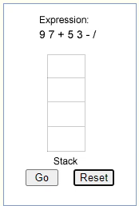
Procedure for Evaluation of a Postfix Expression
Postfix notations are evaluated using STACKS.
Every character of the postfix expression is scanned from left to right.
If (the character is an operand)
it is pushed onto the stack
Else if (it is an operator)
1) the top two values are popped from the stack
2) the operator is applied on these values.
The result is then pushed onto the stack

Slide 35
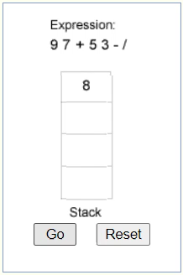
Evaluation of a Postfix Expression
#include <stdio.h>
#include <conio.h>
#include <ctype.h>
#define MAX 100
float st[MAX];
int top=–1;
void push(float st[], float val);
float pop(float st[]);
float evaluatePostfixExp(char exp[]);

Slide 36
int main()
{
float val;
char exp[100];
clrscr( );
printf("\n Enter any postfix expression : ");
gets( exp );
val = evaluatePostfixExp(exp);
printf( "\n Value of the postfix expression = %.2f", val );
getch( );
return 0;
}

Slide 37
float evaluatePostfixExp( char exp[ ] )
{
int i = 0;
float op1, op2, value;
while( exp[i] != '\0‘ )
{
if( isdigit ( exp[i] ) )
push( st , ( float )( exp[ i ] – '0‘ ) );
else
{
op2 = pop( st );
op1 = pop( st );

Slide 38
switch( exp[ i ] )
{
case '+‘: value = op1 + op2;
break;
case '–': value = op1 – op2;
break;
case '/‘: value = op1 / op2;
break;
case '*‘: value = op1 * op2;
break;
case '%': value = (int)op1 % (int)op2;
break;
}
push( st , value );
}
i ++;
}
return( pop( st ) );
}

Slide 39
void push(float st[], float val)
{
if( top==MAX–1 )
printf("\n STACK OVERFLOW");
else
{
top + +;
st[ top ] = val;
}
}

Slide 40
float pop(float st[])
{
float val=–1;
if(top==–1)
printf("\n STACK UNDERFLOW");
else
{
val = st[ top ];
top – –;
}
return val;
}
Output
Enter any postfix expression : 9 3 4 * 8 + 4 / –
Value of the postfix expression = 4.00

Slide 41
Convert the following infix expressions into prefix expressions
(a) (A + B) * C
Solution
(+AB)*C
*+ABC
(b) (A–B) * (C+D)
Solution
[–AB] * [+CD]
*–AB+CD
(c) (A + B) / ( C + D) – ( D * E)
Solution
[+AB] / [+CD] – [*DE]
[/+AB+CD] – [*DE]
–/+AB+CD*DE

Slide 42
Algorithm to convert an infix expression into prefix expression
Step 1: Reverse the infix string. Note that while reversing the string you must
Interchange left and right parentheses.
Step 2: Obtain the postfix expression of the
infix expression obtained in Step 1.
Step 3: Reverse the postfix expression to get the
prefix expression

Slide 43
For example, given an infix expression (A – B / C) * (A / K – L)
Step 1: Reverse the infix string. Note that while reversing the string you must interchange left and right parentheses.
(L – K / A) * (C / B – A)
Step 2: Obtain the corresponding postfix expression of the infix expression obtained as a result of Step 1.
The expression is: (L – K / A) * (C / B – A)
Therefore, [L – (K A /)] * [(C B /) – A]
[LKA/–] * [CB/A–]
L K A / – C B / A – *
Step 3: Reverse the postfix expression to get the prefix expression
Therefore, the prefix expression is
* – A / B C – /A K L

Slide 44
Conversion of an Infix Expression into a Postfix Expression
#include <stdio.h>
#include <conio.h>
#include <ctype.h>
#include <string.h>
#define MAX 100
char st[MAX];
int top = –1;
void reverse(char str[]);
void push(char st[ ], char);
char pop(char st[ ]);
void InfixtoPostfix(char source[ ], char target[ ]);
int getPriority( char );
char infix[100], postfix[100], temp[100];

Slide 45
int main()
{
clrscr();
printf("\n Enter any infix expression : ");
gets(infix);
reverse(infix);
strcpy(postfix, "");
InfixtoPostfix(temp, postfix);
printf("\n The corresponding postfix expression is : ");
puts(postfix);
strcpy(temp,“ ");
reverse(postfix);
printf("\n The prefix expression is : \n");
puts(temp);
getch();
return 0;
}

Slide 46
void reverse(char str[])
{
int len, i=0, j=0;
len=strlen(str);
j=len–1;
while(j>= 0)
{
if (str[j] == '(')
temp[i] = ')';
else if ( str[j] == ')')
temp[i] = '(';
else
temp[i] = str[j];
i + +, j – –;
}
temp[i] = '\0';
}

Slide 47
void InfixtoPostfix( char source[] , char target[] )
{
int i=0, j=0;
char temp;
strcpy( target , "“ );
while( source[i] != '\0‘ )
{
if( source[i] == '(‘ )
{
push( st, source[i] );
i++;
}

Slide 48
else if ( source[i] == ')‘ )
{
while( ( top != –1 ) && ( st[ top ] != '(‘ ) )
{
target[ j ] = pop( st );
j++;
}
if ( top == –1 )
{
printf ( "\n INCORRECT EXPRESSION“ );
exit ( 1 );
}
temp = pop( st );//remove left parenthesis
i++;
}

Slide 49
else if( isdigit( source[ i ] ) || isalpha( source[ i ] ) )
{
target[ j ] = source[ i ];
j + +;
i + +;
}
else if ( source[ i ] == '+' || source[ i ] == '–' || source[ i ] == '*' ||
source[ i ] == '/' || source[ i ] == '%‘ )
{
while( ( top != –1 ) && ( st[ top ] != '(‘ ) && ( getPriority( st[ top ] )
> getPriority( source[ i ] ) ) )
{
target[ j ] = pop( st );
j++;
}
push( st, source[ i ] );
i++;
}

Slide 50
else
{
printf("\n INCORRECT ELEMENT IN EXPRESSION");
exit(1);
}
}
while( ( top != –1 ) && ( st[ top ] != '(‘ ) )
{
target[ j ] = pop( st );
j++;
}
target[ j ]='\0';
}

Slide 51
int getPriority(char op)
{
if(op=='/' || op == '*' || op=='%')
return 1;
else if(op=='+' || op=='–')
return 0;
}
Higher priority *, /, %
Lower priority +, –

Slide 52
void push(char st[], char val)
{
if( top == MAX–1 )
printf("\n STACK OVERFLOW");
else
{
top++;
st[ top ] = val;
}
}

Slide 53
char pop( char st[ ] )
{
char val = ' ';
if( top == –1 )
printf("\n STACK UNDERFLOW");
else
{
val = st[ top ];
top – –;
}
return val;
}
Output
Enter any infix expression : A + B – C * D
The corresponding postfix expression is : A B + C D * –
The prefix expression is : – + A B * C D

Slide 54
Algorithm for evaluation of a prefix expression
Step 1: Accept the prefix expression
Step 2: Repeat until all the characters in the prefix expression have been scanned
(a) Scan the prefix expression from right, one character at a time.
(b) If the scanned character is an operand, push it on the operand stack.
(c) If the scanned character is an operator, then
(i) Pop two values from the operand stack
(ii) Apply the operator on the popped operands
(iii) Push the results on the operand stack
Step 3: End

Slide 55
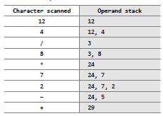
For example, consider the prefix expression + – 2 7 * 8 / 4 12. Let us now apply the algorithm to evaluate this expression.

Slide 56
Evaluation of a Prefix Expression
#include <stdio.h>
#include <conio.h>
#include <string.h>
int stk[10];
int top=–1;
int pop();
void push(int);
int main()
{
char prefix[10];
int len, val, i, opr1, opr2, res;
clrscr();
printf("\n Enter the prefix expression : ");
gets(prefix);
len = strlen(prefix);

Slide 57
for(i=len–1;i>=0;i – –)
{
switch(get_type(prefix[i]))
{
case 0:
val = prefix[i] – '0';
push(val);
break;
case 1:
opr1 = pop();
opr2 = pop();
switch(prefix[i])
{
case '+':
res = opr1 + opr2;
break;
case '–':
res = opr1 – opr2;
break;
case '*':
res = opr1 * opr2;
break;
case '/':
res = opr1 / opr2;
break;
}
push(res);
}
}

Slide 58
printf("\n RESULT = %d", stk[0]);
getch( );
return 0;
}
void push( int val )
{
stk[ + + top ] = val;
}
int pop( )
{
return( stk[ top – – ] );
}
int get_type( char c )
{
if(c == '+' || c == '–' || c == '*' || c == '/')
return 1;
else
return 0;
}
Output
Enter the prefix expression : + – 9 2 7
RESULT = 14

Slide 59
Recursion
A recursive function is defined as a function that calls itself to solve a smaller version of its task until a final call is made which does not require a call to itself.
Since a recursive function repeatedly calls itself, it makes use of the system stack to temporarily store the return address and local variables of the calling function.
Therefore, recursion is defining large and complex problems in terms of smaller and more easily solvable problems.

Slide 60
Recursive solution has two major cases
Base case, in which the problem is simple enough to be solved directly without making any further calls to the same function.
Recursive case, in which
First the problem at hand is divided into simpler sub-parts.
Second the function calls itself but with sub-parts of the problem obtained in the first step.
Third, the result is obtained by combining the solutions of simpler sub-parts.

Slide 61
Types of Recursion
Recursive function can be characterized based on:
If the function calls itself directly or indirectly (direct or indirect recursion)
If any operation is pending at each recursive call (tail recursive or not)
If the structure of the calling pattern (linear or tree-recursive).

Slide 62
Direct recursion
int Func (int n)
{
if (n == 0)
return n;
else
return (Func (n–1));
}
Indirect recursion
int Func1 (int n)
{
if (n == 0)
return n;
else
return Func2(n);
}
int Func2(int x)
{
return Func1(x–1);
}
Non-tail recursion
int Fact(int n)
{
if (n == 1)
return 1;
else
return (n * Fact(n–1));
}

Slide 63
Tail recursion
int Fact(n)
{
return Fact1(n, 1);
}
int Fact1(int n, int res)
{
if (n == 1)
return res;
else
return Fact1(n–1, n*res);
}
Tree recursion
int Fibonacci(int num)
{
if(num == )
return ;
else
return (Fibonacci(num - 1) + Fibonacci(num – 2));
}

Slide 64
Observe the series of function calls. When the function returns, the pending operations in turn calls the function
Fibonacci(7) = Fibonacci(6) + Fibonacci(5)
Fibonacci(6) = Fibonacci(5) + Fibonacci(4)
Fibonacci(5) = Fibonacci(4) + Fibonacci(3)
Fibonacci(4) = Fibonacci(3) + Fibonacci(2)
Fibonacci(3) = Fibonacci(2) + Fibonacci(1)
Fibonacci(2) = Fibonacci(1) + Fibonacci(0)
Now we have, Fibonacci(2) = 1 + 0 = 1
Fibonacci(3) = 1 + 1 = 2
Fibonacci(4) = 2 + 1 = 3
Fibonacci(5) = 3 + 2 = 5
Fibonacci(6) = 3 + 5 = 8
Fibonacci(7) = 5 + 8 = 13

Slide 65
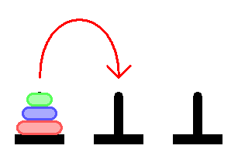
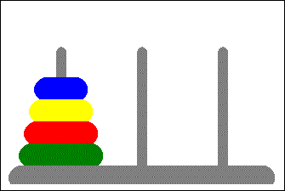
Tower of Hanoi

Slide 66
Tower of Hanoi problem
Tower of Hanoi is a mathematical puzzle where we have three towers (A, B, and C) and N disks. Initially, all the disks are stacked in decreasing value of diameter i.e., the smallest disk is placed on the top and they are on tower A. The objective of the puzzle is to move the entire stack to another tower (here considered C), obeying the following simple rules:
Only one disk can be moved at a time.
Each move consists of taking the upper disk from one of the stacks and placing it on top of another stack i.e. a disk can only be moved if it is the uppermost disk on a stack.
No disk may be placed on top of a smaller disk.

Slide 69
Code implements the solution of the tower of
Hanoi problem
#include <stdio.h>
int main()
{
int n;
printf("\n Enter the number of rings: ");
scanf("%d", &n);
move(n,'A', 'C', 'B');
return 0;
}

Slide 70
void move(int n, char source, char dest, char spare)
{
if (n==1)
printf("\n Move from %c to %c",source,dest);
else
{
move(n–1,source,spare,dest);
move(1,source,dest,spare);
move(n–1,spare,dest,source);
}
}

Slide 71
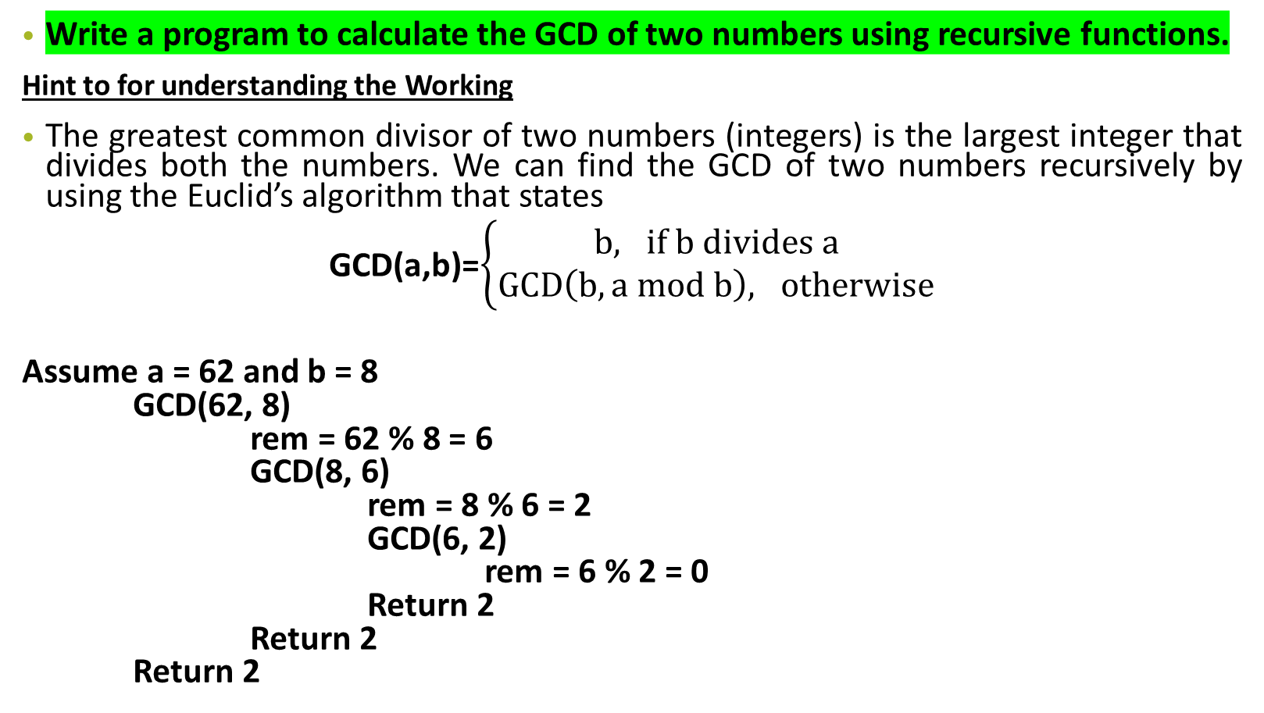
Assignment 1
Write a program to calculate the GCD of two numbers using recursive functions.
Hint to for understanding the Working
The greatest common divisor of two numbers (integers) is the largest integer that divides both the numbers. We can find the GCD of two numbers recursively by using the Euclid’s algorithm that states
GCD(a,b)=$\left\{\begin{aligned}b, if b divides a \\ GCD\left(b, a mod b\right), otherwise\end{aligned}\right.$
Assume a = 62 and b = 8
GCD(62, 8)
rem = 62 % 8 = 6
GCD(8, 6)
rem = 8 % 6 = 2
GCD(6, 2)
rem = 6 % 2 = 0
Return 2
Return 2
Return 2

Slide 72
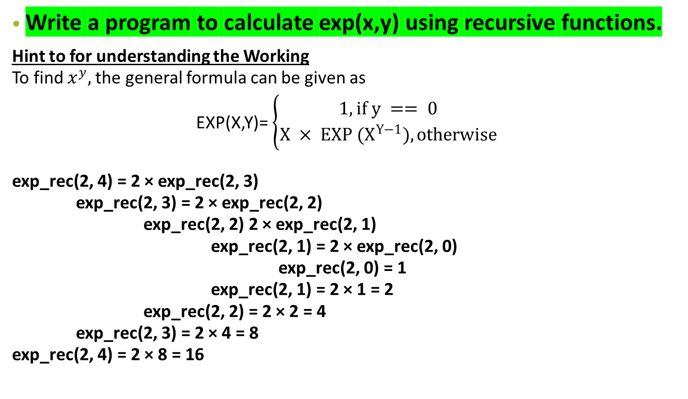
Assignment 2
Write a program to calculate exp(x,y) using recursive functions.
Hint to for understanding the Working
To find $x^{y},$the general formula can be given as
EXP(X,Y)= $\left\{\begin{aligned}1, if y == 0 \\ X × EXP (X^{Y−1}), otherwise\end{aligned}\right.$
exp_rec(2, 4) = 2 × exp_rec(2, 3)
exp_rec(2, 3) = 2 × exp_rec(2, 2)
exp_rec(2, 2) 2 × exp_rec(2, 1)
exp_rec(2, 1) = 2 × exp_rec(2, 0)
exp_rec(2, 0) = 1
exp_rec(2, 1) = 2 × 1 = 2
exp_rec(2, 2) = 2 × 2 = 4
exp_rec(2, 3) = 2 × 4 = 8
exp_rec(2, 4) = 2 × 8 = 16

Slide 73
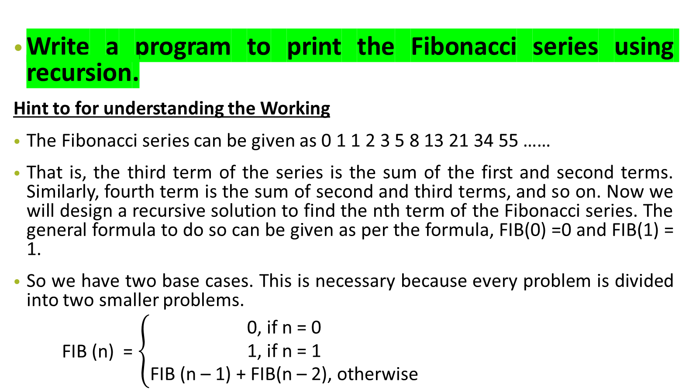
Assignment 3
Write a program to print the Fibonacci series using recursion.
Hint to for understanding the Working
The Fibonacci series can be given as 0 1 1 2 3 5 8 13 21 34 55 ……
That is, the third term of the series is the sum of the first and second terms. Similarly, fourth term is the sum of second and third terms, and so on. Now we will design a recursive solution to find the nth term of the Fibonacci series. The general formula to do so can be given as per the formula, FIB(0) =0 and FIB(1) = 1.
So we have two base cases. This is necessary because every problem is divided into two smaller problems.
FIB (n) = $\left\{\begin{aligned}\text{0, }\text{if} \text{n}\text{ = 0 } \\ \text{1, }\text{if} \text{n}\text{ = 1 } \\ \text{FIB}\text{ (}\text{n}\text{ – 1) + }\text{FIB}\text{(}\text{n}\text{ – 2), }\text{otherwise} \end{aligned}\right.$

Slide 74


Thank you ……
Nest Topic………….

