Slide 1
01 WHO
Could you keep four astronauts alive on the Moon for 30 days?
4 crew | 30 days
Notes:
0:00-0:15 | HOOK
VOICE-OVER: "Could you keep four astronauts alive on the Moon for 30 days? Not by luck. By power, air, water, food, and a plan. Today, you will try."
VISUAL: Dark space, slow zoom to the Moon. Four gold dots appear one by one under it, then a 30-day counter ticks up. Music: soft, hopeful, low.

Slide 2
01 WHO
TEAM HOPE PRESENTS
OUTPOST
COMMANDER
Run a Moon or Mars base. Learn what keeps astronauts alive.
NASA Space Apps Challenge | Bangladesh
Notes:
0:15-0:25 | TITLE
VOICE-OVER: "This is Outpost Commander, a free game where you run a Moon or Mars base."
VISUAL: Title text animates in over slowly orbiting rings. No NASA logos.

Slide 3
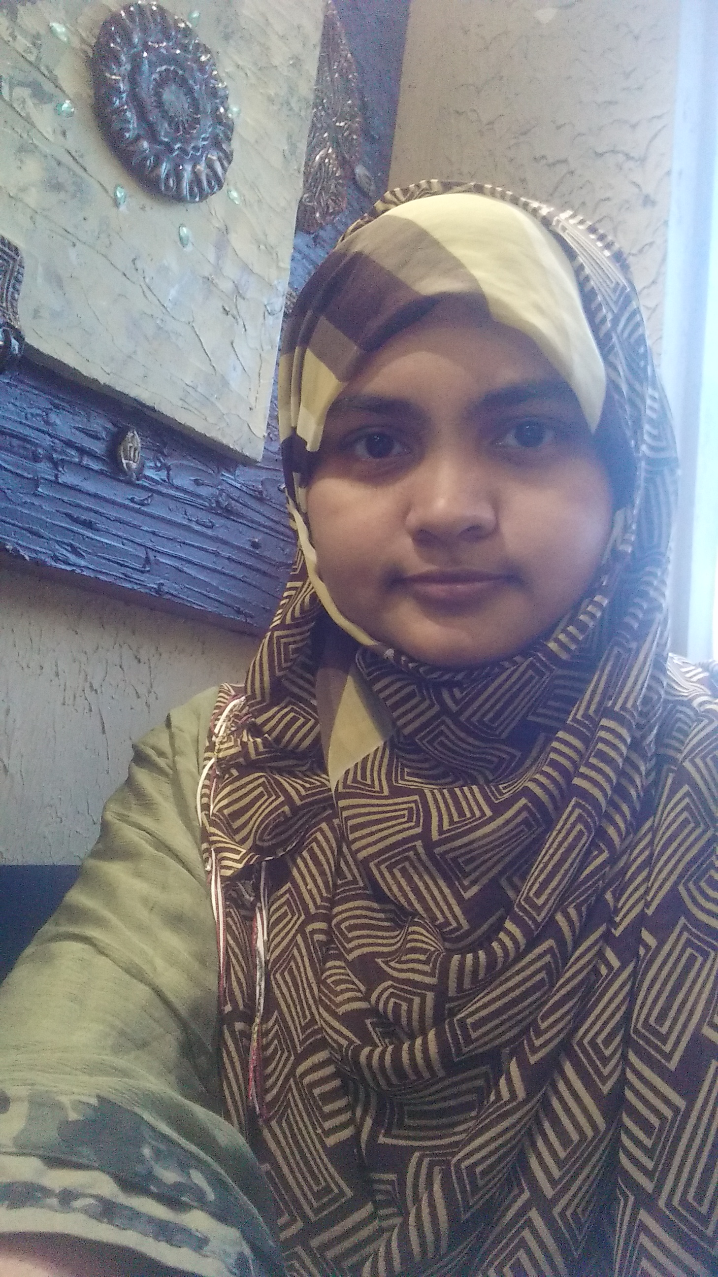

Meet Team : Hope
01 WHO
Tasnimul Jannat Niha
Umme Kulsum Neha
Team Leader
UI/UX Designer
Creative Lead
Developer
Critical Thinker
Researcher
Notes:
0:25-0:42 | TEAM INTRO
VOICE-OVER: "We are Team Hope. Tasnimul Jannat Niha, our team leader, and Umme Kulsum Neha, our developer. We built this game for the NASA Space Apps Challenge."
VISUAL: Replace the two dashed circles with your profile pictures (right-click > Change Picture, or drop a circle-cropped image on top). Names fade in under each photo.

Slide 4




Why we built it
01 WHO
Locked in textbooks
So we made a game
Free for everyone
Space survival stays with experts and reports.
Command a base. See every choice play out.
No sign-up. No install. Works offline.
We built it with passion, so anyone can try it.
Notes:
0:42-1:00 | WHY WE BUILT IT (say it with passion)
VOICE-OVER: "Space is one of humanity's biggest efforts, yet most people never learn why living on the Moon or Mars is so hard. We wanted to change that. So we turned it into a game, free for everyone."
VISUAL: Three cards slide in left to right, gold arrows pulse between them.

Slide 5



The problem
02 WHY
Hard to see
Few safe ways to practise
Not for everyone
Radiation, power and life support feel abstract. One broken machine is hard to picture.
Planning on a budget, making a mistake and trying again is rarely possible.
Many learning tools need money, fast internet or expert knowledge.
Notes:
1:00-1:25 | THE PROBLEM
VOICE-OVER: "The problem has three parts. First, space survival is hard to picture. Radiation, power and life support feel like abstract ideas. Second, there are few safe places to practise planning on a budget, make a mistake, and try again. Third, many learning tools need money or fast internet."
VISUAL: Each card lights up as its part is spoken (about 8 seconds each).

Slide 6




Who it affects
02 WHY
Most people never learn why living on the Moon or Mars is so hard.
Children and students
Teachers and schools
The ideas stay locked in textbooks, technical reports and expert talks.
Families and clubs
Low-resource communities
Notes:
1:25-1:45 | WHO IT AFFECTS
VOICE-OVER: "This affects children and students, teachers, families and science clubs, and most of all, communities with fewer resources. If a tool needs a paid account or fast internet, they are left out."
VISUAL: The four tiles appear one by one; the last tile (low-resource communities) glows orange.

Slide 7





One dusty week
02 WHY
Sun shines
Dust hides the Sun
Power falls
A machine breaks
Crew in danger
Plan backups, then try again.
Illustration only FOR NOW, not real data
Notes:
1:45-2:00 | ONE SHORT STORY (no characters)
VOICE-OVER: "Imagine one dusty week. The Sun is hidden. Power falls. One machine breaks. And a whole crew is in danger. Without a backup plan, small problems grow fast. That is what we want everyone to feel, and to learn."
VISUAL: The power bars shrink step by step as each line is spoken. Soft music dips, then rises on the last line.

Slide 8

What is Outpost Commander?
03 WHAT
neharvard.github.io/Outpost_Commander
Free to play
OUTPOST COMMANDER
One file, no install
Command a base for 4 astronauts
Works offline
Phone, tablet or computer
Moon
Mars
Notes:
2:00-2:07 | WHAT IT IS
VOICE-OVER: "Outpost Commander is a browser game. One file. No install. It even works offline."
VISUAL: Browser frame appears, the four features tick on one by one.

Slide 9


How it plays
03 WHAT
1 Pick a world
2 Build the base
3 Launch
Moon or Mars
Spend 100 launch points
Survive 30 days
EVERY DAY, UNTIL DAY 30 OR THE CREW IS LOST
Next day
Event of the day
Systems update
Why it matters
Report and lessons: score, stars, what you learned
Notes:
2:07-2:19 | ANIMATED FLOW (3 steps, daily loop, report)
VOICE-OVER: "Pick a world. Build your base. Launch. Then every day, an event may hit, systems update, and a short lesson explains why it matters. At the end, you get a report."
VISUAL: Steps light up in order, the loop arrows spin once per beat, the gold report pill glows last.

Slide 10
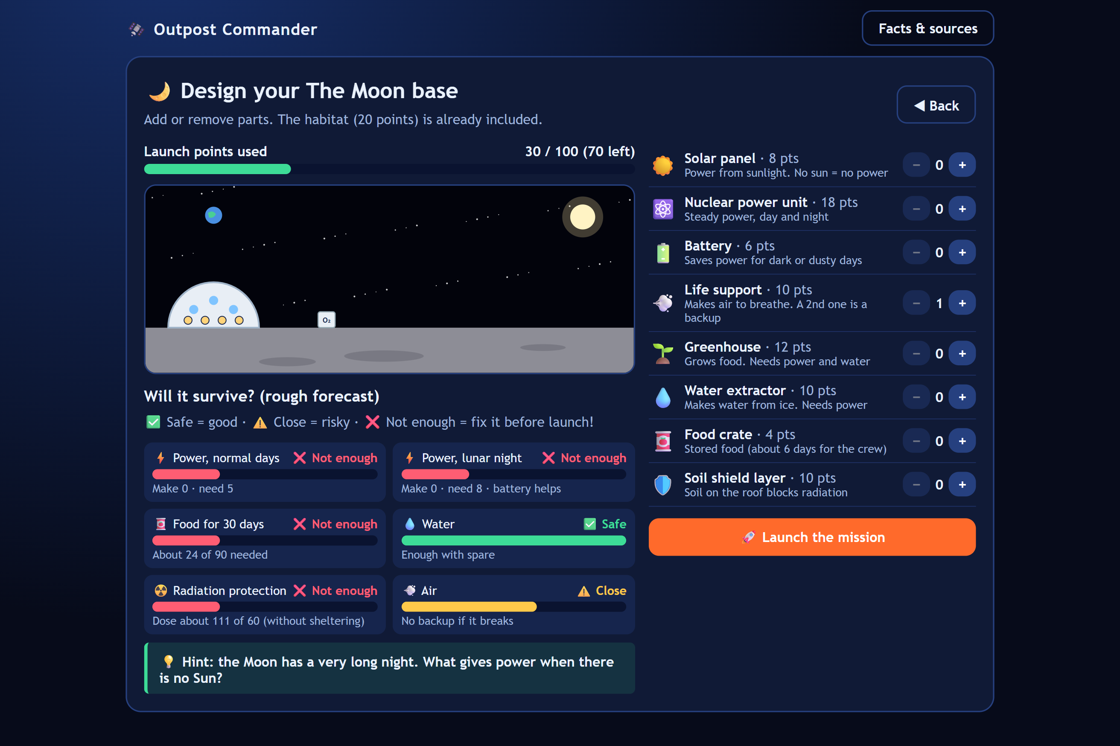







Build your base
03 WHAT
Solar panels
Nuclear power
Batteries
Life support
Greenhouses
Water extractors
Food crates
Soil shields
FORECAST BEFORE LAUNCH
Safe
Close
Not enough
100 launch points
Notes:
2:19-2:31 | DEMO: PICK WORLD + BUILD
VOICE-OVER: "Spend 100 launch points on eight parts, from solar panels to radiation shields. A forecast marks each need Safe, Close, or Not enough."
VISUAL: Play your screen recording of choosing Moon/Mars and building the base in the dashed frame. Parts list stays beside it.

Slide 11
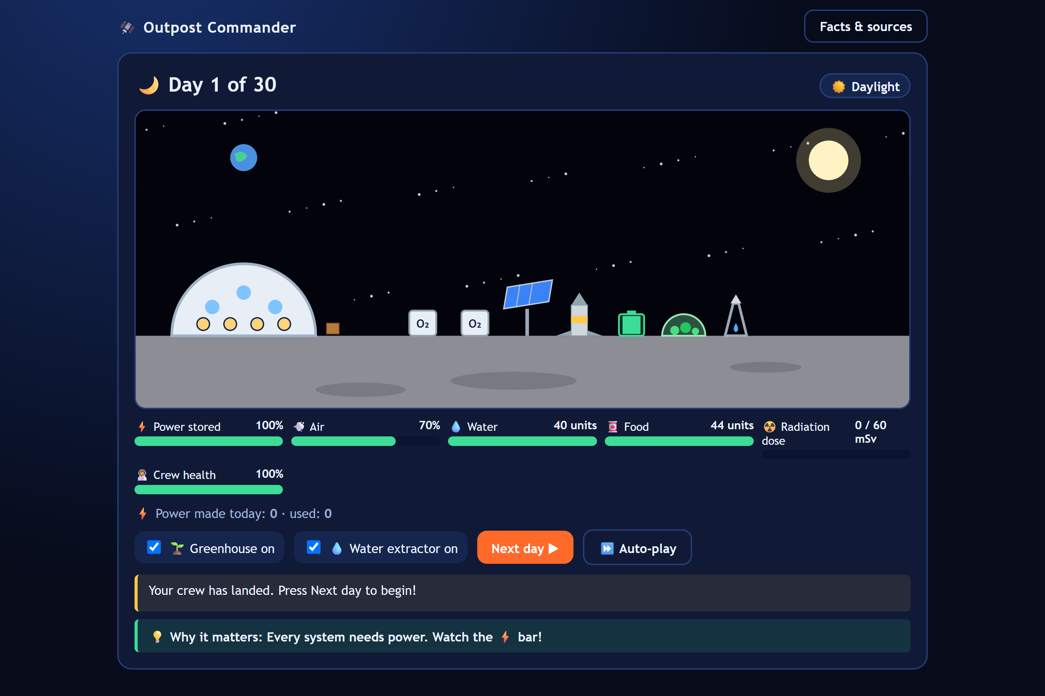



Survive 30 days
03 WHAT
SIX METERS
Power
Air
Water
Food
Radiation
Crew health
EVENTS
Moon
Mars
15-day night, 2 solar flares, life support fault
Dust storm, 1 solar flare, life support fault
Press Next day. Watch the six meters change.
Notes:
2:31-2:41 | DEMO: DAILY SIMULATION
VOICE-OVER: "Then survive 30 days, watching six meters. The Moon has a 15-day night. Mars has dust storms. Solar flares and life support faults can strike."
VISUAL: Screen recording of pressing Next day, meters moving, an event popping up and the green "Why it matters" line.

Slide 12
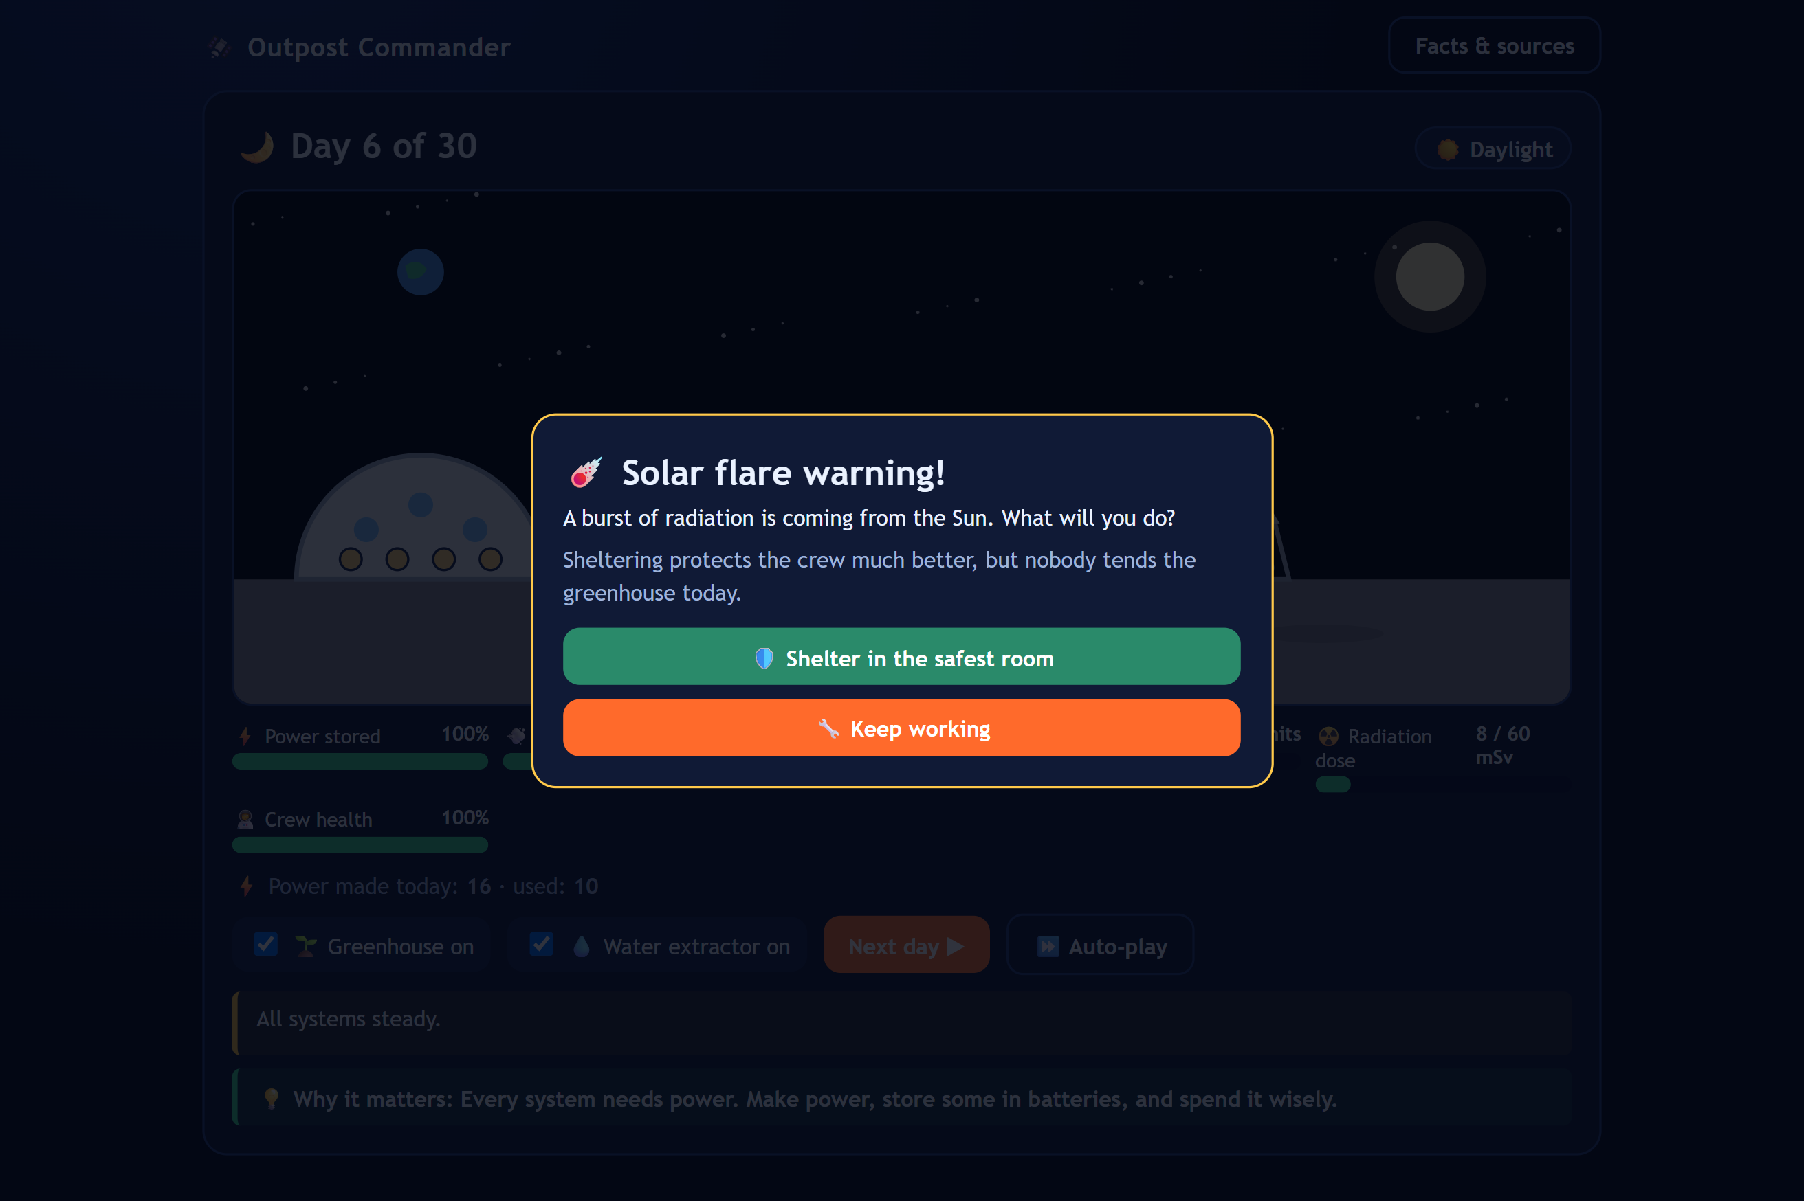


Solar flare: your choice
03 WHAT
Shelter
Cuts radiation. But nobody tends the greenhouse that day.
Keep working
The greenhouse is tended. But radiation can build up.
Reach the radiation limit and the mission fails. A backup life support unit covers the fault.
Every choice is a trade-off.
Notes:
2:41-2:51 | DEMO: SOLAR FLARE CHOICE
VOICE-OVER: "When a solar flare hits, you choose: shelter, or keep working. Sheltering cuts radiation, but nobody tends the greenhouse that day. Every choice has a trade-off."
VISUAL: Screen recording of the flare pop-up and the player picking an option.

Slide 13
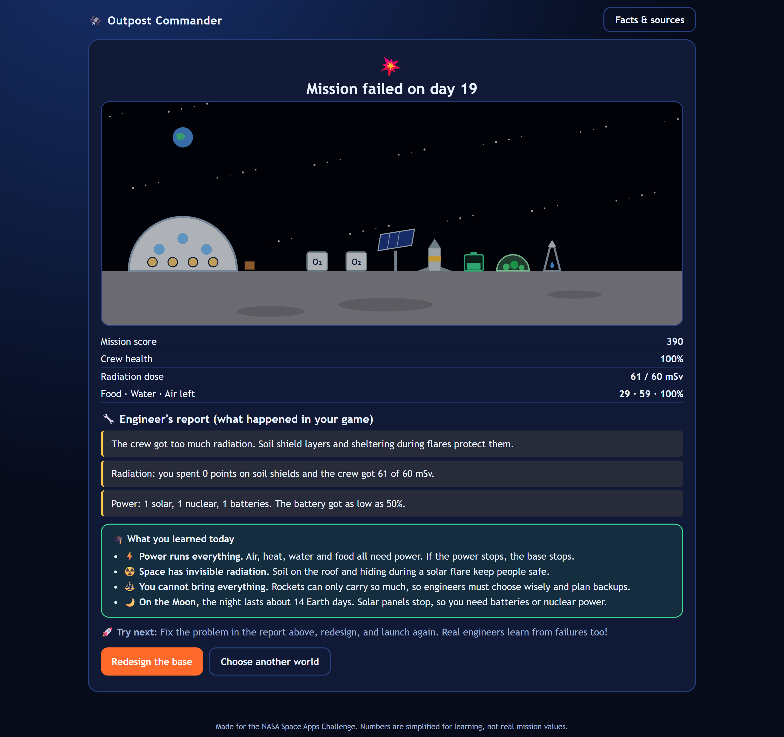




Report and lessons
03 WHAT
Your score and stars
The cause of any failure
Radiation dose and power use
What you learned and what to try next
Every run ends with a lesson. Then you try again.
Notes:
2:51-3:00 | DEMO: END REPORT
VOICE-OVER: "At the end, your report shows your score, what went wrong, and what you learned. Then you try again."
VISUAL: Screen recording of the end screen with score, stars and lessons.

Slide 14



What players learn
04 HOW
Power runs everything
Radiation is real
Life support, heat and water all need it.
Invisible, but soil and shelter can block it.
You cannot bring everything
Each world is different
Choose wisely and plan backups.
Moon: long night. Mars: weak sun, dust storms.
Notes:
3:00-3:15 | IMPACT: WHAT PLAYERS LEARN
VOICE-OVER: "Players learn that power runs everything. Radiation is real. You cannot bring everything. And every world is different."
VISUAL: Four cards pop in on the beat of each sentence.

Slide 15

Skills and reach
04 HOW
Builds skills, sparks curiosity
Free and offline, for all
Planning on a budget
Children and students
Weighing trade-offs
Teachers
Science clubs
Preparing backups
Families
Learning from failure
Low-resource communities
Notes:
3:15-3:28 | SKILLS AND REACH
VOICE-OVER: "They practise planning, trade-offs and backup thinking, and it sparks curiosity in young people. And because it is free and offline, it reaches children, teachers, clubs, families, and low-resource communities."
VISUAL: Left list ticks on, then right pills slide in; last pill glows orange.

Slide 16





What comes next
04 HOW
More worlds
Real NASA data
Many languages
Mars moons, asteroids, stations
Closer to real measurements
For teachers and volunteers
Classroom tools
Multiplayer
Accessibility
Guides, worksheets, challenges
Plan or compete together
Read-aloud, bigger text
Notes:
3:28-3:40 | FUTURE
VOICE-OVER: "Next: more worlds, real NASA data, many languages, classroom tools, multiplayer, and accessibility."
VISUAL: Six tiles appear in a quick left-to-right cascade.

Slide 17


What we need next
04 HOW
Mentoring
Classroom testing
Translation help
Guidance from space and education experts
Try it with real students and teachers
Reach more local languages
Help us bring Outpost Commander to more classrooms.
Notes:
3:40-3:48 | WHAT WE NEED NEXT
VOICE-OVER: "To get there, we need mentoring, classroom testing, and translation help."
NOTE: These three are placeholders from your brief (the [FILL IN] examples). Edit the three cards and this line if your real needs are different.

Slide 18

04 HOW
Learn space by running it.
TEAM HOPE
Tasnimul Jannat Niha
Umme Kulsum Neha
neharvard.github.io/Outpost_Commander
Built for the NASA Space Apps Challenge. Game numbers are simplified for learning.
Notes:
3:48-4:00 | CLOSE
VOICE-OVER: "Learn space by running it. We are Team Hope: Tasnimul Jannat Niha and Umme Kulsum Neha. Play it free at neharvard.github.io/Outpost_Commander."
VISUAL: Title line, both names, link. If you add the gameplay video afterwards, place it after this slide.

